Slide 1



Obesity in childhood
Libyan international medical university
Presented by RAYAN MUSTAFA 2956
G-5
PTS BLOCK
1st Year of AMS
2022/6/1
1

Slide 2
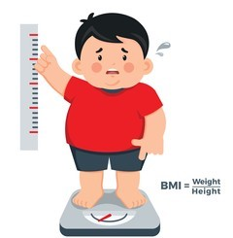
Introduction
2

Slide 3
Objectives :
Define obesity
How to manage obesity on child
Outline causes of obesity at an early age
Discuss how to effect of obesity on general health and mental health
List the role of parents in preventing childhood obesity
3

Slide 4
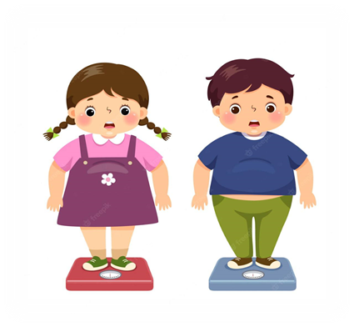
Define obesity
Generally defined by an excess of body fat causing prejudice to health, as this is the point where the risk of severe obesity-related diseases.
4

Slide 5
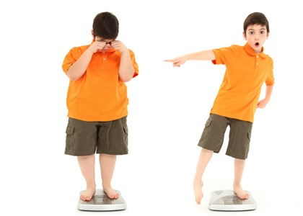
What do you think about the most common causes of obesity at an early age ?
5

Slide 6

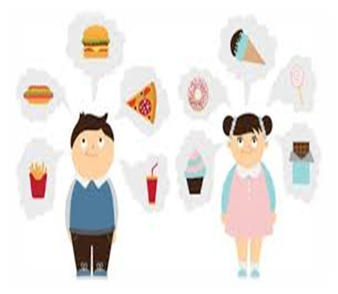

Causes of obesity at an early age
Fast food : Eating fast food that is high in saturated fat with low nutritional values which is a real danger to children's health.
Physical activity: Kids who don't exercise are more likely to be overweight because they don't burn as many calories.
6

Slide 7

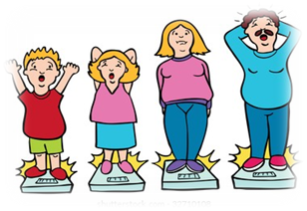

Causes of obesity at an early age
Family factors:
If your child is from an overweight family, may gain weight , This happens especially if the child grows up in an environment where high-calorie foods are constantly.
Health Conditions and Medications:
Some hormone problems may cause overweight and obesity, such as underactive thyroid, Cushing syndrome and polycystic ovary syndrome.
7

Slide 8
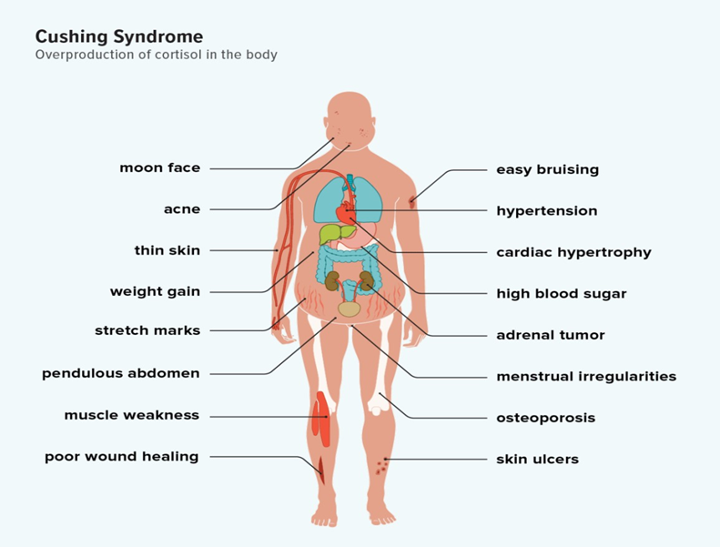
Cushing syndrome
8

Slide 9



Effect of obesity in general health in child
Now
Later
Depression
increased rates of cancer
type 2 diabetes
cardiovascular disease
orthopedic complications (osteoporosis)
obstructive sleep apnea
9

Slide 10
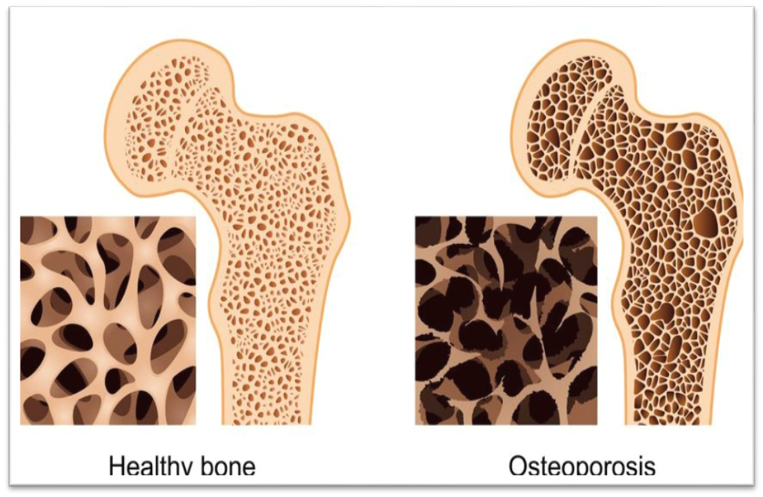
Osteoporosis
10

Slide 11
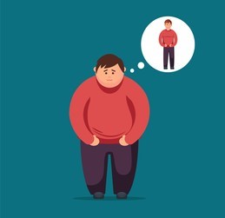
How Obesity Causes Mental Health Problems
Many children who have obesity with issues related to their mood, self-esteem, quality of life, and body image , This emotional distress likely plays a role in treatment seeking but also can impact successful treatment.
11

Slide 12











Weight management programs
Healthy eating, plan and regular physical activity
Management of obesity
Special diet
Weight loss medicines
Changing habits
12

Slide 13
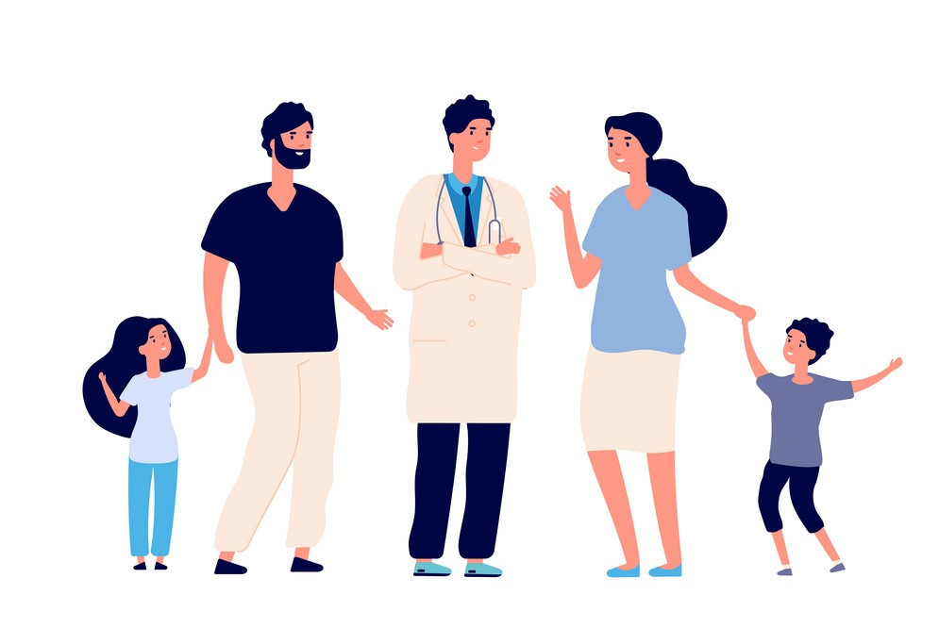
The role of parents in preventing childhood obesity
Avoid Negative comments about child own.
Avoid fast food.
Discourage child eating in front of a TV, computer or video game screen, which can lead to fast eating and lowered awareness of the amount eaten.
Prioritize fruits and vegetables.
Motivation and support.
13

Slide 14

Conclusions
Obesity causes serious health problems and leads to many diseases.
We should encourage children to lead a healthy lifestyle, which includes good eating habits and regular exercise.
Parents play an important role in helping their children to prevent and treat obesity.
14

Slide 15

Reference :
1. Guillaume, M. (1999). Defining obesity in childhood: current practice. The American journal of clinical nutrition, 70(1), 126S-130S.‏
2. Sahoo, K., Sahoo, B., Choudhury, A. K., Sofi, N. Y., Kumar, R., & Bhadoria, A. S. (2015). Childhood obesity: causes and consequences. Journal of family medicine and primary care, 4(2), 187–192. https://doi.org/10.4103/2249-4863.154628
3. Piché, M. E., Tchernof, A., & Després, J. P. (2020). Obesity phenotypes, diabetes, and cardiovascular diseases. Circulation research, 126(11), 1477-1500.‏
4. Jolliffe, C. J., & Janssen, I. (2006). Vascular risks and management of obesity in children and adolescents. Vascular health and risk management, 2(2), 171–187. https://doi.org/10.2147/vhrm.2006.2.2.171
5. Lindsay, A. C., Sussner, K. M., Kim, J., & Gortmaker, S. (2006). The role of parents in preventing childhood obesity. The Future of children, 169-186.‏
15

Slide 16

Thank you for attention!
16

