Slide 1


Libyan International University Faculty Of Business Administration Semester 2
Tittle: Promotion
Prepared and presented by:
Yousra Abdussamad

Slide 2
Contents:
The meaning of promotion.
The meaning of IMC.
IMC vs. Traditional Advertising.
Promotional Campaign.
Factors affect the choice of promotional tools.
The difference between advertising and publicity.

Slide 3

The meaning of Promotion.
Promotions refer to the entire set of activities, which communicate the product, brand or service to the user. The idea is to make people aware, attract and induce to buy the product.

Slide 4

The meaning of IMC.
Integrated marketing communications is an approach to promoting a message through multiple strategies that work together and reinforce one another.

Slide 5
IMC vs. Traditional Advertising.
Integrated marketing communications (IMC) involves coordinating various forms of promotional elements, such as social media, public relations and direct marketing, to communicate the value of a company to their customers.
Traditional promotion and advertising was mass marketed on the television, radio, and in print ads.
Companies shifted away from traditional promotion to adapt to the new ways, to use more targeted communication tools, and also because traditional media was too expensive. Consumers were becoming less responsive to traditional media, and the Internet and social media were changing the ways consumers interacted with companies.

Slide 6
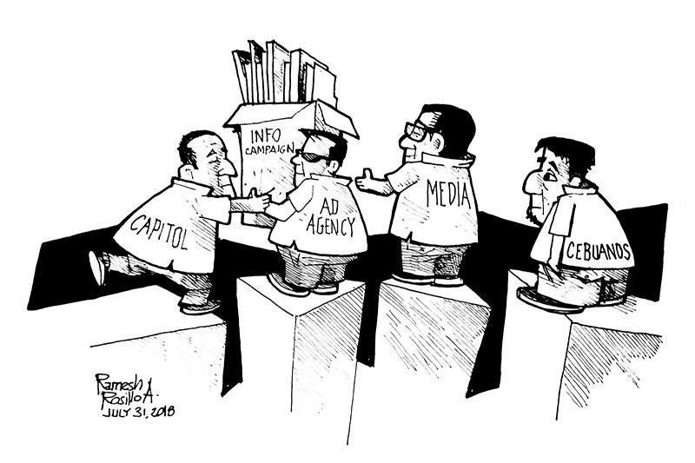
Promotional Campaign.
A series of advertisements using various marketing tools that share the same message and ideas to promote a business or event to a target audience. The typical campaign uses different media resources including internet, newspapers, television, radio, and print advertising.

Slide 7
Promotional tools.
For effective promotion of any product or service there are a number of marketing promotional tools that can be utilized in a promotion program.
The four main tools of promotion are:
Advertising.
Sales promotion.
Public relation.
Direct marketing.

Slide 8
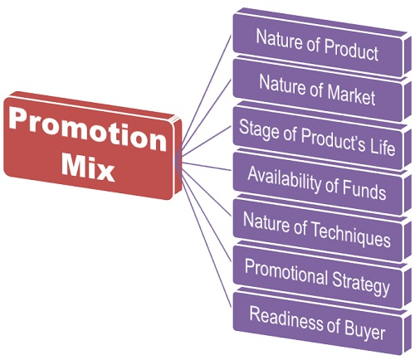
Factors affect the choice of promotional tools.

Slide 9
The difference between advertising and publicity.

Slide 10
BASIS FOR COMPARISON | ADVERTISING | PUBLICITY
Meaning | The activity of generating advertisements of products and services to commercialize them is known as Advertising. | The activity of providing information about an entity, i.e. a product, an individual or a company to make it popular is known as Publicity.
What is it? | It is what the company says about its product. | It is what others say about the product.
Cost involved | Very expensive marketing tool. | Free of cost.
Given by | Company and its representative | Third Party
Is it under the control of the company? | Yes | No
Which type of message it conveys? | Positive | It may be positive or negative.
Credibility and Reliability | Less | Comparatively more
Focus on | Target Audience | Awareness
Repetition | Yes | No

Slide 11
Thank you!

