Slide 1
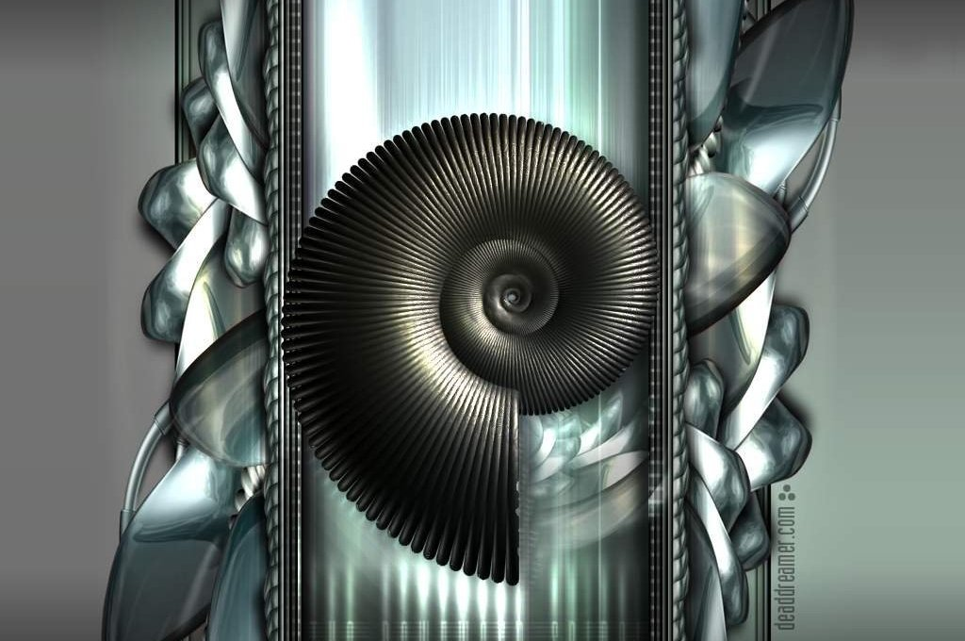
Microsoft Office PowerPoint Presentation

Slide 2
The Jaundiced Patient and Biliary System
Naseralla J Elsaadi
Consultant General Surgeon
Clinical Surgery-in-General
BMC, BENGHAZI

Slide 3
Abstract
Jaundice is common symptom as well as a sign in medical and surgical gastroenterology practice.
Understanding the pathway of bilirubin metabolism helps in a logical approach to the pre-hepatic, hepatocellular and cholestatic mechanisms of jaundice development.
Clinical evaluation (assessment) and easily available blood (biochemical) tests in combination with non-invasive imaging should establish the diagnosis in most cases.
Notes:
Further management may require advanced and invasive techniques, the choice of which should be based on the benefit–risk ratio in a particular clinical scenario, access to these techniques and local available expertise.

Slide 4
Abstract
Jaundice is the result of accumulation of bilirubin in the serum, sometimes from its overproduction from senescent (effete) erythrocytes but more usually through failure of the liver to either remove it from plasma or excrete it into the intestine via the bile ducts.
Overproduction (haemolysis) or reduced conjugation through a defective UDP- glucuronyl transferase (Gilbert’s syndrome) results in modest elevations of unconjugated bilirubin (<90 μmol/ litre - <5 mg/ dl) and absent bile in urine.
Liver (parenchymal) disease and extrahepatic (biliary ducts) obstruction result in conjugated jaundice with dark-coloured urine.
Notes:
With modern imaging, initially transabdominal ultrasonography, it is usually possible to identify extrahepatic obstruction, particularly from malignancy, but bile duct stones may be difficult to visualize and may not usually cause much duct dilatation.
Spiral computed tomography (multislices CT), endoscopic ultrasonography (EUS) and magnetic resonance scanning with computerized reconstruction of the cholangiogram (MRCP) almost always resolve uncertainties about extrahepatic obstruction.

Slide 5
Abstract
The more invasive endoscopic retrograde cholangiopancreatography (ERCP) can be reserved for therapeutic interventions such as aspiration/biopsy and brush sampling, sphincterotomy, stent insertion and retrieval/destruction of bile duct stones.
Where there is no extrahepatic cause of jaundice, it may be an important presentation of liver failure, both acute and chronic, and careful attention should be paid to features of deteriorating liver function that might require specialist care.
Notes:
Obstructive jaundice is a medical emergency. Local (hospital) guidelines should be in place and widely publicized to facilitate timely investigation and management and avoid complications.
Management must involve a multidisciplinary team (MDT) that can offer a full range of investigative techniques (cross-sectional imaging, percutaneous procedures, endoscopic retrograde cholangiopancreatography).

Slide 6
Overview
Jaundice is derived from the French word ‘jaune’ meaning yellow discoloration. It is the most common sign of liver disease. It is characterized by yellow discoloration of the skin and mucous membranes due to an abnormal increase in serum bilirubin concentration.
Clinical examination usually reveals the degree of hyperbilirubinaemia. The earliest place to manifest jaundice is the sclera owing to the high elastin level in the scleral tissue and the affinity of bilirubin for it. Scleral icterus indicates a serum bilirubin of at least 50 μmol – 3 mg/dl or more.
A greenish tinge to the icterus indicates long-standing jaundice and is due to oxidation of bilirubin to biliverdin.
Notes:
Other causes of yellowing of the skin are caroteneoderma which is due to excess consumption of carotene-containing foods like carrots and leafy vegetables; here the sclera are spared and the yellow pigmentation is concentrated over the palms, soles, forehead and nasolabial creases.
Drugs such as quinacrine and exposure to phenols also cause yellow discoloration.
Another indicator of jaundice is dark urine or tea- or cola-coloured urine, which patients commonly describe

Slide 7
Bilirubin Metabolism
Sources of bilirubin
Bilirubin, a tetrapyrrole pigment moiety, is a breakdown product of haem (ferroprotoporphyrin IX). In a healthy person, daily bilirubin production averages about 0.5 mmol (250–300 mg).
About 80% of this bilirubin is derived from breakdown of haemoglobin from senescent (effete) RBCs in the reticuloendothelial system, 15% from ineffective erythropoiesis in the bone marrow, and 5% from turnover of haem proteins such as myoglobin, catalases and the cytochrome enzyme system elsewhere in the body.
Notes:
Production of bilirubin
The production of bilirubin takes place in the reticuloendothelial system in a two-step process. The first step is oxidation of haem by haem oxygenase, which involves breaking open of the α-bridge, resulting in the formation of biliverdin. The second step is reduction of this green pigment by biliverdin reductase to colourless bilirubin.

Slide 8
Bilirubin Metabolism
Plasma transport
The bilirubin formed in the reticuloendothelial cells is virtually insoluble in water and potentially toxic. It transported in blood, binds reversibly and non-covalently with albumin.
Hepatic uptake
Unconjugated bilirubin tightly bound to albumin is transported to the liver where the bilirubin, but not the albumin, is taken up across the basolateral membrane of the hepatocytes by a carrier-mediated transport process, possibly via a member of the organic anion transporter family.
Within the cytosol, two cytosolic binding proteins, ligandins Y and Z, transport the bilirubin to the smooth endoplasmic reticulum of the hepatocyte for conjugation with glucuronic acid and also to prevent efflux of bilirubin back into the plasma.
Notes:
Hepatic conjugation
In the presence of the co-substrate uridine diphosphate (UDP), the enzyme uridine diphosphoglucuronyl transferase (UDP-GT) mediates conjugation of the hydrophobic bilirubin to hydrophilic bilirubin monoglucuronide and diglucuronide conjugates, which are suitable for excretion. UDP-GT activity is well maintained in both acute and chronic hepatocellular damage, and even increased in cholestasis.

Slide 9
Bilirubin Metabolism- Biliary excretion
Normally 80–85% of the bile is made of bilirubin diglucuronide and 15–19% of bilirubin monoglucuronide, with the remainder comprising traces of unconjugated bilirubin.
The conjugated bilirubin excreted into bile drains into the duodenum and passes unchanged in the proximal small bowel until it reaches the distal small bowel and colon, where it is hydrolysed by intestinal bacterial β-glucuronidase to unconjugated bilirubin.
Notes:
This is then further reduced by the gut flora to colourless urobilinogen. 80–90% of this is excreted in the faeces either unchanged or oxidized to urobilin or stercobilin, which imparts the natural colour to the stools.
The remaining 10–20% of the urobilinogen is absorbed passively and circulated in the enterohepatic circulation for reconjugation and excretion in the bile. A trace of this urobilinogen in the enterohepatic circulation escapes hepatic uptake and enters the systemic circulation to be filtered across the glomerulus and excreted in the urine.

Slide 10
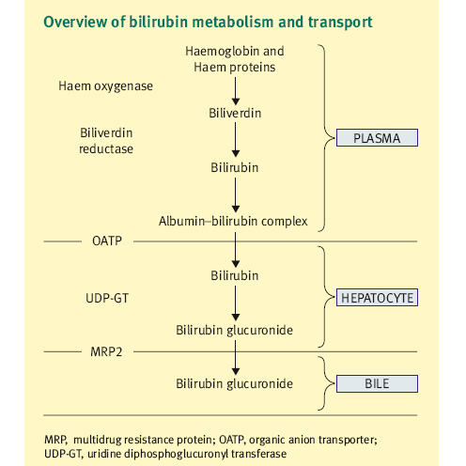

Slide 11
Measurement of Bilirubin
Serum bilirubin is measured using a variation of the original Van den Bergh colorimetric reaction.
Indirect and direct refer to the total and conjugated bilirubin concentrations respectively. With Van den Bergh method, the normal total serum bilirubin concentration is <17 μmol (<1 mg/dl). Up to 30%, that is 5 μmol (0.3 mg/dl) is in the conjugated form.
Notes:
Unconjugated bilirubin is bound to albumin and hence not filtered in the glomerulus, but conjugated bilirubin is; almost all of it is reabsorbed by the proximal tubules and very small traces are excreted in urine. Thus, the presence of bilirubinuria is a suggestion of hepatobiliary disease.
However, in prolonged cholestatic jaundice the conjugated bilirubin fraction in serum binds to albumin covalently; bilirubin levels decline more slowly than clinical recovery owing to the longer half-life of albumin.

Slide 12
Definition
Jaundice can be defined as an increase in the concentration of serum bilirubin (normal serum level is 4-17 µmol/litre - upto 1.0 mg/dl) leading to the clinical manifestation of yellowing of the skin and sclera (icterus).
Cholestasis may occur within the liver (parenchymal) cells and the biliary canaliculi (hepatic cholestasis) or in the extrahepatic bile duct system due to mechanical obstruction (extrahepatic cholestasis or obstructive jaundice).
Notes:
Obstructive jaundice is not a definitive diagnosis and early investigation to find the underlying cause of cholestasis is of great importance because pathological changes (e.g. secondary biliary cirrhosis) can occur if obstruction is chronic and unrelieved.

Slide 13
Aetiological Classification
Pre-hepatic jaundice is due to increased bilirubin load on the hepatocytes (usually due to haemolysis). The increase in serum bilirubin is mainly unconjugated and the concentrations of transaminases and alkaline phosphatase are usually normal.
Hepatic jaundice is failure of excretion of bile pigments from the hepatocytes. Conjugated serum bilirubin is raised. Transaminases are raised, dependent on the cause (e.g. viral or drug-induced).
Post-hepatic jaundice is caused by failure of formation of bile or of bile transports. This may occur at any point from the hepatocyte to the ampulla of Vater.
Notes:
Post-hepatic jaundice is caused by failure of formation of bile or of bile transports. This may occur at any point from the hepatocyte to the ampulla of Vater.
Serum conjugated bilirubin is elevated and alkaline phosphatase is increased.
So, cholestatic jaundice may due to intra- or extra-hepatic (biliary ducts).

Slide 14
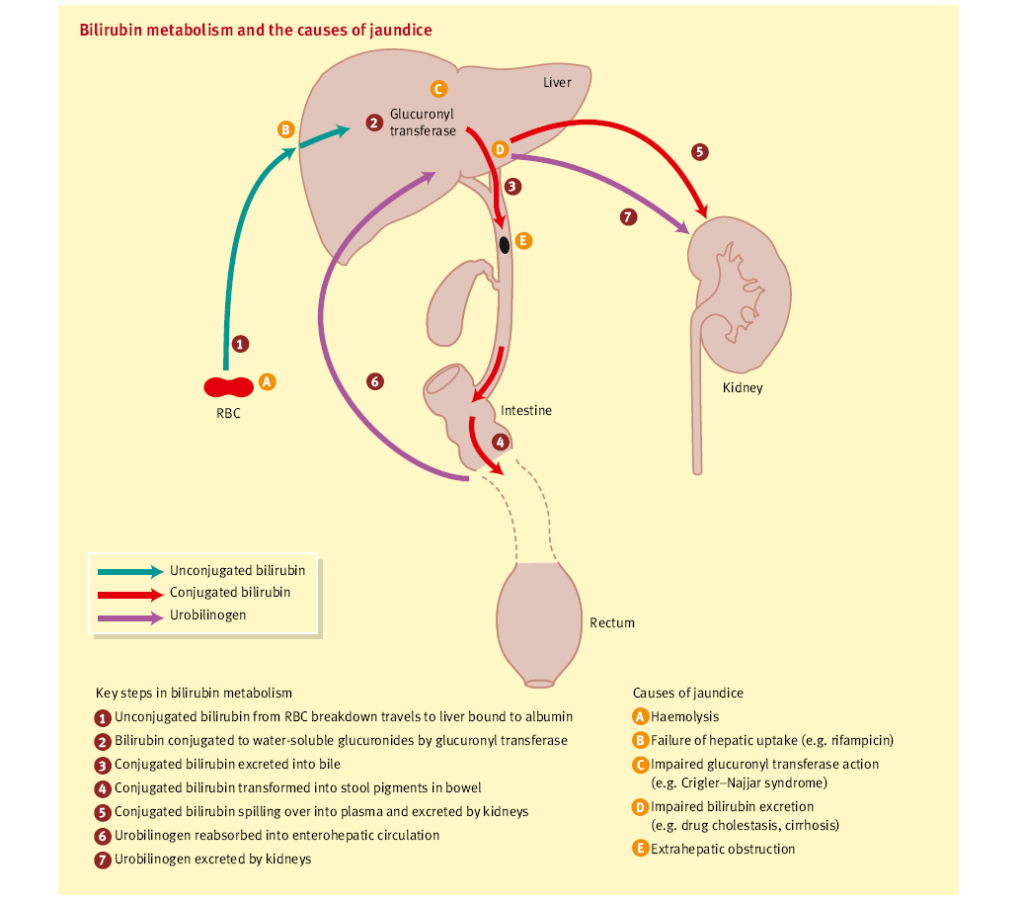

Slide 15
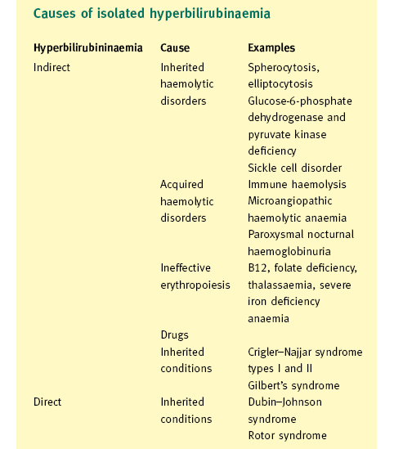
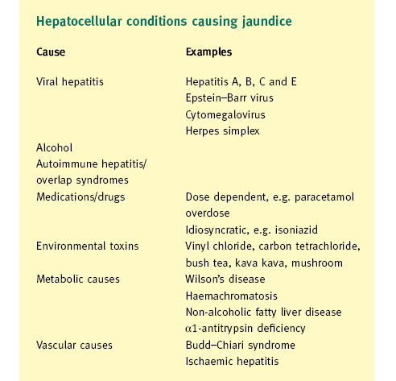

Slide 16
Aetiology of Jaundice
Causes of unconjugated jaundice
Increased bilirubin production: results from any form of haemolysis, whether congenital (e.g. hereditary spherocytosis – sometimes termed ‘acholuric jaundice’ to emphasize the absence of bile in the urine) or acquired (e.g. malaria).
Impaired hepatic uptake of bilirubin: drugs are the main cause; they compete for cytosolic protein binding or for the uptake receptor (e.g. Rifampicin).
Notes:
Impairment of UDP-glucuronyl transferase: enzyme that converts bilirubin into a polar, water-soluble glucuronide suitable for excretion into bile (e.g. is immature in premature babies, is inhibited by the antibiotic novobiocin and is congenitally absent (type-I) or reduced (type-II) in the autosomal recessive condition Crigler–Najjar syndrome.
Isolated mild unconjugated jaundice (<70 µmol/ litre), in the absence of liver enzyme abnormalities, almost always results from Gilbert’s syndrome (defect in the gene encoding glucuronyl transferase), a condition of no clinical importance that should not concern the patient. Haemolysis can be excluded by peripheral blood film and reticulocyte count.

Slide 17
Aetiology of Jaundice
Causes of conjugated jaundice
In most cases of acquired liver disease, whether acute hepatitis or chronic cirrhosis, failure of liver cells (hepatocytes) to excrete conjugated bilirubin into the bile canaliculi overshadows any deficiency in hepatocellular uptake or conjugation. The jaundice is therefore predominantly conjugated and is accompanied by dark-coloured urine.
Notes:
An important mechanism of this jaundice is back-diffusion of the water-soluble bilirubin through leaky tight junctions from bile canaliculi into plasma. It is usually impossible to distinguish by simple biochemistry alone whether the ‘obstruction’ is caused by intrahepatic disease or an extrahepatic block, thus the term ‘cholestasis’ is preferred.
Typically, cholestasis is the most common medical pattern of drug-induced jaundice.

Slide 18
Causes of Conjugated Jaundice
Common causes of extra-hepatic cholestasis (the result of interference of bile flow through the major extrahepatic biliary ducts) are: biliary duct stones, malignant biliary duct obstruction (cholangiocarcinoma or pancreatic cancer). and malignant porta hepatis lymph nodes involvement.
Infrequent causes
Ampullary carcinoma
Pancreatitis
Liver secondaries
Notes:
Rare causes
Benign strictures - iatrogenic, trauma
Recurrent cholangitis
Mirizzi syndrome
Sclerosing cholangitis
Biliary atresia
Choledochal cysts

Slide 19
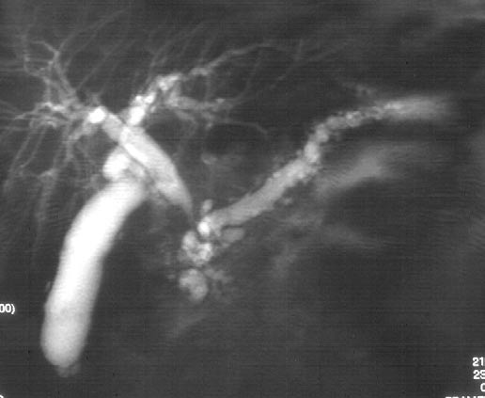
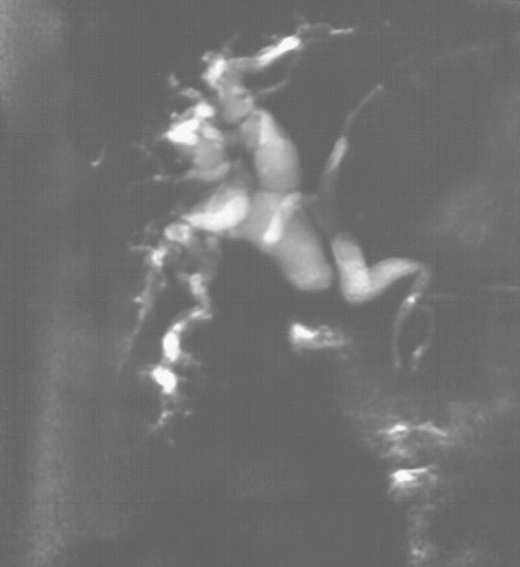
Chronic pancreatitis and benign inflammatory common bile duct stricture as visualized by MRCP.
Iatrogenic injury at laparoscopic cholecystectomy with anomalous biliary anatomy as visualized by MRCP.

Slide 20
Clinical History and Examination of the Jaundiced Patient
It is usually possible to arrive at a probable diagnosis from the clinical history and physical examination with routine blood tests (up to 80%).
Young people with a short history are most likely to have viral hepatitis, and risk factors such as use of intravenous drugs or recent overseas travel, particularly with a casual sexual experience, make hepatitis B likely. Hepatitis C rarely presents acutely.

Slide 21
Clinical History and Examination of the Jaundiced Patient
Diagnostic approach to the patient with jaundice
The key steps in the evaluation of a patient with jaundice are:
• History taking and physical examination;
• Screening laboratory tests and formulation of a working differential diagnosis;
• Specialised tests/tools to further narrow down to the definitive diagnosis.
Notes:
Thus, integrating the clinical history, physical examination and initial laboratory tests helps to distinguish pre-hepatic from hepatocellular or cholestatic causes of jaundice. Further selection of appropriate special investigations, imaging in particular for hepatobiliary obstruction, is based on this initial information.

Slide 22
Clinical History and Examination of the Jaundiced Patient
The diagnostic work-up is geared to answer the following four questions:
Is the jaundice conjugated (cholestatic) or unconjugated?
Has the patient any evidence of hepatic parenchymatous disease?
Is there any evidence of malignancy on clinical assessment?
Is there hepatobiliary abnormalities on imaging (ultrasonographic) examination?

Slide 23
Clinical History and Examination of the Jaundiced Patient
Clinical history and physical examination
A carefully elicited clinical history and physical examination in the light of routine laboratory screening tests can correctly differentiate between hepatocellular and cholestatic jaundice in up to 80% of cases.
Physical examination provides important clues in a patient with jaundice. Fever and abdominal tenderness, especially in the right upper quadrant, suggest cholangitis and biliary sepsis.
Notes:
A palpable gallbladder has been considered a sign suggestive of pancreatic neoplasm and against choledocholithiasis (Courvoisier’s law), but this finding is neither sensitive nor specific.
Ascites, spider naevi and gynaecomastia are suggestive of chronic parenchymal liver disease.
Xanthomas are suggestive of primary biliary cirrhosis.
Skin hyperpigmentation in haemachromatosis and Kayser-Fleischer rings in Wilson’s disease.

Slide 24
Clinical History and Examination of the Jaundiced Patient
The important aspects of the clinical history that must be obtained in every jaundiced patient are include:
Analysis of any abdominal pain, weight change and attacks of pyrexia;
Drug intake- either prescribed or non-prescribed;
Injectable materials- including tattooing;
Alcohol misuse;
Previous history of liver disease;
Blood or blood product transfusion;
History of contact with jaundiced individuals;
Travelling abroad to hepatitis-endemic areas;
Sexual activities- when appropriate;
Ingestion of raw food materials including herbal preparation.

Slide 25
Clinical History and Examination of the Jaundiced Patient
On general physical examination: stigmata of chronic liver disease should be sought:
Hepatosplenomegaly- signifies portal hypertension,
Spider naevi- more than one is clinically significant,
Gynaecomastia and testicular atrophy,
Palmar erythema- may be difficult to interpret,
Leuconychia,
Clotting disturbance- Bruising with trivial trauma,
Water and salt retention- Oedema and ascites,
Muscle wasting- small hand muscles,
Liver (flappy) tremor- indicate advanced liver disease.

Slide 26
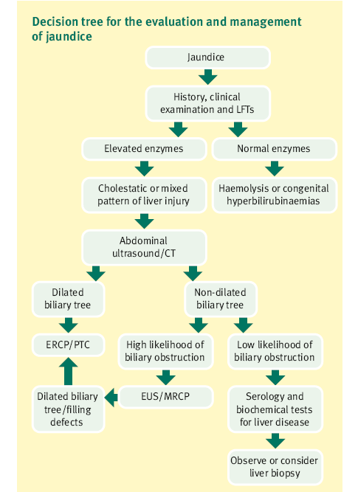

Slide 27
Complications of Obstructive Jaundice
Ascending cholangitis
Clotting disorders
Hepato -renal syndrome
Drug Metabolism
Impaired wound healing
Notes:
Ascending cholangitis
Charcot's triad is classical clinical picture: Intermittent pain, jaundice and fever.
Cholangitis can lead to hepatic abscesses. It is usually need parenteral antibiotics and biliary decompression. Operative mortality in elderly of up to 20%.
Clotting disorders
Vitamin K is required for gamma-carboxylation of Vitamin K–dependent factors II, VII, IX, XI. Vitamin K is fat soluble and not absorbed, and needs to be given parenterally.
Urgent correction of coagulopathy will need Fresh Frozen Plasma .
Hepato -renal syndrome
Poorly understood. Renal failure occurs post-intervention and may due to gram negative endotoxinaemia from gut
Preoperative lactulose may improve outcome. Improves altered systemic and renal haemodynamics
Drug Metabolism
Half life of some drugs prolonged. (e.g. morphine)
Impaired wound healing

Slide 28
Initial Laboratory Evaluation
A battery of tests is helpful in the initial investigation of a jaundiced patient. These include serum bilirubin, liver enzymes (ALT, AST and ALP) and prothrombin time. The activity of ALP rises significantly in the setting of biliary obstruction and intrahepatic cholestasis.
However, an increase in ALP may reflect release of isoenzymes from extrahepatic tissues, especially from bones.
Notes:
Thus more specific markers of biliary canalicular enzymes, such as γ-glutamyl transferase and 5’-nucleotidase, are estimated to confirm the hepatic origin of the elevated ALP level.

Slide 29
Initial Laboratory Evaluation
Prothrombin time (PT) is a measure of the activity of the clotting factors I, II, V, VII and X, which are synthesized in the liver.
Prolongation of the prothrombin time reflects hepatocellular injury or a deficiency of vitamin K, which is involved in the synthesis of clotting factors II, VII, IX and X.

Slide 30
Investigation
Other blood tests are aimed at identifying the cause of jaundice, for instance serology for viral hepatitis (IgM antibody to hepatitis A, hepatitis B surface antigen and antibodies to hepatitis C) and autoantibodies to smooth muscle and mitochondria that suggest autoimmune liver disease which may require liver biopsy.
Notes:
Gallstone obstruction, perhaps because of its intermittent nature, causes less reliable duct dilatation on USG. For this reason, a strong history of biliary pain or other suggestive features (e.g. cholangitis) in the presence of jaundice warrants MRCP, endoscopic ultrasonography (EUS) or ERCP.
With advances in scanner technology, the ability of MRCP to resolve bile ducts and small stones continues to improve, and reserving the more invasive ERCP for those in whom therapy (e.g. sphincterotomy, stone retrieval, stent insertion) is clearly indicated.

Slide 31
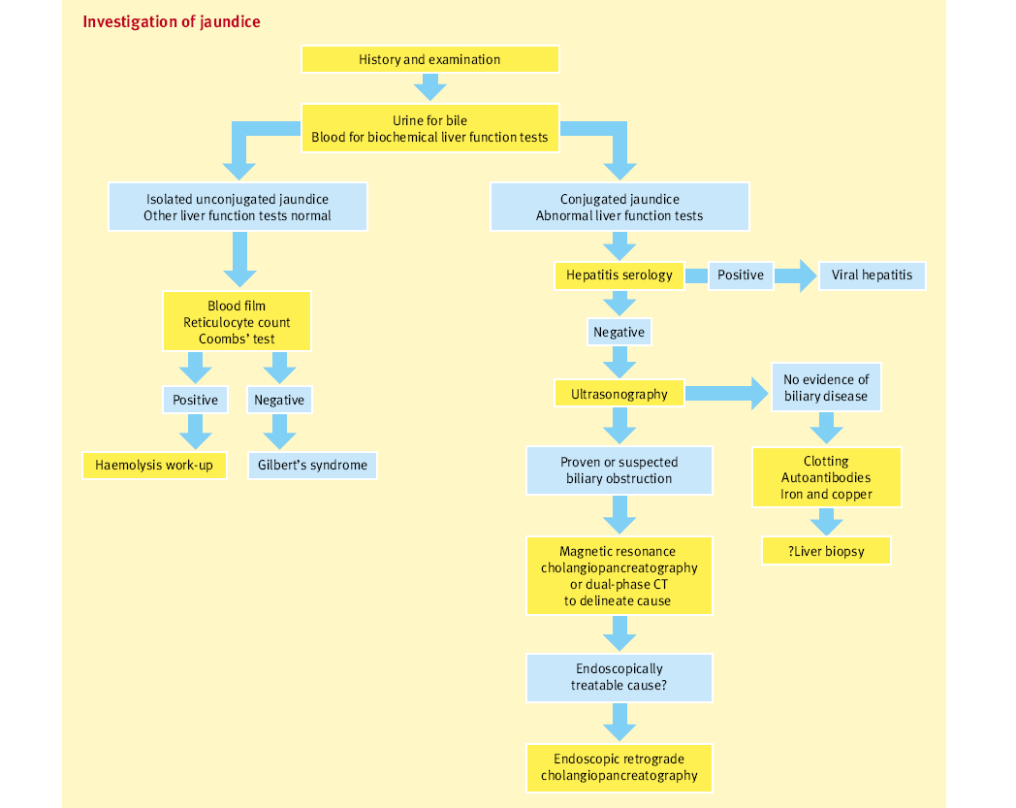

Slide 32
Imaging of Hepatobiliary System
Biliary Ultrasonography:
shows the size of the biliary ducts;
defines the level of the obstruction;
identifies the cause (in some cases);
gives other information related to the disease (e.g. hepatic metastases, gallstones, hepatic parenchymal change).
For obstructive jaundice, ultrasound has a sensitivity 70 - 95% and specificity 80 - 100%.

Slide 33
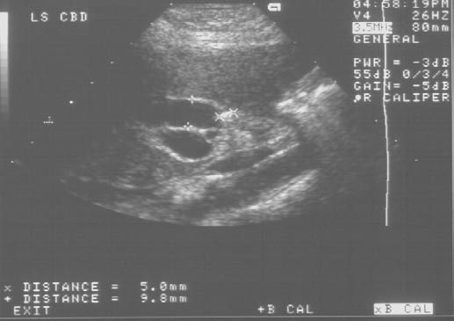
Ultrasound scan showing dilated common bile duct due to stone

Slide 34
Further Hepatobiliary Imaging
Dual-phase Spiral CT and MRCP has revolutionized the management of obstructive jaundice. After initial ultrasound assessment, cross-sectional imaging is used to gain further information for disease staging or if more specific assessment is required. The choice depends on indications, available technology and local expertise.
Either imaging models can be used for tumour staging, but identifying non-calcified gallstones (the majority- 90%) on CT is difficult, so MRCP is preferred if stones in the common bile duct are suspected.
Notes:
MRCP gives exquisite assessment of the pancreatic duct and bile ducts without the risks inherent in endoscopic retrograde cholangiopancreatography (ERCP), rendering diagnostic ERCP virtually obsolete.

Slide 35
Further Hepatobiliary Imaging
Magnetic resonance cholangiopancreatography
Magnetic resonance cholangiopancreatography (MRCP) allows clear-cut and rapid delineation of the biliary tree, and is superior to ultrasonography or CT. With increasing availability, its use is growing in clinical practice. It has a sensitivity of 84–100% and specificity of 94–98% in detecting lesions of the biliary tree.
Notes:
An advantage of this modality is that it does not require administration of contrast and has running costs comparable to those of diagnostic endoscopic retrograde cholangiopancreatography (ERCP).

Slide 36
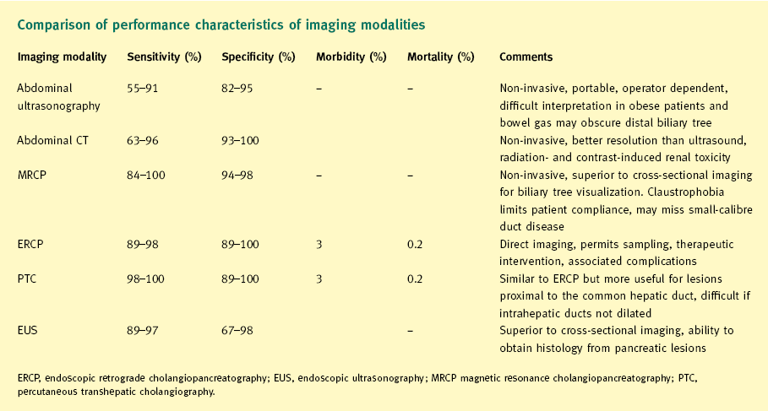

Slide 37
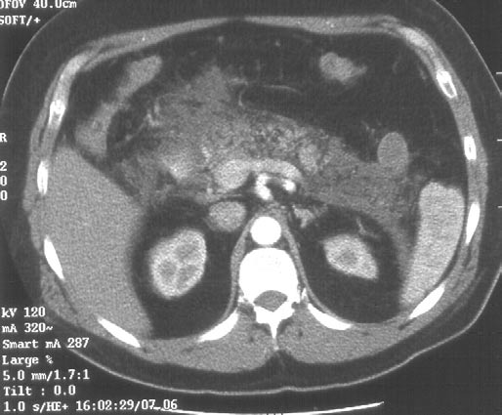
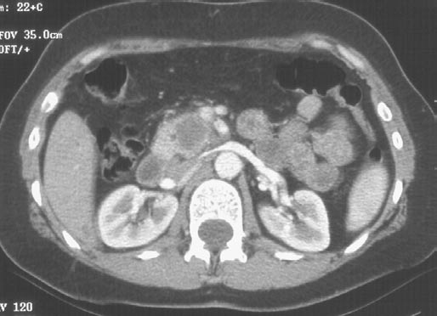
CT scan following ERCP in patient with suspected (later confirmed) pancreatic cancer. Note extensive changes of acute pancreatitis, making accurate interpretation impossible. Surgery was delayed. Staging procedures should be performed prior to endoscopic intervention.
CT scan in young female with small tumour in uncinate process. Tumour is in contact with superior mesenteric vein, and extends towards the superior mesenteric artery. Surgery was attempted in view of age, but complete resection was not possible due to vascular involvement.

Slide 38
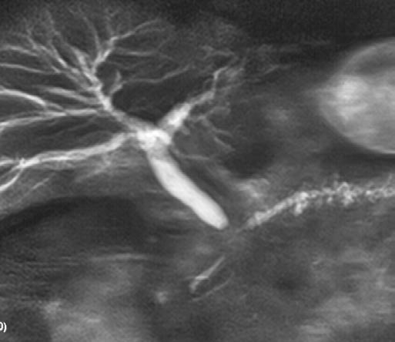
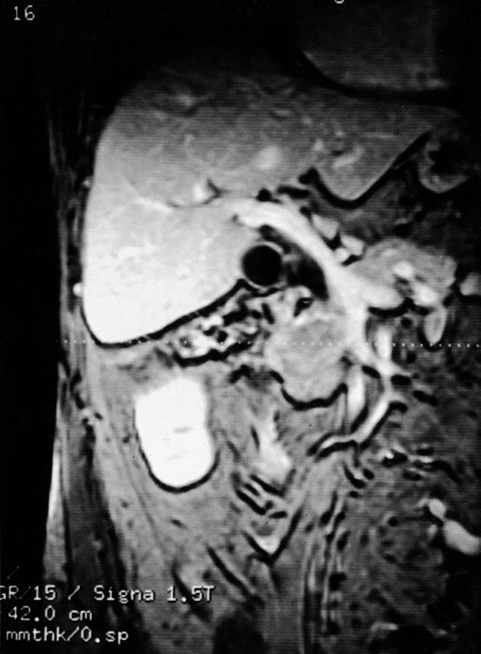
Pancreatic carcinoma as visualized by MRCP
MRI scan showing a pancreatic carcinoma involving the superior mesenteric artery and the portal vein.

Slide 39
Endoscopic Retrograde Cholangiopancreatography
ERCP has been considered the ‘gold standard’ for the investigation of biliary tree pathology in most cases. It involves passage of an endoscope into the duodenum, catheterization of the ampulla of Vater, and injection of contrast medium into the biliary tree and/or pancreatic duct for direct visualization of the pancreatobiliary tree.
Notes:
It is invasive, involving the use of sedation, analgesia and contrast medium. It is highly accurate in diagnosing obstruction of the biliary tree, and permits acquisition of biopsy or brushings for cytology, and therapeutic procedures such as sphincterotomy, stone extraction, stricture dilatation and stent insertion.

Slide 40
Endoscopic Retrograde Cholangiopancreatography
ERCP is highly accurate in the diagnosis of biliary tree pathology with a sensitivity of 89–98% and specificity of 89–100%. The overall technical success rate is above 90%.
The overall cost of ERCP is much higher than that of all other non-invasive imaging.
Notes:
However, it is also associated with risks of pancreatitis (2% in low-risk individuals and an overall mean rate of around 5%). Other complications such as bleeding, perforation and respiratory complications (3%) are more common when interventional procedures are performed.

Slide 41
Percutaneous Transhepatic Cholangiography
This procedure is used when ERCP has been unsuccessful or considered not feasible owing to altered anatomy (following surgery).
In patients with known hilar strictures, PTC has been recommended by some as a preferred initial investigation because of the modest success rate when ERCP is used for decompression in such a clinical scenario.
Notes:
Percutaneous transhepatic cholangiography (PTC) involves passage of a fine-needle catheter through the skin into the liver to cannulate a peripheral bile duct until bile is aspirated, and obtaining images of the biliary tree with injection of contrast medium.
The procedure has a sensitivity and specificity of 98–100% and 89–100% respectively.
The morbidity and mortality are similar to that of ERCP.

Slide 42
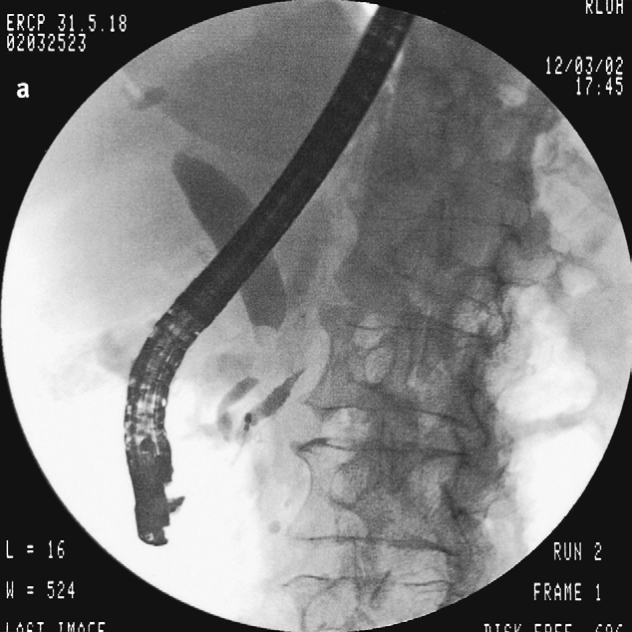
Double-duct sign. Strictures of the common bile duct and pancreatic duct caused by pancreatic ductal adenocarcinoma. Note the relative lack of dilatation of the intrahepatic ducts, in this case resulting from involved nodes at the porta hepatis.

Slide 43
Endoscopic Ultrasonography
Endoscopic ultrasonography (EUS) generates images of the biliary tree with a sensitivity and specificity comparable to that of MRCP, and has the advantage of permitting sampling of pancreatic lesions and more accurate staging of neoplasms comparable to that of CT. In selected cases of doubtful obstruction of the biliary tree, the choice of direct progression to therapeutic ERCP following EUS is an added advantage.
Notes:
The risk of the procedure is similar to that of any diagnostic upper gastrointestinal endoscopy, with mortality and morbidity rates of less than 0.1% when biopsy is involved. EUS is useful when the patient is thought to be a high-risk candidate for ERCP or PTC.

Slide 44
Diagnostic Strategies for Imaging
The choice and order of imaging modalities depend on the clinical probability of biliary obstruction causing jaundice.
Based on a clinical decision analysis model of obstructive jaundice, several diagnostic imaging modalities have been compared.
Notes:
The implication of these studies is that, if the suspicion of biliary obstruction is high and initial ultrasound does not reveal a dilated biliary system, then further studies to visualize the biliary system should be pursued. Thus in a jaundiced patient the initial approach to investigation of the biliary tree would be either an ultrasound or CT scan.
If the bile ducts are dilated the next step would be direct visualization with ERCP or PTC, with institution of appropriate treatment at the same sitting if possible.
If the likelihood of biliary obstruction is low, then investigations should be directed towards diagnosing intrinsic liver disease. In cases of intermediate suspicion of biliary obstruction, then MRCP or EUS is the investigation of choice before investigation of hepatic disorders.
In patients in whom ERCP or PTC is the preferred investigation, the default choice would be ERCP as it offers a broader range of interventional options than PTC. Clinical strategies depend heavily on the local expertise and availability of a particular specialist procedure such as MRCP and EUS.

Slide 45
Serology Work-up in Hepatobiliary disorders
When imaging studies do not reveal biliary obstruction, jaundiced patients with biochemical evidence of cholestasis and or hepatocellular dysfunction should be evaluated for evidence of underlying liver disease.
Notes:
In the light of clinical suspicion, based on the initial clinical history and presentation, various laboratory tests should be performed. These include hepatitis viral serology for hepatitis B and C in chronic cases, and hepatitis A and E, Epstein–Barr virus and cytomegalovirus for acute presentations; iron studies such as serum iron concentration, ferritin and transferrin saturation for haemochromatosis; serum copper and cerruloplasmin for Wilson’s disease; autoantibody profile (antinuclear antibodies, liver-kidney microsomal antibody and smooth muscle antibody) with serum immune electrophoresis or immunoglobulin estimation for autoimmune hepatitis; antimitochondrial and M2 antibodies for primary biliary cirrhosis; and α1-antitrypsin for α1-antitrypsin deficiency.
If none of these serological investigations reveals the cause of jaundice, liver biopsy is suggested, which will which provide precise details of the hepatic lobular architecture; special histological stains can be used to elucidate the cause in most cases of undiagnosed persistent jaundice.

Slide 46
Suspected common bile duct stones: if distal bile duct obstruction is confirmed on ultrasound, and a duct stone suspected (but not confirmed), an assessment of the degree of suspicion for malignancy must be made with certainty.
If doubt exists, MRCP should be done to confirm a stone before proceeding to ERCP. Common bile duct stones may pass spontaneously and the liver function tests improve.

Slide 47
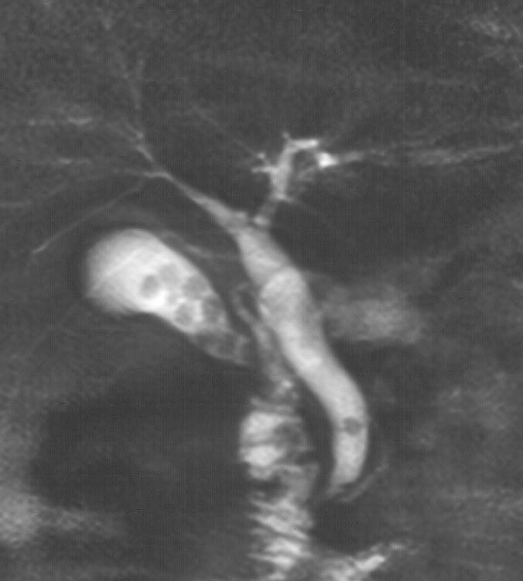
Common bile duct stone and multiple stones in gallbladder as visualized by MRCP.

Slide 48
Management- Bile Duct Stones
Several options are available after investigations have revealed bile duct stones; and selection depends up on:
patient’s physical condition
comorbidity and medical history
previous attempts at biliary intervention
if the patient has had a cholecystectomy
availability of equipment / anaesthetist/ interventionist
patient preference.

Slide 49
Management- Bile Duct Stones
ERCP ± Sphincterotomy: ERCP has a success rate of about 90% and a low complication rate in experienced hands, but risks such as bleeding from damage to a branch of the superior pancreaticoduodenal artery (1–2%), perforation (1–2%), acute pancreatitis (2–5%; severe 0.2%) are inherent to the procedure.
Notes:
An adequate sphincterotomy is undertaken and the duct cleared using a balloon catheter or Dormia basket.
Confirmation of duct clearance should be established with a duct radiograph.
If the stones are too large to clear, they can be crushed in situ using a mechanical lithotripter. These can be difficult to operate and can cause damage to the duct lining.
Other techniques (e.g. chemical dissolution, extracorporeal shockwave lithotripsy, contact lithotripsy, laser under direct vision) have been attempted.

Slide 50
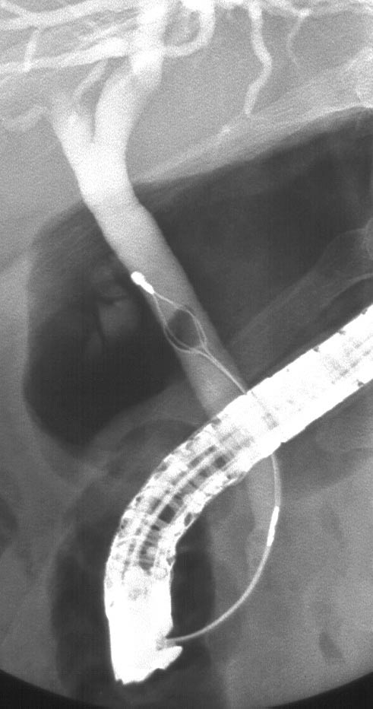
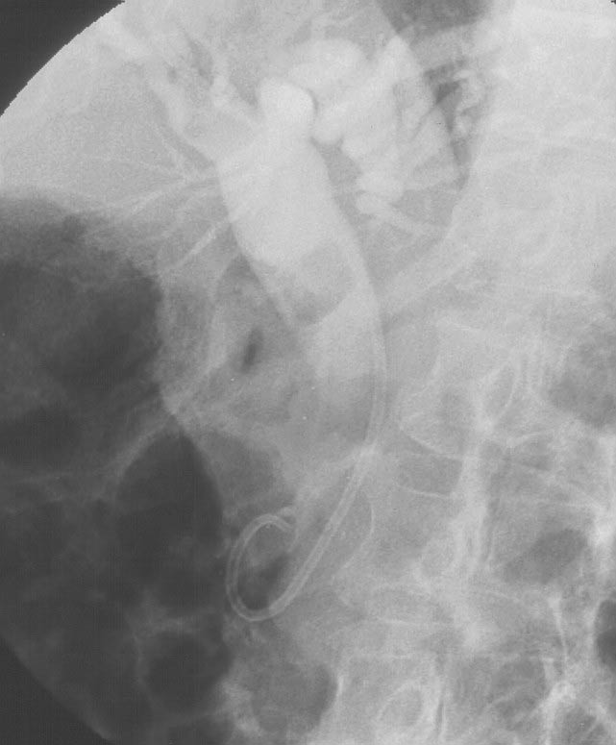
Common bile duct stone extraction using a Dormia basket as visualized by ERCP
Drainage with pigtail stent for large retained stones as visualized by ERCP.

Slide 51
Management- Bile Duct Stones
Open Exploration of the common bile duct is done through a subcostal incision sited over the confluence of the cystic and common bile ducts (i.e. midline to mid-clavicular line).
For fit individuals, this offers the advantage of a single intervention to deal with common duct stones and removal of the diseased gallbladder, but may risk increased morbidity compared with the laparoscopic approach.
Notes:
Technique – open exploration of the common bile duct involves:
a small transverse incision in the right subcostal region;
dissection of Calot’s triangle to define anatomy;
cholecystectomy;
transcystic exploration or supraduodenal longitudinal choledochotomy;
extraction of calculi by Fogarty balloon trawl, Desjardins forceps or Dormia basket;
confirmation of duct clearance superiorly and inferiorly by choledochoscopy and/or operative cholangiography.

Slide 52
Complications of Biliary Stenting
Immediate
Sepsis
Haemorrhage
Acute pancreatitis
Perforation and bile leak (peritonitis)
Late
Recurrent jaundice due to:
Displacement
Sludging
Overgrowth by neoplasm
Erosion into adjacent viscus

Slide 53
Management- Malignant biliary strictures
Malignant strictures
If there is a possible malignant cause for obstructive jaundice, the priority in a fit patient is to stage the disease process and assess the potential resectability.
Several factors are crucial in the assessment:
nature of the primary lesion;
site, spread and extent, as well as local anatomical relationships of the lesion;
liver or peritoneal metastasis;
ascites;
lymphadenopathy;
fitness, comorbidity and preference of the patient.
Notes:
Histological proof of malignancy is often not obtained before resection because of the risk of cancer seeding through percutaneous intervention preoperatively. If palliative treatment is considered, a definitive diagnosis is desirable for prognostic reasons.
After initial clinical assessment, staging and discussion with the multidisciplinary team, patients with a malignant cause of obstructive jaundice can be divided into two categories: - non-resectable and potentially resectable.

Slide 54
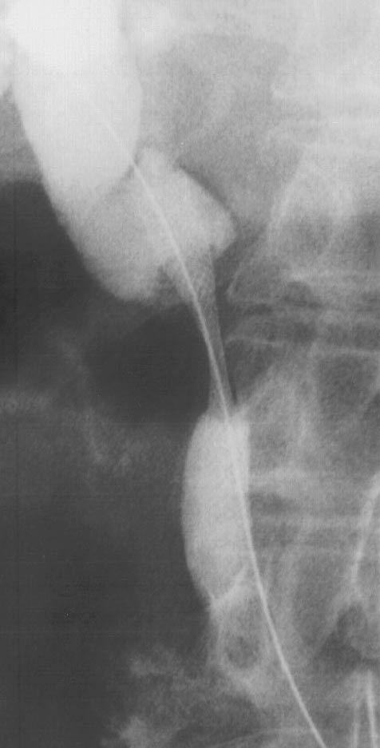
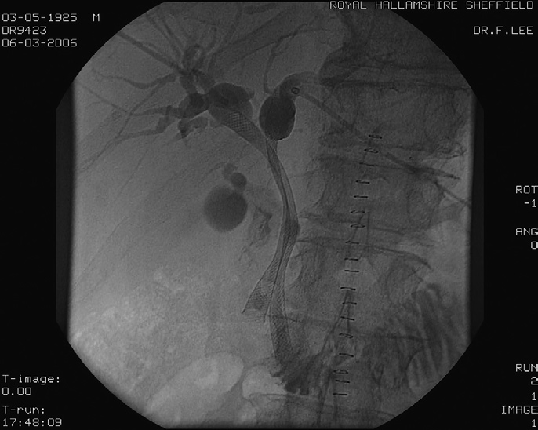
Percutaneous stent insertion for inoperable malignant common bile duct stricture. Stricture was due to lymphadenopathy from metastatic rectal cancer.
Percutaneous transhepatic cholangiography and bilobar stent of Klatskin tumour.

Slide 55
Benign Biliary Strictures
Although uncommon, the commonest cause of benign biliary stricture is iatrogenic injury of the common bile duct during cholecystectomy.

Slide 56
Causes of benign biliary stricture
Trauma
Iatrogenic injury (cholecystectomy - most common)
Infective
Parasitic infestations (e.g. Echinococcus (hydatid disease), Ascaris (roundworm), Clonorchis (liver flukes))
Recurrent cholangitis : Oriental cholangiohepatitis (pyogenic) - Escherichia coli
HIV cholangiopathy
Inflammatory
Pancreatitis: acute/chronic
Sclerosing pancreatitis
Primary sclerosing cholangitis
Inflammatory pseudotumour
Gallstone-related (Mirizzi syndrome)

Slide 57
Biliary Surgery- Post-interventional Care
The monitoring of the followings is crucial to successful outcome:
• Fluid balance: Pre-operative fluid expansion
• Need careful post-operative fluid balance to correct depleted ECF compartment
• Sepsis and Broad spectrum antibiotic prophylaxis
• Parenteral vitamin K +/- fresh frozen plasma to correct coagulopathy
• Urine output and renal function assessment
• Drainage/fluid output chart and appropriate replacement
• Pain control.

Slide 58
Summary
The key to the diagnosis and management of patients with jaundice is to distinguish initially whether the pattern of liver injury is hepatocellular or cholestatic.
In cholestatic conditions, it is important to consider non-obstructive causes and to confirm biliary obstruction with less invasive imaging modalities, followed by appropriate techniques to establish the diagnosis as well as institute prompt treatment.
The choice of test and technique in an individual patient depends on a combination of clinical decision making, availability and expertise in particular techniques.

Slide 59
Thanks a Lot for Your Attention
ANY QUESTION ..?

