Slide 1

Environmental Health
Dr. Nuha Bodaboos, MD, MPH

Slide 2
Definitions:
Environment: It means all external factors which surround man
Sanitation: The science of safeguarding health. A way of life expressed in the clean home, clean farm, clean neighborhood and the clean community.
Environmental Sanitation: The control of all those factors in human’s physical environment that may affect his physical development, health and survival.
Hygiene: the science of health which contains all factors that contribute to healthful living
Contamination: the presence of infectious agent on a body surface or clothes, bedding, toys, surgical instruments, water, milk and food.
Pollution: is distinct from contamination and means the presence of offensive but not necessarily infectious matter in the environment.

Slide 3
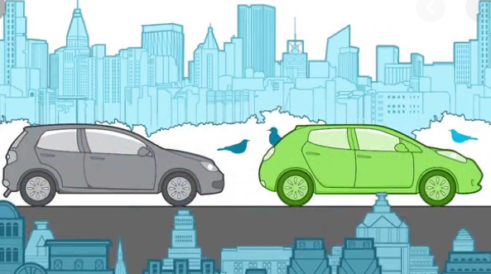

Slide 4
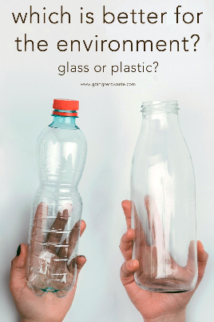

Slide 5
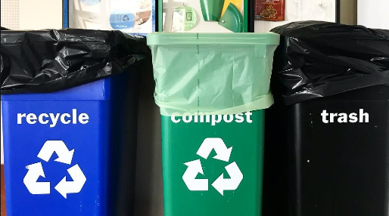

Slide 6


Slide 7
The purpose of environmental health: Is to create and maintain ecological conditions that will promote health and prevent disease.
Environmental components:
1-Physical environment such as water, soil and air
2-Biological environment: All living creatures
3-Social and cultural environment: Income and occupation

Slide 8
Water
Safe water criteria:
Free from pathogens
Free from harmful chemical
Pleasant taste
Water pollution: Dissolved gases, minerals, salts, sewage, industrial waste and radioactive substances.

Slide 9
Water borne diseases:
Caused by presence of infective agents:
Hepatitis A, E, Poliomyelitis
typhoid and cholera.

Slide 10
Purification of water:
Storage
Filtration
Disinfection

Slide 11
Purification of water
Storage: It is considered the first step in water purification by which the total bacterial count may drop by 90% in 5 to 7 days.
Filtration: the second important step in water purification is sand filtration, in which water is passed through well constructed sand filters which reduce the total bacterial count by 99%.
Disinfection: it is the most critical step in water purification, it can be done by one of the following methods:
Chlorination
Chlorine dioxide disinfection
Ozone disinfection
Ultraviolet light

Slide 12
Emergency disinfection of water
During an emergency situation like an outbreak of water borne disease
1- Boiling
2- Chemical disinfection by bleaching powder, chlorine tablets, iodine and potassium permanganate.

Slide 13
Waste: Unwanted substance or material produced as a result of a process
Solid waste:
Hazardous waste
Organic
Recyclable waste
Liquid waste:
Wash water, flushing and human excretion

Slide 14
Waste disposal
Solid waste disposal
Liquid waste(Sewage)

Slide 15
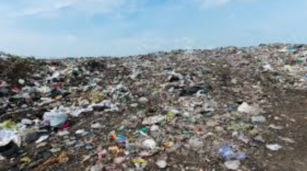
Waste disposal:
Solid Waste disposal:
Storage by using paper sack and public bins.
Collection: The best way of collecting by enclosed vans
Controlled tipping (Sanitary landfill): Buried and covered with soil for 4-6 months

Slide 16
Solid Waste disposal:
Dumping: A simple method of waste disposal in which refused is dumped in low lying areas outside city limits.
Composting: Is a method of combined disposal of refuse and sludge. The compost can be used as a fertilizer.
Incineration: It is the best way of disposing the dangerous hospital wastes.
Burial: it is suitable for small camps
Recycling: Reducing energy loss, consumption of new material an d reduction of landfill.

Slide 17
Liquid Waste Sewage:
It is waste water from a community, containing solid and liquid from houses, streets, factories and industries.
It is collected from individuals households by a network of underground pipes known as the sewage system, these pipes carry sewage to the place of final disposal where it is purified in sewage treatment plants by biological methods.

Slide 18
Air
Primary pollutants: CO. CO2 and Methane
Secondary pollutants: Ozone and sulphoric acid

Slide 19
Types of air pollution and its effect:
Outdoor air pollution: Smog, increase the harmful effects of greenhouse gases and global warming, ozone layer depletion cause increase incidence of respiratory diseases.
Indoor air pollution: More dangerous than out door
molds and heating system cause burning eyes, skin irritation, asthma and lung cancer if it is long term exposure

Slide 20
Criteria of healthful housing:
Provides physical shelter and privacy
Prevents spread of disease
Protection from environmental hazards

Slide 21
Criteria of overcrowding
Number of persons per room
Sex seperation

Slide 22
Poor housing effect on health:
Respiratory infections
Rat infestation
Psychological effects

Slide 23
Greenhouse gases, global warming:
CO2, Methane and Nitrous oxide
When human activities distort those gases means more heat trapped that increase the earth’s temperature leading to serious problem worldwide.

Slide 24
Global Warming:
Increase the temperature on earth’s surface which may cause dangerous effects:
Rising sea level and melting of polar ice caps
Heat island phenomenon that makes cities warmer than surrounding rural areas will lead to many attacks of heat waves.
Species extinction
Change in water supply and contamination of fresh water
Increase risk of water borne disease

