Slide 1


The Different Waves of Feminism Movement
Libyan International Medical University
Faculty of Business Administrator
Rudena Bettamer 2886
Rudena_bettamer@limu.edu.ly

Slide 2
Table of Content:
Introduction
Feminism concept
The First Wave
The Second Wave
The Third Wave
The Fourth Wave
Conclusion
References
2

Slide 3
Objective:
Identify the different waves of feminism movement.
3

Slide 4
Introduction:
Feminism is the belief in full social, economic, and political equality for women. Feminism largely arose in response to Western traditions that restricted the rights of women, but feminist thought has global manifestations and variations.
4

Slide 5
Feminism is one of the oldest movements in global history. There’s no single definition, but feminism boils down to ending gender discrimination and bringing about gender equality.
Feminism can be divided into waves:
5

Slide 6
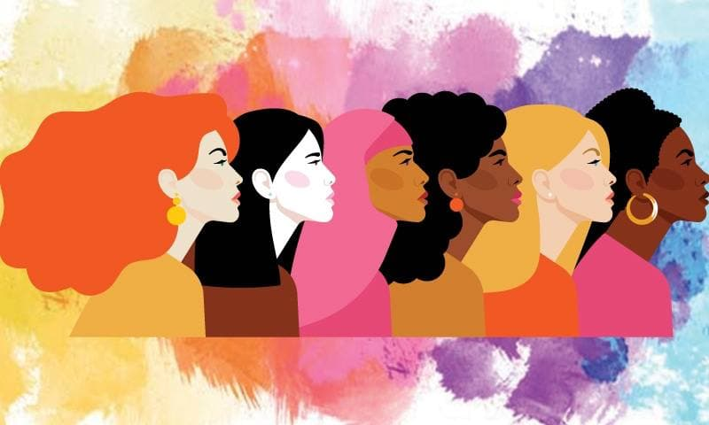
The first wave:
First-wave feminism had a fairly simple goal: have society recognize that women are humans, not property.
6

Slide 7
The second wave:
It is built on the first wave, which means reducing gender discrimination and giving women access to male dominated spaces and promoting equality.
7

Slide 8

The third wave:
Women enjoyed more rights and power. They were able to think of other aspects of their identity. This was the era of reform, women have become more aware.
8

Slide 9

The fourth wave:
The fourth wave seeks greater gender equality by focusing on gendered norms and marginalization of women in society.
9

Slide 10
Conclusion:
Women became more active in the labour movement. As their female membership increased, unions began to fight for such reforms as affirmative action, pay equity, day care, and equal pension plans for women workers.
10

Slide 11
References:
Bettamer, R. H. (2021, February 28). Types of feminism: The Four waves. Human Rights Careers. Retrieved November 8, 2021, from https://www.humanrightscareers.com/issues/types-of-feminism-the-four-waves/.
Bettamer, R. H. (2021, February 28). Types of feminism: The Four waves. Human Rights Careers. Retrieved November 8, 2021, from https://www.humanrightscareers.com/issues/types-of-feminism-the-four-waves/.
11

Slide 12
Thank you
12

