Slide 1



Climate Change and global food system
Abdulrahman Mangoush 3446
18/5/2022

Slide 2
Objectives
Discuss the impact of climate change on agriculture production
Explain the changes that occur to arable lands
How does agriculture utilize carbon dioxide
What is the importance of adaptation

Slide 3
Climate change and Agriculture
Increasing temperature.
Frequent extreme weather events.
Distribution changes of arable land.
Increasing carbon dioxide levels.

Slide 4

Increasing temperature

Slide 5
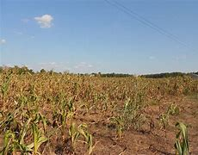
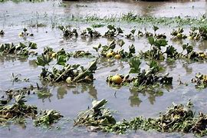
Frequent extreme weather events
Droughts
Floods
1- The crop
2- Its growth stage
3- The duration of flooding
4- The temperature during flooding

Slide 6
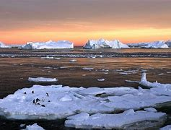
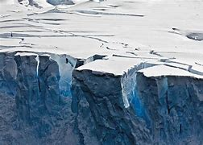
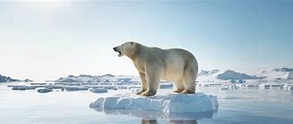
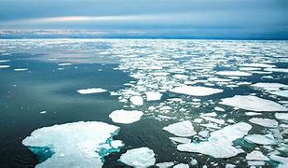
Changes in access to arable land

Slide 7
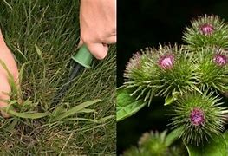
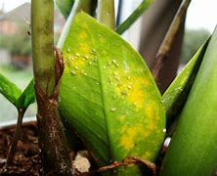
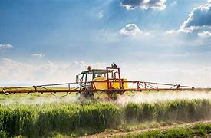
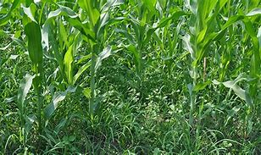
Agricultural utilization of carbon dioxide

Slide 8
The importance of adaptation

Slide 9
References
Climate Change Effects on Food Security | Forbes and Fifth | University of Pittsburgh

Slide 10
THANK
YOU

