Slide 1



Libya International medical university
Faculity of Applied Medical Science
Presentation Titel/Flu viruses in children
Editing by : Retag Hamdy
Number/3467 ..Year/1

Slide 2

OBJ :
Introduction
List types of Flu viruses
Outline risk factor of Flu viruses in children
List symptoms of the flu in child
Outline diagnoses of Flu viruses in a child
Identify treatment of Flu viruses in child
Outline prevention of Flu viruses in children

Slide 3
Introduction
Influenza (flu) is a very contagious viral infection that affects the air passages of the lungs.
It causes a high fever, body aches, a cough, and other symptoms.
It's one of the most severe and common in the winter season.

Slide 4
Flu viruses are divided into 3 types:
Influenza types A and B.
These 2 types of viruses cause widespread illness (epidemics) almost every winter. They often lead to more people needing to go to the hospital, and more people dying from the flu.

Slide 5
Influenza type C.
This type of virus causes a very mild respiratory illness. It rarely causes epidemics. It does not have the severe public health impact that influenza types A and B do.

Slide 6
Outline risk factor of Flu viruses in children
A child is more at risk for the flu if they
Are around people infected with the flu
Haven't had the flu vaccine
Don't wash their hands after touching infected surfaces
Young children and children with certain underlying health conditions are at increased risk for a hospital stay or severe or complicated influenza infection.

Slide 7
List symptoms of the flu in child

Slide 8
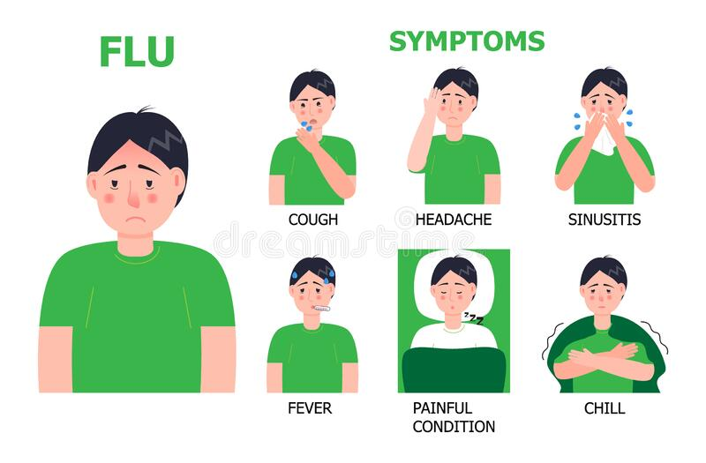

Slide 9
describe diagnoses of Flu viruses in a child
Ask about the child's symptoms and health history.
Do a physical examination of the child.
Other tests such as a nose or throat swab may be done.

Slide 10
Identify treatment of Flu viruses in child
Treatment may include medicines such as:
Acetaminophen. This is to help lessen body aches and fever.
Antiviral medicine. This may help to ease symptoms, and shorten the length of illness.

Slide 11
Outline prevention of Flu viruses in children
Avoid touching your eyes, nose, and mouth. ...
Wash your hands often. ...
Limit contact with family members who are ill. ...
Clean your home. ...
Practice healthy habits.

Slide 12
Summary
Discuss this presentation Influenza (flu) is a very ,types of Flu viruses and thier risk factor , symptoms also diagnoses of Flu viruses in a child and treatment of Flu viruses in child , prevention of Flu viruses in children.

Slide 13
Reference
https://www.hopkinsmedicine.org/health/conditions-and-diseases/influenza/influenza-flu-in-children

Slide 14
Thank you

