Slide 1


The Guide for Emotional Competence in Your Expression of ,and Response to Emotion
Libyan International Medical University
Faculty of Bussines Adminstration
By:Ahmed Jadalla Hamad
Email:ahmed_2726@limu.edu.ly
ID/2726
Date:1/12/21

Slide 2
Table of Content:
The Meaning of Emotional Competence.
The Parts of Emotional competence.
Explain each part clearly.
Conclusion .
References .

Slide 3

The Meaning of Emotional Competence:
Emotional competence refers to the essential set of personal and social skills to recognize, interpret, and respond constructively to emotions in oneself and others.

Slide 4
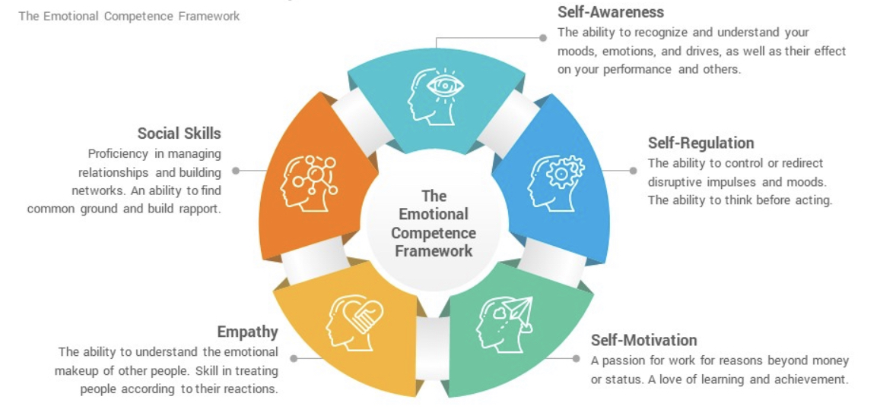
The Parts Of Emotional Competence:

Slide 5

Self-Awareness:
Self-awareness is the ability to tune in to your feelings, thoughts, and actions. Being self-aware also means being able to recognize how other people see you.

Slide 6
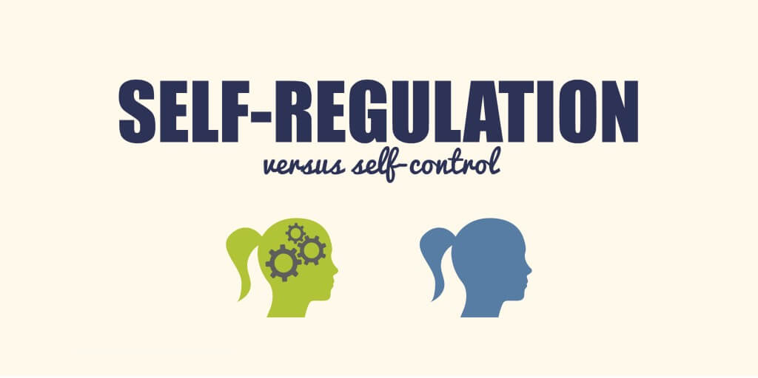
Self Regulation:
Self-regulation is the ability to manage your emotions and behaviour in accordance with the demands of the situation.

Slide 7

Self Motivetation:
Self motivetation is the ability to drive oneself to take initiative and action to pursue goals and complete tasks.

Slide 8

Empathy:
Empathy is the ability to emotionally understand what other people feel, see things from their point of view, and imagine yourself in their place. Essentially, it is putting yourself in someone else's position and feeling what they must be feeling.

Slide 9

Social skills:
Proficiency in managing relationships and bulding networks,an ability to to find common ground and build rapport.

Slide 10

Conclusion
Emotional Competence helps you build stronger relationships, succeed at school and work, and achieve your career and personal goals. It can also help you to connect with your feelings, turn intention into action, and make informed decisions about what matters most to you.

Slide 11
References
Melinda. (2021, October 12). Improving emotional intelligence (EQ). Help Guide. org. Retrieved November 29, 2021, from https://www.helpguide.org/articles/mental-health/emotional-intelligence-eq.htm
Bridges, C. A. and C. (n.d.). A guide to the core SEL competencies [activities included]. A Guide to the Core SEL Competencies [Activities Included]. Retrieved November 29, 2021, from https://www.panoramaed.com/blog/guide-to-core-sel-competencies

Slide 12


