Slide 1



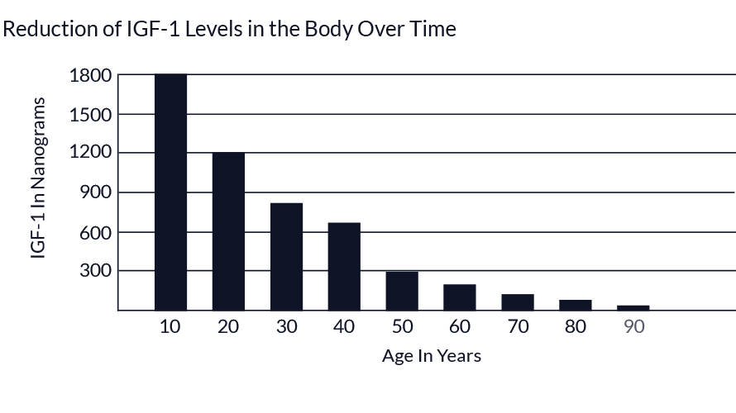





Age is just a number !!!
Muhammad Hussein Eltaib 1506
Faculty of Basic Medical Science
Libyan International Medical University
L I M U
Introduction
Conclusion
Ageing can be defined as the time-related deterioration of the physiological (loss of muscle and bone mass, increase visceral fat ) and mental functions (decline in
Cognitive, memory and motor performance). Ageing is mainly associated with the decrease of some hormones level such as sex hormones and growth hormone (GH). These hormones play a major role in normal human growth, metabolism and functions. Also, there is many factors or habits that affect human age like factors that cause cellular damage such as smoking and elevated free radicals that come from oxidative stress.
[1,2]
Ageing is a complex process, that depends on several factors such as diseases, environmental or even genetic. Anything harm or damage our body is a possible factor for ageing, so we have to follow up on our health and try to get the best lifestyle to stay young as possible as we can.
Reduction of IGF-1 levels in the body over time. [6]
References
So how to slow our
ageing process?
1-Chertman LS, Merriam GR, Kargi AY. Growth Hormone in Aging. [Updated 2015 May 4]. In: Feingold KR, Anawalt B, Boyce A, et al., editors. Endotext [Internet]. South Dartmouth (MA): MDText.com, Inc.; 2000
2- Astrid M. Horstman, E. Lichar Dillon, Randall J. Urban, Melinda Sheffield-Moore, The Role of Androgens and Estrogens on Healthy Aging and Longevity, The Journals of Gerontology: Series A, Volume 67, Issue 11, November 2012, Pages 1140–1152
3-Jin K. Modern Biological Theories of Aging. Aging Dis. 2010;1(2):72–74.
4-Gilbert SF. Developmental Biology. 6th edition. Sunderland (MA): Sinauer Associates; 2000. Aging: The Biology of Senescence.
5-Meryl, H. and KAROL (2009). How Environmental Agents Influence the Aging Process. Biomolecules & Therapeutics, pp.113-124.
6-Nutronics Labs. (2019). IGF-1 and Anti-aging. [online] Available at: https://www.nutronicslabs.com/blogs/posts/igf1-anti-aging [Accessed 1 Apr. 2019].
7-Mullington JM, Simpson NS, Meier-Ewert HK, Haack M. Sleep loss and inflammation. Best Pract Res Clin Endocrinol Metab. 2010;24(5):775–784. doi:10.1016/j.beem.2010.08.014
8-Sies H, e. (2019). Antioxidant functions of vitamins. Vitamins E and C, beta-carotene, and other carotenoids. - PubMed - NCBI. [online] Ncbi.nlm.nih.gov. Available at: https://www.ncbi.nlm.nih.gov/pubmed/1444060 [Accessed 1 Apr. 2019].
9-Nakao A, Toyoda Y, Sharma P, Evans M, Guthrie N. Effectiveness of hydrogen rich water on antioxidant status of subjects with potential metabolic syndrome-an open label pilot study. J Clin Biochem Nutr. 2010;46(2):140–149. doi:10.3164/jcbn.09-100
10-Longo VD, Mattson MP. Fasting: molecular mechanisms and clinical applications. Cell Metab. 2014;19(2):181–192. doi:10.1016/j.cmet.2013.12.008
Factors that are believed affect aging
Do Regular exercise
Sleep at least 8 hours per day
Take vitamin supplements
Avoid smoking and polluted environment
Do regular investigations to avoid diseases
Drink 1.5 L of water per day
Try Intermittent Fasting for two or one days per week
Try to avoid stress
While these steps fight ageing, some elderly people or people with (GH Deficiency) needs a low dose of GH. [1,5,7,8,9,10]
References
Declines in some hormones such as (GH).
Telomere length shorting.
Free radicals of the oxidative stress.
Smoking or Polluted environment
Chronic Diseases.
Inflammation.
Decreased level of Sirtuins (family of protein deacetylases).
Genetics (Hutchinson-Gilford progeria syndrome).
[1-5]

