Slide 1
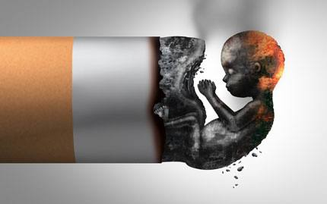

(Tobacco control)
smoking During pregnancy
2021_2022
Student Name :Mahmoud Ali Alshrta
Student Number :3519

Slide 2
Objectives:
1 Define smoking During pregnancy
2 Describe Health Effects of Smoking and Secondhand smoke on
Pregnancies
3 Describe Health Effects of Smoking and Secondhand smoke on Babies
4 Smoking During pregnancies :A Review of Effects on Growth and Development of offspring

Slide 3
A recent British study found that smoking by a pregnant woman makes her baby in the womb wrinkle indicating the negative impact of mother smoking on her fetus.
The research was conducted by Dr. Nadja Resland in collaboration between the Universities of Durham and Lancaster in the United Kingdom and its results were published in the journal Acta Pediatrica
Define smoking During pregnancy

Slide 4
A recent new study found that women smoking during pregnancy is associated with poor reading skills in children
Define smoking During pregnancy
This study showed that the fetuses of pregnant smokers may have a delay in the development of the nervous system

Slide 5
Describe Health Effects of Smoking and Secondhand Smoke on Pregnancies
Women who smoke have more difficulty becoming pregnant
and have a higher risk of never becoming pregnant.
Smoking during pregnancy can cause tissue damage in the
unborn baby particularly in the lung and brain and some
studies suggests a link between maternal smoking and cleft lip.

Slide 6

Studies also suggest a relationship between tobacco and miscarriage.
Carbon monoxide in tobacco smoke can keep the developing baby from getting enough oxygen.
Tobacco smoke also contains other chemicals that can harm unborn babies

Slide 7
Describe Health Effects of Smoking and Secondhand Smoke on Babies?
Mothers who smoke are more likely to deliver their babies early. Preterm delivery is a leading cause of death disability and disease among newborns.
One in every five babies born to mothers who smoke during pregnancy has low birth weight.
Mothers who are exposed to secondhand smoke while pregnant are more likely to have lower birth weight babies.
Babies born too small or too early are not as healthy

Slide 8
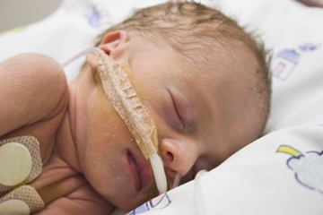
Babies whose mothers smoke are about three times more likely to die from SIDS

Slide 9
Smoking During Pregnancy: A Review of Effects on Growth and Development of offspring
Smoking during pregnancy is associated with pre- and postnatal growth retardation and increased risks of placental mortality morbidity and behavioral anomalies
The most likely explanation for these effects is that smoking causes fetal hypoxia resulting in interference with regulating state mechanisms and attenuation of cellular growth

Slide 10
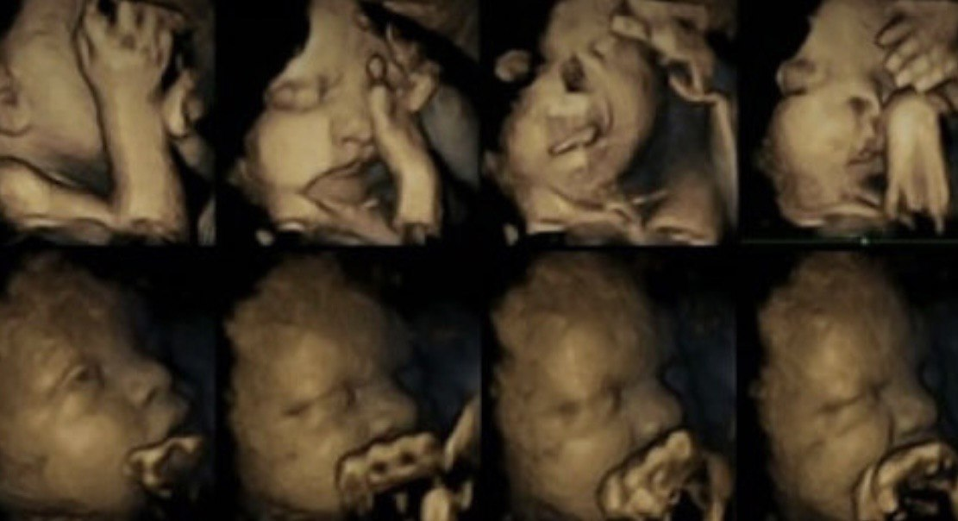
smoking also increases the incidence of various complications of pregnancy which in turn compromises optimal development of the growing fetus
10

Slide 11
References:
[Internet]. 2022 [cited 17 May 2022]. Available from: https://www.cdc.gov/tobacco/basic_information/health_effects/pregnancy/index.htm
Curtin SC, Matthews TJ. Smoking prevalence and cessation before and during pregnancy: data from the birth certificate, 2014. Natl Vital Stat Rep. 2016;65(1):1–1

Slide 12


