Slide 1


Netflix Business Model
Libyan International University
Faculty of Business Administration
Mohamed Alzanati 2344
Instructor: Mr. Mohammed Alzwawi

Slide 2

Content…
Introduction
The Risks that Netflix faces during its Business Main Features of NPM
SWOT analysis for Netflix
Business Model of Netflix

Slide 3

Introduction…
Netflix has experienced significant growth throughout the years and now boasts 222 million subscribers worldwide. With paid subscriptions in more than 190 nations, it is one of the top internet entertainment providers worldwide.

Slide 4

…
Netflix members binge-watch TV shows to the tune of 70%. It includes movies, documentaries, and feature films in a variety of genres and languages, not only TV shows.

Slide 5

…
Reed Hastings and Marc Randolph co-founded Netflix in 1997. Initially a mail-order DVD rental and sales service, its focus shifted to an online DVD rental service after a year.

Slide 6

The Risks that Netflix faces during its Business Main Features of NPM
Strategy Risk
Competitor Risk
Supplier Risk
Regulation Risk
International Risk

Slide 7
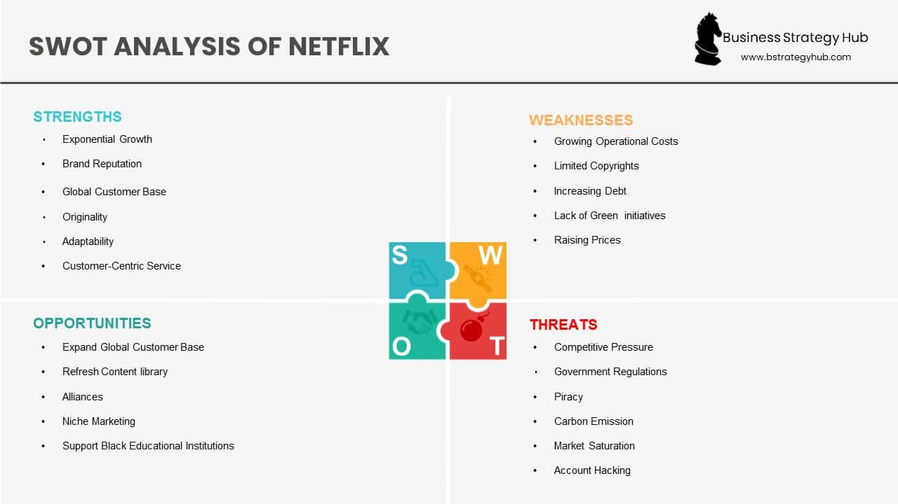
SWOT analysis for Netflix

Slide 8
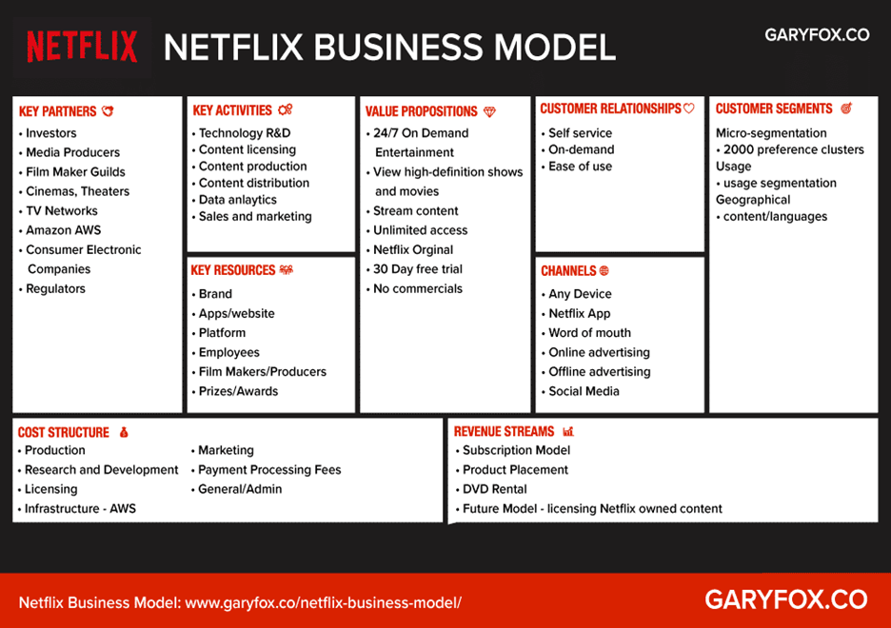
Business Model of Netflix

Slide 9
References
Netflix SWOT Analysis 2022 | SWOT Analysis of Netflix. (2022). Retrieved 16 June 2022, from https://bstrategyhub.com/swot-analysis-of-netflix-2019-netflix-swot-analysis/
Winnie, Y. (2021). 5 Strategic Risks For Netflix: From Competition to Regulation. Retrieved 16 June 2022, from https://journo.com.tr/netflix-strategic-risks

Slide 10


