Slide 1
Pericardial Disease
Dr. Zaki bettamer
Zikoecho@yahoo.com

Slide 2
Case
23 years old male presented 4 days history sharp, stabbing chest pain increased by inspiration and when he is in supine position and improved by sitting upright foreword, his past medical history is free apart from history of acute febrile illness one week back.
On examination: vital sign stable, he is in pain, on auscultation of the heart there is Pericardial friction rub is audible.
ECG show Diffuse ST segment elevation

Slide 3
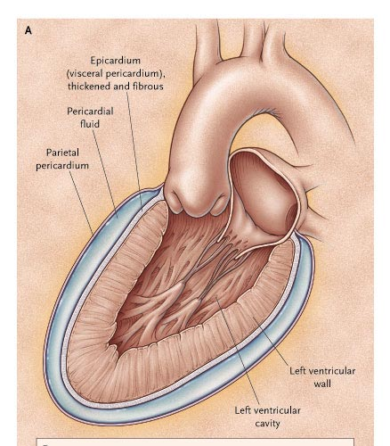
The Pericardium
A fibroelastic sac composed of visceral and parietal layers
Both these layers are separated by a pericardial cavity.
The cavity normally contains 15 to 50 ml of straw-colored fluid.
Visceral layer is in contact with the epicardium (ST elevation)

Slide 4
Acute Pericarditis
The Clinical problem
Can be an isolated entity or part of a systemic disease
0.1% of all hospitalized patients
5% of ER visits for chest pain without an MI

Slide 5
Etiology-Acute Pericarditis
Infectious
  Viral : Coxsackie, Echo, EBV, Influenza, HIV
  Bacterial: TB, staph, hemophilus, pneumococcal, salmonella
  Fungal/other: histo/blasto/coccidio, rickettsial
Rheumatologic
  SLE, Sarcoid, RA, Dermatomyositis, Ankylosing Spondylitis, Scleroderma, PAN

Slide 6
Neoplastic
  Primary: angiosarcoma, mesothelioma
  Metastatic: breast, lung, lymphoma, melanoma, leukemia
Immunologic
  Inflammatory Bowel Disease
Drug
  Hydralazine, Procainamide
Other
  MI, Dressler’s, Post Pericardiotomy, Chest Trauma, Aortic dissection
  Uremic, Post Radiation
  IDIOPATHIC

Slide 7
Clinical Presentation
Chest pain
Pericardial friction rub
Diffuse ST segment elevation on ECG
Pericardial effusion
Presence of at least two of the above features is necessary to make the diagnosis

Slide 8
Chest Pain
Retrosternal in location
Pleuritic and sharp in nature
Exacerbated by inspiration
Worsens when supine and improves upon sitting upright or leaning forward.
Can often radiate to the neck, arms, or left shoulder.

Slide 9
Pericardial Friction Rub
Present in 85% of cases of pericarditis
Highly specific with a variable sensitivity
A high-pitched scratchy sound best heard with the diaphragm at the LSB with the patient leaning forward.
Corresponds temporally to the movement of heart within the pericardial sac.
Has 3 components, which correspond to atrial systole, ventricular systole, and early diastole.
Pericardial friction rub is audible throughout the respiratory cycle, whereas the pleural rub disappears when respirations are on hold.

Slide 10
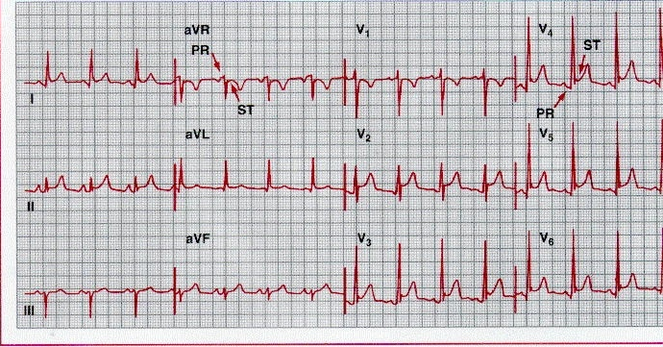

Slide 11
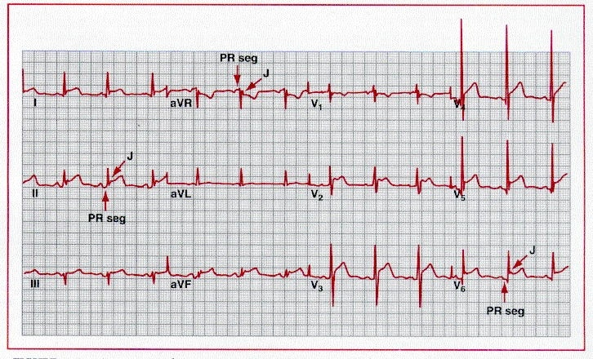

Slide 12
Differential Diagnoses
      Clinical
Myocardial Infarction
Myocarditis
Pulmonary embolism
Pneumothorax
Pneumopericardium
Musculoskeletal
    EGG (ST elev)
AMI
Early Repolarization
Myocarditis
Hyperkalemia
Ventricular Aneurysm
Normal Variant

Slide 13
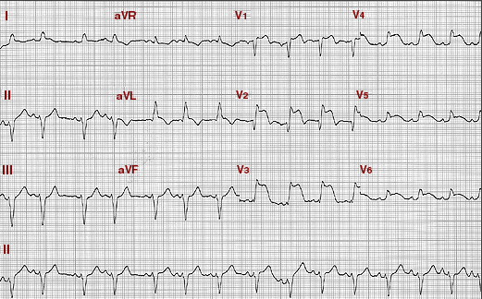
Acute Anterior MI

Slide 14
Laboratory testing
Laboratory abnormalities
    CBC – WBC
    ESR , CRP
    RFT
    ANA, Rheumatoid factor
    Viral serology in some cases

Slide 15
Other Studies
Echocardiogram
    Normal unless there is an effusion
    Presence of effusion supports the diagnosis, but absence does not exclude it.
Chest X-ray
    Recommended in all cases
    Typically normal
    Enlarged cardiac silhouette in effusion (with clear lung fields)
Tuberculin skin testing

Slide 16
Complications
Pericardial Effusion/ Tamponade
Constrictive Pericarditis
Recurrent Pericarditis (15-32%)
  Most likely an autoimmune etiology
  Uremia
  Drugs

Slide 17
Treatment
Goals of acute therapy:
  Relieve Pain
  Treat the inflammation
  Prevent Cardiac tamponade
Most viral infections are self-limited
Treat the underlying disease process

Slide 18
NSAIDs
Aspirin
    2-6 gm daily→650mg Q3-4 hrs
    Preferred in patients with CAD
Ibuprofen
    1600-3200 mg daily→400-800 mg q 6-8 hrs
    above average response rate and has a very good side effect profile
Indomethacin
    75-225 mg daily
Colchicine
Can prevent recurrent pericarditis

Slide 19
Steroids
In patients refractory to NSAIDs and colchicine
Specific conditions that will benefit:
    Acute pericarditis due to connective tissue diseases
    Auto-immune pericarditis
    Uremic pericarditis

Slide 20
Myocardial Infarction-Associated Pericarditis
Early post MI pericarditis is a consequence of transmural infarction.
    Aspirin is the drug of choice in this setting. (650 mg Q4h)
Late MI associated pericarditis (Dressler syndrome), occurs days to months after infarction,
    Autoimmune in etiology.
    NSAIDs are the treatment of choice.
    Colchicine seems to be the most effective if NSAIDs fail
    Corticosteroids seem to provide symptomatic benefit but do not prevent recurrence.

Slide 21
Pericardial effusion
An effusion is difficult to detect clinically.
The heart sounds may become quieter, although a friction rub is not always abolished.
The QRS voltages on the ECG are often reduced in the presence of a large effusion.
The QRS complexes may alternate in amplitude (electrical alternans).
The chest X-ray may show an increased size of the cardiac silhouette and, when there is a large effusion, this has a globular appearance.
Echocardiography is the definitive investigation and is used to monitor the size of the effusion and its effect on cardiac function

Slide 22
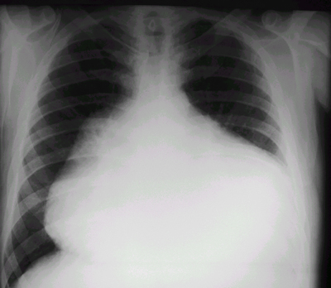

Slide 23
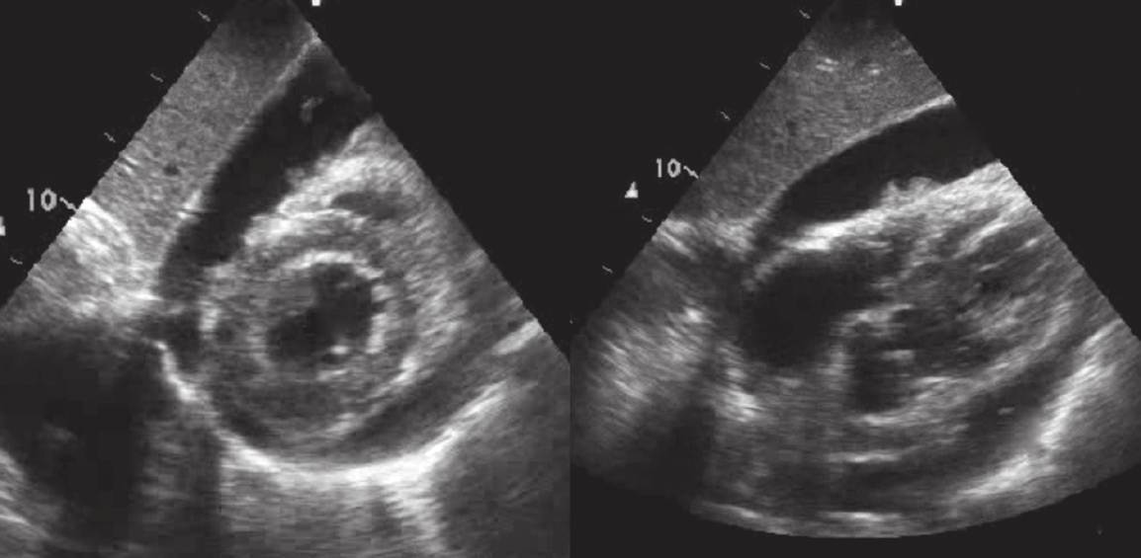

Slide 24
Cardiac tamponade
This term is used to describe acute heart failure due to compression of the heart by a large or rapidly developing effusion.
Typical physical findings are of a markedly
raised JVP, Tachycardia, hypotension, pulsus paradoxus and oliguria.
15% of patients with idiopathic pericarditis or as many as 60% of those with neoplastic, tuberculous, or purulent pericarditis can present with Cardiac Tamponade.

Slide 25
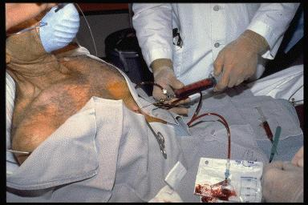

Slide 26
Tuberculous pericarditis
Tuberculous pericarditis may complicate pulmonary tuberculosis but may also be the first manifestation of the infection.
In Africa, a tuberculous pericardial effusion is a common feature of AIDS
The condition typically presents with chronic malaise,weight loss and a lowgrade fever.
An effusion usually develops and the pericardium may become thick
leading to pericardial constriction or tamponade.
An associated pleural effusion is often present.
The diagnosis may be confirmed by aspiration of the fluid and direct examination or culture for tubercle bacilli.
Treatment requires specific antituberculous chemotherapy in addition, a 3-month course of prednisolone (initial dose 60 mg a day, tapering down rapidly) improves outcome.

Slide 27
Chronic constrictive pericarditis
Constrictive pericarditis is due to progressive thickening, fibrosis and calcification of the pericardium.
the heart is encased in a solid shell and cannot
fill properly.
The calcification may extend into the myocardium, so there may also be impaired myocardial contraction.
often follows an attack of tuberculous pericarditis but can also complicate haemopericardium, viral pericarditis, rheumatoid arthritis and purulent pericarditis.
It is often impossible to identify the original insult.

Slide 28
Clinical features and management
The symptoms and signs of systemic venous congestion are the hallmarks of constrictive pericarditis.
Atrial fibrillation is common and there is often dramatic ascites
and hepatomegaly
Breathlessness is not a prominent symptom because the lungs are seldom congested.
The condition is sometimes overlooked but should be suspected in any patient with unexplained right heart failure and a small heart.

Slide 29
A chest X-ray, which may show pericardial calcification and echocardiography often help to establish the diagnosis.
CT scanning is useful for imaging the pericardial calcification.
Constrictive pericarditis is often difficult to distinguish from restrictive cardiomyopathy and the final diagnosis may depend on complex echo–Doppler studies and cardiac catheterisation.
Surgical resection of the diseased pericardium can lead to a dramatic improvement but carries a high morbidity with disappointing results in up to 50% of patients.

Slide 30
Clinical features of constrictive pericarditis
• Fatigue
• Rapid, low-volume pulse
• Elevated JVP with a rapid y
descent
• Kussmaul’s sign (a paradoxical rise in the JVP
during inspiration)
• Loud early third heart sound or ‘pericardial
knock’
• Hepatomegaly
• Ascites
• Peripheral oedema
• Pulsus paradoxus
(excessive fall in BP during inspiration): present in some cases

Slide 31
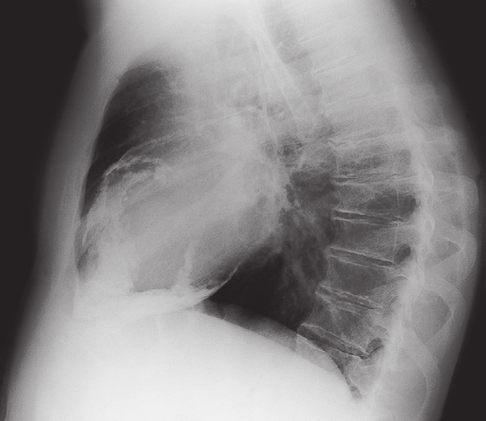

Slide 32
THANKS

