Slide 1



Effect of parent substance abuse of children
\
Presented by sokeenah almashay 3067
Pts. block

Slide 2
Introduction
Video

Slide 3
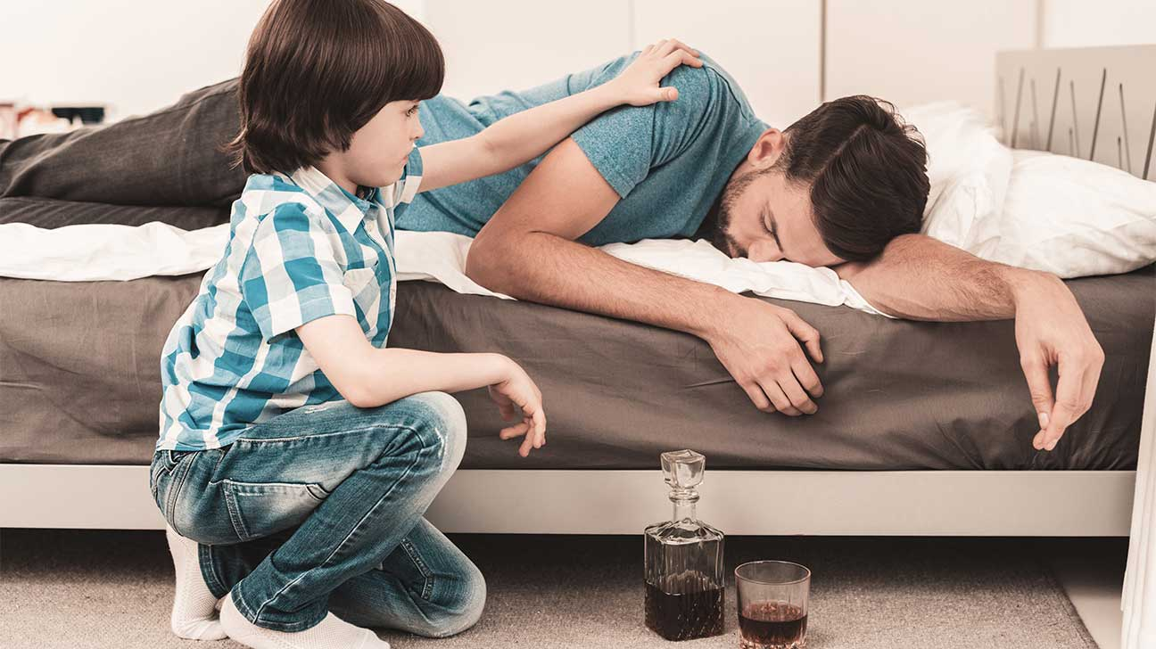
Objective
.Explore effective on children
.Discus studies on how on parental drug abuse affect on children
.Explain how you can help parents drug abuse

Slide 4
Effects on children
1Emotional effect
2Psychological effect
Physical effect 3

Slide 5

Emotional effect Effects on children
■Family life may be characterized by chaos and unpredictability.
■ children can suffer from neglect

Slide 6
“Psychological effect Effects on children”
■this can lead to many childhood psychological difficulties
■such
1 learning problems
2difficulties at school
3anxiety and panic attack

Slide 7

“Psychological effect What are panic attacks?

Slide 8

Physical effect Effects on children
■children who live in a house with parent drug abuser my be exposed to physical effects
■ the child with neglect due to drug abuse parent suffers from many health problem
‼

Slide 9
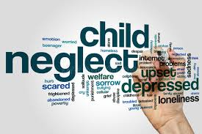
Studies
- Nearly 30 million children in the U.S
live in alcoholic household
-according to the national child abuse and neglect data system

Slide 10
Studies
-Children of substance abusive parents are 4 more likely than children of parents who do not abuse substance to develop substance abuse issues themselves .
WHY ‼

Slide 11
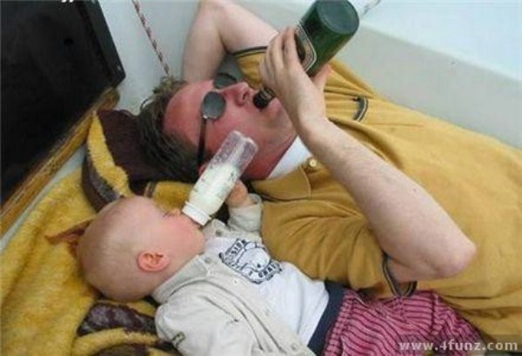

Studies

Slide 12
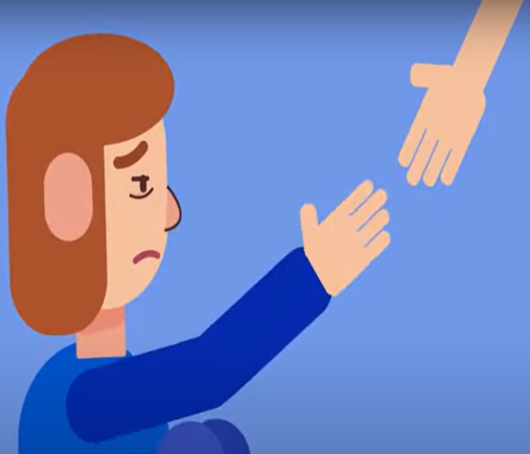
strategies for mitigating the impact of parental substance abuse
-According to national institute of drug abuse drug addiction is complex but treatable
Reduce criminal activity up to 80 percent and reduce arrests up to 64 percent

Slide 13
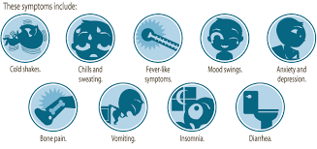

Treating parental substance abuse

Slide 14




Conclusion
Children whose parent abuse drugs or alcohol are more likely to repeat grades or drop out of school
stress experienced by children live with parent abuse can cause GIT disorders
Parents exposure to alcohol can cause birth defects and mental retardation
Children of substance abusers are more likely to exposed physical or sexual abuse

Slide 15
Reference
[Internet]. Medicinenet.com. 2022 [cited 4 March 2022]. Available from: https://www.medicinenet.com/teen drug_abuse/article.http
Serenity. 2022. parent Drug Abuse UK: Causes & Stats | Serenity. [online] Available at: <https://www.rehabclinic.org.uk/teenage-drug-abuse-in-the-uk/> [Accessed 4 March 2022].
rug Addiction & Alcohol Abuse [Internet]. The Recovery Village Drug and Alcohol Rehab. 2022 [cited 4 March 2022]. Available from:

Slide 16
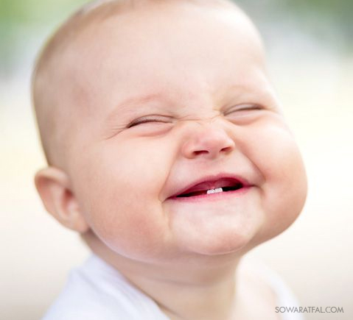
Thank you

