Slide 1


Libyan International Medical University
Faculty of Business Administration
Democratic and Non Democratic Government
Name : Nouri Founas
Student ID : 2733
E-mail : nouri_2733@limu.edu.ly
2021-December-1

Slide 2
Table of content
1
Introduction
2
Democratic
3
Several Variations in Democratic Government
4
Non Democratic
5
Characteristics of a Non-Democratic Government
6
Difference Between Democratic and Non-Democratic Government
7
Conclusion
8
References
2

Slide 3
INTRODUCTION
In the world, there are many different sorts of government. Democracy is a form of government in which the people have ultimate control. Non-democracy is a term that describes governance systems that are not democratic. Monarchies, oligarchies, and theocracies are examples of these. Thus, the main distinction between democratic and non-democratic governments is the power bestowed in the people; in a democratic system, power is vested in the people, whereas power is vested in the rulers in a non-democratic government.
3

Slide 4
01
Democratic
4

Slide 5

Democracy is a system of government in which all citizens are given an equal say in choices that impact their lives. People can participate in the proposal, development, and creation of laws in a democratic manner, either directly or through elected representatives. It refers to the social, economic, and cultural conditions that allow individuals to exercise political self-determination in a free and equal manner.
5

Slide 6
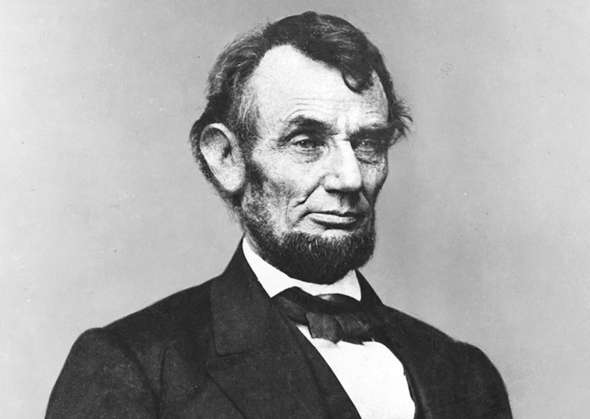
In his famous Gettysburg Address of 1863, U.S. President Abraham Lincoln defined democracy as "government of the people, by the people, for the people..."
Abraham Lincoln. Library of America. (n.d.). Retrieved November 30, 2021, from https://www.loa.org/writers/187-abraham-lincoln.
6

Slide 7
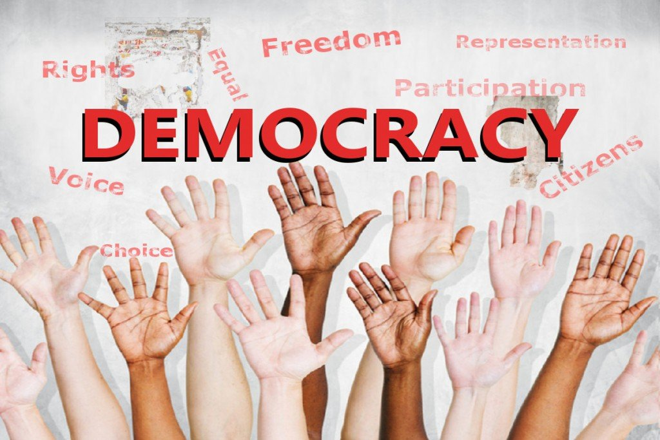
The four main elements in a democracy:
1- A political system in which the government is chosen and removed by free and fair elections.
2- Citizens' active participation in politics and civic life.
3- All citizens are subject to the same laws.
4- All citizens' human rights are protected.

Slide 8
The several types in democratic government.
Representative
Democracy.
Direct Democracy.
8

Slide 9

The most common kind of democracy in the modern world is representative democracy. Ordinary citizens elect officials to represent them under this system. A democratic republic is one in which the leader or head of state is also chosen through democratic elections.
Representative
Democracy.
9

Slide 10

Direct democracy is a form of government in which citizens have direct input into decision-making. Although they are mostly employed in a representational democracy, electoral instruments such as referendums, recall elections, and citizens' initiatives are referred to as direct democracy tools.
Direct Democracy.
10

Slide 11
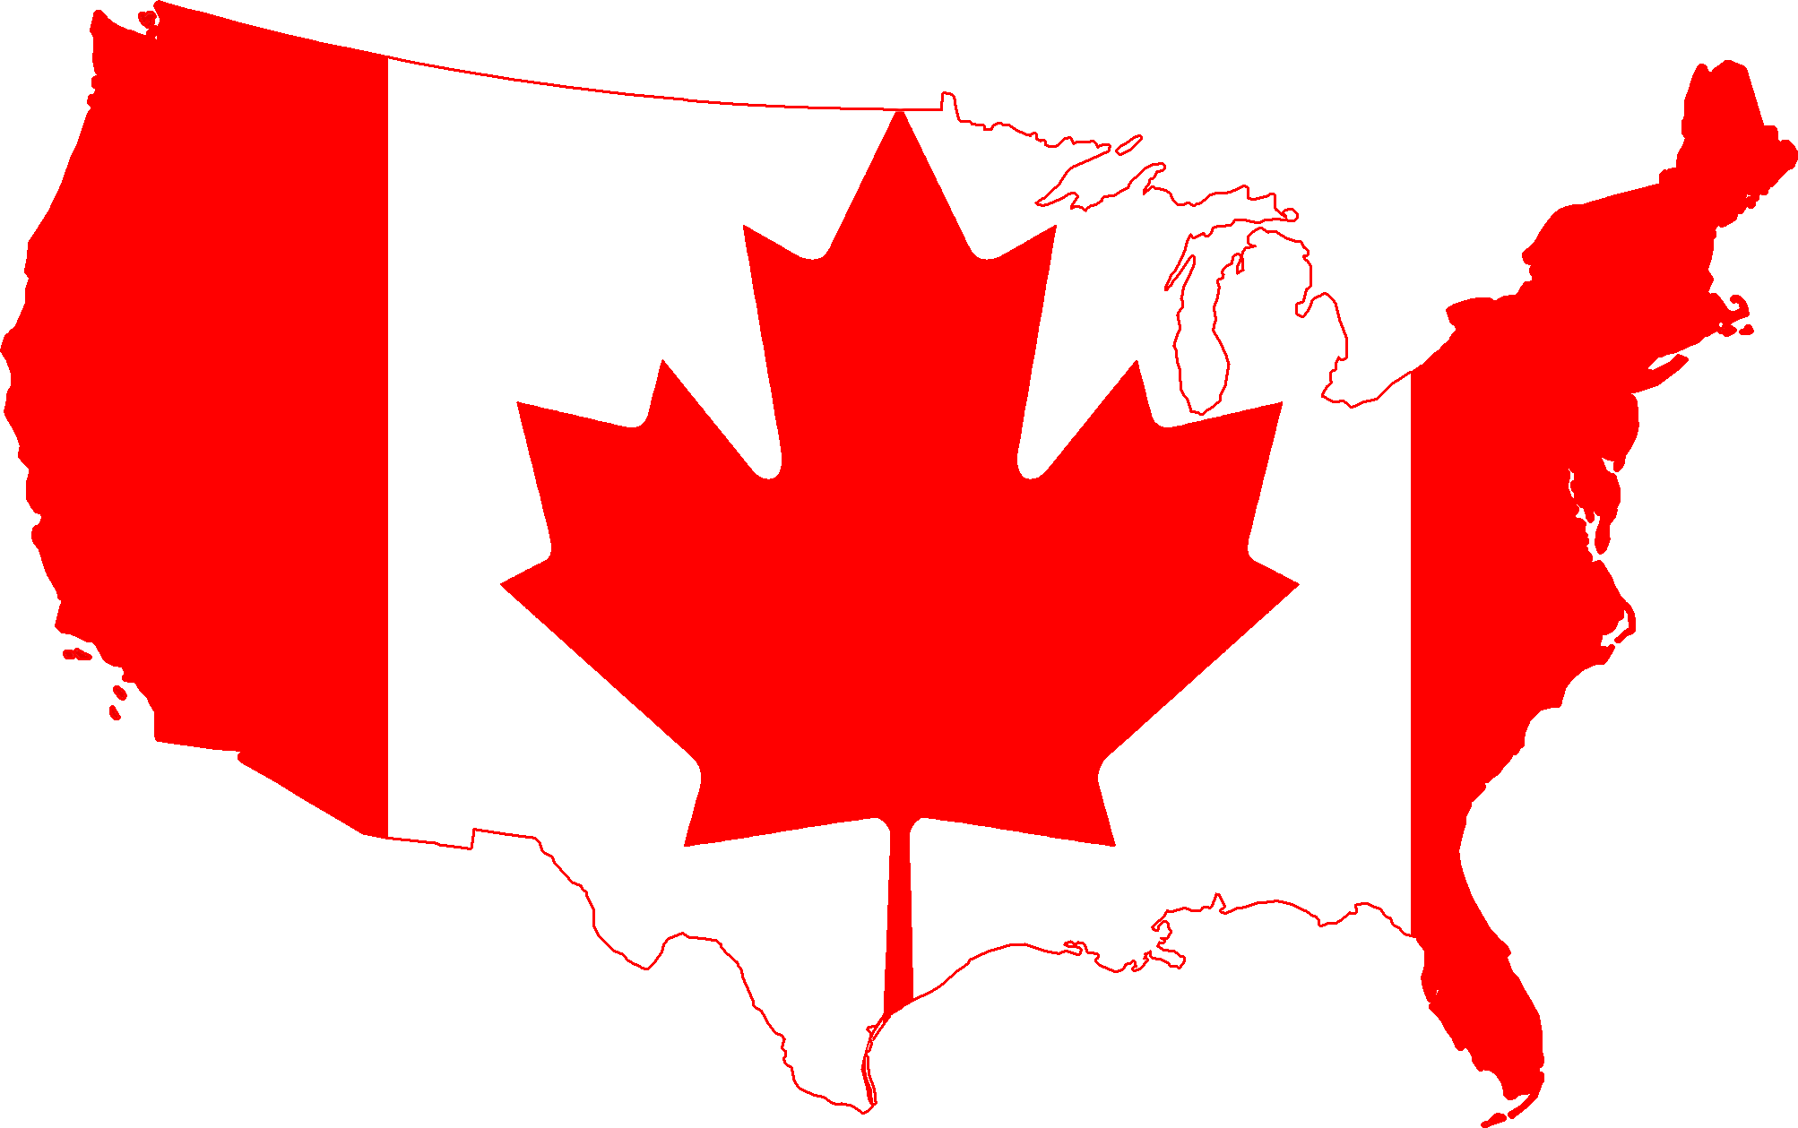

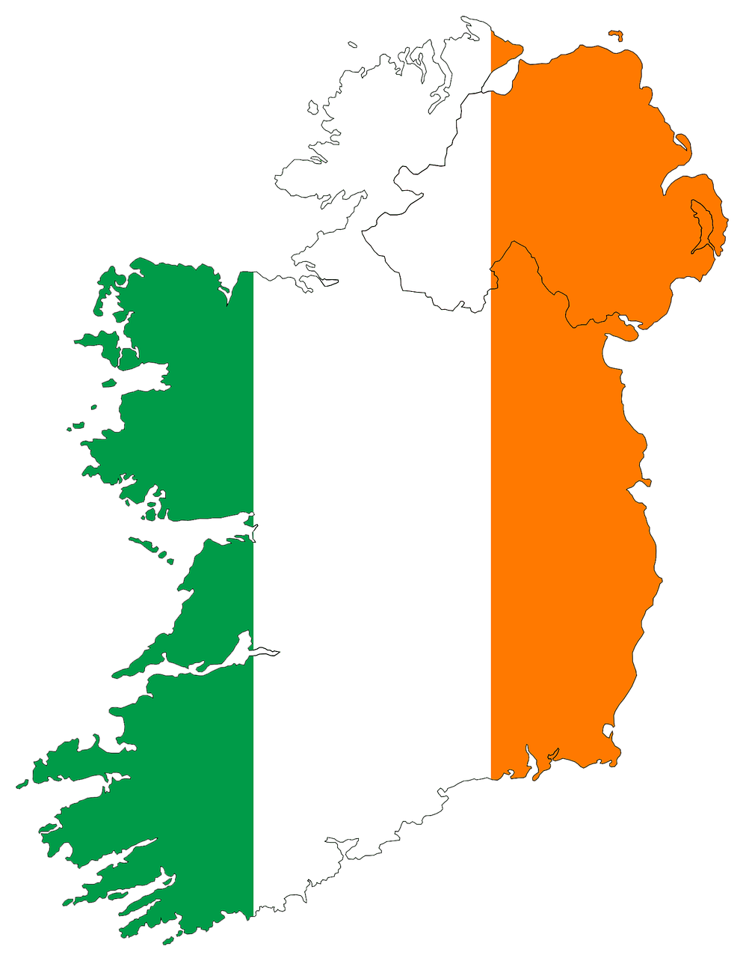
Democratic countries
11

Slide 12
02
Non- Democratic
12

Slide 13

A non-democratic administration is one that does not adhere to democratic principles. A monarchy, oligarchy, aristocracy, anarchy, feudalism, theocracy, or any other type of government can be considered non-democratic.
13

Slide 14
characteristics of a non-democratic government.
Aristocracy
Theocracy
A state in which a small group of people wields ultimate authority.
A state in which religious authority have absolute power.
14

Slide 15
characteristics of a non-democratic government.
Monarchy
Oligarchy
A state where absolute power is actually or nominally lodged in a monarch (sovereign head of state, typically a king, queen, or emperor).
A state where absolute power is with a small group of people.
15

Slide 16
Totalitarianism
Dictatorship
Totalitarianism is a political system in which the state has complete control over society and attempts to exert control over all elements of public and private life.
A dictatorship is an authoritarian system of government in which the government is run by a single person: the dictator. In today's context, dictatorship refers to an authoritarian kind of absolute rule by a leader who is not bound by the law.
16

Slide 17
Examples of Non democratic countries
1- People are unable to choose or replace their leaders.
2- Fundamental human rights are not guaranteed to anyone.
3- Not everyone is treated similarly.
17

Slide 18

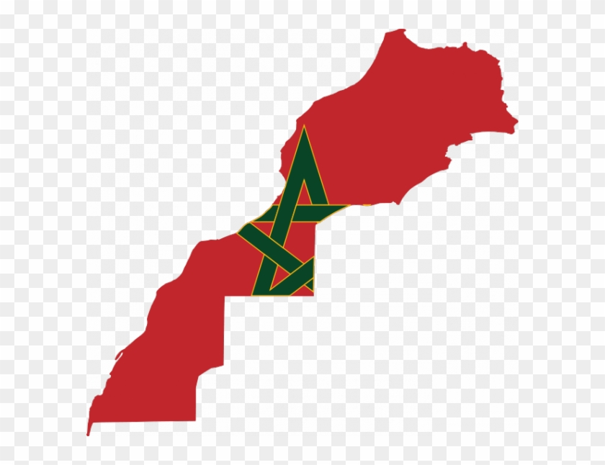
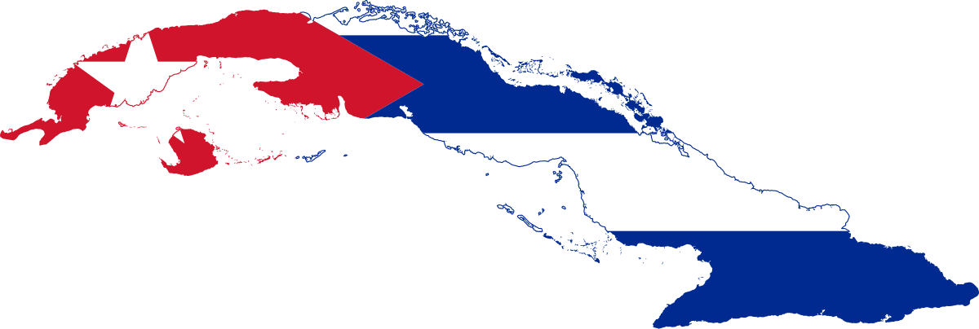

Non-Democratic countries
18

Slide 19
Difference Between Democratic and Non-Democratic Government
Democratic | Non Democratic
Power - Democratic Government: The power lies with the people. | Power - Non-Democratic Government: The power lies with the government.
Decisions -People make their own decisions about what is best for them. | Decisions -The government makes choices on behalf of the public.
Equal Rights - Regardless of their class or position, everyone has the same rights. | Equal Rights - Not everyone is treated similarly.
Leaders -The people elect their leaders or representatives. | Leaders -Leaders cannot be chosen or replaced.
If citizens are dissatisfied with their leaders, they have the right to have them replaced. | In non-democratic regimes, citizens do not have the right to choose their leaders.
19

Slide 20
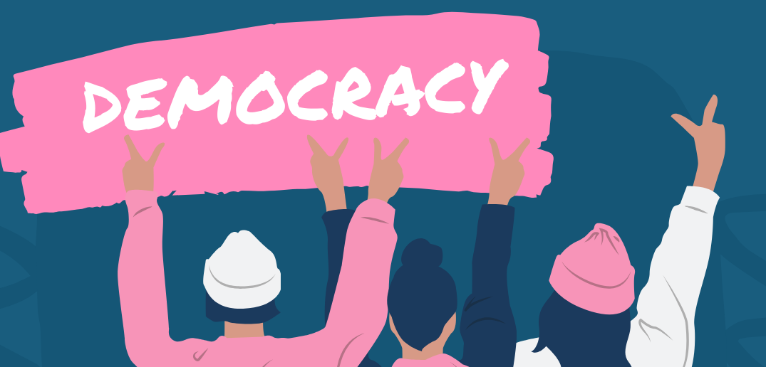
Conclusion
Democracy is that every individual can guarantee his right and has several rights in his country and has complete freedom to express his opinions. Whereas in Non democracy, individuals cannot express their issues, needs, and opinions because they do not have complete freedom, unlike democracy.
20

Slide 21


Admin. (2021, August 11). Distinguish between Democratic and non-democratic elections. - GK Q&A. BYJU'S. Retrieved November 30, 2021, from https://byjus.com/questions/distinguish-between-democratic-and-non-democratic-elections/.
File:flag-map of north korea.svg. Wikimedia Commons. (n.d.). Retrieved November 30, 2021, from https://commons.wikimedia.org/wiki/File:Flag-map_of_North_Korea.svg.
IMGBIN.com. (n.d.). Flag of canada map png - free download. IMGBIN.com. Retrieved November 30, 2021, from https://imgbin.com/png/ip5Vm2xW/flag-of-canada-map-png.
johnchalla, A. (2017, September 5). Difference between Democratic and non-democratic government. Future Generation Learning Resources. Retrieved November 30, 2021, from https://johnchalla.wordpress.com/2017/09/05/difference-between-democratic-and-non-democratic-government/.
wikiHow. (2021, May 6). How to tell someone to be quiet. wikiHow. Retrieved November 30, 2021, from https://www.wikihow.com/Tell-Someone-to-Be-Quiet.
21

Slide 22
THANKS
Do you have any questions?
22

