Slide 1


Evidence-based Practice in Nursing
Libyan International Medical university
Faculty of Business Administration
By : Sondos Aloud
ID : 1500

Slide 2
Table of Contents
01
02
03
INTRODUCTION
HISTORY of EBP
IMPORTANT of EBP
04
05
CONCLUSION
REFERENCE
2

Slide 3
INTRODUCTION
Evidence-based practice is a method by which practitioners across the healthcare professions review and assess the most current, highest-quality research to inform their delivery of care.
3

Slide 4
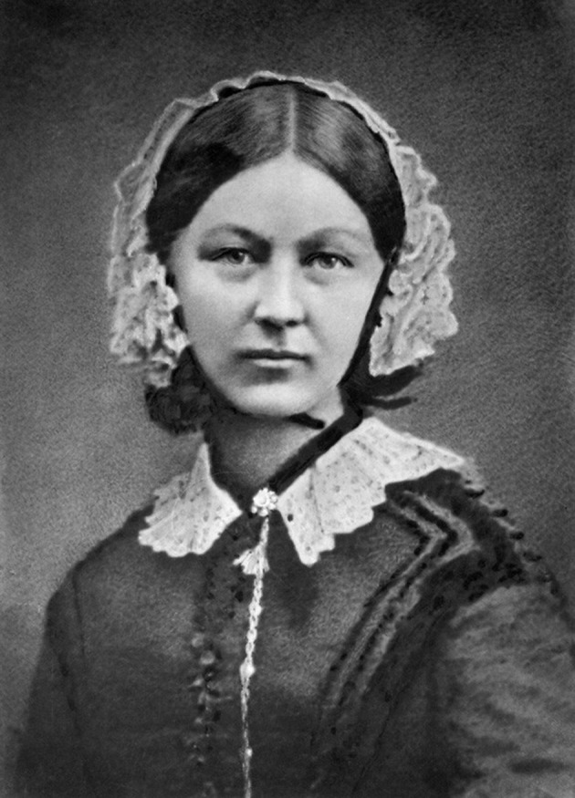
HISTORY
Although EBP has only recently found widespread integration in modern nursing practice, starting in the 1990s, its roots run deep in nursing history.
While most of the literature credits physician Archie Cochrane in the 1970s as the originator of EBP, then called evidence-based medicine, some nurse researchers trace it back to Florence Nightingale. In the 1800s, her effort to improve patient outcomes in the face of unsanitary conditions by employing accurate observation and analysis is often considered the first example of EBP.
4
Notes:
While supervising the barrack hospital in Scutari, Turkey, during the Crimean war, Nightingale applied critical thinking skills, evidence and experimentation to improve patient health. She also used statistics to better anticipate morbidity and mortality in her patients. Although she lacked the wealth of research we have today, she was nevertheless a trailblazer for EBP in nursing.

Slide 5
IMPORTANT of EBP
Knowledge of evidence-based practice and its tenets, also known as “levels of evidence,” is of significant importance to every clinician, including nurses. EBP guides nurses and other clinicians in how much they should draw from “a study, report, practice alert, or clinical practice guideline in making decisions about a patient’s care.”
The benefits of EBP in nursing include:
Providing nurses with the scientific research to make well-informed decisions.
Encouraging nurses to provide individualized patient care.
Improving time management by driving efficiency in nursing.
Guiding implementation of new technologies into healthcare practice.
Helping nurses stay updated about new medical protocols for patient care.
5

Slide 6
CONCLUSION
EBP is a crucial component of safe, quality patient care. Utilizing the EBP approach helps nurses and other clinicians provide the highest-quality and most cost-efficient patient care possible.
It is highly essential that nurses know the current practices so that they can provide care to patients with complex and debilitating conditions.
6

Slide 7
REFERENCE
Karimi, Hosein, and Negin Masoudi Alavi. “Florence Nightingale: The Mother of Nursing.” Nursing and Midwifery Studies, vol. 4, no. 2, 27 June 2015, www.ncbi.nlm.nih.gov/pmc/articles/PMC4557413/, 10.17795/nmsjournal29475. Accessed 15 Apr. 2019.
University of St. Augustine. “The Role of Evidence-Based Practice in Nursing.” University of St. Augustine for Health Sciences, 19 Aug. 2020, www.usa.edu/blog/evidence-based-practice/.
“What Is Evidence-Based Practice in Nursing?” Western Governors University, 17 Dec. 2020, www.wgu.edu/blog/evidence-based-practice-nursing2012.html#close.
“What Is Evidence-Based Practice in Nursing?” University of Maine Fort Kent Online, 2 Sept. 2020, online.umfk.edu/articles/rnbsn/evidence-based-practice-nursing.aspx.
7

Slide 8
THANKS

