Slide 1


Covid-19 In Children
Prepared by
Mourad massoud idris (3644)
Block ( GBMS 2 )
Year 1
2021-2022

Slide 2
Objectives
Discuss risk factor for serious covid-19 in children .
Mention treat children from covid-19
List ways to protect children from covid-19.

Slide 3
Introduction
Coronaviruses are a large family of viruses that are known to cause illness ranging from the common cold to more severe diseases.
A novel coronavirus (COVID-19) was identified in 2019 in Wuhan, China. This is a new coronavirus that has not been previously identified in humans.

Slide 4
Signs & Symptoms of Corona virus (COVID-19)
Infection can cause a range of symptoms.
Most common are:
Fever.
Cough.
Trouble breathing.
Gastrointestinal problems.

Slide 5
:Other complaints include
Headaches.
Muscle aches.
Loss of taste and smell.
Cold.

Slide 6
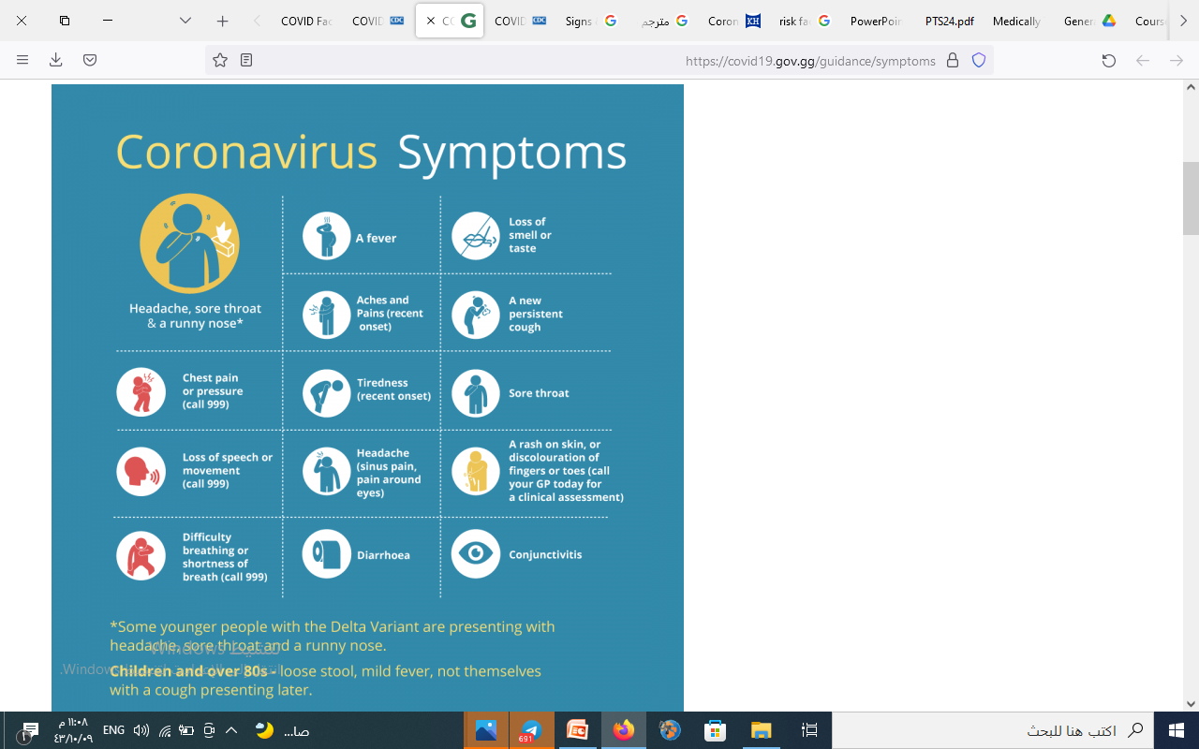

Slide 7
Signs & Symptoms of Corona virus (COVID-19)
Some kids get symptoms caused by inflammation throughout the body, sometimes several weeks after they were.
infected with the virus.
affect many different body systems :
Lungs.
Heart.
Brain.
Skin.
Eyes.

Slide 8
Corona virus (COVID-19) Treatment
Most people with a mild illness, including children, don’t need any specific treatment. They get better with rest, fluids, and fever-reducing medicine.
Some people who get very sick from COVID-19 will need hospital care, possibly in the ICU machine.

Slide 9
Protecting my child from covid-19
Can get a COVID-19 vaccine.
Avoid people who are sick.
Wash your hands well.
Clean surfaces and objects that people touch a lot.

Slide 10
Protecting my child from covid-19
Try not to touch your eyes, nose, and mouth.
Wear a mask at home if you are sick.

Slide 11
Reference
https://kidshealth.org/en/parents/coronavirus-young-kids.html?ref=search

Slide 12


