Slide 1


Tongue cancer
STU ID : Salma Abd Al Qadir Al sharif
STD NU : 3395
DAY : 4/6/2022 , Saturday
PTS : 8
YEAR 1

Slide 2

OBJECTIVE .
List types of tongue cancer .
Outline tongue Cancer Causes .
List Tongue Cancer Symptoms.
The ways of Diagnosing the tongue cancer .
LIST Tongue Cancer Treatment.

Slide 3
Muscular organ
Cover by mucosa membrane
Testing
tongue
Swallowing
Speaking
Only muscle that isn’t connected to bone at both ends.
It is connected on one end to the hyoid bone .
Mastication

Slide 4


Tongue cancer :
Begins in the thin, flat cells that line the surface of the tongue.
These are called ( squamous cells ) .
Small changes to the DNA of the squamous cells make the cells grow abnormally .

Slide 5
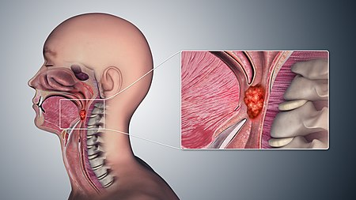
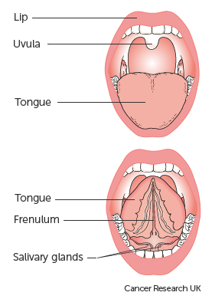
List types of tongue cancer .
Cancer of the oral tongue.
that develops when abnormal cells within the lining of the cheeks, gums, roof of the mouth, tongue, or lips grow uncontrollably.
Cancer of the base of the tongue.
is called oropharyngeal cancer—that affects the soft palate, side and back walls of the throat, back third of the tongue, and the tonsils .

Slide 6
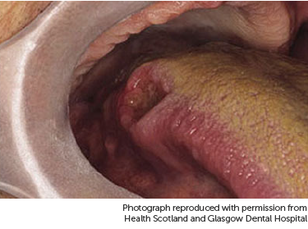
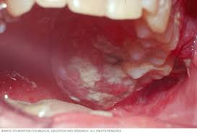
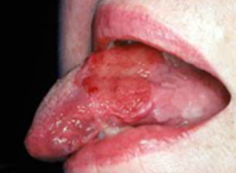
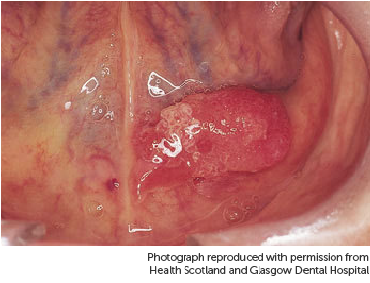
List tongue cancer symptoms .
Red or white area on the tongue .
Ulcer that doesn't go away .
Pain when swallowing .
Numbness in the mouth .
Pain or burning feeling over the tongue .
Problems in moving or speaking .
Lump in the neck .
Unexplained bleeding from the tongue .
Pain in the ear .

Slide 7

The ways of tongue cancer diagnosis .
The doctor will take a medical history .
Examination of the tongue closely .
Examine the lymph nodes closely .
Take a biopsy from the patient .
X-rays of the mouth and throat, including CT (computed tomography) .

Slide 8
Outline causes tongue cancer .
Smoking
Drinking alcohol
Causes
Chewing tobacco
Family history
Human papillomavirus (HPV)

Slide 9


How is tongue cancer treated ?
The treatment depends on :
Stage of cancer .
Site of cancer in tongue .
How big the cancer is .
General health .
treat tongue cancer by :
Surgery .
Radiotherapy .
Chemotherapy .

Slide 10

Conclusion .
Begins in squamous cell ,Oral cancer is associated with tobacco and alcohol use , The base of tongue cancer
linked to HPV infection, All forms of oral cancer are amenable to detection and diagnosis by biopsy .

Slide 11
Reference.
: Healthline. 2022. Tongue Cancer: Symptoms, Pictures, Prognosis. [online] Available at: <https://www.healthline.com/health/oral-cancer/tongu
Cancerresearchuk.org. 2022. About tongue cancer | Cancer Research UK. [online] Available at: <https://www.cancerresearchuk.org/about-cancer/mouth-cancer/stages-types-grades/tongue-cancer/about> [Accessed 2 June 2022].
Cedars-sinai.org. 2022. Tongue Cancer | Cedars-Sinai. [online] Available at: <https://www.cedars-sinai.org/health-library/diseases-and-conditions/t/tongue-cancer.html#:~:text=Smoking%20and%20drinking%20alcohol.,the%20risk%20of%20tongue%20cancer.> [Accessed 2 June 2022].
Cancerresearchuk.org. 2022. Treating tongue cancer | Tongue cancer | Cancer Research UK. [online] Available at: <https://www.cancerresearchuk.org/about-cancer/mouth-cancer/stages-types-grades/tongue-cancer/treatment> [Accessed 2 June 2022].

Slide 12
Adobe Stock. 2022. Tongue Cancer Images – Browse 677 Stock Photos, Vectors, and Video. [online] Available at: <https://stock.adobe.com/search?k=tongue%20cancer> [Accessed 6 June 2022].

Slide 13


