Slide 1


Dentist & patient position
Name : Alzahra albijou
Student Number : 3126
Block : PTS
Date : 2021/2022

Slide 2
OBJECTIVES
Describe dentist and patient position.
Explain dental chair positioning & pregnancy.
Describe muscle skeletal disorders related to abnormal position for dentist.

Slide 3
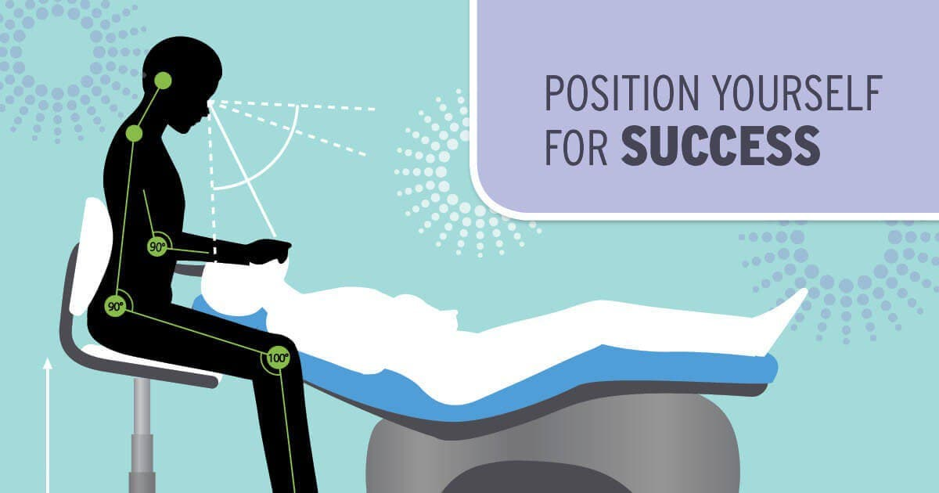
The dental profession causes muscle pain and dentist usually, neglect the symptoms to develop into a chronic condition and become a permanent injury due to the incorrect sitting position.

Slide 4
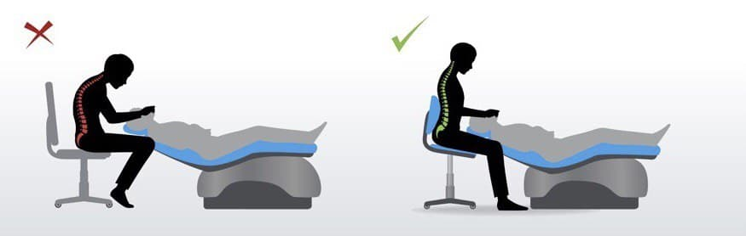
During procedure , the forearms and thighs should remain parallel to the floor, the hip angle should be of 90 degrees.
Dentist and patient position

Slide 5
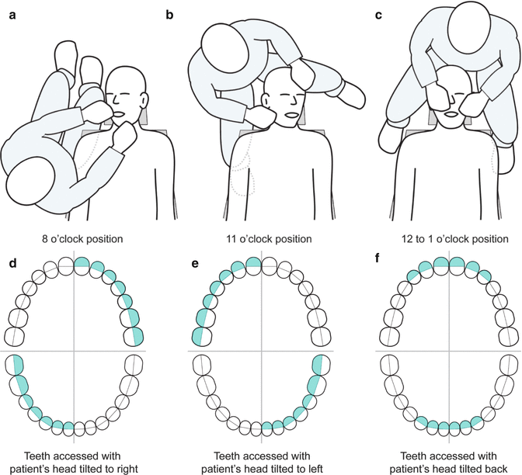
The clinician should also observe the correct positioning when treating the patient:
7 o clock, 9 o clock, 10 to 11 or 12 o clock positions when right handed.
5 o clock, 3 o clock, 2 to 10 o clock or 12 o clock positions when left handed.

Slide 6
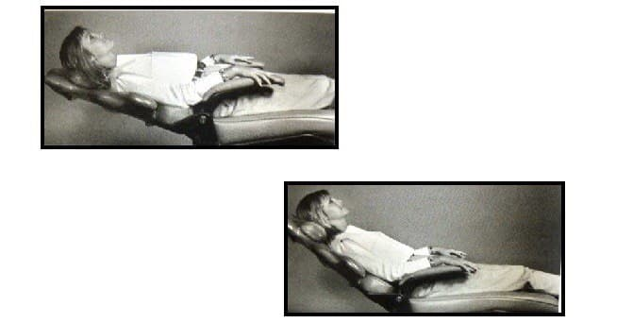
Patient should mostly be in an almost supine position or reclined 45 degrees during operative procedures.

Slide 7
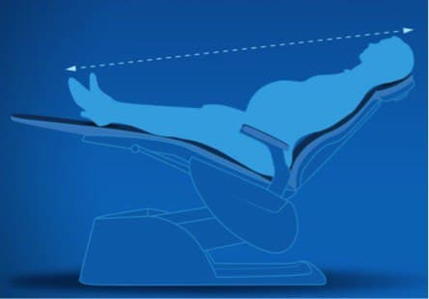
Dental Chair Positioning & Pregnancy
When performing procedures it is a great importance to make sure that the pregnant patient are seated in a correct and safe position.

Slide 8
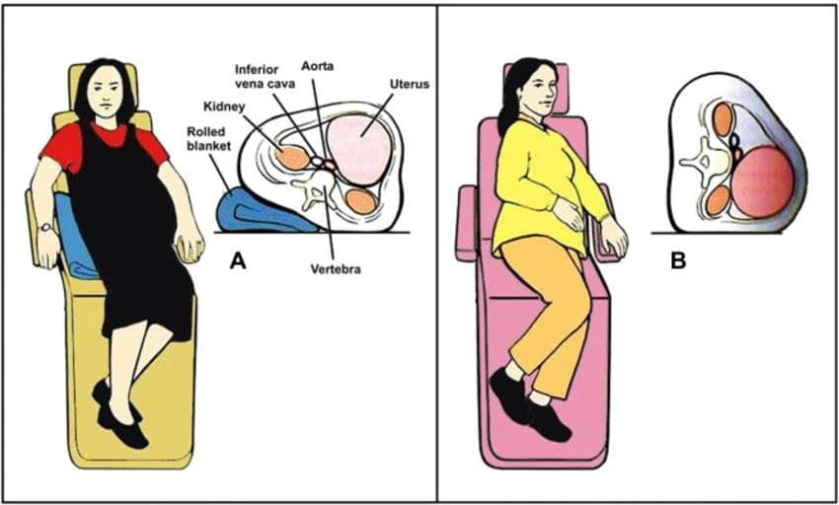
Therefore, it is important that the dentist makes pregnant patient seated in a right position which is on her right hip elevated 10 _12cm so that the pressure on the vena cava is reduced.

Slide 9
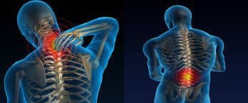
Musculoskeletal Disorders
Dentist are prone to musculoskeletal disorders, due to their job characteristics such as the need for high attention, concentration and being in the one posture for a long time .

Slide 10
Conclusion
A dentist can spend up to 60.000 hours in a lifetime working in tense and distorted position, with consequent musculoskeletal problems.
Dentistry does not lend itself to good posture; however, it is possible with instruction and practice to correct the harmful posture habits that may be the causes of such stress and pain.

Slide 11
References
Gupta G, Gupta A, Mohammed T, Bansal N. Ergonomics in Dentistry. International Journal of Clinical Dentistry. 2014;7(1):30-34.
2. Naseem M, Khurshid Z, Khan H, Niazi F, Zohaib S, Zafar M. Oral health challenges in pregnant women: Recommendations for dental care professionals. The Saudi Journal for Dental Research. 2016;7(2):138-146.

Slide 12


