Slide 1


Food and healthy physical activity
Fatma Fahmi Gaouda
Student NO. 2993

Slide 2
Objectives :
- Define Nutrition.
- Classify nutrients, list their functions
and recognize their sources.
- Outline the required intake of nutrients
for ages from 6 years to older adult.
- Outline Benefits of physical activity.

Slide 3
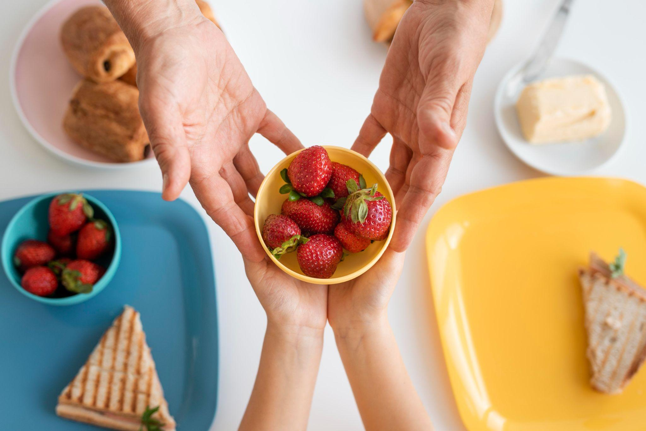
Introduction
1

Slide 4
Nutrients: Is a chemical substance in the
food that helps maintain the
body.
2

Slide 5
* It is the main source of energy for the body. * One gram gives 4 calories. * Carbohydrates are classified by the number and complexity of saccharides.
Carbohydrates :
3

Slide 6
Protein :
* It is made up of different combination of amino acids
* One gram of protein gives 4 calories.
4

Slide 7
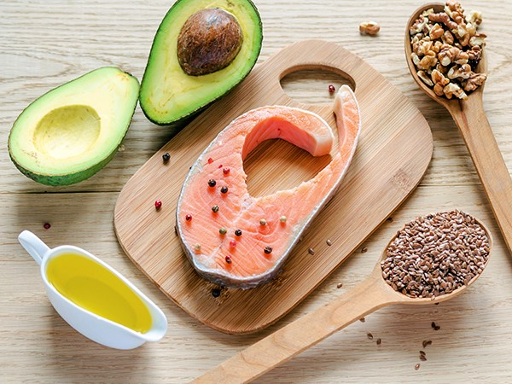
Fats :
* A class of nutrients with the highest
energy content.
* One gram of fat gives 9 calories.
5

Slide 8
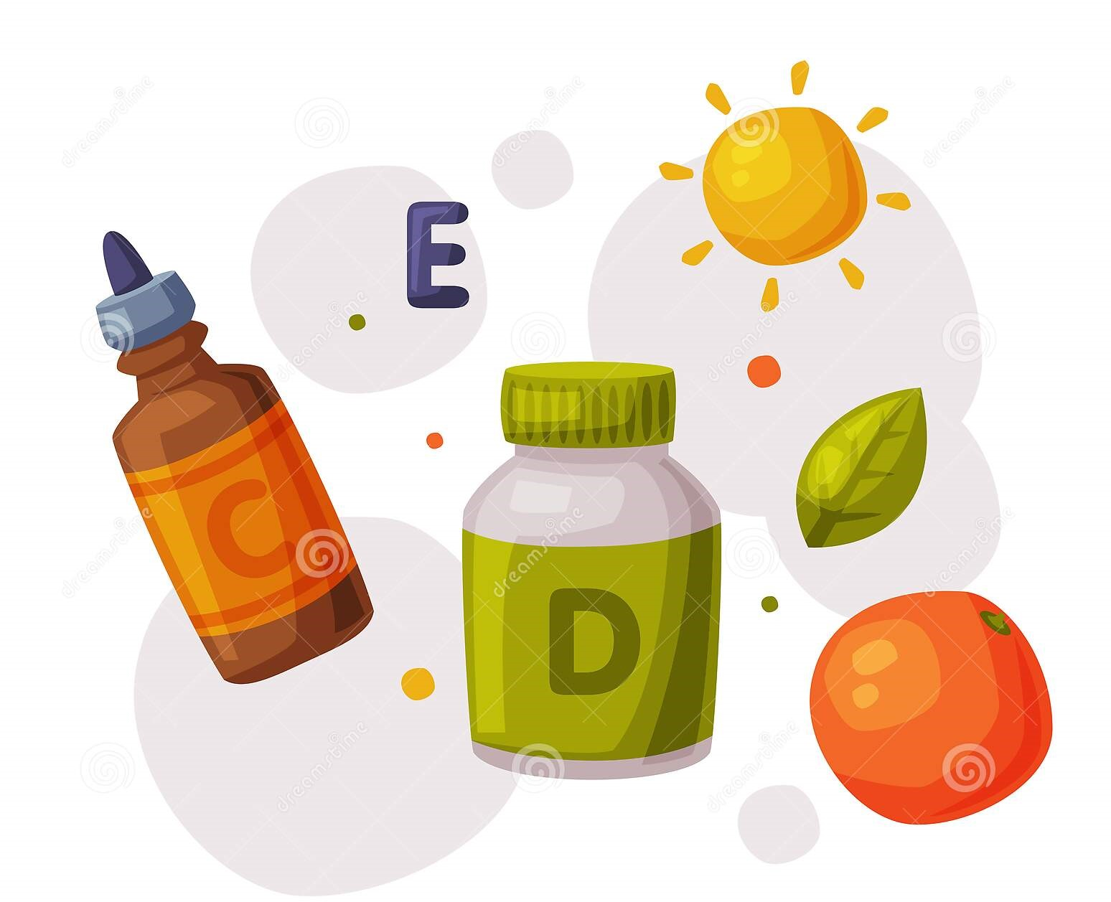
Vitamins :
* They are not source of calories.
* They are co factors which do not do anything
by themselves.
6

Slide 9
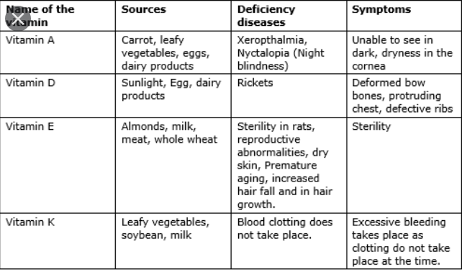
Fat soluble vitamins :
7

Slide 10
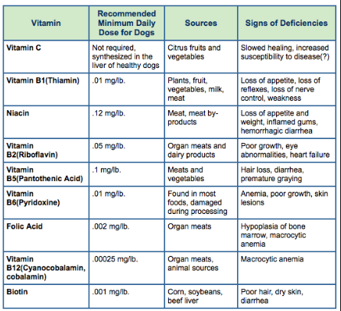
Water soluble vitamins :
8

Slide 11
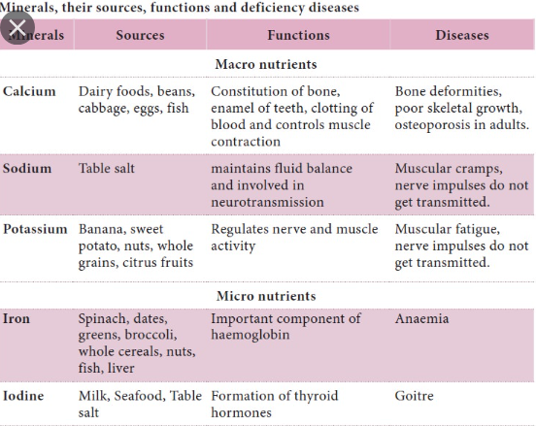
Minerals :
9

Slide 12
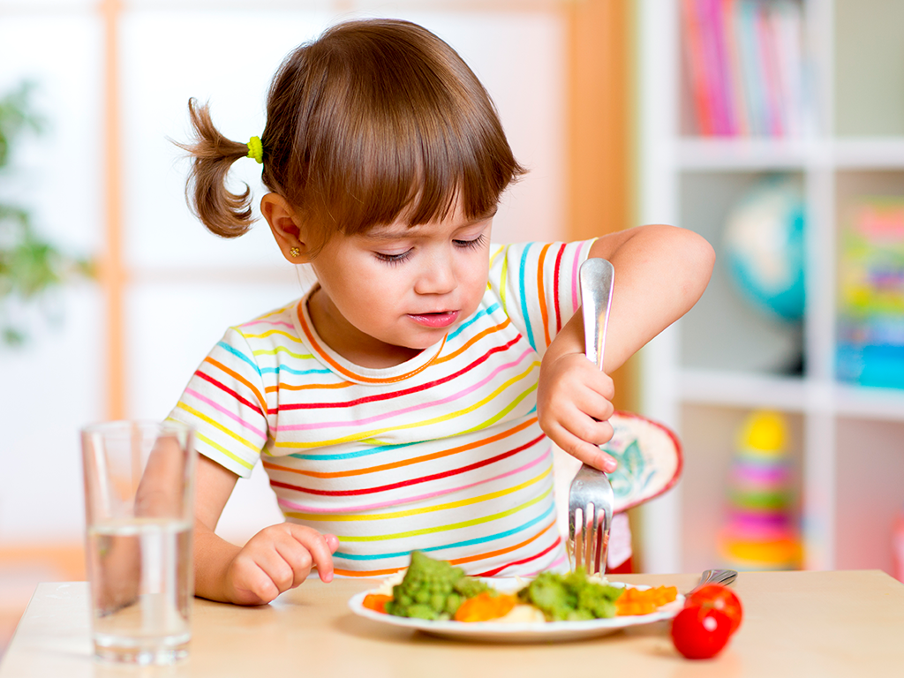
1- Nutritional requirement of school age children- Pre-adolescents (6-12 years of age ) :
* This age group is characterized by
a moderate growth rate of about
2- 4 kg/ year and 5-6 cm/ year.
10

Slide 13
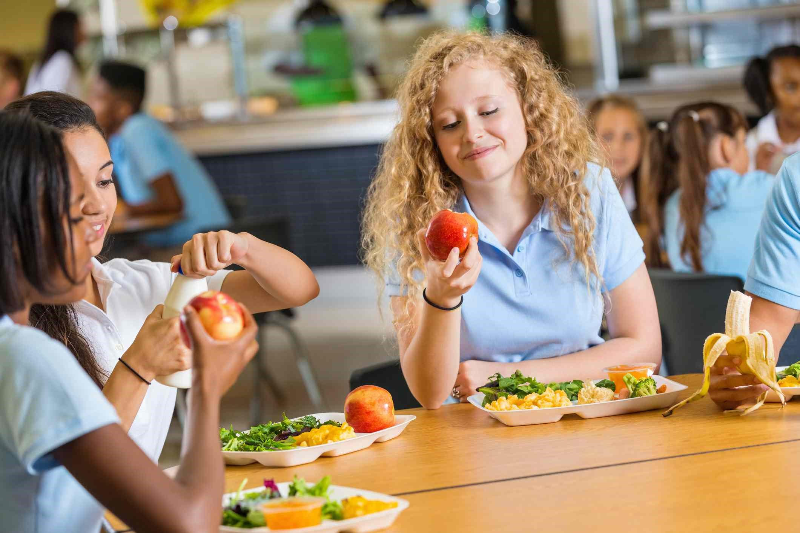
2- Nutritional requirement of adolescence ( 10-19 years of age ) :
* This period requires special attention because of growth
spurt (Sudden increase in growth with some physiological
changes).
11

Slide 14
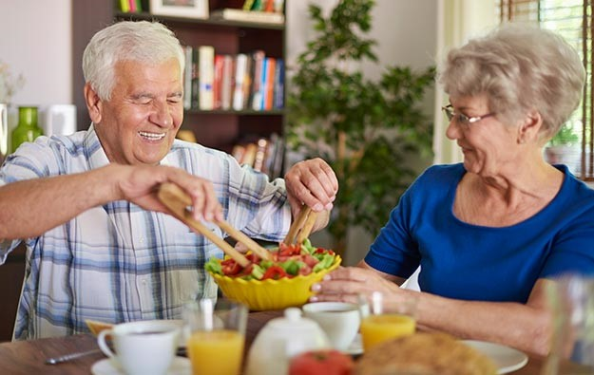
3-Nutritional requirement for older adult :
* Many elderly over 65 years of age have low dietary
intake of thiamine, riboflavin, vitamin c, vitamin B6,
folate, calcium and zinc.
12

Slide 15
Physical Activity
Physical activity is any form of movement
that uses energy. It is essential part of
person overall health and well being.
It helps the body function better.
Finally, regular Physical activity and proper
nutritions are critical for optimal health.
13

Slide 16
Benefits of physical activity :
1-Anatomical benefits :
-PA strengthens bones and muscles .
-PA helps to avoid obesity.
-PA reduces the risk of cardiovascular disease , diabetes.
2-psychological benefits :
-PA increases self-esteem.
-PA provides well-being .
-PA reduces stress , anxiety and sedentary lifestyle.
-PA improves mood .
3- Social benefits :
-PA reassures autonomy and integration.
-PA encourages sociability.
14

Slide 17
Conclusion
Nutrition is defined as the processes by which an animal or plant takes in and utilizes food substances. Essential nutrition include protein, carbohydrate, fat, vitamins, minerals and electrolytes. Normally 85% of daily energy use is form fat and carbohydrates and 15% from protein.
Physical activity engaging in regular physical activity may produce improvements in an individual’s physical health, cognitive performance and psychological well-being, improve overall quality of life.
15

Slide 18
References :
The Atlas of food by Erik Millstone; Tim Lang; Marion Nestle.
Hand book of Nutrition and food, Third edition by Carolyn D.Berdanier (editor) Johanna T. Dwyer (editor); David heber (editor).
Dipietro L. physical activity in older people institute of medicine commentary 2015.
Barmdge EK, Radvanyi C, Duggan K, Motton F, Wiggs I, Baker EA, Brownson RC, understanding and addressing barriers to implementation of environmental and policy interventions to support physical activity and healthy eating in rural communities. Journal of rural health. 2013;29(1):97-105.
16

Slide 19
Thank you

