Slide 1
Diabetes insipidus and SIADH
Dr Mousa Tuwati Alfakhri

Slide 2
Outlines
Antidiuretic hormone (ADH):Synthesis ,storage and function
Diabetes insipidus
Clinical features
Types of DI
Causes of diabetes insipidus
Investigations and diagnosisof DI
Management
Syndrome of Inappropriate AntiDiuretic Hormone Secretion (SIADH)

Slide 3
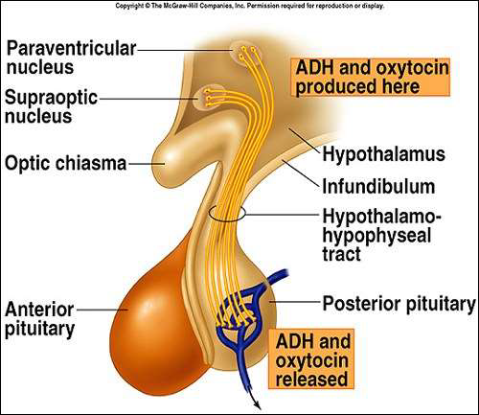
Anti-diuretic hormone (Arginine Vasopressin)
Polypeptide hormone
Produced by in hypothalamus,In response to increased osmolality,and reduced extracellular volume,and stored and released in posterior Pituitary

Slide 4
Mechanism of action of ADH
Stimuli for ADH secretion
Hyperosmolarity – sensed by osmoreceptors in the hypothalamus.
Circulating volume depletion – sensed by baroreceptors in carotid sinus, aortic arch,pulmonary veins and left atrium.

Slide 5
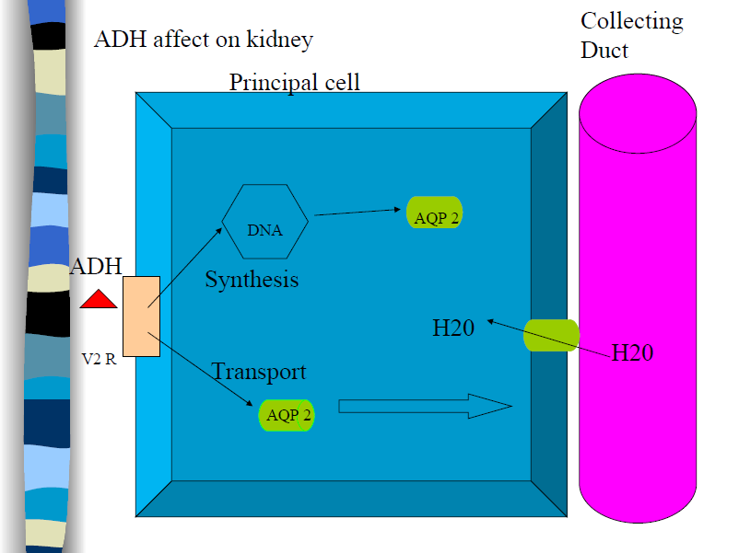
Target organ,Receptors and Action:
V1a: inVascular smooth muscle →Vasoconstriction
V1b :in Anterior pituitary→ ACTH release
V2 :Renal collecting duct→antidiuretic respose

Slide 6
Function of ADH
ADH increases permeability of renal distal tubule and collecting ducts to water.
Less free water is excreted in urine
Urine volume is decreased
Concentration of urine is increased

Slide 7
Diabetes insipidus
This uncommon disorder is characterised by the persistent excretion of excessive quantities (>3L/24hr)of dilute urine (< 300 mOsm/kg)and by thirst.
It is classified into two types:
• Cranial diabetes insipidus, in which there is deficient production of vasopressin by the hypothalamus
• Nephrogenic diabetes insipidus, in which the renal tubules are unresponsive to vasopressin

Slide 8
Other forms of diabetes insipidus
Primary polydipsia, or Psychogenic polydipsia
(Dypsogenic DI):
Primary defect in osmoregulation of thirst
Gestational DI:
Due to degradation of vasopressin by placental vasopressinase

Slide 9
Clinical features
The most marked symptoms are polyuria and polydipsia
The patient may pass 3–20 L or more of urine in 24 hours (low specific gravity and osmolality)

Slide 10
Causes of diabetes insipidus
Cranial diabetes insipidus
Acquired
Idiopathic.30 %
Trauma—head injury 16%, neurosurgery.20%
Tumours 25%—craniopharyngiomas, pituitary infiltration by metastases.
Inflammatory conditions—sarcoidosis, tuberculosis, Langerhans cell histiocytosis, lymphocytic hypophysitis, Wegener’s granulomatosis.
infections—meningitis, encephalitis.
Vascular—Sheehan’s syndrome, sickle cell disease.
Familial
• Autosomal dominant (vasopressin gene).
• Wolfram or DIDMOAD syndrome (DI, diabetes mellitus, optic atrophy, deafness).

Slide 11
Causes of Nephrogenic diabetes insipidus
Genetic defect
X-linked recessive—vasopressin receptor gene.
• Autosomal recessive aquaporin-2 gene.
Metabolic abnormality
• Hypokalaemia
• Hypercalcaemia
Drug therapy
Lithium
demeclocycline
Poisoning
• Heavy metals
Chronic kidney disease
• Polycystic kidney disease
• Sickle-cell anaemia
• Infiltrative disease (amylodosis)

Slide 12
Differential diagnosis of polydipsia/ polyuria
Diabetes mellitus
Renal failure( at early stages)
Diabetes insipidus
Psychogenic polydipsia

Slide 13
Investigations of DI
Diagnosis of DI
• Confirm large urine output (>3L/day).
• blood glucose and RFT to Exclude DM and CRF.
• Check electrolytes. Hypokalaemia and hypercalcaemia (nephrogenic DI).
Urine and plasma osmolality
In DI :urine osm is low and plasma osm is high
(normal urine osm. 600-1200 mmol/kg ,plasma osm. 275-295 mOsmol/kg)
• Fluid deprivation test and assessment of response to vasopressin.

Slide 14
water deprivation test
Protocol
No coffee, tea or smoking on test day
• Free fluids until 07:30 on the morning of the test
• No fluids from 07:30 AM
• at 08:30 AM measurement of body weight and plasma
and urine osmolality
• Record body weight, urine volume, urine and plasma osmolality every 2 hrs for up to 8 hrs
• Stop the test
if the patient loses 3% of body weight
• If plasma osmolality reaches > 300 mOsmol/kg and urine osmolality < 600 mOsmol/kg,
then administer DDAVP 2 μg IM

Slide 15
water deprivation test
Interpretation
Diabetes insipidus is confirmed by plasma osmolality
> 300 mOsmol/kg with urine osmolality < 600 mOsmol/kg
• Cranial diabetes insipidus is confirmed if urine osmolality rises by at least 50% after DDAVP
• Nephrogenic diabetes insipidus is confirmed if DDAVP does not concentrate urine
Primary polydipsia is suggested by low plasma osmolality at start of the test

Slide 16
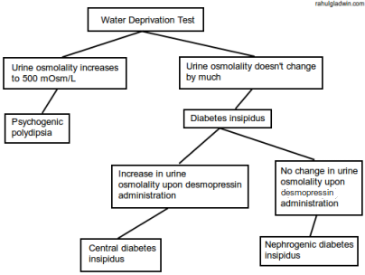

Slide 17
Investigations....cont
In nephrogenic diabetes insipidus: ultrasound of the kidneys and urinalysis
In cranial DI
investigation for causes :MRI head: Looking for tumours (Pituitary ,and hypothalamic)

Slide 18
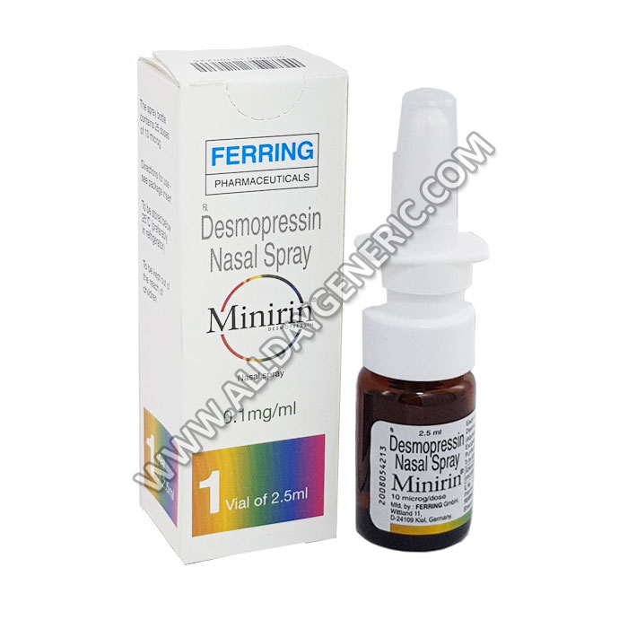
Management
Cranial diabetes insipidus
(desmopressin, DDAVP),
an analogue of vasopressin
that has longer half-life,
administered intranasally .
In sick patients, DDAVP given by intramuscular injection.

Slide 19
Nephrogenic diabetes
thiazide diuretics (bendroflumethiazide , amiloride)
NSAIDs (indometacin)

Slide 20
Syndrome of Inappropriate AntiDiuretic Hormone (SIADH)
is clinical condition involving excess of ADH secretion.
Inappropriate, continued secretion or action of ADH despite normal or increased plasma volume.
Results in impaired water excretion, and subsequently hyponatremia and hypo-osmolality).

Slide 21
Causes of SIADH
• Tumours(Small cell lung cancer Nasopharyngeal cancer,lymphoma,...)
• CNS disorders: stroke, trauma, infection
• Pulmonary disorders: pneumonia, tuberculosis,
• Drugs: anticonvulsants, psychotropics, antidepressants, cytotoxics, oral hypoglycaemic agents, opiates
• Idiopathic

Slide 22
Clinical Features
Signs and symptoms depends on both degree of hyponatremia and rate at which hyponatremia develops.
When sodium conc’n decreased slowly asymptomatic or non specific symptoms like anorexia, nausea, vomiting, irritability, headaches and abdominal cramps.
Rapid decline- more severe symptoms as result of cerebral edema, including :headache, nausea, restlessness, irritability, generalized weakness, hyporeflexia,confusion, coma, seizures, brainstem herniation or death.

Slide 23
Clinical features
Syptomes differ according to Na level
If Plasma Na(125 - 130 mmol/l) the symptoms will be :anorexia, nausea, vomiting and abdominal pain
plasma sodium( 115 - 125 mmol/l)
agitation, confusion, hallucinations
Hyponatraemia < 115 mmol/l
seizures and coma, due to increased intracranial pressure.

Slide 24
Evaluation and diagnosis
Careful history– comorbidities, current medications and patient’s symptoms.
No significant findings in physical examination but signs of dehydration or edema would make diagnosis unlikely.
Key points in diagnosing SIADH are-
Serum sodium concentration.
osmolarity of plasma and urine
Urine sodium concentration
Clinical volume status.

Slide 25
Diagnosis of SIADH
Essential Features:
Low plasma Na ( < 130 mmol/L)
Plasma osmolality <275 mOsm/kg.
Urinary osmolality >100 mOsm/kg.
Urinary Na >20 mEq/l .
Normal thyroid, adrenal, cardiac, liver and kidney function.
Clinical euvolemia i.e no clinical signs of dehydration, nor overload .
No recent use of diuretic agent

Slide 26
Treatment
Treatment depends on:
Symptoms
Serum sodium concentration
Rapidity of onset of hyponatremia

Slide 27
Treatment
Mild asymptomatic hyponatremia(serum Na
>125mEq/L)-
Fluid restriction is the 1st line treatment.
It generally improves with correction of underlying cause and restriction of free fluid intake to 800-1000 ml/d.
Mild symptomatic hyponatremia-
Fluid restriction.
Loop diuretic- it interfere with the action of ADH in
collecting tubules by inhibiting free water reabsorption.

Slide 28
Severe symptomatic hyponatremia (serum Na
<125 mEq/L)-
Fluid restriction
Hypertonic saline
Be cautious!!!! Aggressive and overly rapid correction of hyponatremia may induce central pontine myelinosis.
Central pontine myelinosis
demyelinating of pontine and extrapontine neurons. It leads to quadriplegia, pseudobulbar palsy,seizures, coma or even death.
For this reason :Serum Na level should be raised at rate no faster then 1-2 mEq/h and rate should not exceed 8-12mEq/d.

Slide 29
Other drugs can be used :
Demeclocycline
Lithium
Vassopresin resptors blockers

Slide 30
Demeclocycline
tetracycline derivative utilised in the treatment of SIADH because it causes nephrogenic
diabetes insipidus in about 60% of patients.
The mode of action interfere with the vasopressin-aquaporin signalling cascade .

Slide 31
Lithium
causes nephrogenic diabetes insipidus in 30% of
patients , by downregulation of vasopressin-stimulated aquaporin-2 expression .
with chronic treatment sometimes producing
interstitial nephritis and renal failure.

Slide 32
Vasopressin receptor antagonist
Called as Vaptans
Still under evaluation for efficacy and safety

Slide 33
thanks

