Slide 1

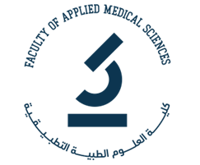
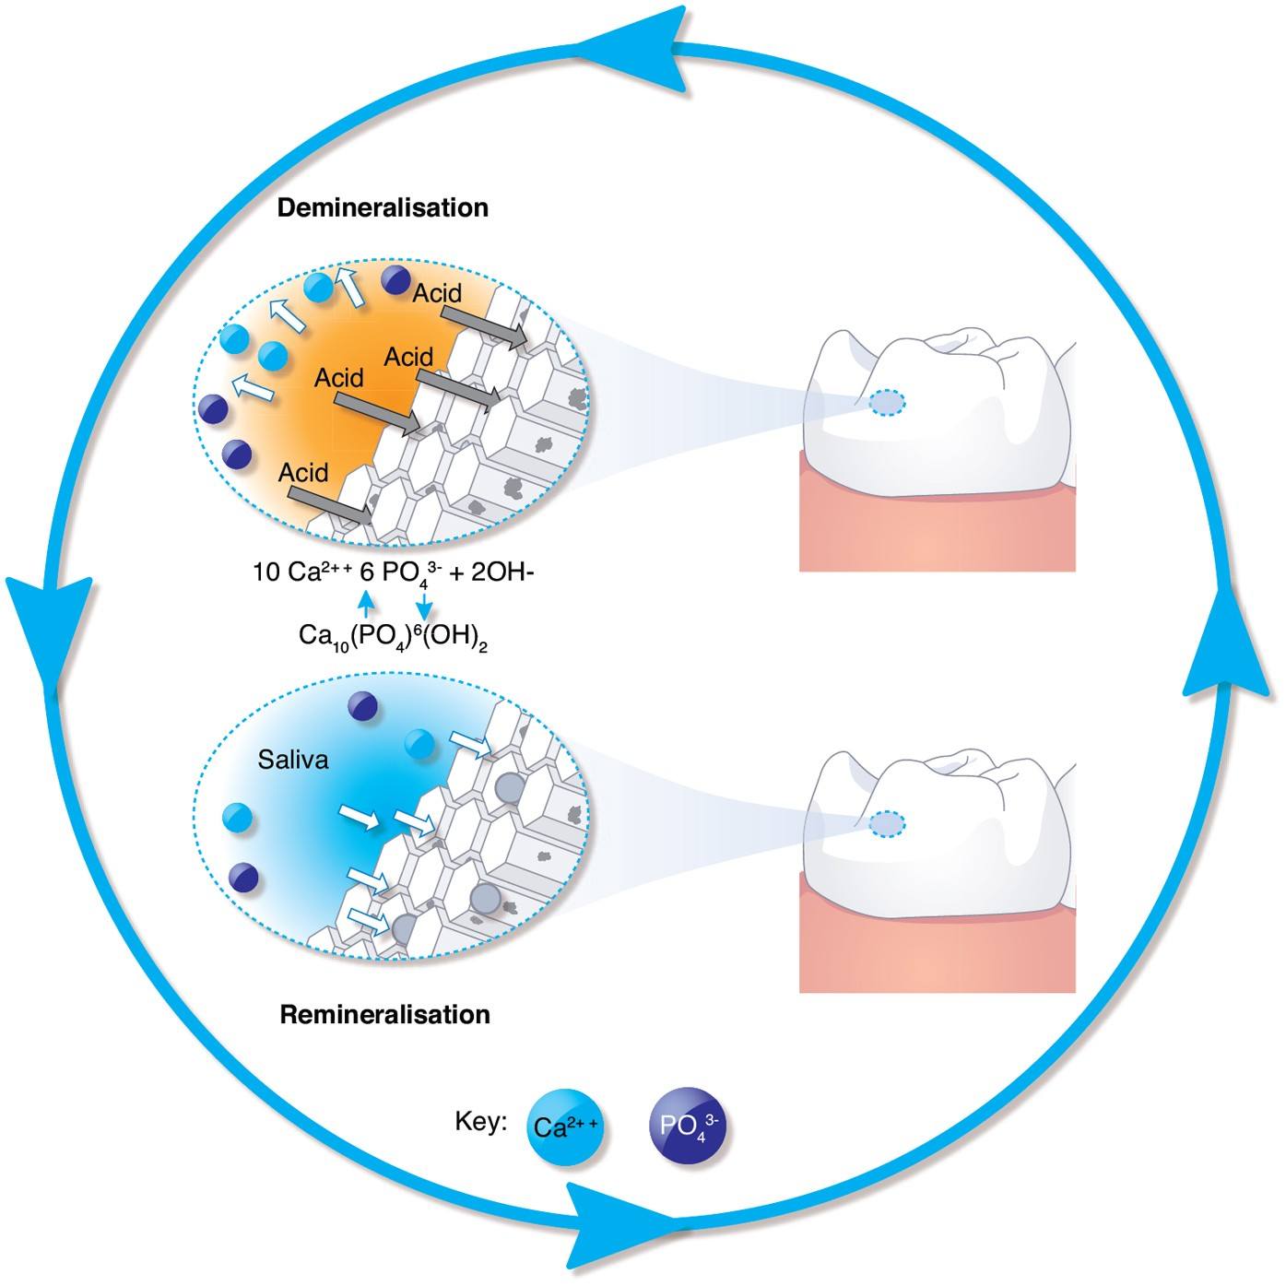
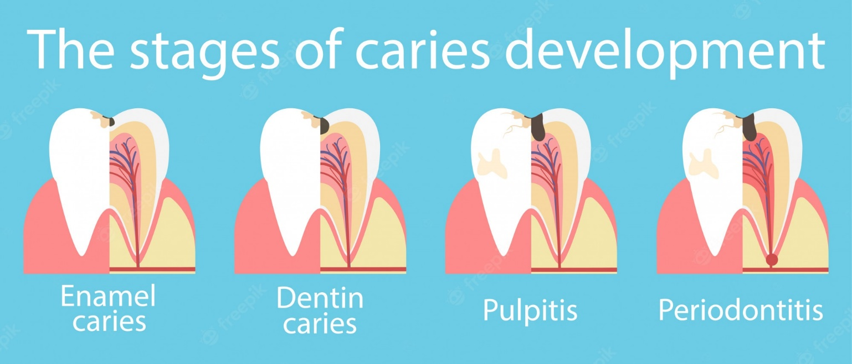
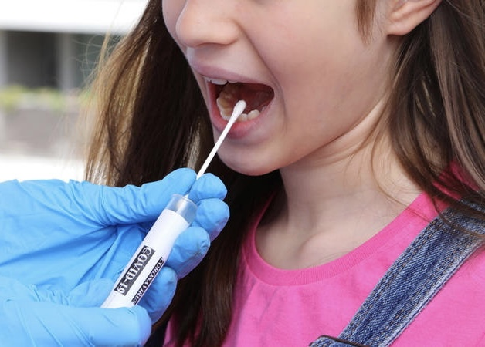
Factors Influencing Dental Caries in HIV/AIDS Patients
Rafa mussa alsarah
Supervised by : Dr.Alaa Fathalla
Libyan international medical university
Introduction
Results
Conclusion
Human immunodeficiency viruses (HIV) / Acquired immunodeficiency syndrome (AIDS) is a virus that infects cells from the immune system. As the infection progresses, the immune system becomes weak and people become more susceptible to infection, is one of the most significant public health challenges in Surabaya, Indonesia where the greatest number of people living with HIV/AIDS (PLWHA) among key populations is in areas served by Sememi Public Health Center. HIV-infected persons have a greater risk for developing dental caries, such as salivary gland enlargement, and decreased salivary glands function. Given the fact that PLWHA are at high risk of dental caries, utilization of dental health service among PLWHA are still low.
Nine out of 16 respondents had low salivary flow rate (56.25%). One patient had low DMF-T score (6.3%) and eight had high DMFT score (50%). Among seven respondents who had normal salivary flow rate (43.75%), two of whom had low DMFT score (12.5%) and five of whom had high DMFT score (31.3%)
People living with HIV/AIDS have high DMFT and low salivary flow rate.
Figure1,stages of dental caries.
Figure 5, the role of the saliva
Methods
Figure 3, salivary flow rate
This is a descriptive, cross-sectional study conducted on 16 HIV-seropositive individuals. They were asked to complete a WHO questionnaire concerning basic oral health and quality of life. Dental caries was assessed using the Decayed, Missing, and Filled Teeth (DMFT) index. Whole stimulated saliva samples were also collected.
Percentage | Frequency | DMFT
12.50% | 2 | Very low
6.25% | 1 | Low
18.75% | 3 | Average
37.50% | 6 | High
25% | 4 | Very high
References
1- Astindari A, Lumintang H. Ways of Transmitting HIV & AIDS in the Infectious Disease Intermediate Care Unit (UPIPI) Dr. Soetomo Surabaya. Berkala Ilmu Kesehatan Kulit Kelamin (BIKKK). 2014; 26(1):36-40.
2-Malhotra A, Ahlawat J, Hegde MN, Mahajan A. Dental caries status in human immunodeficiency virus-positive and acquired immunodeficiency syndrome patients. Indian J Oral Sci. 2016; 7(2):103-6.
3-5. Pradanta YE, Adhani R, Khatimah IH. Relationship between pH and Volume of Saliva to Caries Index of Society of Angling Lokpaikat District, Tapin District. Dentino. 2016; 1(2):76-80.
Figure 2, saliva samples collecting.
Figure4, DMFT category

