Slide 1


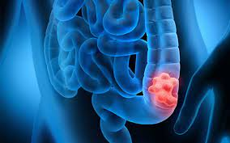
cancer
Colon cancer
STUDENT :NAME :: ghazala moftah 3398
BLOOK :: PTS
THE YEAR ::(2021 - 2022)
DATE ::2022/5/1

Slide 2

Objective :
01
03
02
04
Define the colon cancer.
List the risk factor of colon cancer
List the symptoms of colon cancer.
How to be protective from colon cancer

Slide 3

Introduction
Colon cancer typically affects older adults, though it can happen at any age. It usually begins as small, noncancerous (benign) clumps of cells called polyps that form on the inside of the colon. Over time
some of these polyps can become colon cancers
3

Slide 4
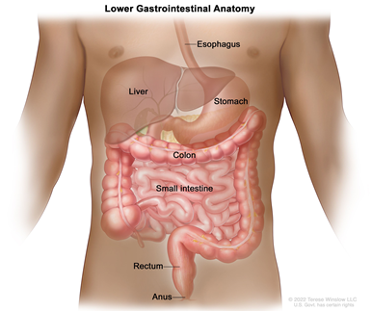
Define the colon cancer
malignant tumor arising from the inner wall of the large intestine (the colon). In the US, colon cancer is the third leading type of cancer in males and the fourth in females.
4

Slide 5
List the symptoms of colon cancer
1
3
change in bowel habits, such as diarrhea, constipation.
Blood in the stool, which might make it look dark brown or black.

Slide 6
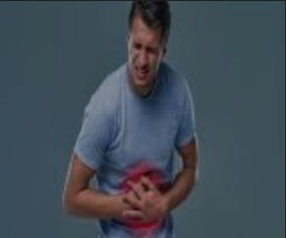
Symptoms
3
5
Losing weight.
Weakness and fatigue.
4
6
Cramping or abdominal (belly) pain.
Rectal bleeding with bright red blood

Slide 7
List the risk factor of colon cancer
1. Being overweight or obese.
3. Smoking.
4. types of diets.
2. Not being physically active.
7

Slide 8
Risk factor
7. history of colorectal polyps or colorectal cancer
5. Alcohol.
8. history of IBD.
6. Being older.
8

Slide 9
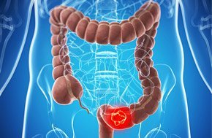
How to be protective from colon cancer
1. Get screened for colorectal cancer.
2. Eat lots of vegetables, fruits, and whole grains.
3. Get regular exercise. If you are not physically active
4. Take control of your weight

Slide 10

prevention
5. Don’t smoke. People who have been smoking for a long time are more likely.
6. Avoid alcohol. Alcohol use has been linked with a higher risk of colorectal cancer.

Slide 11
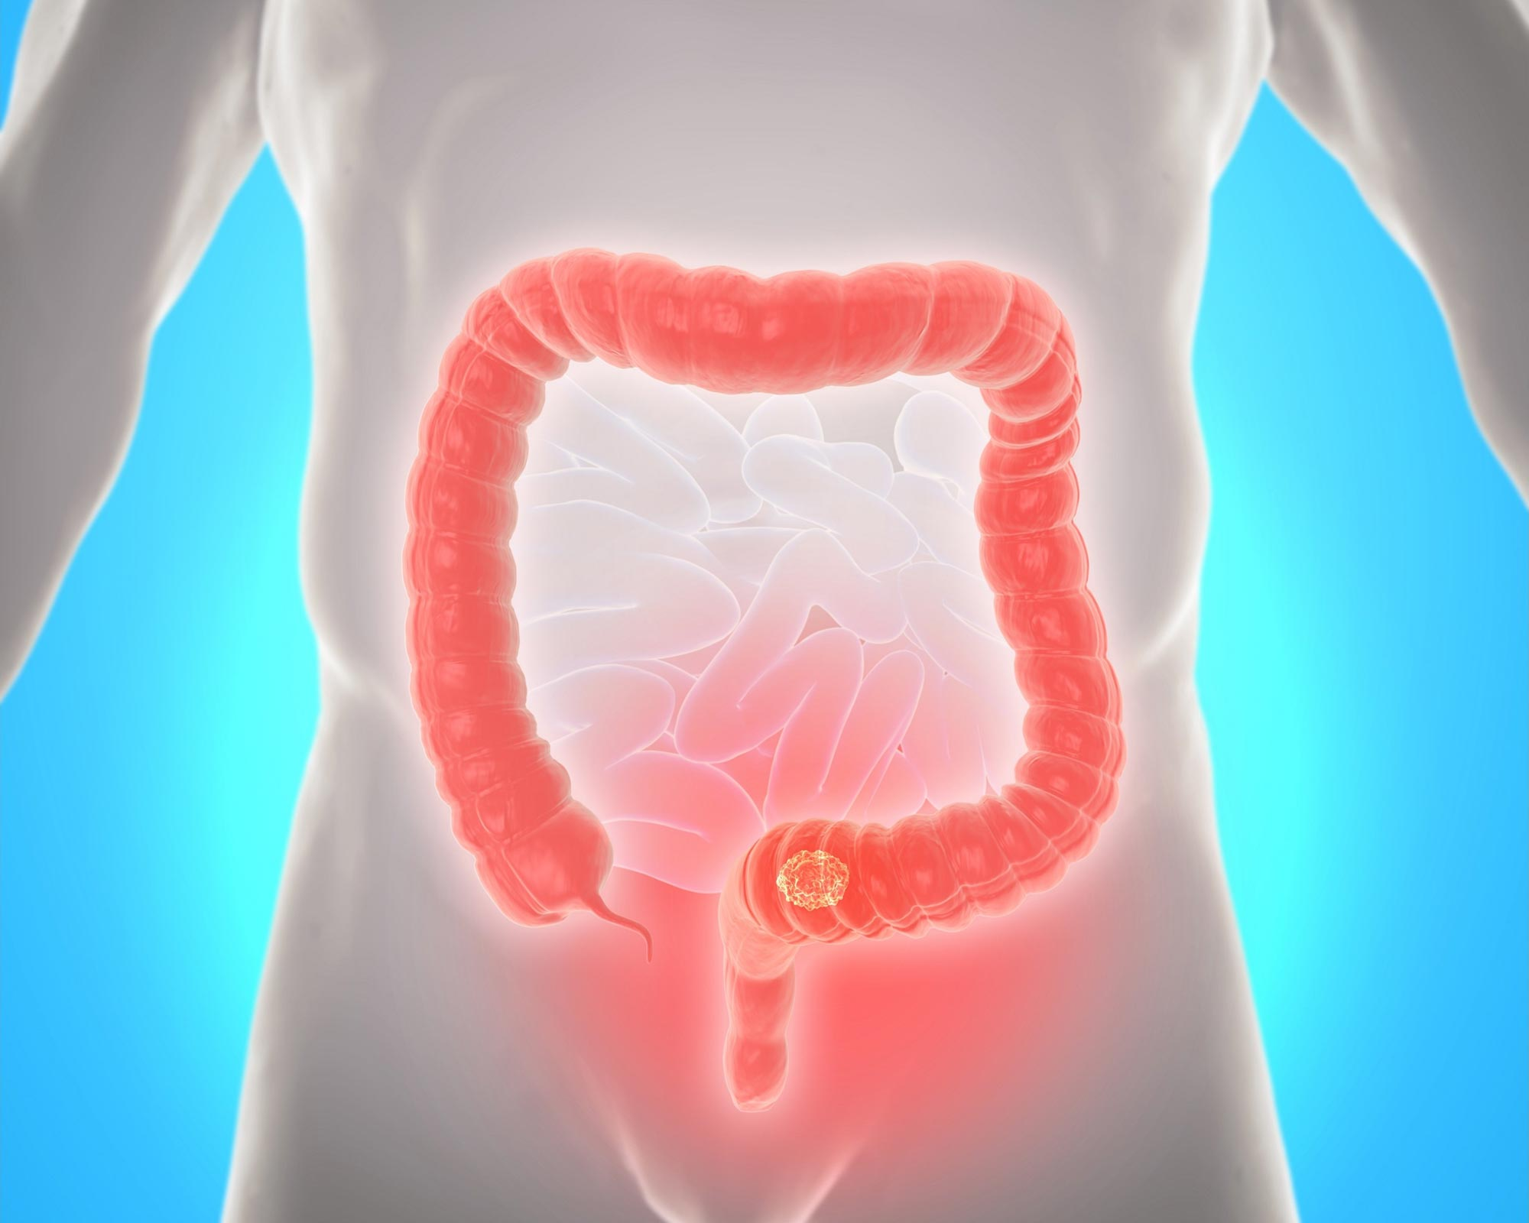
Conclusions
- Risk factors for cancer of the colon and rectum (colorectal cancer) include colon polyps, long-standing ulcerative colitis, and genetic family history.

Slide 12
Reference
Cancer.org. 2022. Colorectal Cancer Risk Factors | Hereditary Colorectal Risk Factors. [online] Available at: <https://www.cancer.org/cancer/colon-rectal-cancer/causes-risks-prevention/risk-factors.html> [Accessed 13 May 2022].
Rxlist.com. 2022. [online] Available at: <https://www.rxlist.com/colon_cancer/definition.htmhttps://www.rxlist.com/colon_cancer/definition.htm> [Accessed 13 May 2022].
12

Slide 13
Thanks!
13

