Slide 1



Tourism Marketing TITLE: National Tourism
Libyan International Medical University Faculty of Business Administration
Student Name: Sukina Adel
ID: 2282
Email: sukina_2282@limu.edu.ly
Instructor: Inaas Bubtana

Slide 2
TABLE OF CONTENTS:
Introduction
Design marketing strategy for National tourism
Interviews
Marketing Plan
Conclusion
References

Slide 3
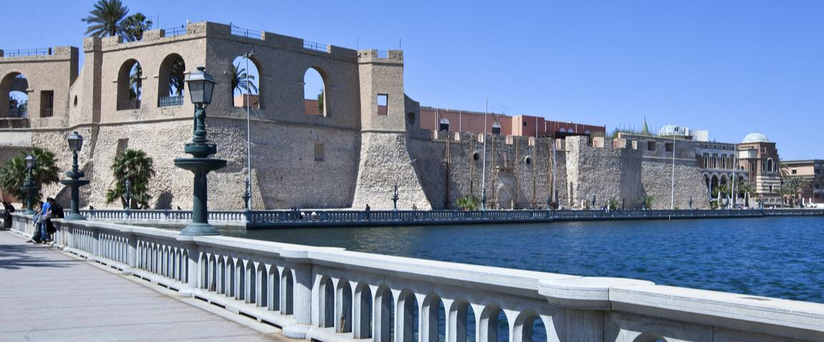

INTRODUCTION
Libya, country located in North Africa. Most of the country lies in the Sahara desert, and much of its population is concentrated along the coast and its immediate hinterland, where Tripoli (Ṭarābulus), the de facto capital, and Benghazi (Banghāzī), another major city, are located.

Slide 4
DESIGN MARKETING STRATEGY FOR NATIONAL TOURISM :

Slide 5


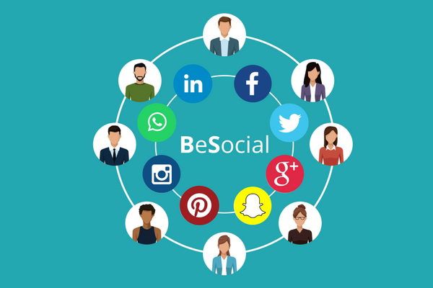
The first thing you need to do is to understand your ideal customers.
You need to do (STP) strategy
Understand your customers
Video marketing is king right now, especially for brands in the tourism sector.
Travelers are frequently searching for videos of destinations they want to travel to. The problem is that they no longer want just pre-recorded videos
Live video marketing
Be social
Social media is one of the most effective marketing channels for the tourism industry.
Use influencer marketing individuals, Like (Rahalista) he does a great job on social media
The top social media channels for influencer marketing are: Instagram, YouTube, TikTok

Slide 6
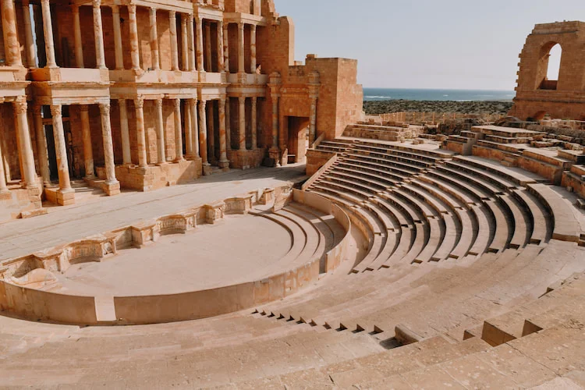
The coastal town of Sabratha, or Sabrata , located about 40 km east of Zuwarah city, is one of the best preserved Roman sites outside Italy, and one of the world’s best archaeological sites to visit. Its strategic location by the sea.
Is well worth a visit for anyone interested in history or architecture.

Slide 7
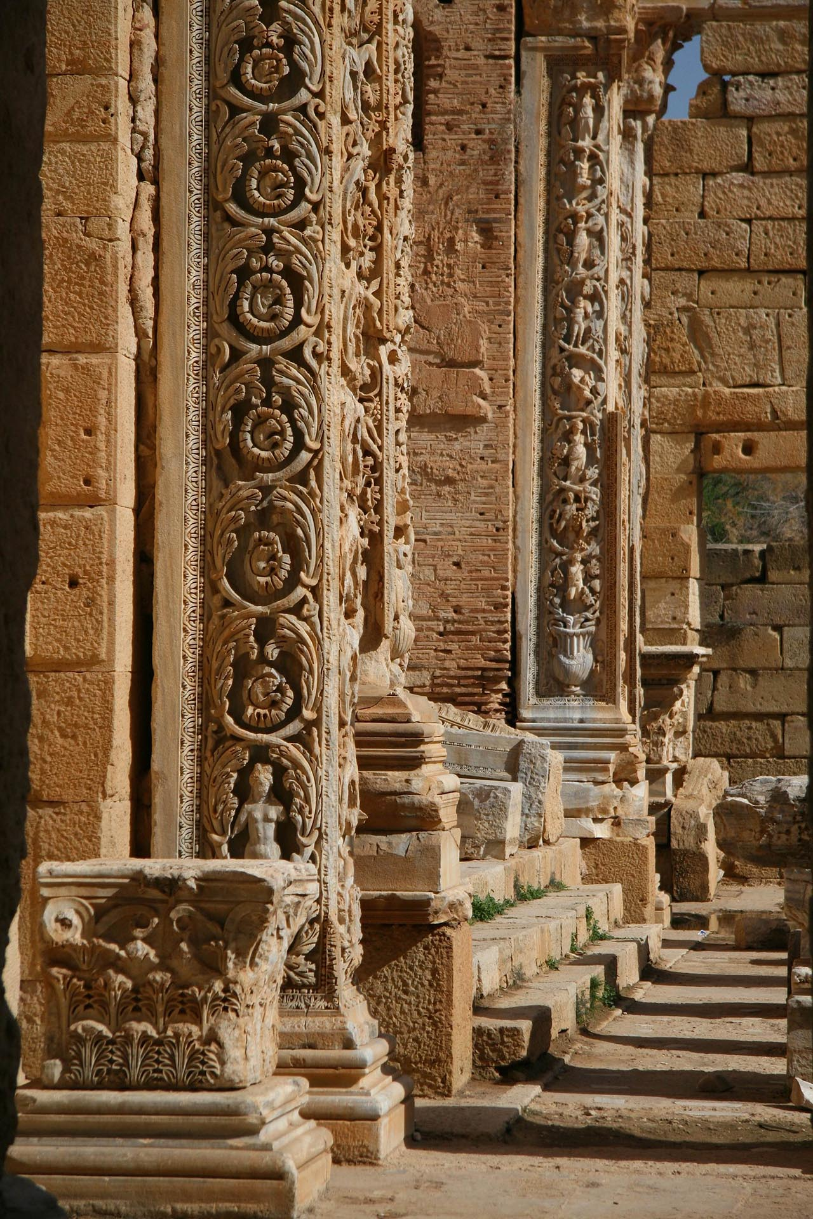
LEPTIS MAGNA:
Leptis Magna has deservedly earned a reputation of having the most complete and impressive Roman ruins in the entire North Africa.
Here we will target people who interested in history, and architecture.
And then make a good image in their mind

Slide 8
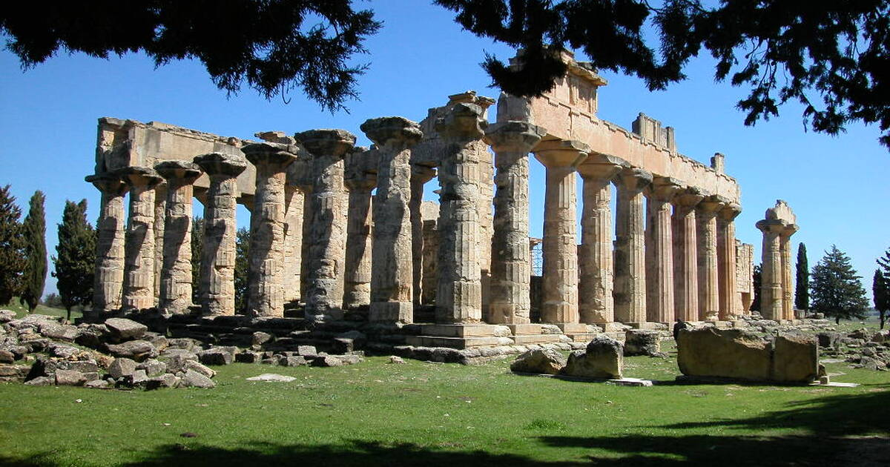
CYRENE
The ancient city of Cyrene, which is situated back from the Mediterranean coast in the al-Jabal al-Akhdar region, was a crossroads of European and North African culture and trade. It is an important part of the long and multiethnic history of Libya. Cyrene was established in 631 BC by a group of immigrants from the Greek island of Thera in the Aegean Sea and is now found in Shahhat in eastern Libya. Their first monarch Battus established the Battiad dynasty, which ruled Cyrene for eight generations (until 440 BC). The city had economic growth and expansion throughout the Battiad era, adding additional ports that are now part of Benghazi, al-Marj, and Marsa Susah.

Slide 9
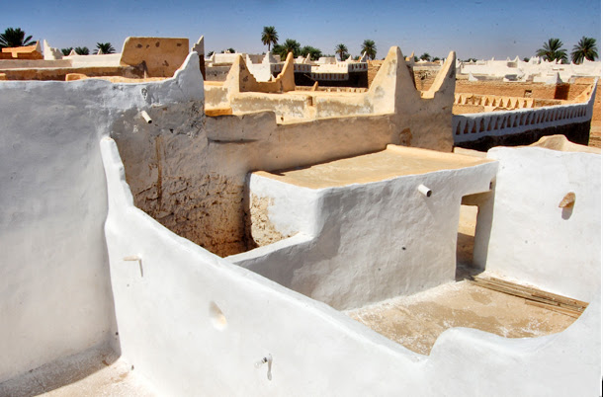
GHADAMES
Libya is home to the historic and ethereal city of Ghadames. The Phoenicians who founded it in the fifth century B.C. put it under Carthaginian and Roman control. During the reign of Emperor Septimius Severus, the city reached its zenith (193-211 AD). It is now a UNESCO World Heritage Site and is highly recommended for anyone with a passion for history or architecture. A theater, temples, basilicas, and a forum are among the spectacular ruins of Ghadames. Additionally, the location has been well-preserved, making it an intriguing spot to visit.

Slide 10
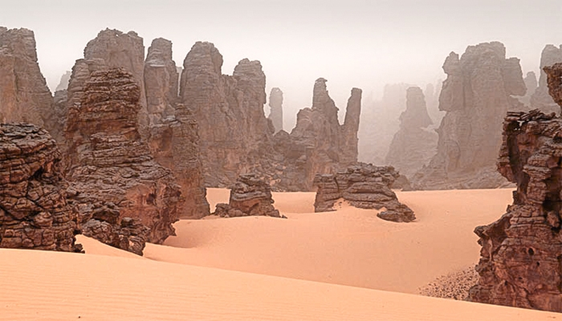
TADRART ACACUS
Tadrart Acacus comes last but surely not least. It is a natural marvel of Libya that shouldn't be missed. The site, which is in southwest Libya, is made up of seven magnificent mountain ranges, including the Tadrart Range, where Tadrart Acacus is found.

Slide 11
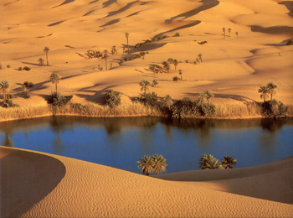
INTERVIEWS
I asked some people about this sites and if they have an experience.
Most of them have visited Eastern side, and they said it’s a good places to visit but it lacks hygiene, care, and transportation methods should be easy and available.

Slide 12
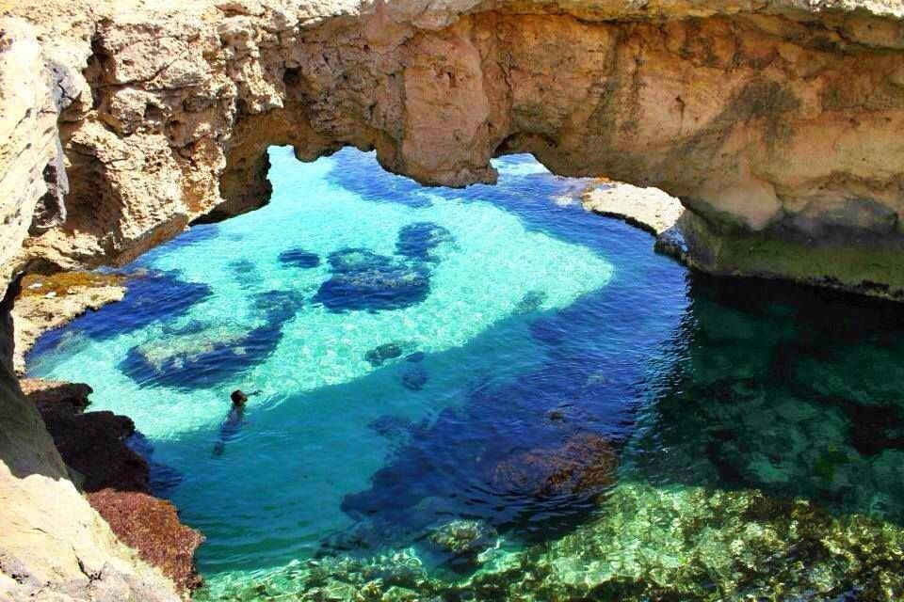
MARKETING PLAN
First we use STP strategy to segment, targeting, and positioning the most potential costumers.
Second, we want to know which strategy we want to use in Ansoff matrix, we use Market Penetration Strategy, because it’s an existing product in existing markets.
Third, do the 4Ps which is Product, Price, Place, Promotion.
Product: Archaeology.
Price: All things including money such as Tickets.
Place: Where the archaeology is such as Sabrata, Cyrene.
Promotion: activity that supports this sites, such as coupons, advertising across multiple mediums and channels, including TV, online ads, sponsorships, etc.
Fourth, we use social media platforms such as YouTube which is affected University students for making trips,
And Instagram, Tiktok which is the most important way to affect peoples in this days.

Slide 13
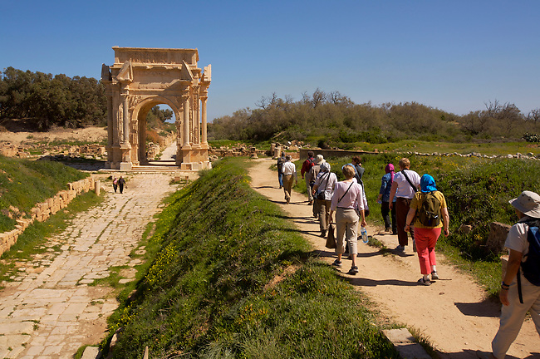
CONCLUSION
Libya is the home of several impressive archaeological and cultural sites that are truly unique and unparalleled in the whole world. The hardly known valleys of the Libyan Sahara are the home of an array of sophisticated and stylish prehistoric civilisations. Five of these sites have been added to the World Heritage List between 1982 and 1986. These sites are now the responsibility of the whole of humanity and not just Libya, to protect, preserve and ultimately explore and enjoy. We kindly invite our visitors and all tourists to report to us or to the appropriate authorities any illegal activity within these protected sites.

Slide 14
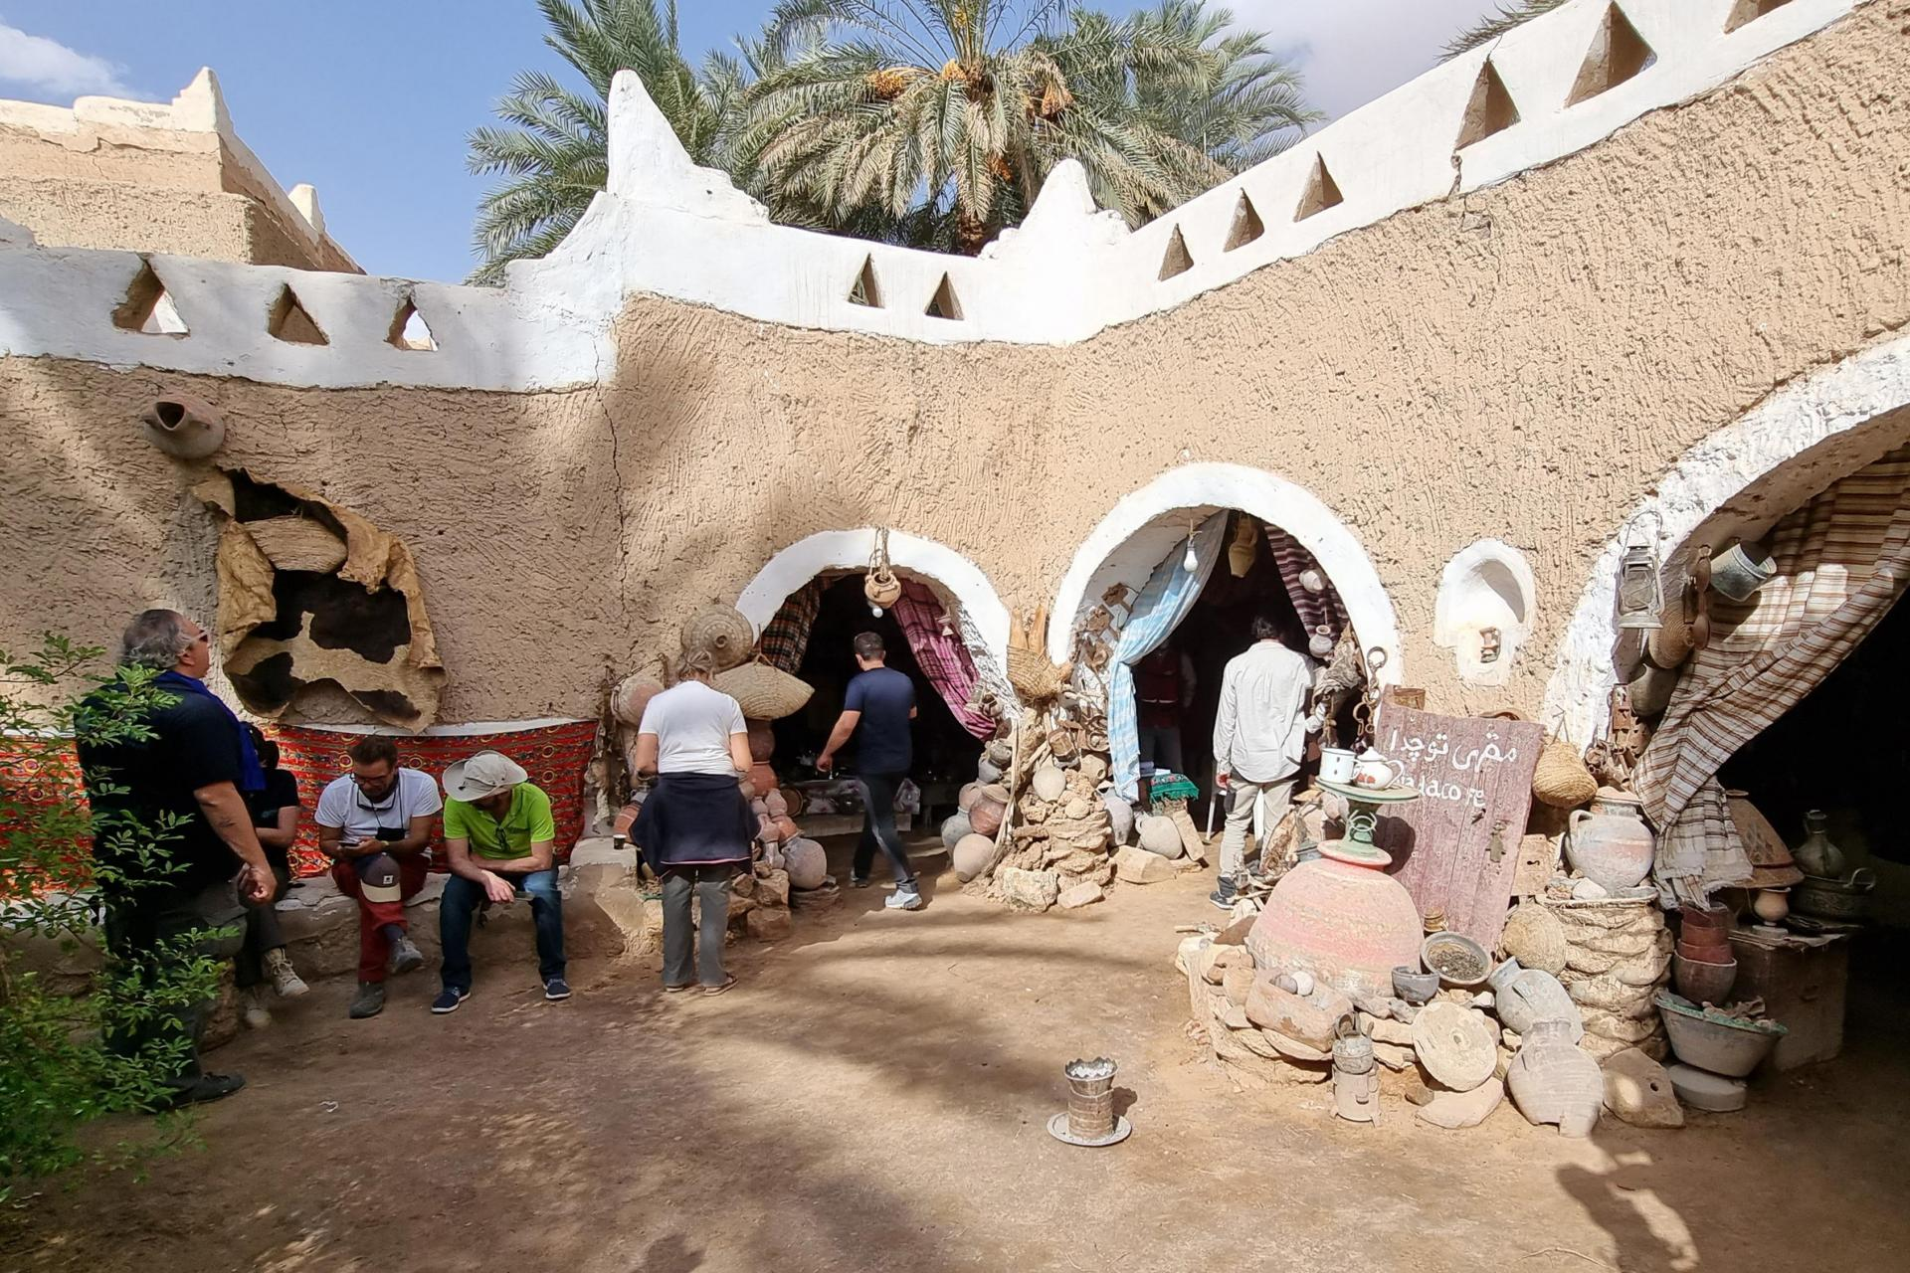
REFERENCES
5 UNESCO World Heritage Sites in Libya You Need to See | Libya Adventures. 6 June 2016, libyaadventures.com/5-unesco-world-heritage-sites-in-libya/.
“Ancient Cities of Libya: Cyrene.” Www.embassyoflibyadc.org, www.embassyoflibyadc.org/news/ancient-cities-of-libya-cyrene. Accessed 18 Jan. 2023.
“Libyan Tourism”: Www.temehu.com, www.temehu.com/responsible_travel/libyantourism.htm. Accessed 18 Jan. 2023.

Slide 15
YOU GONNA SAY THANK YOU AFTER VISITING LIBYA 🇱🇾

