Slide 1


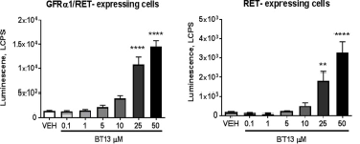
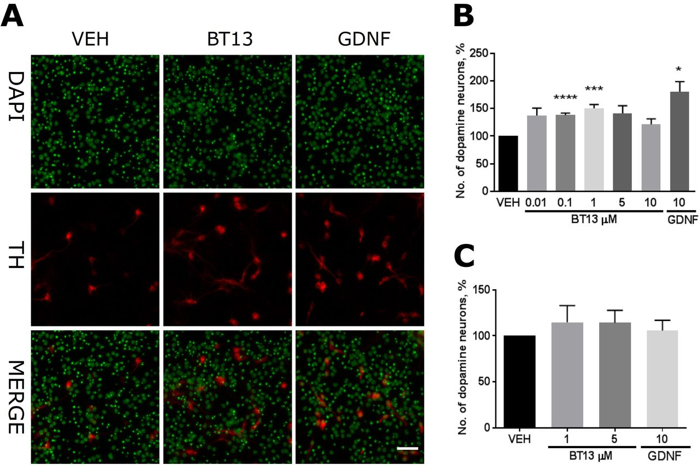
parkinson's disease become curable?
Faculty of Medicine, Libyan International Medical University
Sanad Hamed Aldenaly, 4rd year medical student
كلية الطب البشري
Faculty of Medicin
Introduction
Results
Discussion
Parkinson' s disease PD is the second most common age related neurodegenerative disorder prevalence of PD is 0.3% in the general population characterized by Progressive degeneration in dopaminergic neurons & receptors.
Patients exhibit a range of clinical symptoms, with the most common affecting motor function and including resting tremor, rigidity, akinesia, bradykinesia and postural instability.
The disease is named after a British physician, James Parkinson, who first described it in “An Essay on the Shaking Palsy” in 1817.[1]
BT13 was found to protect against Parkinson’s-related neurodegeneration, which was simulated in the lab by exposing dopaminergic neurons in dishes to 6-OHDA and MPP+ — both neurotoxins that induce cell death and mimic disease symptoms. Importantly, BT13 only protected these neurons when they expressed the RET receptor.
BT13 was administered to mice — through an injection directly into the brain — it was able to cross the blood-brain barrier.[3]
Conclusion
therapeutic molecule
Figure 1: BT13 stimulates phosphorylation of RET in immortalized cells[3].
One of the biggest challenges for Parkinson’s research is how to get drugs past the blood-brain barrier, so the exciting discovery of BT13 has opened up a new avenue for research to explore, and the molecule holds great promise as a way to slow or stop Parkinson’s
(GDNF) Receptor (RET) Agonist Supports the growth, survival, and differentiation Dopamine Neurons In Vitro and Enhances Dopamine Release In Vivo .
GDNF is not able to cross the human blood-brain barrier (BBB), and complex surgery is required to deliver the treatment to the brain via stereotaxic surgery, .
BT13, another molecule that binds the same signaling receptor — or RET receptor — for the GDNF molecule family, is much smaller in size than GDNF. Researchers say BT13 able to more easily cross the(BBB).[2]
References
1-Balestrino, R., & Schapira, A. H. V. (2019). Parkinson disease. European Journal of Neurology, 27(1), 27–42. https://doi.org/10.1111/ene.14108
2-Pierce, J. (2020, February 26). Scientists Uncover New Therapeutic Molecule BT13 That May Possibly Protect Against Neurodegeneration. Parkinson's News Today.
3-Mahato, A. K. (2019, January 1). GDNF receptor agonist supports dopamine neurons in vitro and protects their function in animal model of Parkinson’s. BioRxiv.
Figure2: BT13 supports the survival of cultured dopamine neurons[3].
Glial cell line-derived neurotrophic factor [GDNF], rearranged during transfection[RET]

