Slide 1
APPROACH TO ANEMIA
WHO defines anemia when HB level < 13gm/dl in
men and <12gm/dl in women .
Anemia is not a diagnosis , it is a manifestation
of an underlying disease .
Symptoms of anemia develops when there is
marked reduction of HB level or when it
develops rapidly.

Slide 2
Diagnostic Approaches To Anemia
1- Is the patient anemic ?
2- How severe is the anemia ?
3- What type of anemia ?
4- Why the patient is anemic ?
5- What should be done ?

Slide 3
EVALUATION OF ANEMIA :
A- HISTORY :
- Nutritional history : Vegans , alcoholism.
- Bleeding history.
- History of associated systemic disease,
malignancy, rheumatic disorder.
- Family history of anemia.
- Drug history.
- History of pica.

Slide 4
B- Physical examination:
- Full, complete physical examination
( general & systemic).
- Demonstration of signs of underlying disorder
may suggest the type and or cause of anemia.
a- pallor & jaundice and splenomegaly ;
suggests Hemolytic Anemia.
b- Pallor & epistaxis & purpura & melena ;
suggests IDA .
c- Pallor & neurological abnormalities ; suggests
Vit. B12 deficiency.

Slide 5
C- Investigations :-
- CBC , PBF ,ESR , Reticulocyte count.
- RBCs , RBC indices.
- Coagulation profile.
- Iron study “ S. iron, TIBC, S. ferritin ”.
- Vit. B12 level, folate.
- LFT & RFT & stool for occult blood .
- HB electrophoresis.
- Coomb’s test.
- Endoscopy & Radiological study.
- BMA + biopsy.
- Other specific inv. According to underlying
problem.

Slide 6
Symptom of anemia :-
- Symptoms vary depends on severity of anemia
and how rapidly it develops.
- Asymptomatic.
- Fatigue, lethargy, dizziness, headache, poor
concentration, visual disturbance, tachycardia.
- Dyspnea “ exertional, at rest ” chest pain, HF.

Slide 7
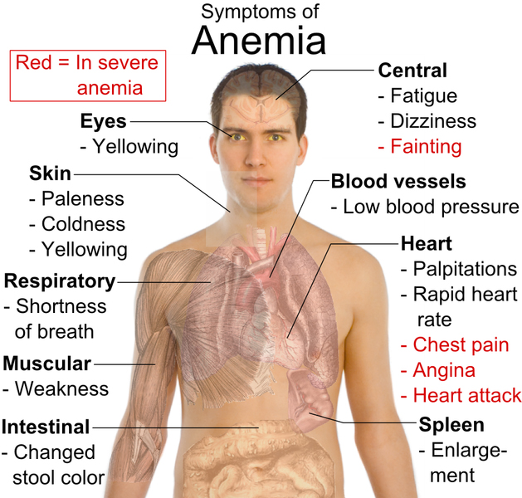

Slide 8
Classification Of Anemia
A- On basis of cause :-
* bleeding.
* inadequate production of normal RBCs.
* excessive destruction of RBCs .
B- On basis of RBC morphology :-
* normocytic .
* macrocytic .
* microcytic .

Slide 9
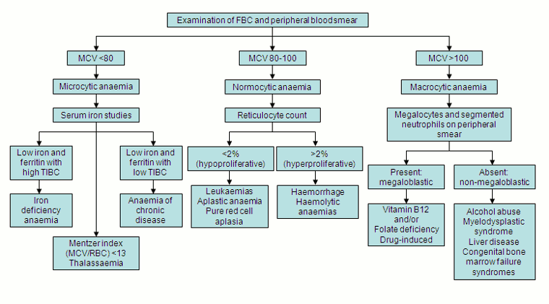

Slide 10
IMPORTANT TO REMEMBER
* Anemia is a clinical sign of disease .
* It is not a single disease by itself .
*Need to look for the underlying cause !
* Its diagnosis is not that simple!! , we will
make it .
* It is very common and important in our
practice .
*Drug treatment depends on the cause .

Slide 11
