Slide 1


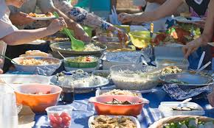
Food and water contamination
Name : Jehad Haweel
Number : 2848
Year : 2
Date :16-5-2022

Slide 2
Objective
01
Define food and water contaminations
02
Discuss Types and causes of food and water contamination
03
list Diseases caused by food and water contamination
04
Outline Prevention of the food and water contamination

Slide 3
Introduction
3

Slide 4
Definition of food and water contamination
-Food contamination occurs when food is not cooked properly or is not stored properly allowing viruses and bacterial spores to contaminate the food.
-Water contamination is the contamination of water sources by substances which make the water unusable for drinking, cooking
4

Slide 5
Types of contamination
A
B
C
Chemical contamination of food and water
Physical contamination of food and water
Microbial contamination of food and water
5

Slide 6
Causes of chemical contamination of food
Mycotoxins
Heavy metals - lead and mercury
Organic pollutants - dioxins
Acrylamide which may result from food being processed
6

Slide 7
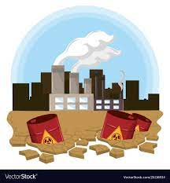
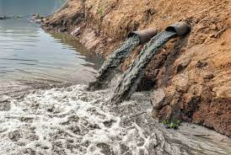
Chemical contaminants can enter the food chain from multiple sources:
Contamination can occur during primary production from various environmental sources
Chemical contaminants can also enter the food chain at the secondary production stage
7

Slide 8
Contamination during primary production stage include
contaminated water for example, dioxins, halogenated organic compounds or heavy metals
contamination from weeds, for example, plant toxins
waste from factories
carry over of certain substances from animal feed
8

Slide 9
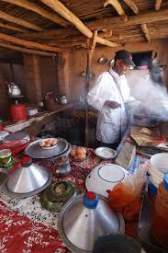
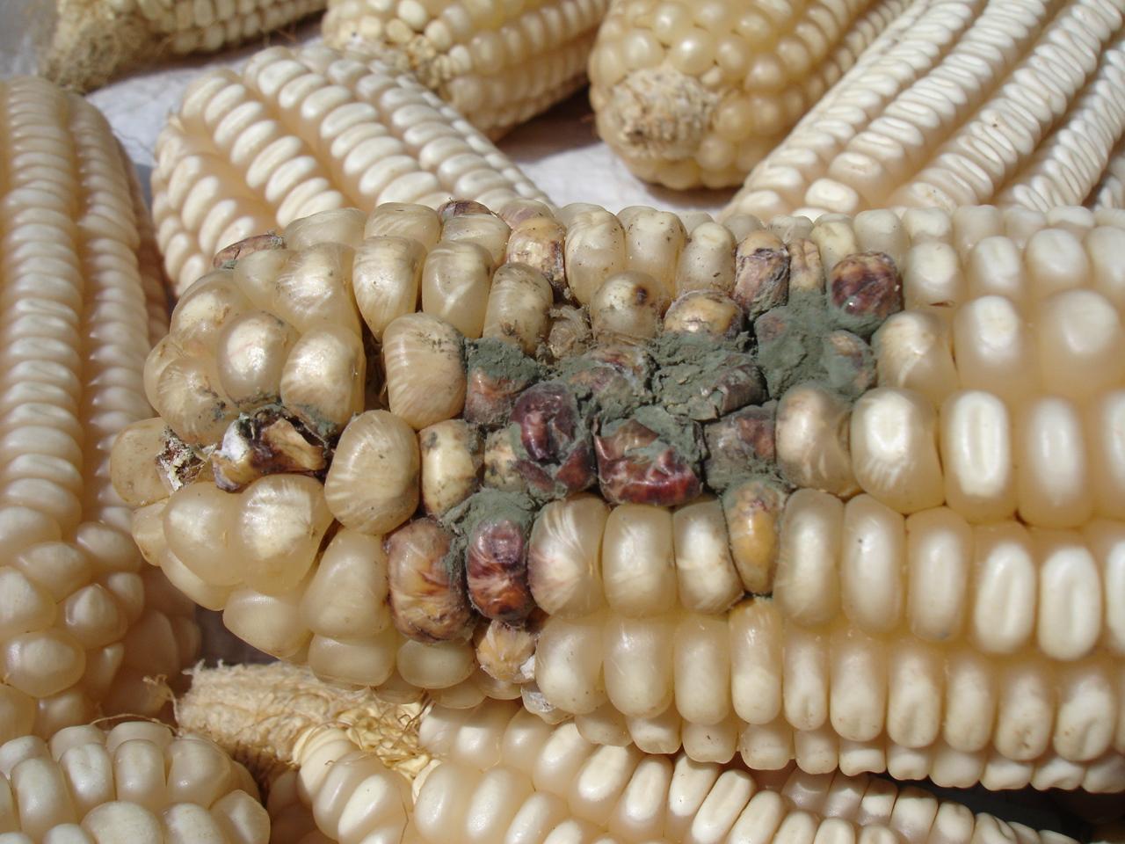
Contamination during secondary production stage include
transportation and handling.
during cooking and processing, for example, polycyclic aromatic hydrocarbons.
storage for example, mycotoxins.
9

Slide 10
Causes of chemical contamination of water
Crude oil and various petroleum products (including gasoline, diesel fuel)
Half a million tons of oil and gasoline are leaked into the marine environment and caused by factories, cities and farms
Fertilizers (including nitrates and phosphates) while small amounts are useful to life higher amounts of nitrates and phosphates in water are only beneficial to algae and harmful microorganisms and are poisonous to human and aquatic life
10

Slide 11
Causes of Physical contamination of food and water
-Physical contamination refers to contamination by a foreign body and can occur at any stage of the assembly stage.
-Physical pollution has the additional consequence of causing serious harm to consumers, such as breaking teeth or suffocation.
11

Slide 12
Causes of Physical contamination of food and water
1
2
Typical physical contaminants found in food include, plastic, bones, stones, hair, and problems with the food premises or equipment
Physical pollutants mainly affect the physical appearance or other physical properties of water. E.g. Sediment or organic matter resulting from soil erosion
12

Slide 13
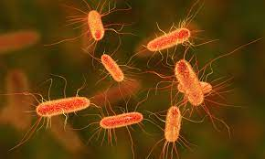
Causes Microbial contamination of food and water
A-Microbial contamination happens when a food has been contaminated by microorganisms, including bacteria, viruses, fungi, and toxins
Undercooking chicken can give rise to campylobacter
During the rearing and slaughtering of animals the salmonella that lives in animal intestines can transfer onto food products
13

Slide 14
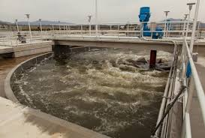
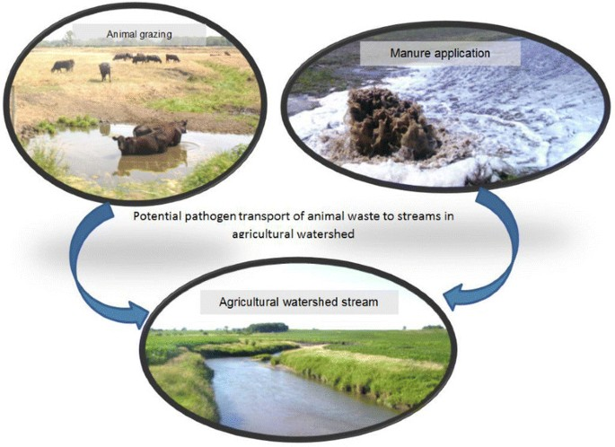
Causes Microbial contamination of food and water
B1
B2
The microbial contamination of water is often of fecal nature related to humans (water sewage treatment plants More than 80 percent of the world's wastewater flows back into the environment without being treated or reused.
Animals are the main source of bacterial contamination of natural water resources
14

Slide 15
List diseases caused by food and water contamination
E. coli infection.
Listeriosis.
Giardiasis.
Norovirus.
Hepatitis A.
Salmonellosis.
15

Slide 16
outline Prevention of the food and water contamination
Dispose of chemical cleaners oils and non-biodegradable items properly to prevent them from entering the marine environment
Wash your hands thoroughly before and after handling or preparing food
Keep raw foods separate from ready-to-eat foods
Avoid applying pesticides and herbicides
16

Slide 17
CONCLUSION
Water management is fundamental
Food should be considered as a public health issue not only an agricultural and\ or trade commodity
Food and water security issues are still daunting in the developing world
17

Slide 18
Reference
1-Brook I. Other clostridium species. In: Long SS, Prober CG, Fischer M, eds. Principles and Practice of Pediatric Infectious Diseases. 5th ed. Philadelphia, PA: Elsevier; 2018:chap 191.
US Food & Drug Administration website. Food safety at home. www.fda.gov/consumers/free-publications-women/food-safety-home. Updated October 28, 2021. Accessed January 6, 2022.
2- Aiyar A., Pingali P. Pandemics and food systems—towards a proactive food safety approach to disease prevention & management. Food Secur. 2020;12:749–756. [PMC free article] [PubMed] [Google Scholar]
3- https://www.nrdc.org/stories/water-pollution-everything-you-need-know#prevent
18

Slide 19
Thank you
19

