Slide 1


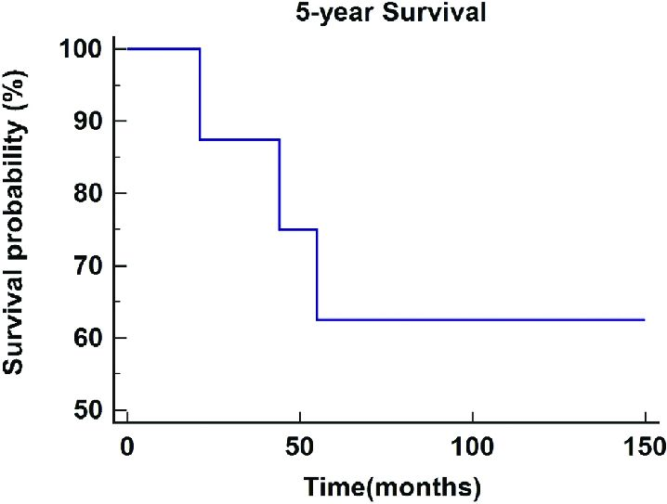
Oral cancer
Diagnosis of Squamous cell carcinoma
Mahmoud shawish 2918
Asma Al-Sheikhi
Introduction
Result
Survival rates for oral cancer are very poor (around 50% overall), and no remarkable improvements have occurred in recent decades despite advances in therapeutic interventions. Variables like age, DNA content, immunological status, size and location of the tumor, nodal status have been assessed as independent prognostic markers for oral cancer but stage at diagnosis remains as the most important prognostic indicator for oral and oropharyngeal squamous cell cancers.
-A total of 88 patients (mean age 60±11.3), mostly males (65.9%) entered the study. The most frequent tumor sites were tongue (36.4%), floor of the mouth (27.3%) and gingivae (17%).
-The median for the interval between the first sign/symptom to pathological diagnosis was 45 days.
-45.5% of the oral carcinomas were diagnosed at early stages (I-II). The most frequent clinical lesions were ulcers (70.5%)
Discussion
Figure 1
-The current recommendations to screen for oral cancer at every routine check-up is not practical and has not produced the intended results.
-Selective opportunistic screening may be a more realistic and effective solution.
Method and Material
-Detection of oral and oropharyngeal SCCs during a non-symptom-driven examination has proved an association to lower stage at diagnosis, in the same way as patients with a regular primary care dentist are significantly more likely to be diagnosed at early stages
The study sample was made of 88 patients treated at the Oral and Maxillofacial Surgery Service of the CHUAC from January 1998 to December 2003.
The criteria that was used as follows:
1- The primary sites of oral cancer were.
2- The variables considered included age, gender, smoking history, alcohol usage, tumor site.
-Unfortunately, about a 60% of cancers are identified late (stages III or IV) with survival rates ranging from 10% to 40% after 5 years
-On the other hand, poor differentiation of the tumor (biologically more aggressive) behaved as an independent risk factor for diagnosis at stages III-IV.
3- The time interval from the self-reported date The variables considered included age, gender, smoking history, alcohol usage, tumor site, macroscopic pattern of the lesion.
4- pathological diagnosis of OSCC (primary tumor) at any oral site and suffering from a tumor at any TNM stage.
Reference
Seoane-Romero, Juan-Manuel, et al. "Factors related to late stage diagnosis of oral squamous cell carcinoma." Medicina oral, patologia oral y cirugia bucal 17.1 (2012)

