Slide 1


Leukemia
Libyan International Medical University
Faculty of Applied Medical Science
First Year medicine
2021/2022
name: FIDA AWAD BODALAl
Number: 3614
18/5/2022

Slide 2
objectives
Define Leukemia and the underlaying causes
Classify Leukemia and its types
Identify the common symptoms and signs of the disease and the individuals at high risk
Describe the methods of treatment
What are the complications of the disease

Slide 3
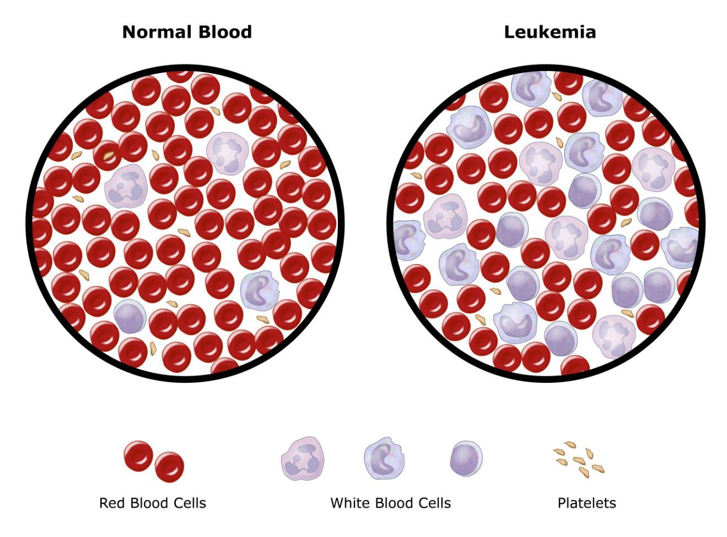
introduction

Slide 4
What is leukemia?
Leukemia is cancer of the body's blood-forming tissues, including the bone marrow and the lymphatic system.
In leukemia, the bone marrow produces an excessive amount of abnormal white blood cells, which don't function properly

Slide 5
Classification of leukemia
By the type of Leukocyte affected:
By Leukemia's speed of progression:
Acute leukemia the abnormal blood cells are immature blood cells and it requires aggressive, timely treatment.
Chronic leukemia. There are many types of chronic leukemia's and it involves more-mature blood cells.
Lymphocytic leukemia. This type of leukemia affects the lymphoid cells (lymphocytes)
Myelogenous leukemia. This type of leukemia affects the myeloid cells

Slide 6
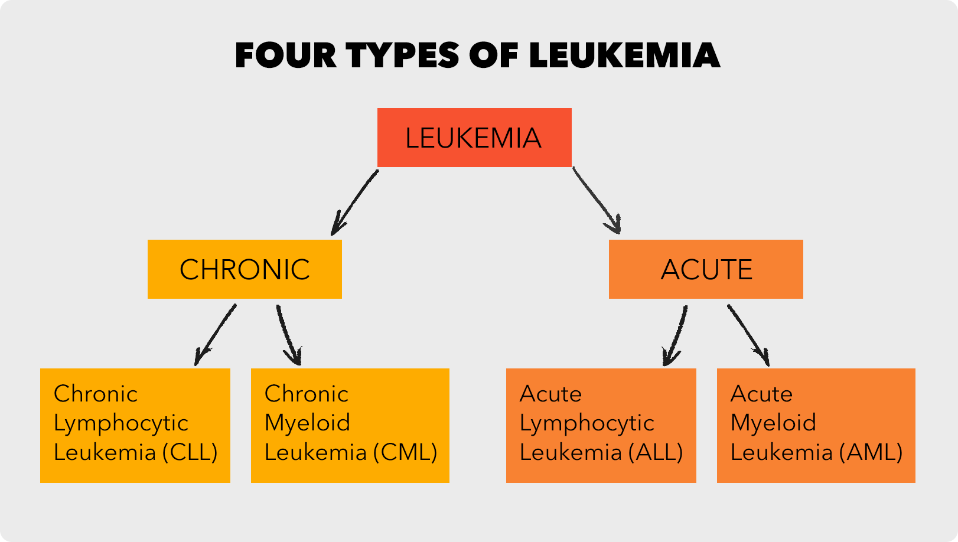

Slide 7
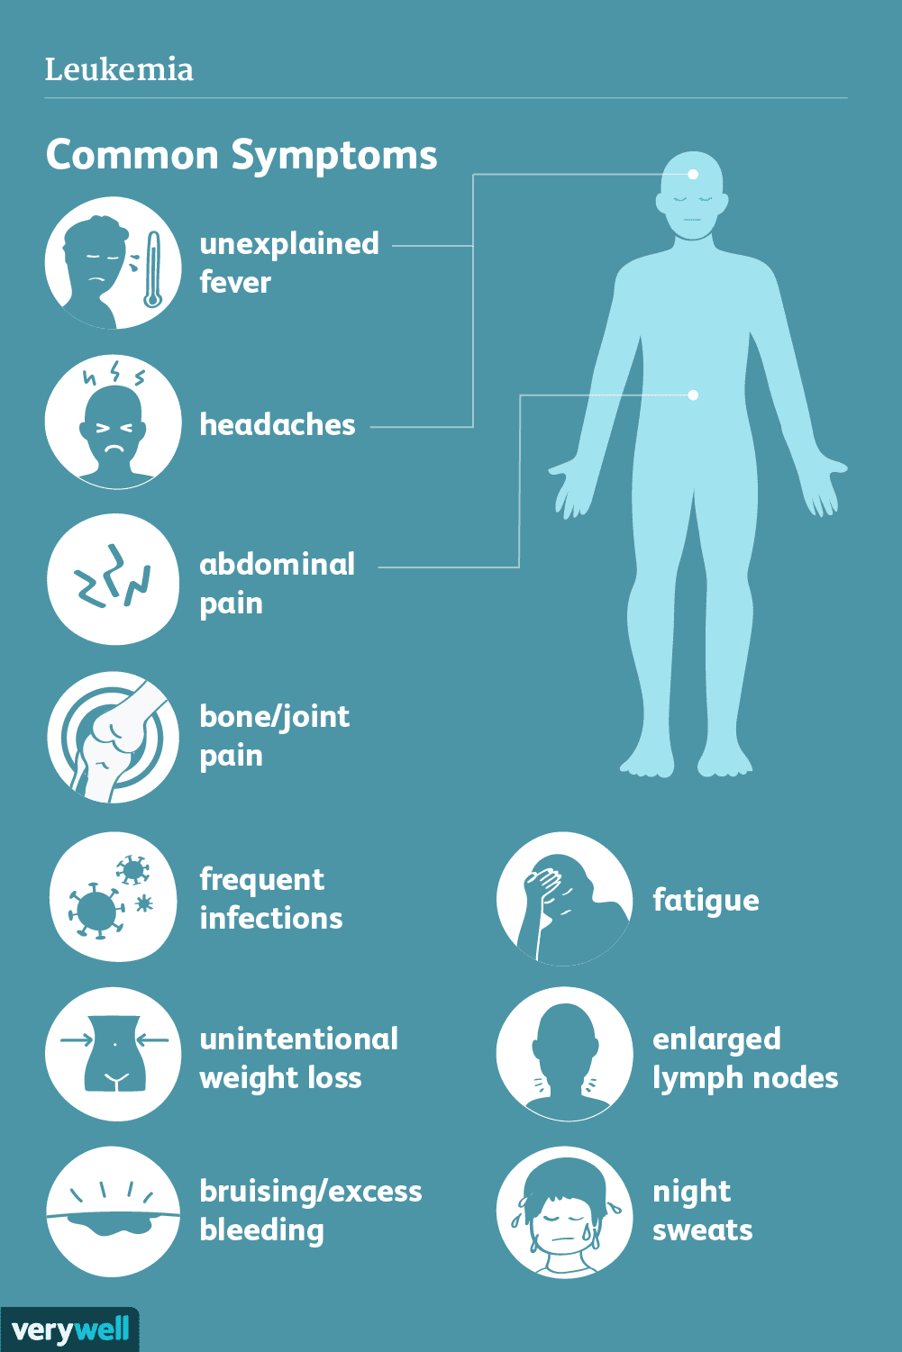
Common symptoms and signs

Slide 8
Causes of Leukemia
A genetic predisposition
Down syndrome
(HIV) virus
Exposure to petrochemicals, such as benzene
Extensive exposure to artificial ionizing radiation
Tobacco use
Use of certain hair dyes

Slide 9
Risk factors
For AML include smoking, exposure to radiation,and certain genetic disorders
For ALL include having certain viral infections or genetic disorders as well as prior exposure to high doses of radiation or benzene
For CLL include a family history of this cancer or exposure to Agent Orange (a tactical herbicide)
No risk factors have yet been identified for CML.

Slide 10

Can Leukemia be cured?

Slide 11
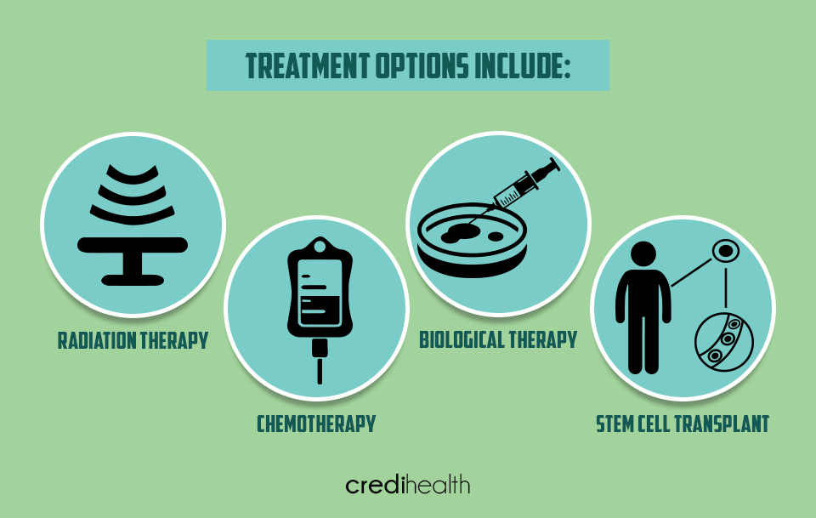
Can leukemia be cured?
While there is no cure for leukemia at this point in time, there are a range of advanced treatment for leukemia patients to achieve remission without recurrence, including:

Slide 12
Complications of Leukemia
Weight Loss
Anemia
Chances of developing autoimmune disorders.
Infertility
Slow growth
Damage of central nervous system.
Cataract
Side effects of chemotherapy drugs

Slide 13
CONCLUSION
Today in our topic we talked about Leukemia, which is a type of cancer, to help spread awareness about this disease, and to highlight the importance for early check ups. And taking in consideration the risk factors in mind to save our lives ,and the lives of our loved ones.

Slide 14
references
What Causes Leukemia | Moffitt
Leukemia - Symptoms and causes - Mayo Clinic

Slide 15
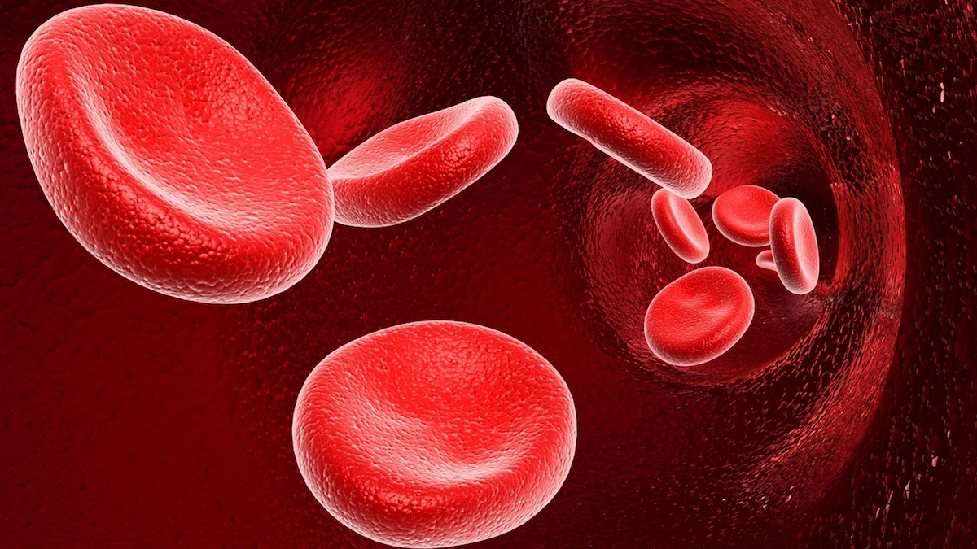
THANK YOU!

