Slide 1



Principles of Conversation
Libyan International Medical University
Faculty of Business Administration
Name : Mohammed Gargoum
ID : 3312
Email : mohammed_3312@limu.edu.ly
01

Slide 2
Table of Content
01
Introduction
02
4 Elements of Communication
03
Types of Communication
04
Conclusion
05
References
02

Slide 3
Introduction
A conversation is communication by two or more people, or sometimes with one’s self, on a particular topic.
Conversation are the ideal form of communication in some respects, because they allow people with different views on a topic to learn from each other
03

Slide 4
02
4 Elements of Communication
04

Slide 5
4 Elements of Communication
Message: The actual content or information that is being communicated is termed as a message.
Source/ Sender: Source or sender is the one who sends the message or information to another person.
Medium/ channel: A system or the means to transfer information or message between the sender and receiver.
Receiver: As the term indicated, the receiver is the one who receives messages or information transmitted by the sender
05

Slide 6
03
Types of Communication
06

Slide 7
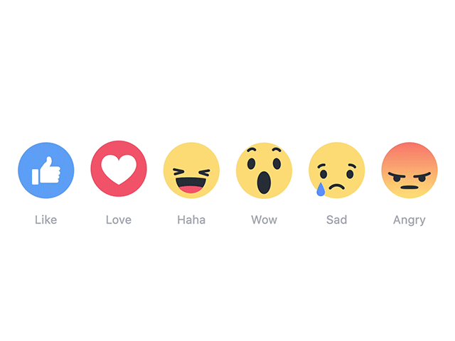
Types of Communication
Verbal Communication
Written Communication
Non-Verbal Communication
The process of transmitting messages or information in the written form of words is known as written communication.
The non-verbal means can be body movements or postures, eye contact, facial expressions, gestures, touch and use of space, etc.
Verbal or oral communication is defined as the flow of message or information between the sender and audience through different verbal mediums like speech or words, presentation, discussion or conversation, etc.
07

Slide 8
Conclusion
There are different types of communication; Verbal, Written and non-verbal and they are used in different situations.
08

Slide 9
Reference
Principles of conversation - ppt download. Slide Player. (n.d.). Retrieved December 7, 2021, from https://slideplayer.com/slide/17827680/.
Studious Guy. (2019, October 8). Basic principles of communication. Studious Guy. Retrieved December 7, 2021, from https://studiousguy.com/basic-principles-of-communication/#C_Types_of_Communication.
09

Slide 10
Thanks🤍
10

