Slide 1
Pulmonary tuberculosis
What is the cause of TB?
Tuberculosis is a chronic infection,
caused by mycobacteria tuberculosis(acid fast bacili.

Slide 2
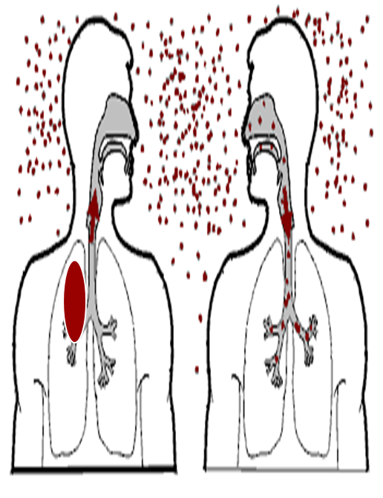
Transmission
Depend on
The intimacy and duration of contact
The degree of infectiouseness of case
Health status of recipient.

Slide 3
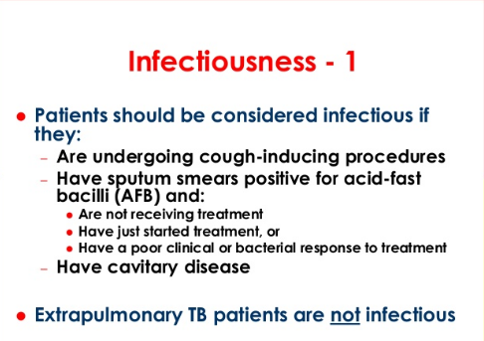

Slide 4
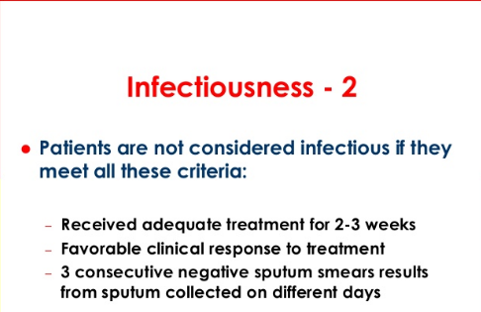

Slide 5
RISK FACTORS
Old age,
Alcoholic,
Silicosis,
DM type I,
Malignancy and immunosupression due to anyresson.

Slide 7
The result of the tuberculosis after infection
Fibrosis
Calcification
Deterioration: enlargement of infected aeras or spreading.

Slide 8
Primary infection
Previously healthy
Progressive primary disease: Haematogenous (milliary), lymphatic, endobronchial or local spread
Spontaneous resolution
the natural history
of Tuberculosis
Latent disease
Post primary disease
Reactivation of quiescent disease
at any site, re-infection or
Haematogenous spread (milliary)
Clinical disease

Slide 9
what are the clinical patterns of tuberculosis?
1. Primary pulmonary tuberculosis (Primary Complex and Bronchial Lymphnode-Tuberculosis)
2. Milliary Tuberculosis (acute hematogenous pulmonary tuberculosis)
3. Post primary or secondary pulmonary tuberculosis jnfiltrative pulmonary tuberculosis Chronic fibrocavitary pulmonary tuberculosis .
4. Tuberculous pleuritis
5. Extrapulmonary tuberculosis

Slide 10
WHAT ARE THE SYMPTOM OF TB? Or
When we suspect tb in apatient
fever, loss of apatite ,weight loss, night sweats and
Cough and sputum, Hemoptysis and chest pain,
physical signs: nonspecific.

Slide 11
Clinical Features of Miliary TB
Cryptic | Classical
> 60 years | < 40 years | Age
Constitutional symptoms | Constitutional symptoms | Symp
HepatosplenomegalyNO lymphadenopathy. NO eye involvement. NO meningeal involvement | Hepatosplenomegaly + lymphadenopathy. Eye (Choroidal tubercles) occur in 1/3 of pt. & are pathognomonic. Meningismus occurs in <10%. | Sings

Slide 12
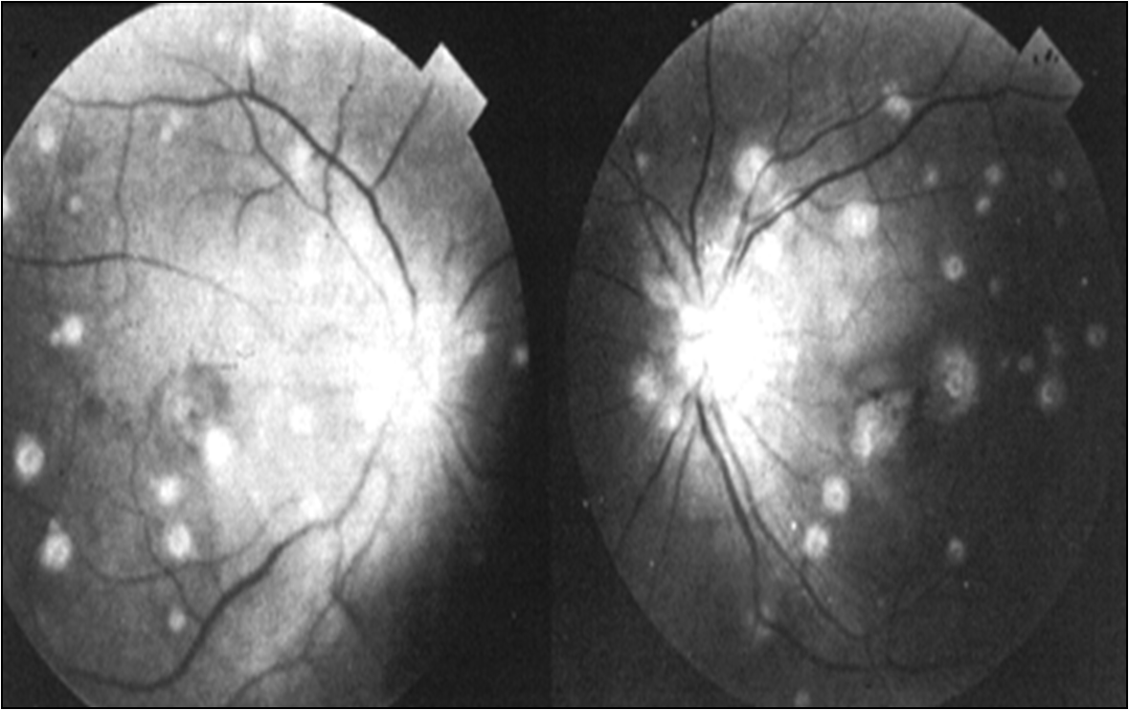
Choroidal tubercles

Slide 13
How to diagnose TB?
1-Chest x ray
2-Sputum examination for acid fast bacilli (sputum AFB TEST) Ziehl-Neelsen stain AND CULTURE
3-Tuberculin testingPurified protein derivative (PPD)
4-PCR test to detect TB
5-bronchoscopy

Slide 14
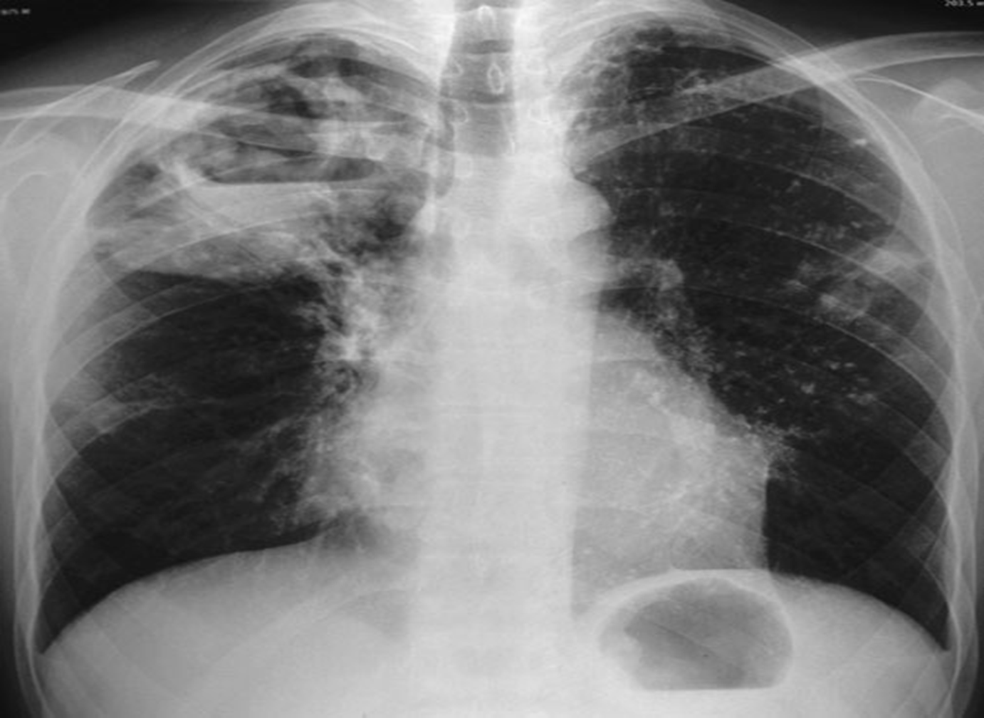
X ray apperance
shadows mainly in the upper zone
the presence of a cavity or cavities,
the +_ calcification.

Slide 15
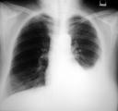
Tuberculous effusion

Slide 16
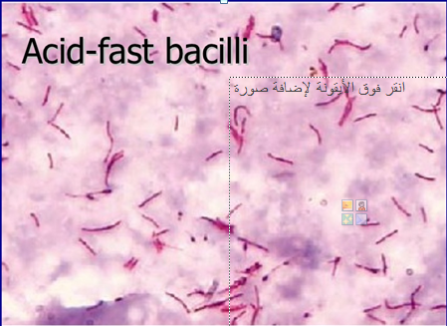

How we diagnose TB?
1)Sputum examination
Request sputum AFB
(ACID FAST BACILI)
Three morning soutum samples should be send to send to laboratory for AFB
DONE IN
Kwefia chest centr

Slide 17
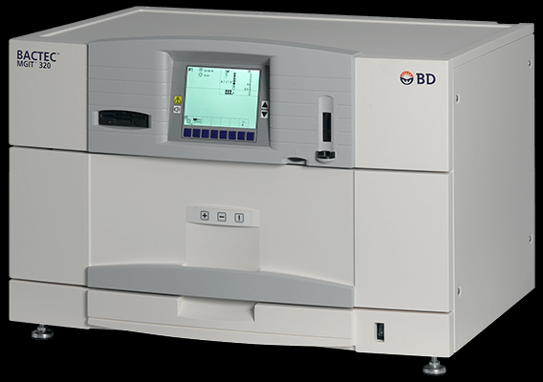
2)AFB culture
A)Löwenstein–Jensen medium, more commonly known as LJ medium, is a growth medium specially used for tb Result takes 6-8 weeks
B)BACTEC :automated mycobacterial detection system 7-10 days
3)PCR polymerase chain reaction test to detect TB in samples is better.

Slide 18
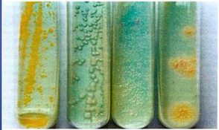
Mycobactrium culture
Culture & sensitivity:
Lowenstein-Jensen media takes 4-8 wks. to give +ve results

Slide 19
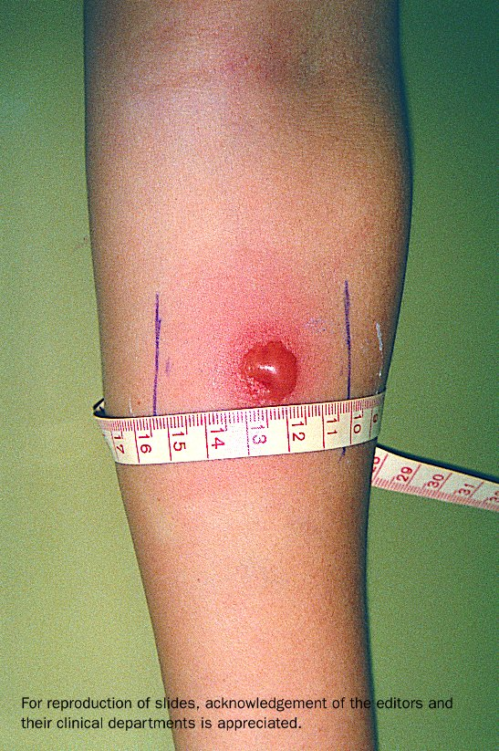
4)Tuberculin testing
Skin reaction after 48 hours of intradermal injection OF TUBERCULIN(contain very weak tb bacili (act as antigen)

Slide 20
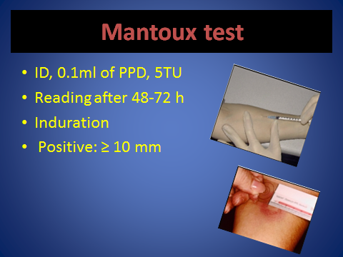
Tuberculin test =mantoux test
Id =intra dermal ppd purified protien dervavative from killedmycobactrial origin

Slide 21
How to read tuberculin test ?
A reaction of less than 5 mm is considered
negative
MORE THAN 10- mm is considered positive
5-9 mm is considered positive IN IMMUNE COMPROMIZED only

Slide 22
False positive & False-negative
Causes of False-negative Tuberculin skin test:
Miliary TB.
Immunocompromised pts. (HIV, Malnutrition, Malignancy)
Sarcoidosis.
15% of normal patients with TB.
Causes of False positive tuberculin skin test:-
Previously vaccinated.
Infection with atypical mycobacterium.

Slide 23
Diagnosis
According to the history, clinical signs, sputum afb and sputum culture of afb, tuberculin test and chest X-ray and some other examinations for other organs if involved.

Slide 24
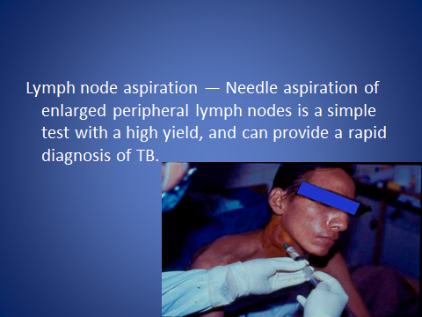

Slide 25
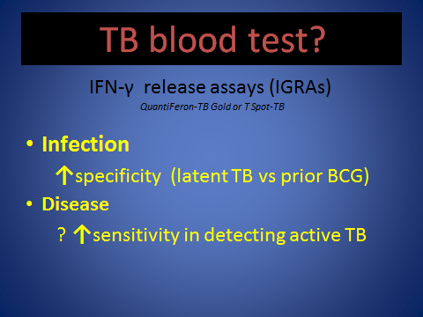

Slide 26
What are the complications of pulmonary tb?
Pneumothorax(air in pleural space)
Bronchiectasis,irrgular permanent dilation of bronchi
Tuberculous Empyema( TB pus in pleural space).
Extrapulmonary expansion to other organs.
Fibrosis.
Cor pulmonale( right heart failure due to chronic lung dis)

Slide 27
Prevention
Vaccination
BCG Vaccination can obtain immunity acquired for tubercle bacillus.
Vaccination target: infants children and youngster of tuberculin negative.

Slide 28
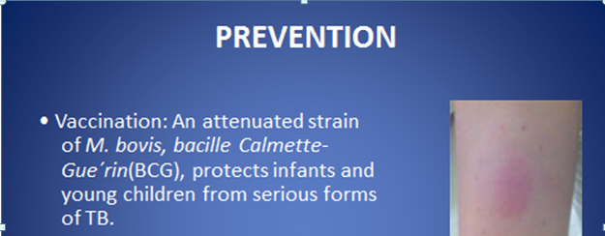

Slide 29
Prevention
Finding patients earlier(ISLOLATION+USE OF MASK DURING HIGH INFECTIVETY PEROID)
Treatment and management of patients
Prevention with medicine INH (isoniazid) IN CERTAIN SITUATIONS.

Slide 30
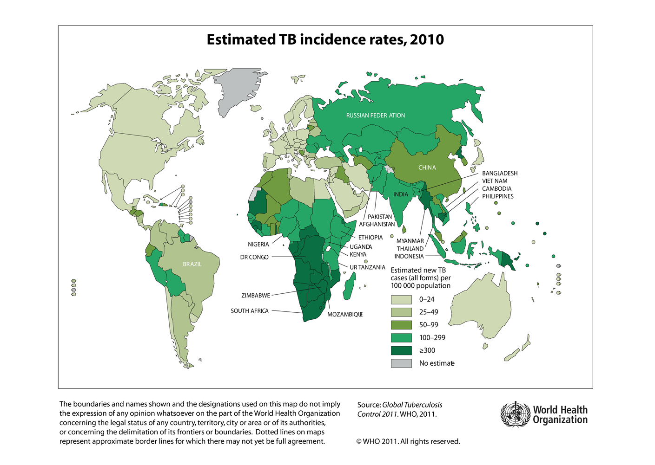

Slide 31
Therapy
Chemotherapy
Support therapy

Slide 32
Treatment
The most important is adopting the DOTS ( Directly Observed Treatment),
Isoniazid (INH)
Rifampicin (RIF)
Pyrazinamide (PZA)
Ethambutol
6 MONTHS REGIMENS
Rif +inh+pyrazinamide+ethambutol - 2months 4x2
then rif+inh-4 months2x4
.

Slide 33
Side effects of anti TB rx
Isoniazid hepatic enzyme elevation peripheral neuropathy -Pyridoxine may prevent peripheral neuropathy.
Pyrazinamide Hepatitis-hyperuricemia
Rifampin Hepatitis-Colors body fluids orange.
Ethambutol Optic neuritis- periodic tests of visual acuity and color vision.
Streptomycin Auditory and renal toxicity

Slide 34
Chemoprophylaxis for Asymptomatic TB infection
Recent tuberculin conversion
No previous BCG
Close contact to T.B patient
Rifampicin & Isoniazid for 3 months
or Isoniazid alone for 6 months

Slide 35
(Multidrug resistance (MDR-T.B
Resistant to isoniazid & rifampicin ..
Treated by second line drugs:
  Ciprofloxacin
  Streptomycin
Extensively drug resistant
No treatment options, it is fatal.

Slide 36
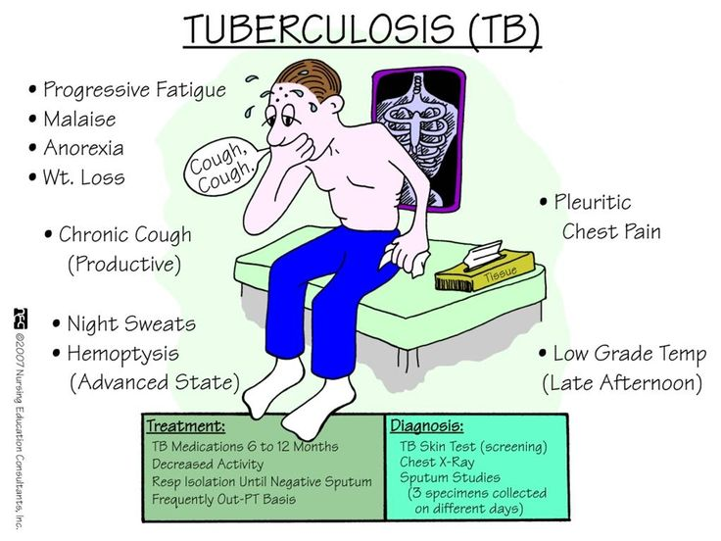

Slide 38
THANK U

