Slide 1
Ocular tumours
Dr. Raja S. Bengharbia

Slide 2
The conjunctiva

Slide 3
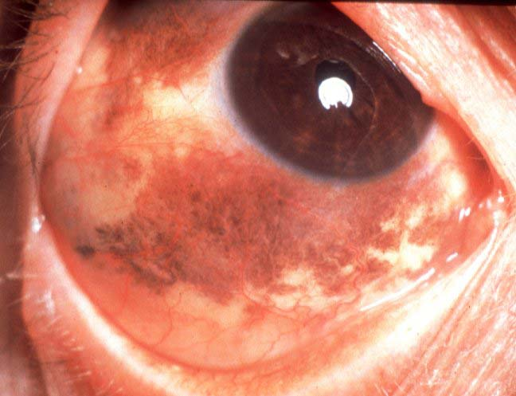
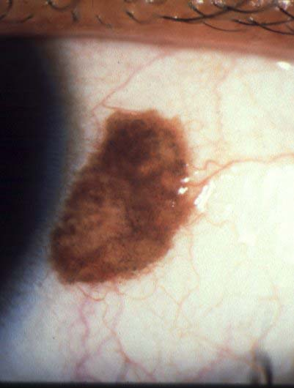
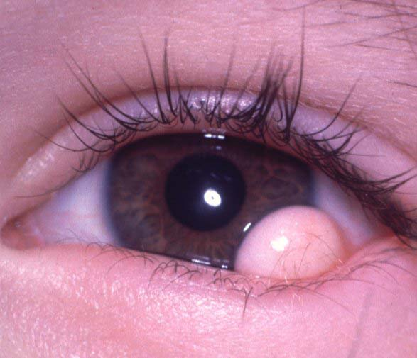
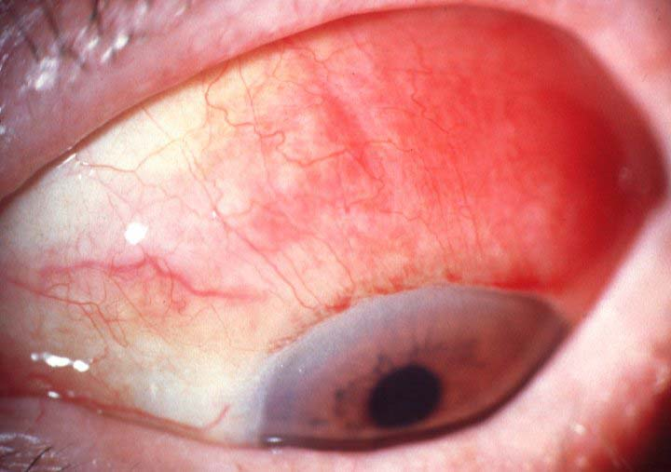
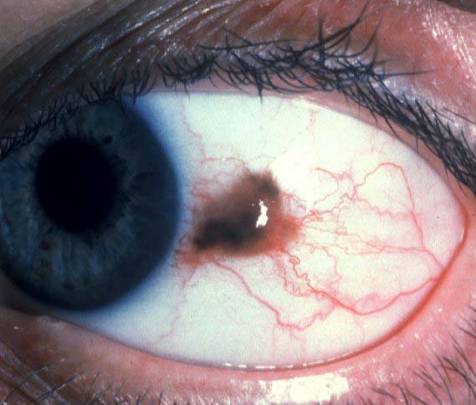

Slide 4
THE IRIS

Slide 5
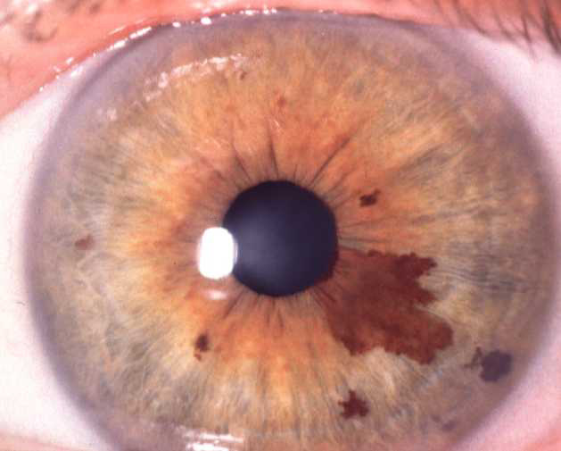
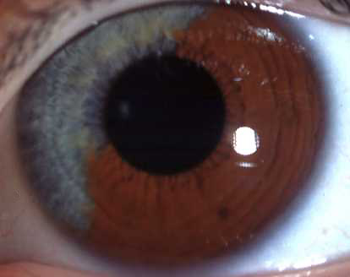
Iris naevus
Typical
Diffuse
Pigmented, flat or slightly elevated
Obscures iris crypts
Diameter usually less than 3 mm
May cause ipsilateral hyperchromic
heterochromia
Occasionally mild distortion of pupil and ectropion uvea
May be associated with Cogan-Reese syndrome

Slide 6
Lesions suggestive of melanoma:
-Ectropion uvea.
-Interinsic vessels
-Sectoreal lens opacity.
-Rapid growth.
-Old age with fair colour
-Glaucoma.

Slide 7
Iris Melanoma
1. Very rare - 3% of uveal melanomas
2. Presentation - fifth to sixth decades
3. Very slow growth
4. Low malignancy
5. Excellent prognosis

Slide 8
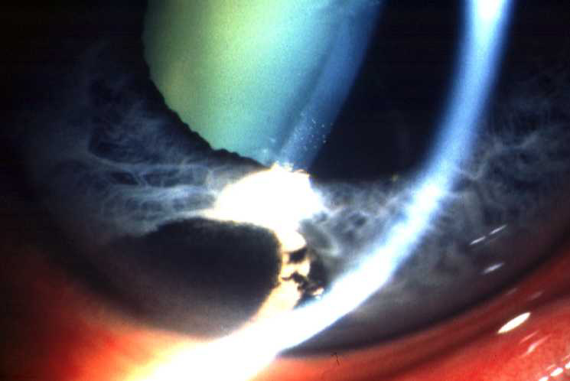
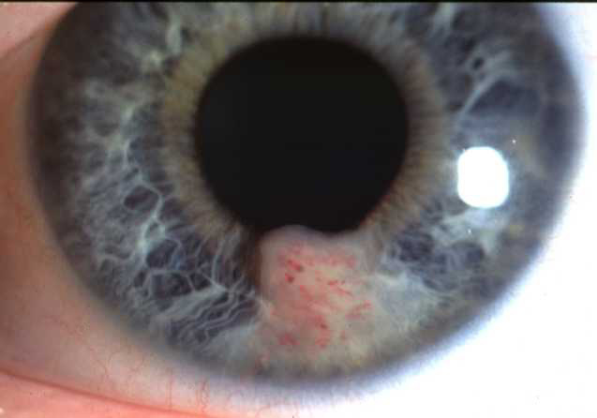
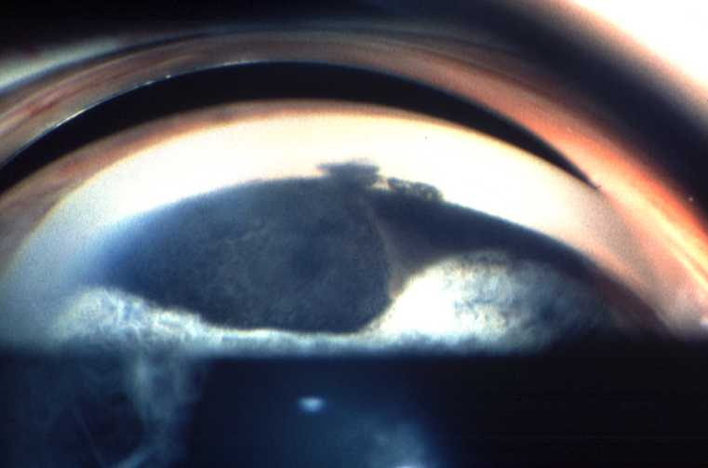
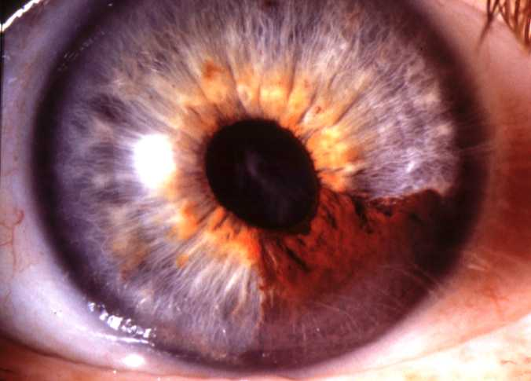
presentation
Usually pigmented nodule at
least 3 mm in diameter
Invariably in inferior half of iris
Occasionally non-pigmented
Surface vascularization
Angle involvement may cause glaucoma
Pupillary distortion, ectropion
uveae and cataract

Slide 9
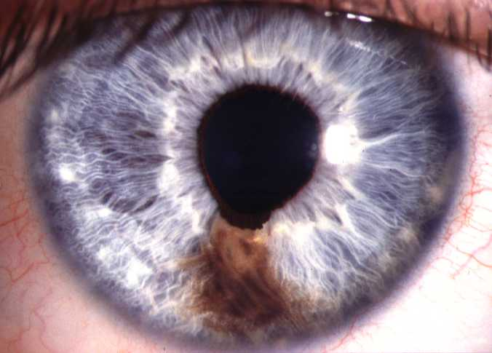
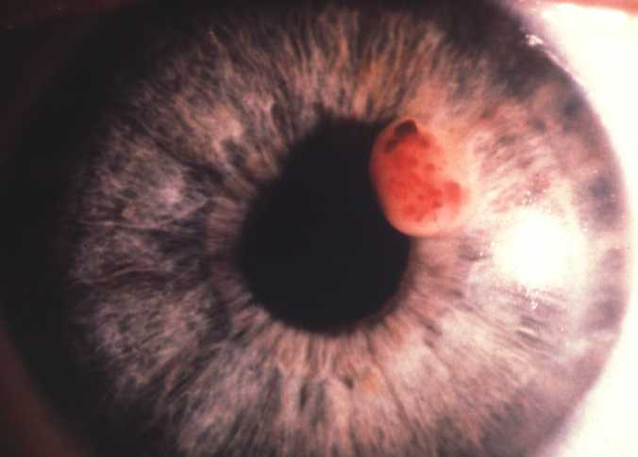
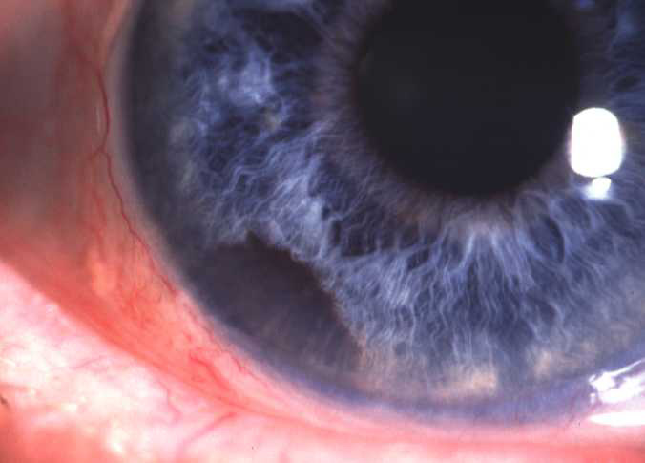
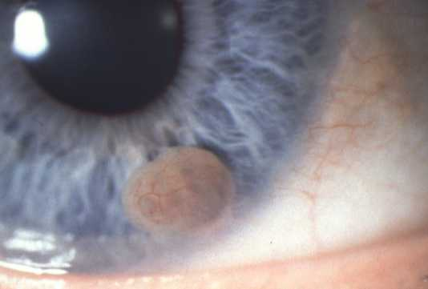
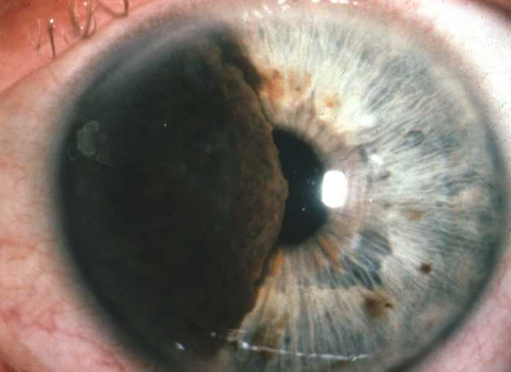
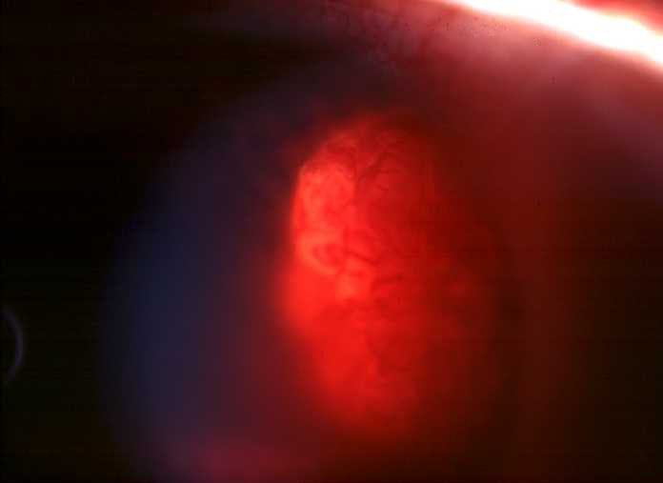
Differential diagnosis of iris melanoma
Large iris naevus distorting pupil
Leiomyoma
Adenoma of pigment
epithelium
Primary iris cyst
Ciliary body melanoma
eroding iris root
Metastasis to iris

Slide 10
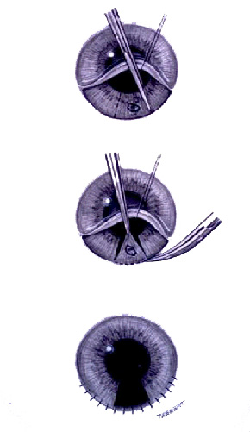
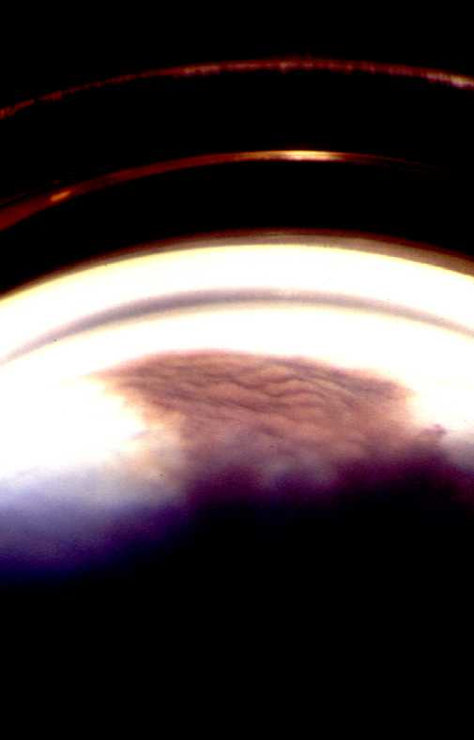
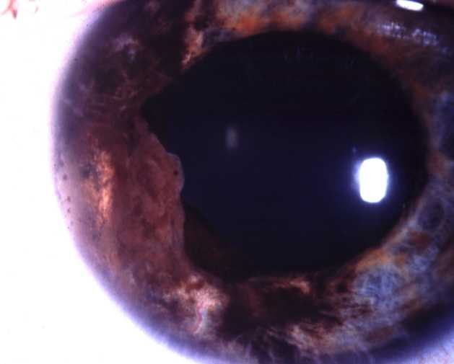
Treatment of iris melanoma
Small tumour
- broad iridectomy
Angle invasion by tumour
- iridocyclectomy
Non-resectable tumour
- radiotherapy or enucleation

Slide 11
CILIARY BODY TUMOUR

Slide 12
Ciliary body melanoma
Rare - 5% of uveal melanomas
Presentation - 6th decade
May be discovered by chance
Prognosis - guarded

Slide 13
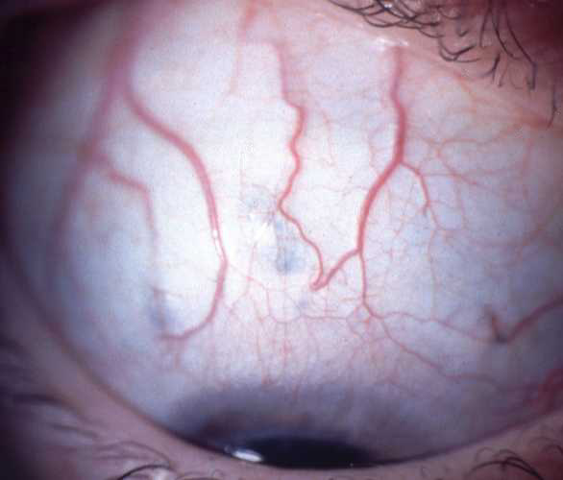
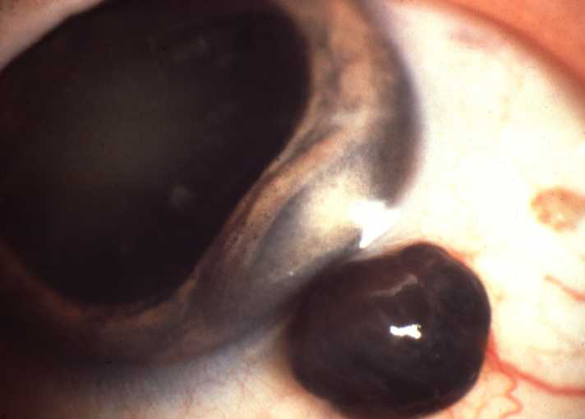
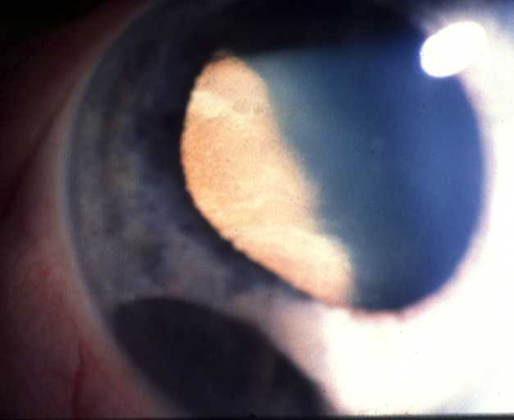
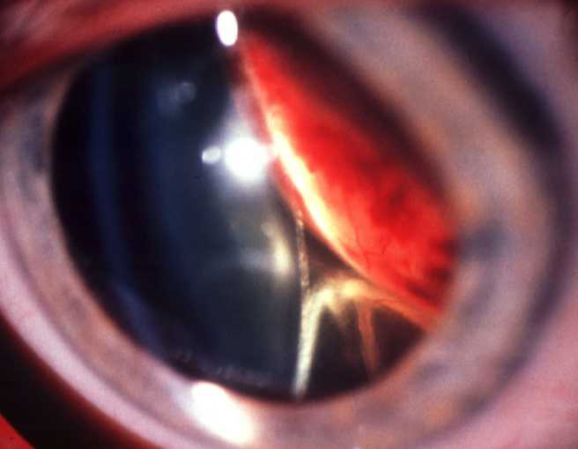
Signs of ciliary body melanoma
Sentinel vessels
Extraocular extension
Erosion through iris root
Lens subluxation or cataract, RD

Slide 14
Investigations:
1- triple mirror contact lens.
2-transillumination.
3-ultrasonography (US)
4-biopsy.

Slide 15
Treatment options of ciliary body melanoma
1. Iridocyclectomy
- small or medium tumours
2. Enucleation
- large tumours
3. Radiotherapy
- selected cases

Slide 16
TUMOUR OF THE CHOROID

Slide 17
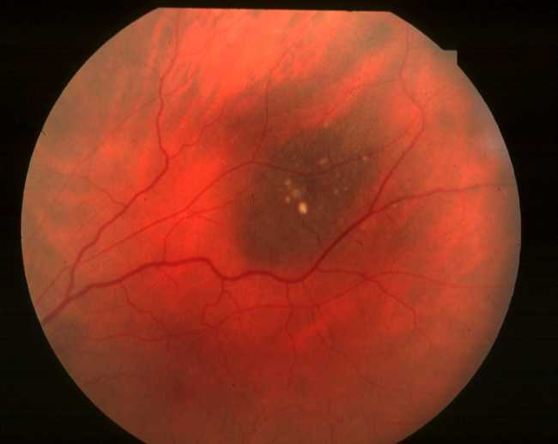
Typical choroidal naevus
-5-10% of caucasians
Round slate-grey with
indistinct margins
Associated with NF 1
Flat or slightly elevated
Diameter less than 5 mm
Location – usually at post. equatorial
Asymptomatic

Slide 18
Investigation:
-flourescein angiography: hypofluorescence
Iodocyanine green angiography
US..flat or slightly elevated lesion

Slide 19
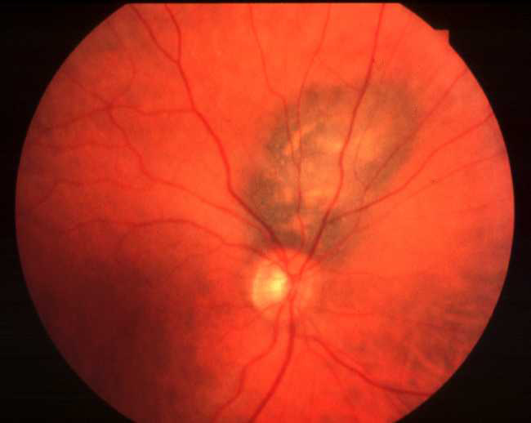
Suspicious choroidal naevus
Diameter more than 5 mm
Elevation 2 mm or more
Surface lipofuscin
Posterior margin within
3 mm of disc
May have symptoms due
to serous fluid

Slide 20
Choroidal melanoma
Most common primary intraocular tumour in adults
Most common uveal melanoma - 90% of uveal melanomas
Presentation - sixth decade
Prognosis - usually good

Slide 21
Clinical features:
1- asymptomatic for small size tumour
2-decrease V/A, metamorphopsia, visual field loss, floaters , photopsia

Slide 22
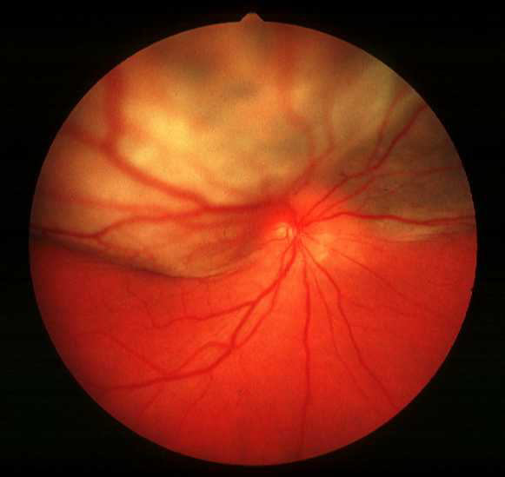
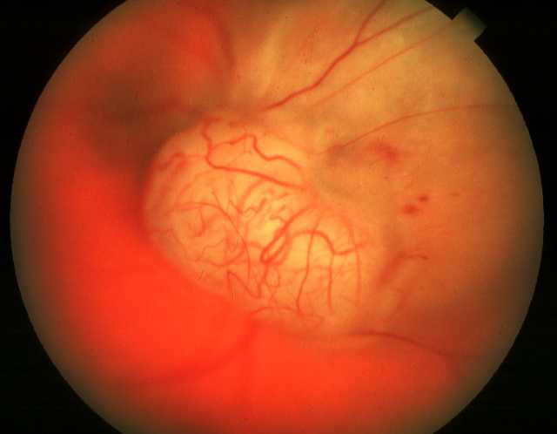
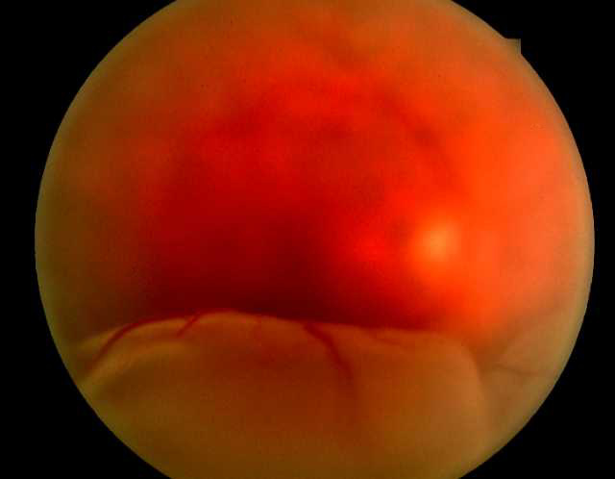
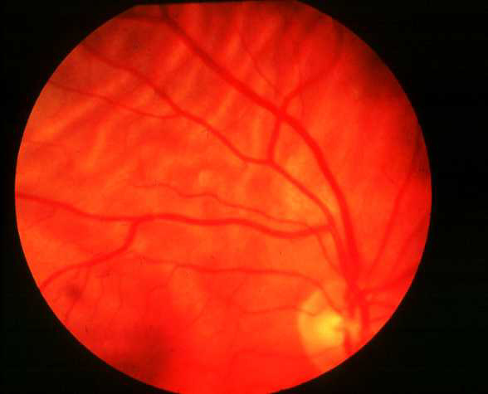
Brown, elevated, subretinal mass
Occasionally amelanotic
Double circulation
Secondary retinal detachment
Choroidal folds

Slide 23
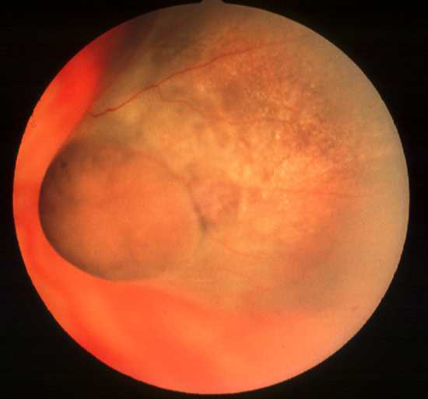
Surface orange pigment (lipofuscin) is common
Mushroom-shaped if breaks through Bruch’s membrane
Ultrasound - acoustic hollowness,
choroidal excavation and orbital
shadowing

Slide 24
Treatment of choroidal melanoma
1. Brachytherapy
- less than 10 mm elevation and 20 mm diameter
2. Charged particle irradiation
- if unsuitable for brachytherapy
3. Transpupillary thermotherapy
- selected small tumours
4. Trans-scleral local resection
و - carefully selected tumours less than 16 mm in diameter
5. Enucleation
- very large tumours, particularly if useful vision lost
6. Exenteration
- extraocular extension

Slide 25
Poor Prognostic Factors of Uveal Melanomas
1. Histological
Epithelioid cells
Closed vascular loops
Lymphocytic infiltration
2. Large size
3. Extrascleral extension
4. Anterior location
5. Age over 65 years

Slide 26
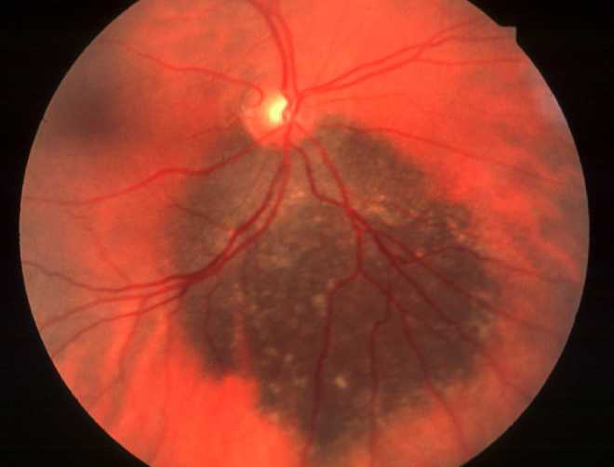
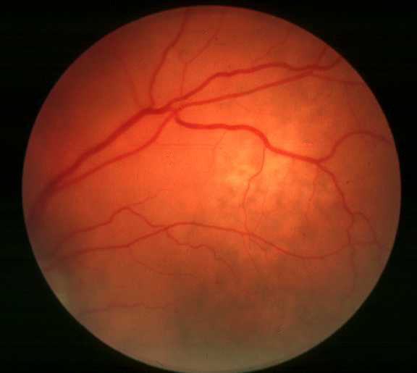
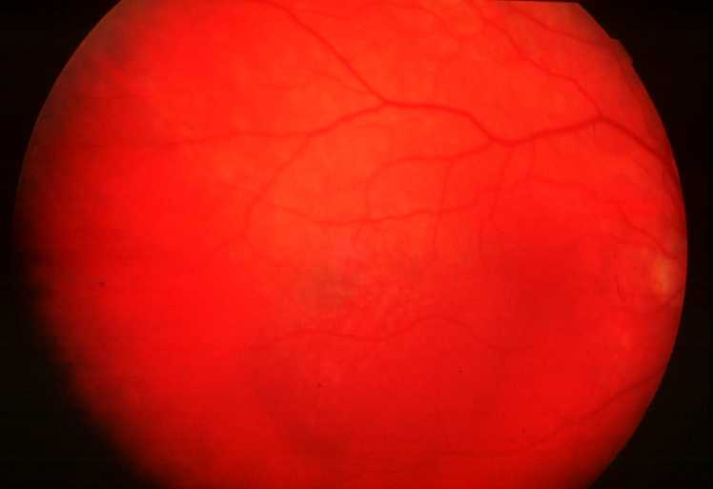
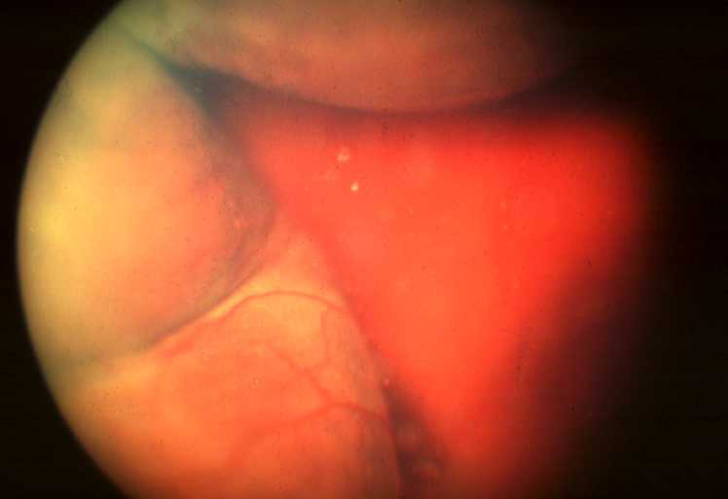
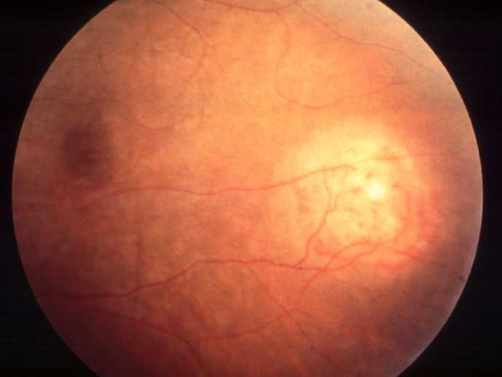
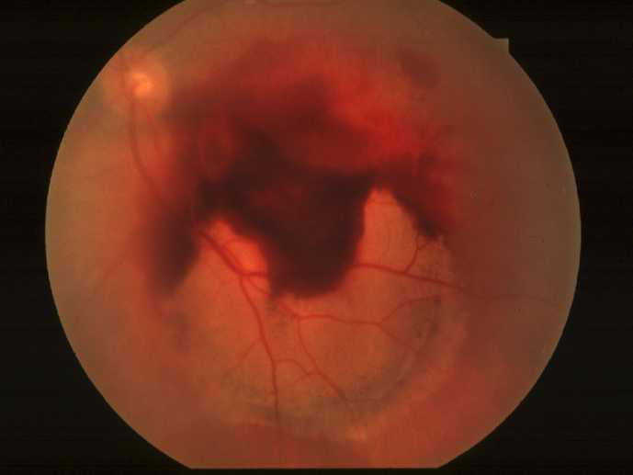
Differential diagnosis of choroidal melanoma
Large choroidal naevus
Metastatic tumour
Localized choroidal
haemangioma
Choroidal detachment
Choroidal granuloma
Dense sub-retinal or
sub-RPE haemorrhage

Slide 27
Choroidal haemangioma
1- circumscribed choroidal haemangioma
2-diffuse choroidal haemangioma

Slide 28
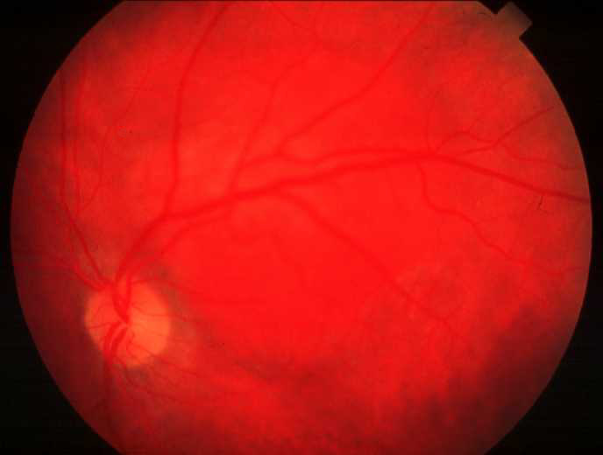
Circumscribed choroidalhaemangioma
Presentation - adult life
Dome-shaped or placoid,
red-orange mass
Commonly at posterior
pole
Between 3 and 9 mm in
diameter
May blanch with external
globe pressure
Surface cystoid retinal
degeneration
Exudative retinal
detachment
Treatment - radiotherapy
if vision threatened

Slide 29
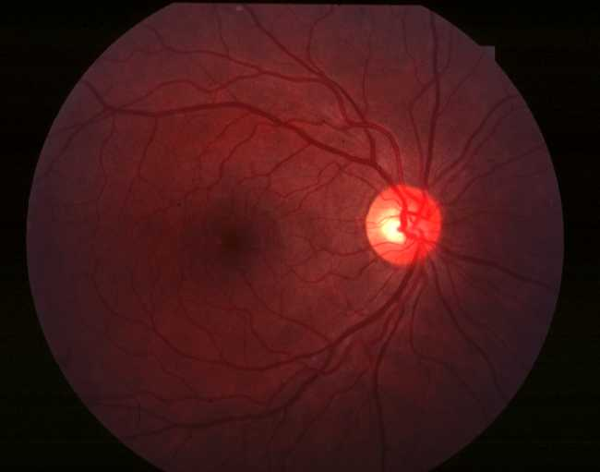
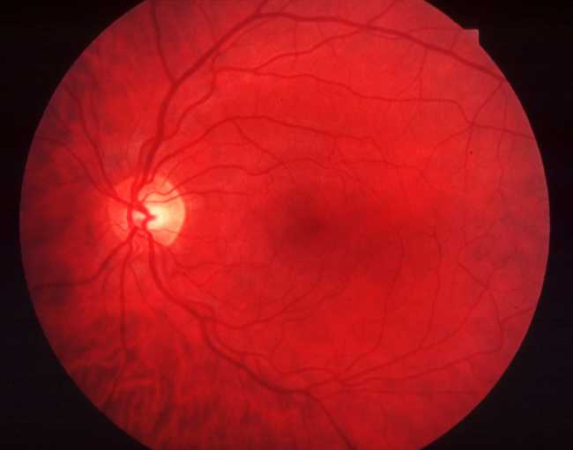
Diffuse choroidal haemangioma
Typically affects patients with Sturge-Weber syndrome
Can be missed unless compared with normal fellow eye as shown here
Diffuse thickening, most marked at posterior pole

Slide 30
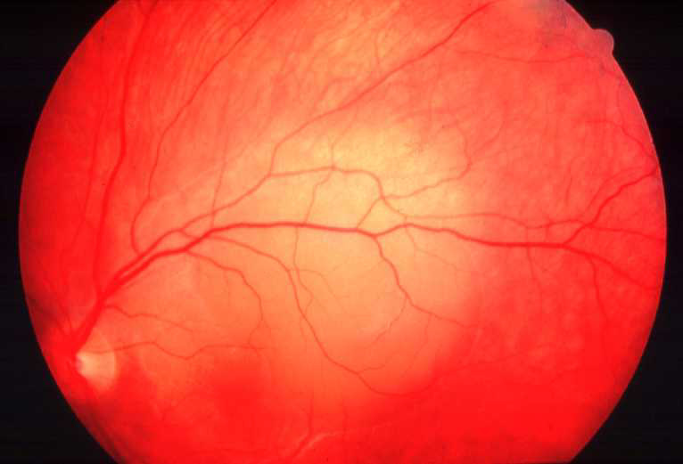
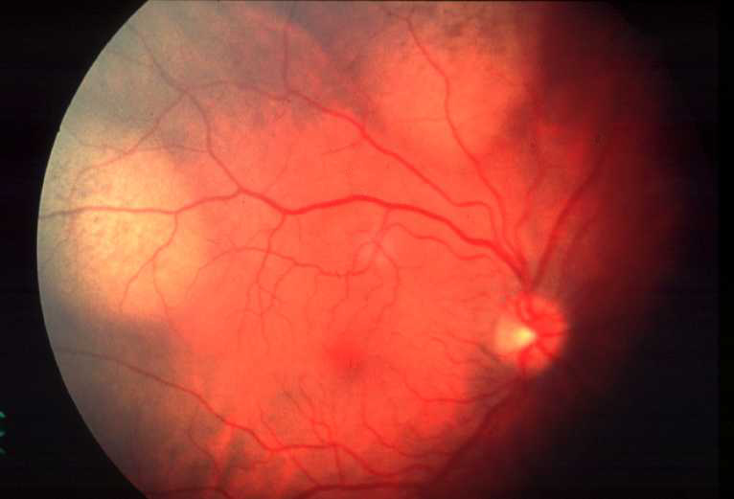
Choroidal metastatic carcinoma
Most frequent primary site is breast in women and bronchus in both sexes
Fast-growing, creamy-white,
placoid lesion
Deposits may be multiple
Most frequently at posterior pole
Bilateral in 10-30%

Slide 31
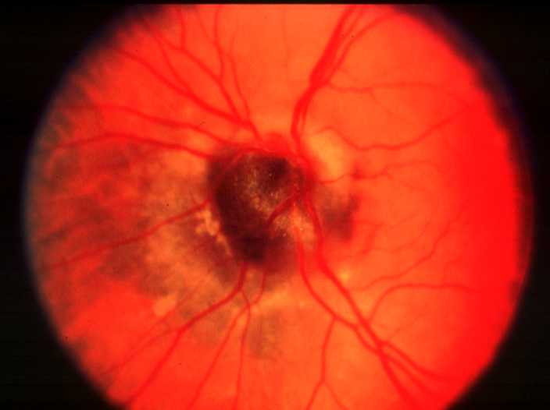
Melanocytoma
Affects dark skinned
individuals
Usually asymptomatic
Most frequently affects
optic nerve head
Black lesion with feathery
edges

Slide 32
TUMOURS OF THE RETINA

Slide 33
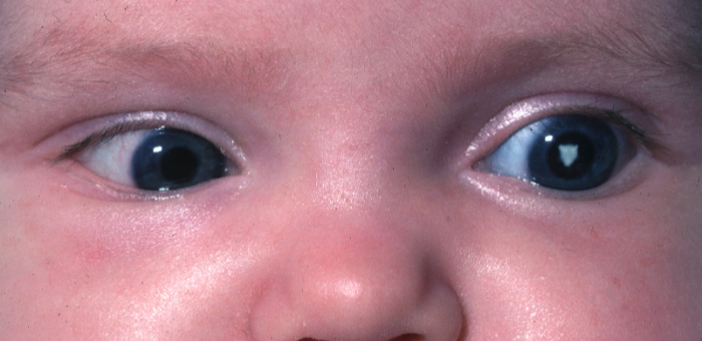
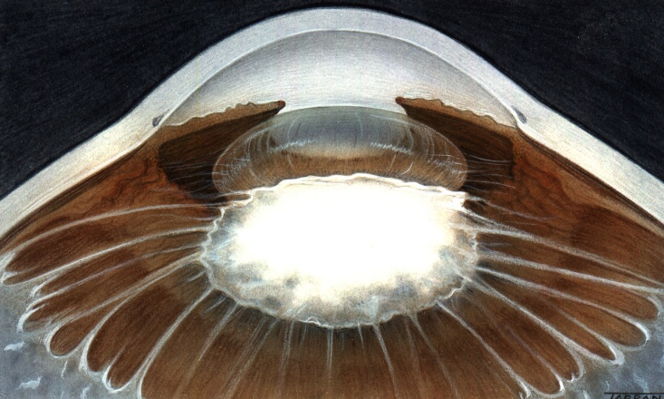
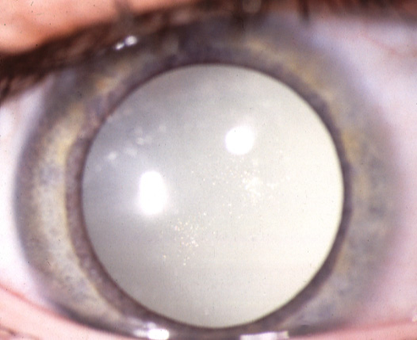
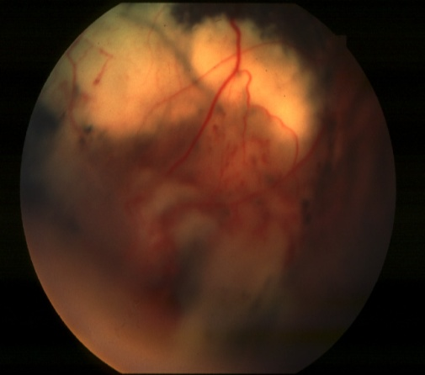
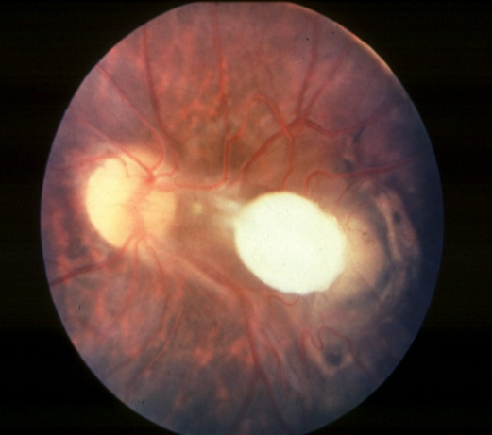
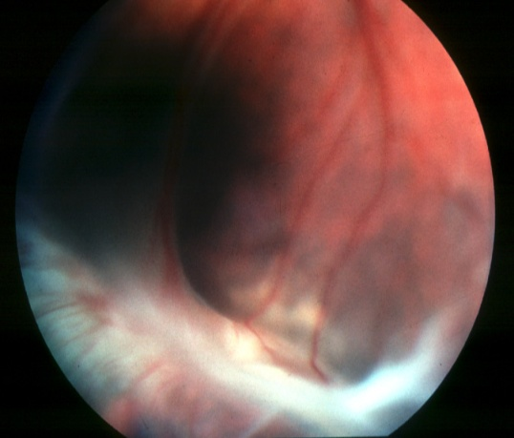
Differential diagnosis of leukocoria
Congenital cataract
Persistent hyperplastic
primary vitreous
Inflammatory cyclitic
membrane
Unilateral or bilateral
Unilateral
Unilateral or bilateral
Coats disease
Posterior pole toxocara
granuloma
Advanced retinopathy
of prematurity
Unilateral
Unilateral
Always bilateral but
may be asymmetrica

Slide 34
Retinoblastoma

Slide 35
1. Most common primary, malignant, intraocular tumour of childhood
2. No sexual predilection
3. Presents before age of 3 years (average 3 months )
4. Heritable (40%) or non-heritable (60%)
5. Predisposing gene (RPE 1) on 13q14
6- B/L in 25 % of cases .

Slide 36
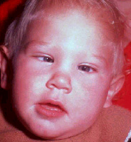





Presentations of retinoblastoma
Secondary glaucoma
Leukocoria - 60%
Strabismus - 20%
Anterior segment invasion
Orbital inflammation
Orbital invasion

Slide 37

Investigations:
US to detect calcification and to R/O other
cause (Coats disease )
MR to detect optic nerve involvement and extra-optic extension
CT

Slide 38




More advanced retinoblastoma
Friable white mass
Cottage cheese appearance
Fine surface blood vessels
Vitreous seedings

Slide 39


Multiglobulated white mass with
overlying retinal detachment
May be difficult to visualize through deep detachment

Slide 40
Treatment Options of Retinoblastoma
1. Small tumours
Laser photocoagulation
Transpupillary thermotherapy
Cryotherapy
2. Medium tumours
Brachytherapy
Chemotherapy
External beam radiotherapy
3. Large tumours
Chemotherapy followed by local treatment
Enucleation
4. Extraocular extension
External beam radiotherapy
5. Metastatic disease
Chemotherapy

Slide 41
Poor Prognostic Factors in Retinoblastoma
1. Optic nerve involvement
2. Choroidal invasion
3. Large tumour
4. Anterior location
5. Poor cellular differentiation
6. Older children

Slide 42
THANK YOU

