Slide 1


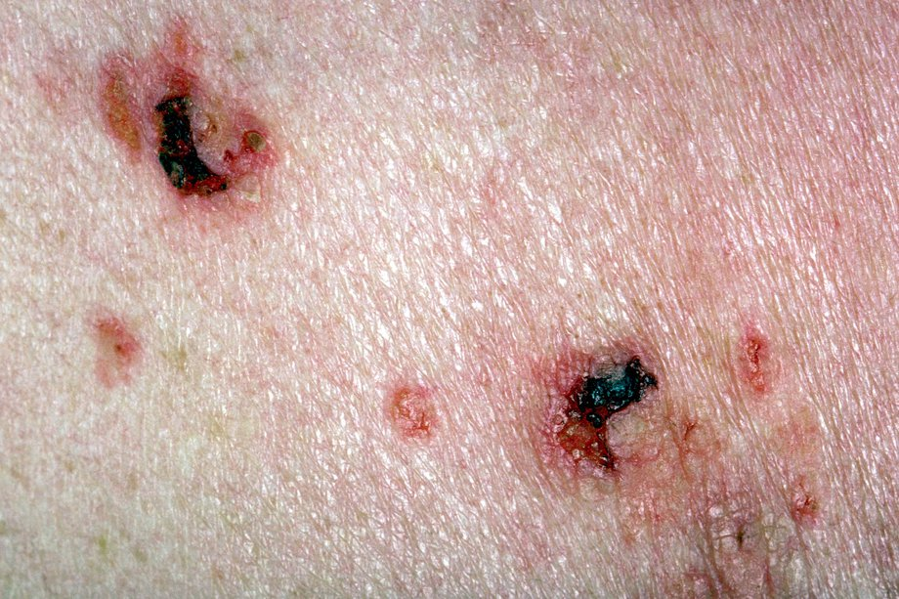
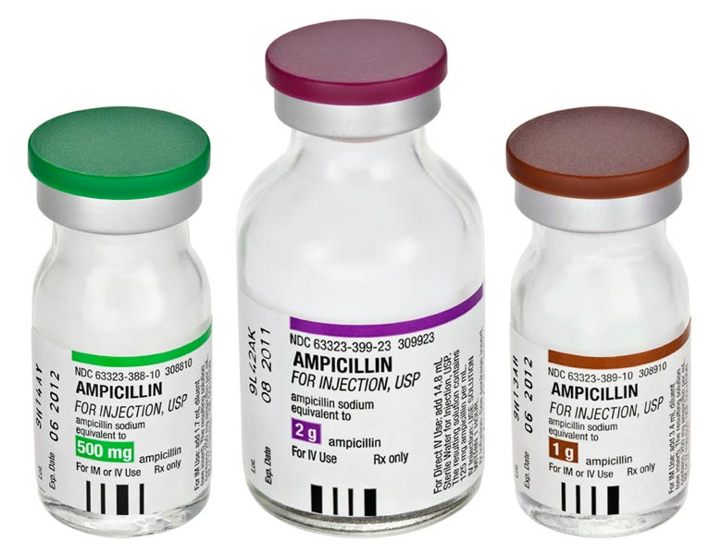
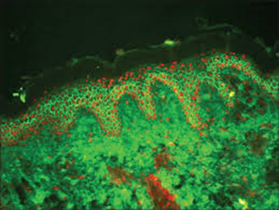
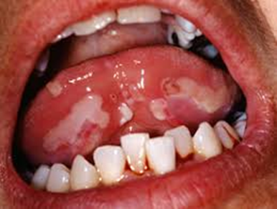
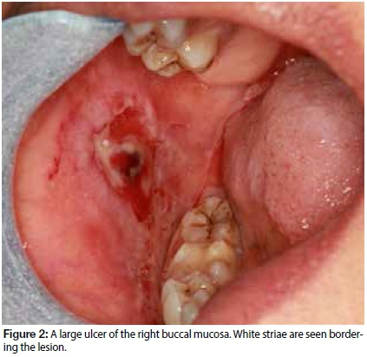
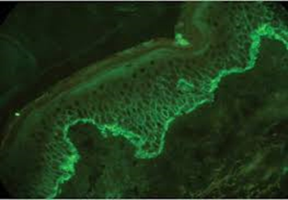
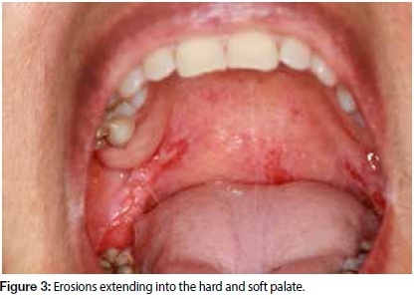
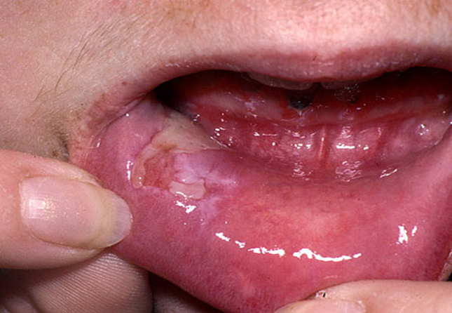
Pemphigus vulgaris
Mohammed Ahmed Shamsy 2nd year Dentistry
Faculty Of Basic Medical Science
Libyan International Medical University
Introduction
Risk Factors
Diagnosis
Treatment
Pemphigus vulgaris is an autoimmune disorder that involves blistering and erosion of the skin and mucous membranes. It occurs almost exclusively in middle-aged or older females. The primary lesion of pemphigus vulgaris is a soft blister filled with clear fluid that appears on healthy or irritated skin and mucous membranes.(1)
Genetic Factors : in particular alleles of human leukocyte antigen (HLA) DR4, appear to increase susceptibility to pemphigus vulgaris.
Disease Association: myasthenia gravis and thymoma(5)
The main diagnostic test is immunofluorescence (direct , indirect).
biopsy of lesion and surrounding normal skin.
enzyme-linked immunosorbent assay (ELISA).
Nikolsky`s sign: Upper layers of epidermis move laterally with slight pressure or rubbing of skin adjacent to a bulla.(4)(5)
Medications and therapies are used to decrease blister formation and promote healing of blisters and reduce scarring The most common first line therapy for pemphigus vulgaris is:
Steroids (Corticosteroids) oral or IV.
immunosuppressants.
plasma exchange or IV immune globulin (IVIG).(2)(4)
Clinical Features
Age 40-60 years approximately.
Rapid appearance of multiple large flaccid bullae.
Fragile, ruptures easily- painful hemorrhagic erosion.
Early lesion- watery fluid and later purulent or sanguineous fluid.(2)(3)
Figure 5: erosions on the skin.
Pathophysiology
References
In the case of pemphigus vulgaris, the immune system mistakenly produces antibodies against specific proteins in the skin and mucous membranes, known as desmogleins 1 and desmoglein 3 present in desmosomes. These proteins form the glue that keeps skin cells attached and the skin intact. When desmogleins are attacked, skin cells separate from each other and fluid can collect between the layers of skin, forming blisters that do not heal.(1)(3)
Figure 6: Indirect immunofluorescence.
inforBerman K. Pemphigus vulgaris. MedlinePlus. April 29, 2016.
Pemphigus Vulgaris, Familial. Online Mendelian Inheritance in Man (OMIM). 2012.
Zeina B. Pemphigus Vulgaris. Medscape Reference. June 14, 2018.
Kridin K. Emerging treatment options for the management of pemphigus vulgaris. Therapeutics and Clinical Risk Management. April 27, 2018; 14:757-778.
Pemphigus. National Institute of Arthritis and Musculoskeletal and Skin Diseases (NIAMS). 2015.
Figure 1: Confluence of bullae increases size and discomfort.
Figure 4: painful erosions in lower lip.
Figure 7: Direct immunofluorescence.

