Slide 1


Breast Caner
BY : Shahd Maria Alobedy
SN : 3643
PTS Course
1ST Year
Supervisor: dr. Fatima tarhuni
Date : 4/6/2022

Slide 2
Objective:
Introduction breast cancer.
Types of breast cancer .
Symptom of breast cancer.
Stages breast cancer .
Breast cancer cure rate.
2

Slide 3
Introduction
Breast cancer is a malignant cell growth in the breast if left untreated, the cancer spreads to other areas of the body excluding skin cancer breast cancer is the
(Most common type of cancer in women)
3

Slide 4
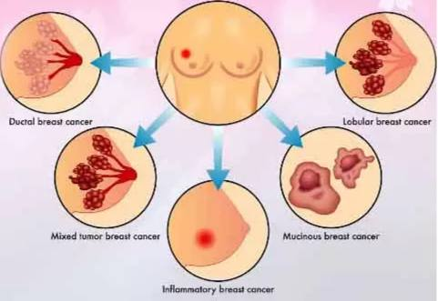
Types breast cancer
Angiosarcoma.
Ductal Carcinoma in Situ [DCIS]
Lobular Carcinoma in Situ [LCIS]
Invasive Lobular Cancer [ILC]
Inflammatory breast cancer [IBC]
Pagets Disease of the Breast .
Recurrent Breast Cancer.
4

Slide 5

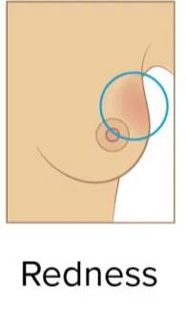
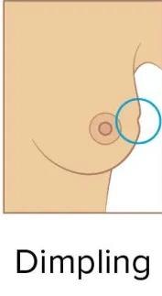
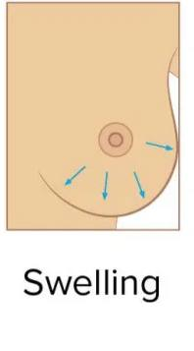
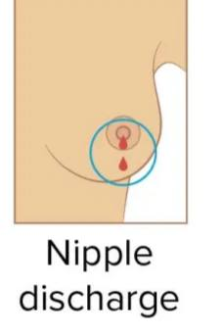
Symptom breast cancer
Swelling in the breast, upper chest or armpit.
A change to the skin, such as puckering
Rash or crusting around the nipple
Changes in size or shape of the breast
5

Slide 6
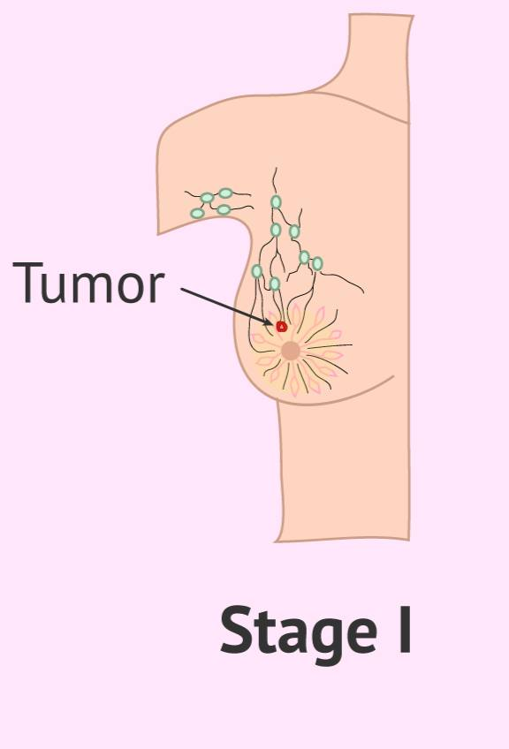
Stages breast cancer
Stages 0 :
describes disease that is only in the ducts of the breast tissue and has not spread to the surrounding tissue of the breast.
Stages I: the tumor is small, invasive, and has not spread to the lymph nodes.
6

Slide 7
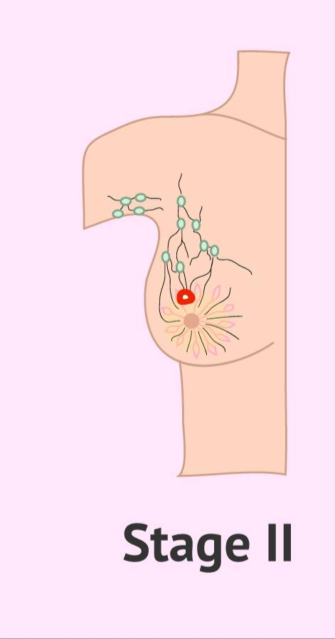
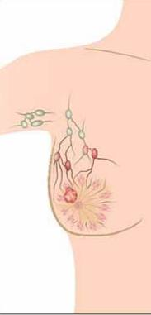
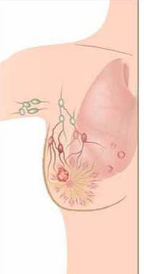
Stage II: Cancer has spread to the lymph nodes and the cancer in the lymph node is larger than 0.2 mm but less than 2 mm in size.
Stage III : There is no evidence of a tumor in the breast, but the cancer has spread to 1 to3 axillary lymph nodes. It has not spread to distant parts of the body.
Stage IV:
breast cancer, meaning that the cancer has spread from its site of origin in the breast to other parts of the body, the most common being the brain, lung, bone, and liver.
7

Slide 8

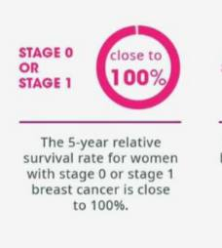
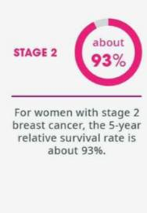
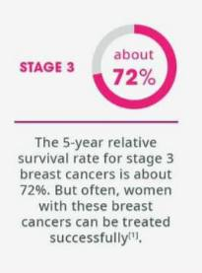
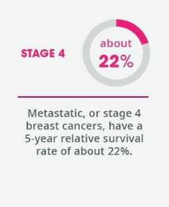
Breast cancer cure rate
8
1American Cancer Society.December20,2017.https>/www.cancer.orq/cancer/breast-cancer/understandinq-a-breast-cancer-diagnosis/breast-cancer-surviva/fates.huni
8

Slide 9


Conclusion
9
Today we told the breast cancer and we know its symptoms and signs.
The main goal of the presentation is to spread awareness among women of the importance of early and periodic detection to preserve half of society.

Slide 10
References
CEDOLINI, Carla, et al. Type of breast cancer diagnosis, screening, and survival. Clinical breast cancer, 2014, 14.4: 235-240.‏
Barlow, William E., et al. "Performance of diagnostic mammography for women with signs or symptoms of breast cancer." Journal of the National Cancer Institute 94.15 (2002): 1151-1159.‏
Sharma, Ganesh N., et al. "Various types and management of breast cancer: an overview." Journal of advanced pharmaceutical technology & research 1.2 (2010): 109.‏
INGVARSSON, Sigurdur. Breast cancer: introduction. In: seminars in CANCER BIOLOGY. Academic Press, 2001. p. 323-326.‏
Rahimzadeh, M., Baghestani, A. R., Gohari, M. R., & Pourhoseingholi, M. A. (2014). Estimation of the cure rate in Iranian breast cancer patients. Asian Pacific journal of cancer prevention, 15(12), 4839-4842.‏

Slide 11
Thanks you.

