Slide 1


Libyan International Medical University
Faculty of Business Administration
The Major Factors That Influence Business Buying Behavior
Name : Shatha wail elwerfalli
ID number : 3299
Email : shatha_3299@limu.edu.ly
Date : 18th / April / 2022

Slide 2
Objectives :
Get to know what are The Major Factors That Influence Business Buyer Behavior.
Understand and gain more knowledge about them .
1

Slide 3
Table of Contents
What’s Business Buyer Behavior
What are The Major Factors That Influence Business Buyer Behavior
Examples
Conclusion
Reference
2

Slide 4
Business Buyer Behavior :
It’s the buying behaviour of organizations that buy goods and services for use in the production of other products and services that are sold, rented or supplied to other.
3

Slide 5
What are The Major Factors That Influence Business Buyer Behavior:
Environmental Factors
Organizational Factors
Interpersonal Factors
Individual Factors
4

Slide 6





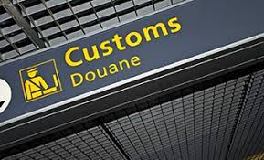

Supply
Environmental
Economy
Competitions
Technology
5

Slide 7





Organizational
Structure
Procedures
System
6

Slide 8



Interpersonal
Influence
Authority
7

Slide 9






Individual
age
Job Position
Buying style
Personality
8

Slide 10
Conclusion
There are alot of factors that can influence a Business Buyer Behavior , and businesses are confronted with ethical decision making every day, and business leaders and managers need to reinforce the importance of using ethics as a guiding force when conducting business.
9

Slide 11
References
Techthug99. (2021, August 8). Business buyer behaviour - type, process, factors, roles. Geek Tonight. Retrieved April 18, 2022
Boundless. (n.d.). Boundless marketing. Lumen. Retrieved April 18, 2022
10

Slide 12


