Slide 1


Libyan International
Medical University
Faculty of
Business Administration
The Effect of Consumer Behavior on The Marketing Concept
Prepared and presented by:
Alaa S Rashwan 3313
Heba N Bushiha 3285
Fatima A Eldukaly 3163
Hajer K Elsaaiti 3178
Notes:
Download more minimal templates here: https://crmrkt.com/GK9Dwa

Slide 2
Introduction
01
Factors of Consumer Behaviour
TABLE OF CONTENTS
02
What is Marketing Concept?
03
04
05
2
Conclusion
References

Slide 3

3
Introduction
Consumer behavior shows how consumers make decisions about what to buy, when to buy it, and how to do so. As well as purchasing behavior, it also involves how consumers think about numerous brands, how they choose between them.
Hajer Elsaaiti

Slide 4
Factors of Consumer Behaviour
4
Cultural Factors
Social Factors
Is when a person get influenced by people around them and try to copy them in order to be accepted in a specific society , Some of the social factors are family, reference group and roles and status.
Is a set of values and perceptions a specific group of people has in a particular community and have a strong influence on consumer buying behavior.
Heba Bushiha
Notes:
Download more minimal templates here: https://crmrkt.com/GK9Dwa

Slide 5
Factors of Consumer Behaviour
5
Personal Factors
Economic Factors
Are factors that are different from a person to another,each person would have factors that are different from others such as age, income , occupation and lifestyle .
Are the factors that the buying behaviour depends on the personal saving , income, and liquidity.
It can also be affected by the economy of the nation.
Fatima Eldukaly
Notes:
Download more minimal templates here: https://crmrkt.com/GK9Dwa

Slide 6
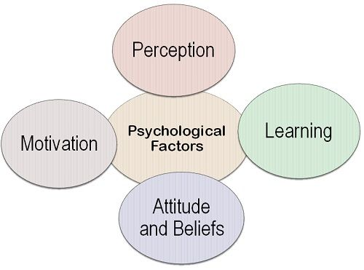
Factors of Consumer Behaviour
6
Psychological Factors
Human psychology is a major determinant of consumer behavior. These factors are difficult to measure but are powerful enough to influence a buying decision.
Some of the important psychological factors are: Motivation, Perception, Learning , attitudes and beliefs.
Alaa Rashwan

Slide 7

What is Marketing Concept?
7
Is the collection of marketing data to focus on the consumer needs and wants and then develop a marketing strategy to satisfy their needs and wants.
Hajer Elsaaiti

Slide 8
Product Concept
7
8
Production Concept
Is the idea that consumers will buy the product that has high quality and performance and it would be better for them if the product is innovative.
The marketing strategy starts with production because consumers will buy the product that is cheap and available at the same time has good quality .
Heba Bushiha

Slide 9
9
Selling Concept
Marketing Concept
Is the concept of competition and its goal to put the brand and the product ahead of competitors.
Marketing concepts have direct influence on the consumers buying behaviour.
Is the idea that consumers will not buy the product until the company show them the benefits of the product and persuade them to buy it .
Alaa Rashwan
Notes:
Download more minimal templates here: https://crmrkt.com/GK9Dwa

Slide 10

Conclusion
10
In conclusion, the consumer buying behaviour get effected by some factors that will differs the buying behaviour of consumers.
Marketers should study the consumer behaviour in order to choose their marketing concept.
Marketing concept has a direct influence on consumer buying behaviour.
Fatima Eldukaly

Slide 11
REFERNCES
“What Does Consumer Behavior Mean for Marketing?” Www.appier.com, www.appier.com/en/blog/what-does-consumer-behavior-mean-for-marketing.
“What Are the 5 Factors Influencing Consumer Behavior? - Clootrack.” Www.clootrack.com, www.clootrack.com/knowledge_base/major-factors-influencing-consumer-behavior#:~:text=Cultural%20Factors%20have%20a%20strong.
‌

Slide 12
THANK YOU
Notes:
Download more minimal templates here: https://crmrkt.com/GK9Dwa

