Slide 1


COVID 19 & Dentistry
Presented by : Jannat Kamal Bala
Student number : 3556
Block : PTS
Date : 6/6/2022

Slide 2
Objectives:
1. Outline the transmission of COVID-19.
2.Discuss the prevention steps of COVID-19.
3. List the Prevention steps that followed by dental clinics during COVID-19 pandemic.

Slide 3
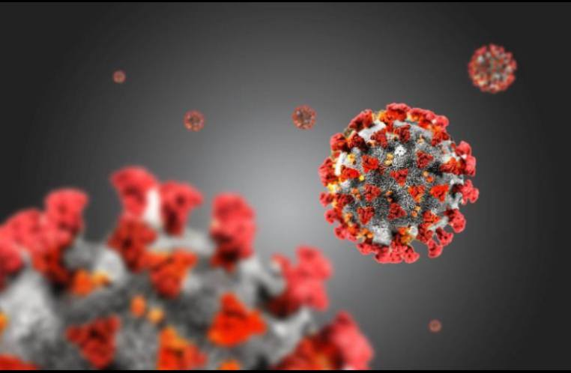
COVID-19
Coronavirus disease 2019 (COVID-19) was first detected in China in December, 2019, and declared as a pandemic by the World Health Organization (WHO) on March 11, 2020.
Since then, the virus has spread all over the world, and as of 20 May 2020, it has infected 4,806,299 people, and caused 318,599 deaths
The current management of COVID-19 is based generally on supportive therapy and treatment to prevent respiratory failure.
The effective option of antiviral therapy and vaccination are currently under evaluation and development.

Slide 4

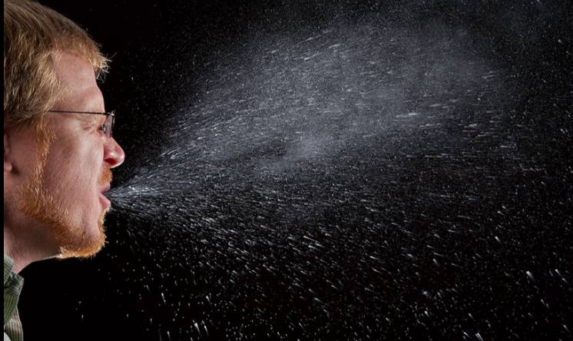
Transmission of COVID-19
SARS-CoV-2 can spread through both direct means droplet and human-to-human transmission.

Slide 5
Or by indirect contact (contaminated objects and airborne contagion).

Slide 6
Prevention from COVID-19
Staying at home
avoiding any direct contact
avoiding nonessential travel.
observing social distancing rules.
avoiding shaking hands when meet others.
frequently washing hands with soap and water or hand sanitizer .
disinfecting surfaces using household sprays or wipes
avoiding touching eyes, nose, and mouth with unwashed hands

Slide 7
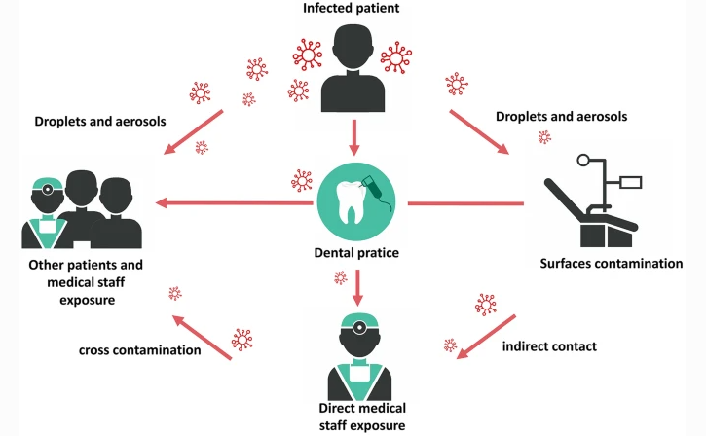
Prevention steps that followed by dental clinics during COVID-19 pandemic

Slide 8
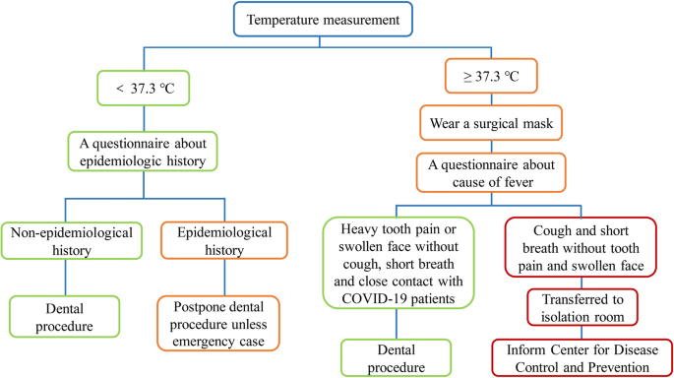
Prevention steps that followed by dental clinics during COVID-19 pandemic

Slide 9
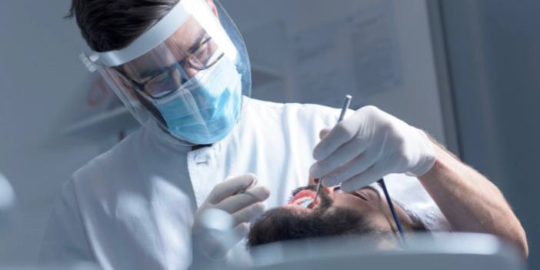
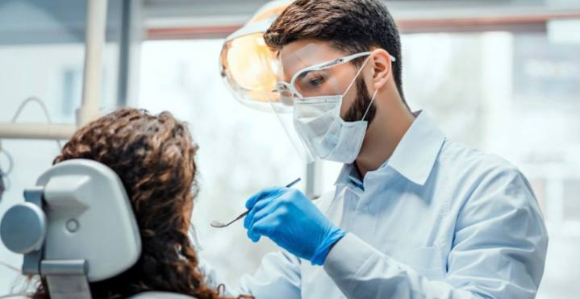

Slide 10
Conclusion
The coronavirus disease continues to spread across the world following a trajectory that is difficult to predict.
Dental clinics have made full preparations in terms of ensuring the safety of patients, doctors and nurses during COVID-19 pandemic.

Slide 11
Reference
Sharma A, Ahmad Farouk I, Lal SK. COVID-19: A Review on the Novel Coronavirus Disease Habas K, Nganwuchu C, Shahzad F, Gopalan R, Haque M, Rahman S, Majumder AA, Nasim T. Resolution of coronavirus disease 2019 (COVID-19). Expert Rev Anti Infect Ther. 2020 Dec;18(12):1201-1211. doi: 10.1080/14787210.2020.1797487. Epub 2020 Aug 4. PMID: 32749914.
Evolution, Transmission, Detection, Control and Prevention. Viruses. 2021;13(2):202. Published 2021 Jan 29. doi:10.3390/v13020202
Wolf TG, de Col L, Banihashem Rad SA, Castiglia P, Arghittu A, Cannavale M, Campus G. How the COVID-19 Pandemic Affects Risk Awareness in Dentists: A Scoping Review. Int J Environ Res Public Health. 2022 Apr 20;19(9):4971. doi: 10.3390/ijerph19094971. PMID: 35564366; PMCID: PMC9103177.

Slide 12


