Slide 1


Non-verbal messages
Libyan International Medical University
Faculty Of Business Administration
The principals the govern:
BY: AishA elshaare
Id: 2869
E-mail:aisha_2869@limu.edu.ly
Dec 3rd, 2020

Slide 2
Content
What is body language?
The importance of nonverbal communication.
Types of nonverbal communication.
How to improve nonverbal communication?
Conclusion.
Reference.

Slide 3

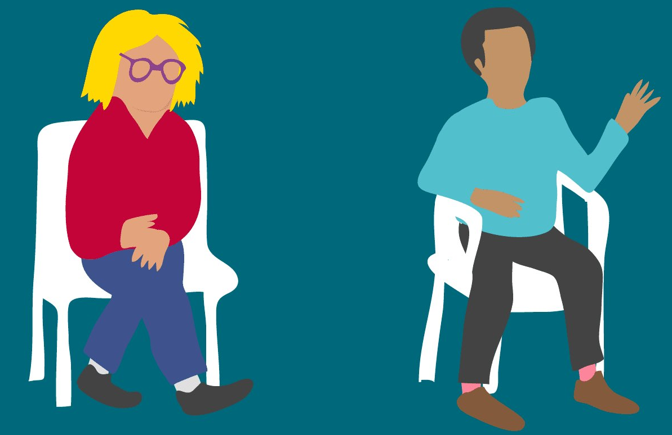
What is body language?
Body language is the use of physical behavior, expressions, and mannerisms to communicate nonverbally, often done instinctively rather than consciously.

Slide 4

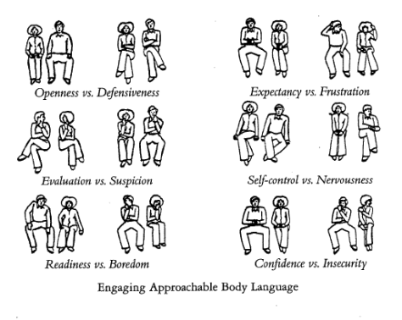
Nonverbal communication
Why is it so important?
It plays five roles:
Repetition
Contradiction
Substitution
Complimenting
Accenting

Slide 5

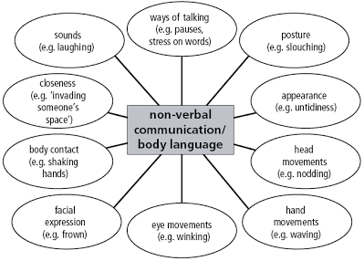
Types of nonverbal communication:
Facial expressions
Body movement and posture
Gestures
Eye contact
Touch
Space
Voice

Slide 6

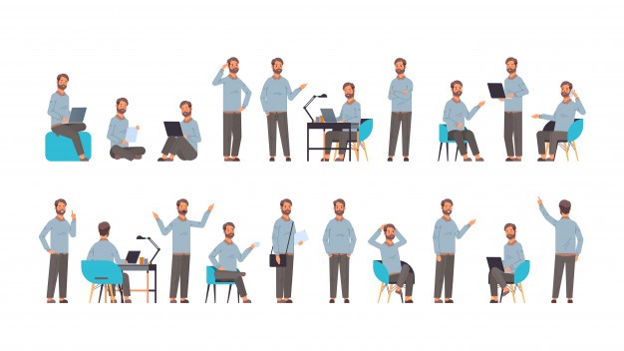
How to improve it?
Learn to manage stress in the moment
develop your Emotional awareness

Slide 7

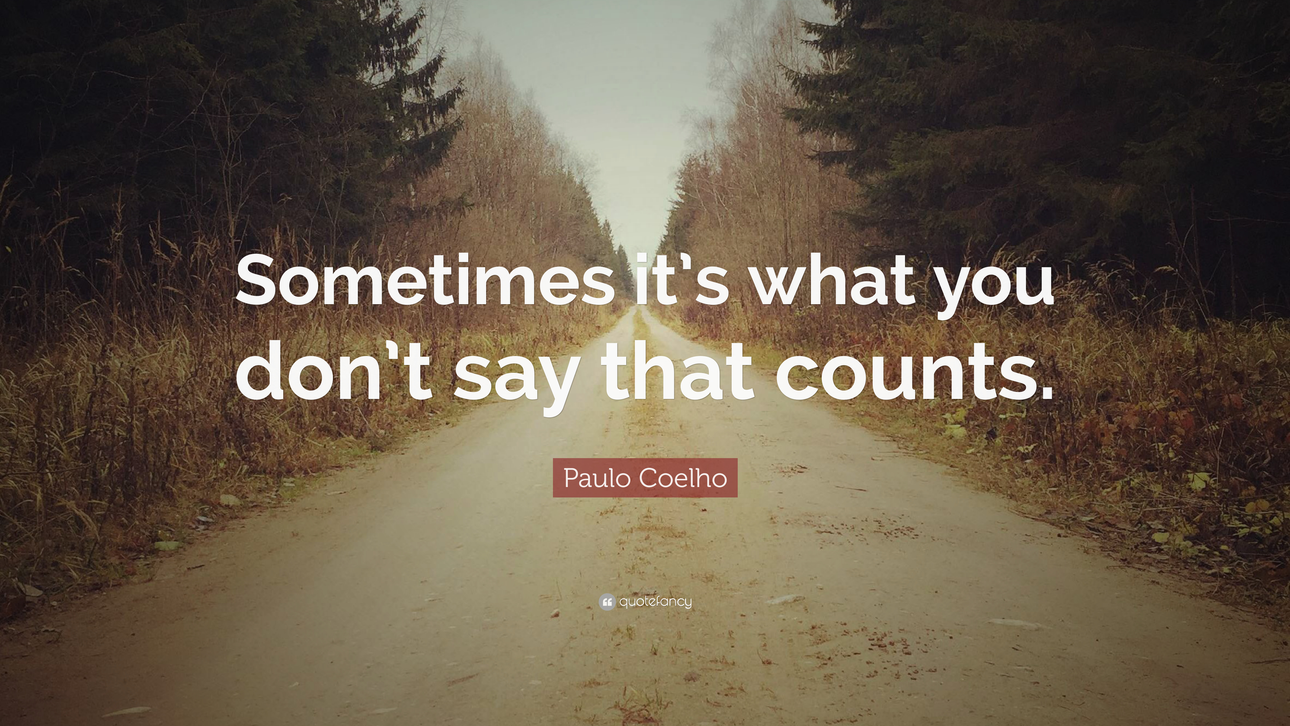
conclusion
While the key to personal and professional success lies in your ability to communicate well, its not only the words you choose but the body gestures you adopt.

Slide 8
Reference
Jeanne,s. Ph.D., Melinda Smith, M.A., Lawrence,r. and Greg Boose. Retrieved from https://www.helpguide.org
The Importance of Effective Communication, Edward G. Wertheim, Ph.D. Retrieved from https://www.helpguide.org

Slide 9

:)

