Slide 1


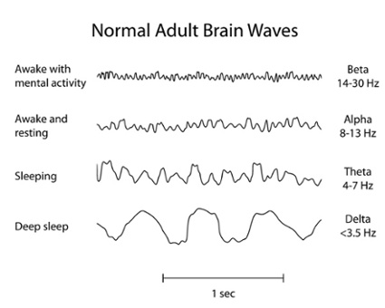
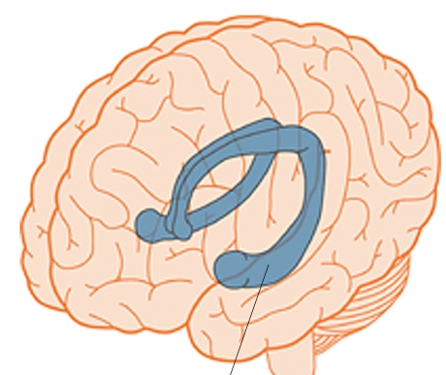
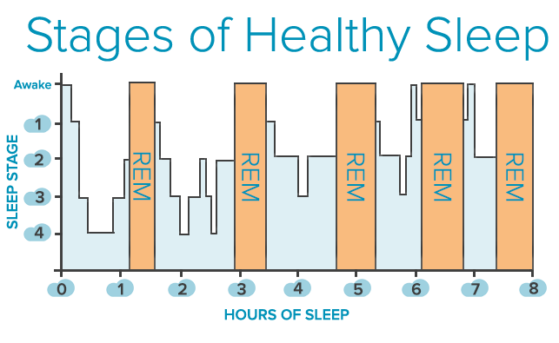
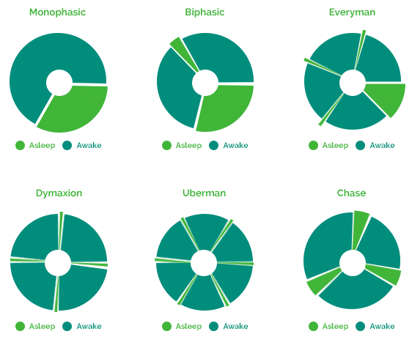
24 Hours a Day is Always Enough
The Effect of Polyphasic Sleep Pattern On Lifestyle
Ghada Suliman Elshatiti 1126 l 5th Year Faculty of medicine
Libyan International Medical University
Introduction
Discussion
sleep cycle lasts about 90 minutes and during that time we move through five stages of sleep. The first four stages make up our non-rapid eye movement (NREM) sleep, and the fifth stage is when rapid eye movement (REM) sleep occurs.
Day 2
●According to the results polyphasic sleep had positive effects upon the maintenance of the daytime vigilance level.
● This way of sleeping could help in learning and approaching new levels by waking up in
the (REM) phase².
●A lot of famous scientist where using this sleep pattern and they were very healthy and productive³.
Day 3-4
They get immediately into (REM)during the day naps.
Hippocampus and the
long-term memory
Polyphasic sleep is a sleep trend wherein sleep takes place in fairly brief naps throughout a 24-hour timeframe¹.
Day 5
They start to wake up without alarm and had a lot of free time
Conclusion
Its strategy employed by people who want to spend more time awake. The aim is to have shorter sleep periods throughout the 24-hour day, rather than one 8-hour sleep through the night. this allows the practitioner to sleep less total time, and therefore have more time for waking activities. The idea is that with more waking time, the person will be able to accomplish more productive work.
Materials & Methods
●The data in this poster was collected from 6 different individuals
● people where from different ages and different occupations, they all were healthy .
Day 6-7
Their working capacity had been improved, they feel very energetic after every day nap, and the stopped drinking coffee
Results
References
The result of the study were collected to observe the physiological changes that happened with each individual along 10 days.
Day 1
They couldn’t fall a sleep during the day naps.
1. scientific American. 2018. Available at: https://www.scientificamerican.com/article/what-is-the-function-of-t-1997-12-22/. Accessed March
6, 2018.
2.Hayashi, M., Watanabe, M. and Hori, T. (2018). The effects of a 20 min nap in the mid-afternoon on mood, performance and EEG activity. [online] neurophysiology. Available at: http://www.clinph-journal.com/articleAccessed 16 Mar. 2018].
3. Nugent P (Psychology Dictionary). Psychology Dictionary. 2018. Available at: https://psychologydictionary.org/polyphasic-sleep. Accessed March 16, 2018.
Day 8-10

