Slide 1


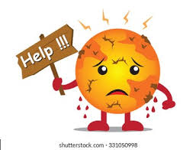
Global Warming
Libyan International Medical University Faculty of Basic Medical Science
Student name: Mohammed Saad
Role number : 3099
Block : PTS
Date :4-6-2022

Slide 2
OBJECTIVES:
Define global warming.
Explain the causes of the global warming.
Discuss the climate change due to global warming.
Outline the diseases that caused by global warming.
Discuss how Can we slow or even reverse global warming.

Slide 3
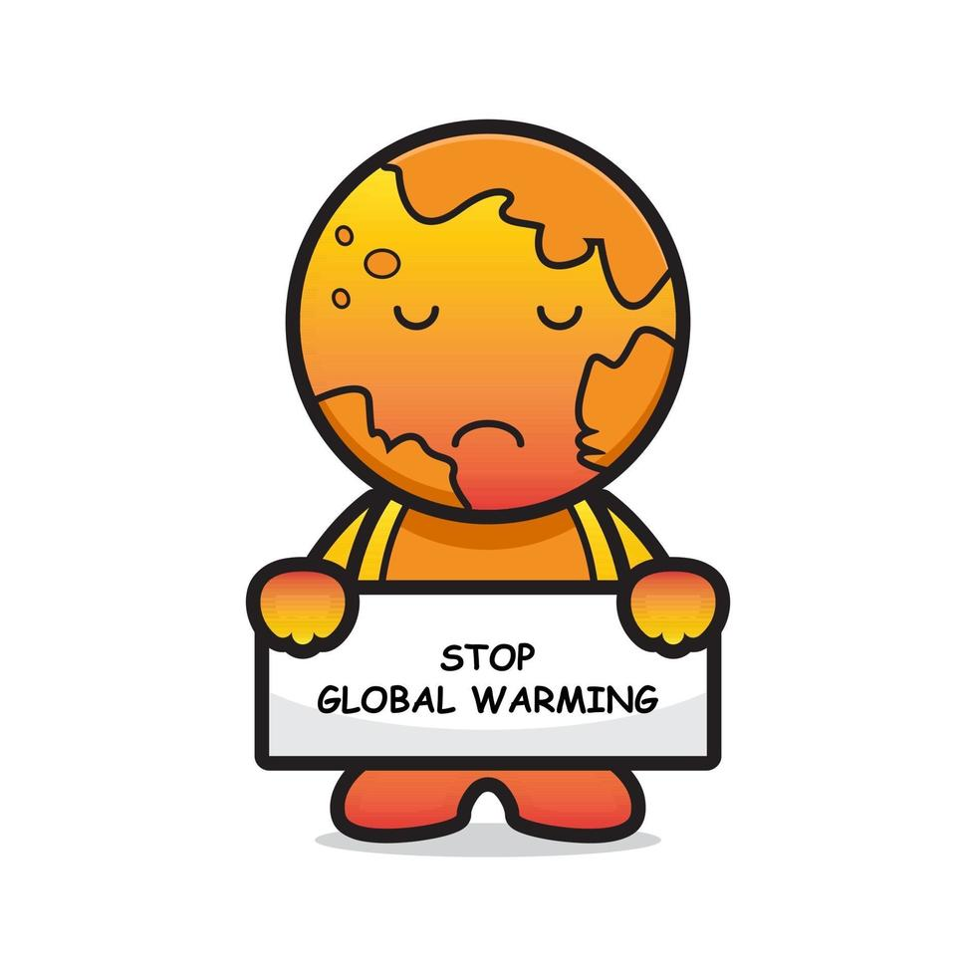
Introduction:
In 1824 & 1896
200 years ago!

Slide 4
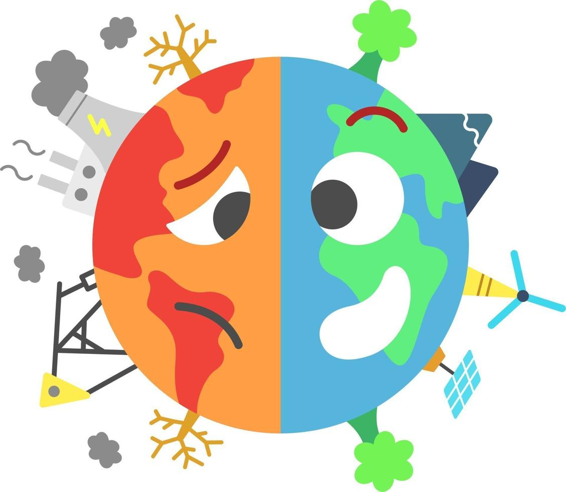
Global Warming:
Global warming is the phenomenon in which the absorption and emission of infrared radiation leads to heating the Earth’s surface as a result of the increase in the concentration of greenhouse gases in the atmosphere.

Slide 5

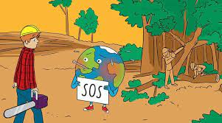

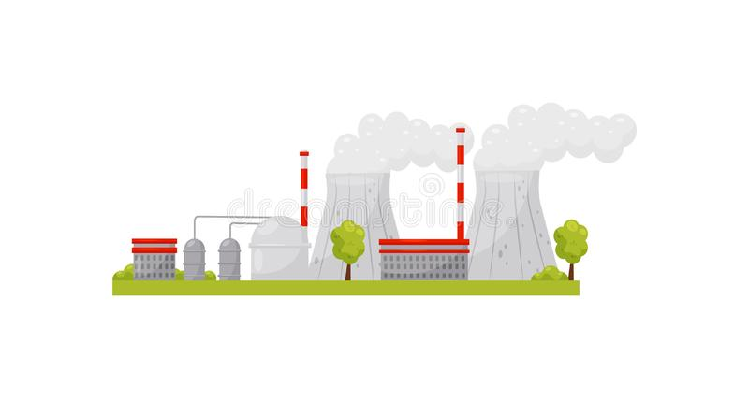
The causes of the global warming:
1. Oil and Gas
2. Deforestation
3. Waste
4. Power Plants

Slide 6

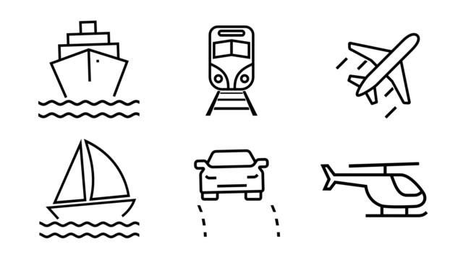
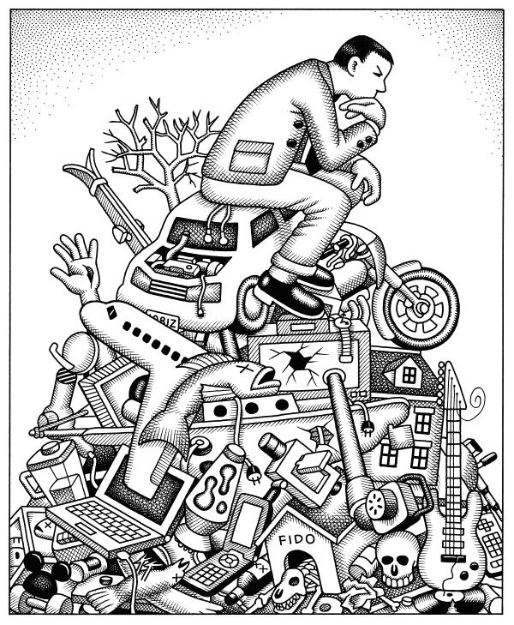

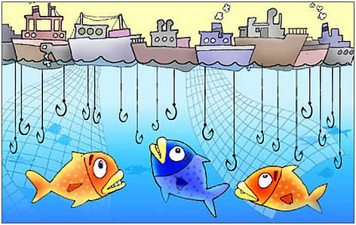
5. Oil Drilling
6. Transport and Vehicles
7. Consumerism
8. Farming
9. Industrialization &Overfishing

Slide 7
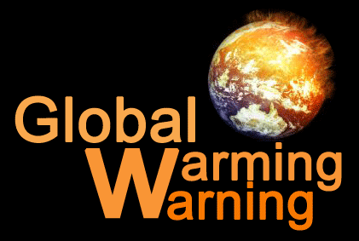
The climate change due to global warming:
More frequent and severe weather.
Higher death rates.
Dirtier air.
Higher wildlife extinction rates.
Higher sea levels.

Slide 8

The diseases that caused by global warming:
Malaria
Dengue fever
Japanese encephalitis (JE)
tick-borne encephalitis.

Slide 9
How Can we slow or even reverse global warming:
Replacing energy sources
Reducing environmental pollution
Stop urban sprawl
Increase the rate of natural cover
Household Recycling

Slide 10
Conclusion:
Humans are facing the problem from climate change today, and the one who are causing these conflicts are from human. It is impossible to stop the global warming, but people still can reduce and slow down this problem.

Slide 11
Reference:
Top 10 Causes Of Global Warming. 2021. [online] Available at: <https://sustainabilitymag.com/top10/top-10-causes-global-warming> [Accessed 3 June 2022].
NRDC. 2022. Are the Effects of Global Warming Really that Bad?. [online] Available at: <https://www.nrdc.org/stories/are-effects-global-warming-really-bad> [Accessed 3 June 2022].
Green America. 2006. Top 10 Solutions to Reverse Climate Change. [online] Available at: <https://www.greenamerica.org/climate-change-100-reasons-hope/top-10-solutions-reverse-climate-change> [Accessed 3 June 2022].
Kurane I. The effect of global warming on infectious diseases. Osong Public Health Res Perspect. 2010;1(1):4-9. doi:10.1016/j.phrp.2010.12.004.

Slide 12
Thank you for listening

