Slide 1


Checkups During Pregnancy
Aisha Saad El Gaoud
Student No. 3141
Block: PTS
Date: March 7th, 2022
1

Slide 2
Define Pregnancy
Outline the Importance of checkups on mother’s safety
Objectives
Dental checkups
Monitoring mother’s nutrition
Reduce the risk of post-pregnancy complications
Controlling pre-existing conditions
Outline the importance of checkups on fetus’ safety
Infections
2

Slide 3


What is Pregnancy
The condition of a women who is carrying a growing embryo, that normally persists 266 days from the date of conception to date of birth
3

Slide 4

Checkups and Mother’s Safety
4

Slide 5
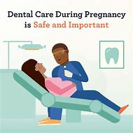

Pregnancy and Dental Care
Bad oral hygiene during pregnancy can lead to:
  Periodontal diseases:
    Gingivitis
    Periodontitis
    Premature delivery
    Pregnancy granuloma
  Loose teeth leading to tooth loss
  Dental erosions
  Cavities.
5

Slide 6
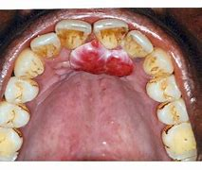
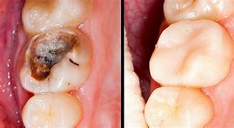
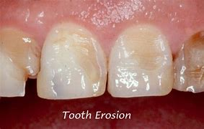
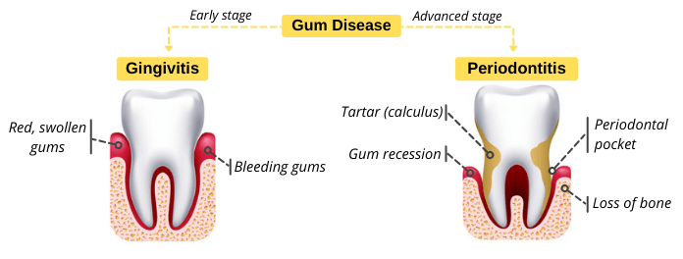
6

Slide 7
Nutrition During Pregnancy
Why is nutrition important during pregnancy?
Important minerals and vitamins:
.
.
Nutrition helps to handle the extra demands on body as pregnancy progresses.
Balance getting enough nutrients to support the growth of fetus and maintaining a healthy weight
Folic acid
Iron
Calcium
Vit D
Choline
Omega-3 fatty acids
Vit B & C
7

Slide 8
Nutrition During Pregnancy
Daily Intake:
Sources:
.
.
Vit C
Vit B(12 & 6):
  1.9 (B6)
  2.6 (B12)
Omega-3 Fatty acids
Milk, cheese yogurt
Red meat, fish, dried beans, dates
Iodized salt, seafoods, bread, eggs
Milk, beef liver, soy products
Enriched FA bread & pasta, peanuts, green leaves, beans, orange juice
Citrus fruits
Beef, liver, ham, bananas, fish
Fish, walnut, eggs, almonds
Calcium:
  1300mg
Iron:
  27mg
Iodine
  22ugrams
Choline
  450mg
Folic acids
  600ugram
Vit D
  600Iunits
8

Slide 9

Pregnancy and post-partum complications
Hypertension
Diabetes
  Supplemental insulin
  Healthy diet
  Regular exercise
Depression
Hemorrhage
  Medications
  Breastfeeding
9

Slide 10
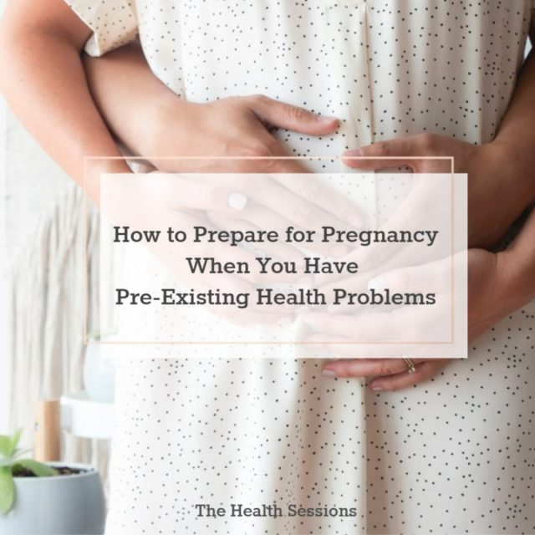
Controlling Pre-Pregnancy Health Problems
High blood pressure
  Monitoring
  Medications
Diabetes:
  Hemorrhage
  Miscarriages
  Macro-baby
  Pre-eclampsia
S.T.I Infections
  Vaccines
  S.T.I tests
  Drug treatments
10

Slide 11

Checkups and Fetus’ Safety
11

Slide 12
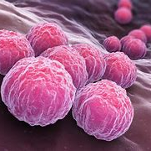
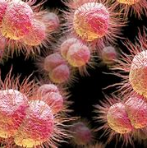
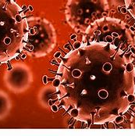
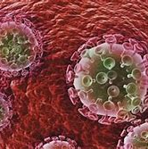
Mother to Infant Infections – S.T.Is
Chlamydia
Gonorrhea
Genital Herpes
H.I.V
Bacterial based infections
Viral based infections
12

Slide 13
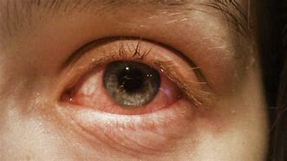
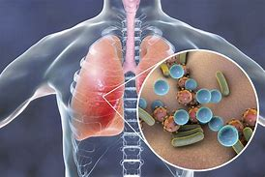
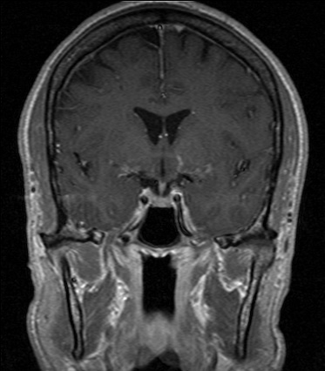
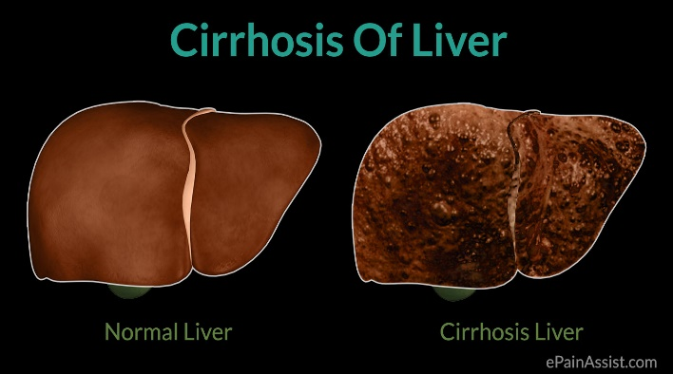


S.T.I caused Diseases
Eye Infection
Pneumonia
Meningitis
Chronic Liver Disease
Brain Damage
Deafness
13

Slide 14

Treating Bacterial S.T.Is
Gonorrhea
Chlamydia
Updated:
Ceftriaxone (500mg) + oral Azithromycin
Oral Cefixime (400mg) + oral Azithromycin
Old:
Penicillin (20%)
Tetracycline (69%)
Ciproflaxin (36%)
Drug medications include:
Azithromycin
Doxycycline
14

Slide 15
Treating Viral S.T.Is
Uncurable
Anti-viral medicine may help reduce the symptoms
C-section
.
Genital Herpes
H.I.V
15

Slide 16

Conclusion
During pregnancy it’s essential to have regular checkups as it has a positive effect on the mother’s health during and post-pregnancy; as well on the fetus, so that both can live a healthy, happy and long lives.
16

Slide 17
Thank You for Listening
Any Questions?
17

Slide 18
References
DL;, L. W. P. F. M. M. R. (n.d.). The relation of preventive dental behaviors to periodontal health status. Journal of clinical periodontology. Retrieved March 7, 2022, from https://pubmed.ncbi.nlm.nih.gov/8157773/
Yenen, Z., &amp; Ataçağ, T. (2019, November 28). Oral care in pregnancy. Journal of the Turkish German Gynecological Association. Retrieved March 7, 2022, from https://www.ncbi.nlm.nih.gov/pmc/articles/PMC6883753/
1. Postpartum complications: What you need to know [Internet]. Mayo Clinic. 2022 [cited 7 March 2022]. Available from: https://www.mayoclinic.org/healthy-lifestyle/labor-and-delivery/in-depth/postpartum-complications/art-20446702
2. Chlamydia pneumoniae: Causes, How It Spreads, and Risk Factors | CDC [Internet]. Cdc.gov. 2022 [cited 7 March 2022]. Available from: https://www.cdc.gov/pneumonia/atypical/cpneumoniae/about/causes.html
3. Nutrition During Pregnancy [Internet]. Acog.org. 2022 [cited 7 March 2022]. Available from: %20rows%20 https://www.acog.org/womens-health/faqs/nutrition-during-pregnancy#:~:text=Frequently%20Asked%20Questions%20Expand%20All%20%20%20,soy%20pro%20...%20%206%20more
4. Postpartum hypertension: When a new mom's blood pressure is too high | Heart | Your Pregnancy Matters | UT Southwestern Medical Center [Internet]. Utswmed.org. 2022 [cited 7 March 2022]. Available from: https://utswmed.org/medblog/postpartum-high-blood-pressure/
5. Causes [Internet]. Stanfordhealthcare.org. 2022 [cited 7 March 2022]. Available from: https://stanfordhealthcare.org/medical-conditions/womens-health/gestational-hypertension/causes.html
18

