Slide 1


The left and the right wing
Libyan International Medical University
Faculty of Business Administration
Name: Saad Bensoud
Student ID: 2732
Email: saado_2732@limu.edu.ly

Slide 2
Content
What are Left and right wings and how did they start?
Left wing
Right wing
Middle wing
Conclusion
References

Slide 3

What are the Left and Right wings?

Slide 4

delineate between political parties on the basis of their opposing ideologies. In fact, left and right wings are positions on a long political spectrum that help people to identify the policies of a political party.

Slide 5
How did it start?

Slide 6
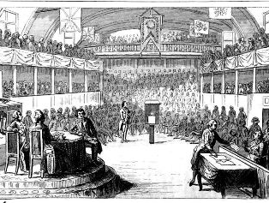
The French revolution in the 18th century

Slide 7

Left wing
around the world, the left wing has come to connote the political ideology that represents liberalism, progressiveness, socialism, democracy, communism, and a few other isms.

Slide 8

Right wing
the right wing, in simple terms refers to those who are in favor of centralization of power. These are the parties and people who want a strong central government and are conservatives by nature.

Slide 9
Difference between Left wing and Right wing

Slide 10
Government Involvement

Slide 11
Businesses

Slide 12
Income Equality

Slide 13
Left-Wing | Right-Wing
Left-wing politics is more liberal in its approach and outlook | Right-wing politics are more conservative.
Left-wing economics policies involve reducing income equality, increasing tax rates for the wealthy, and government spending on social programs and infrastructure | Its economic policies involve low taxes, less regulation on businesses by the government
Those belonging to the left-spectrum of politics believe that society will benefit from an expanded role for the government | Right-wing ideologies believe that the best outcome for society is delivered when individual rights and civil liberties are paramount with limited involvement of the government
Left-wing politics is characterized by an emphasis on equality, fraternity, progress, and reform | Right-wing politics is characterized by ideas of authority, hierarchy, tradition, and nationalism
Left-wing nationalism is based on social equality, popular sovereignty, and national-determination. It associates itself closely with national liberation movements | Right-wing nationalism is influenced by Romantic Nationalism where the state derives its legitimacy from the culture it governs, including, language, race, and custom “born” within this culture
Left-wing politics is traditionally against religious institutions and believe that state and religion must be separate from each other (Secularism) | Right-wing politics have always found supporters who believe that religion should play an expanded role in society.
Populist ideas in the left-wing do not include horizontal exclusion and will rely more on egalitarian ideals. | Populism is a recurring theme in right-wing political circles. Populism is a political approach that appeals to ordinary people who feel that their rights are ignored.
The term ‘Left-wing’ has a similar origin during the French revolution where anti-monarchy revolutionaries were seated on the left side of the hall. | The term ‘Right-wing’ has its origins during the days of the French Revolution (1789-1799) where the supporters of the Monarchy were seated on the right hall of the National Assembly

Slide 14
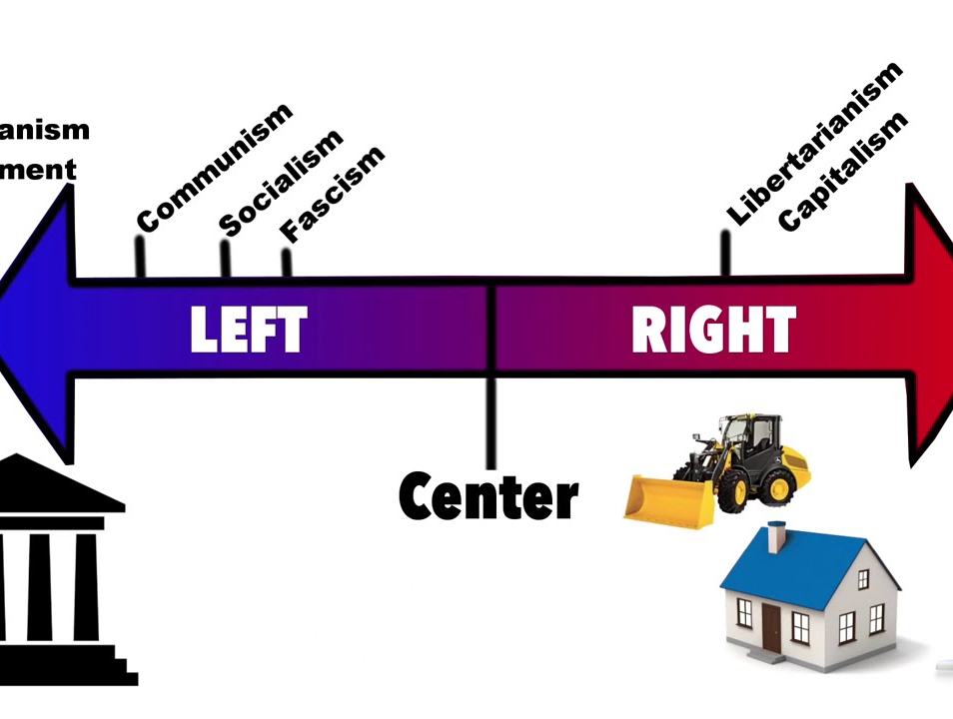
Middle wing

Slide 15
Conclusion

Slide 16
References
Bhosale, T. (2020, July 20). Public Sector vs Private Sector. WallStreetMojo. https://www.wallstreetmojo.com/public-sector-vs-private-sector/?fbclid=IwAR1d8upntFZ2k1ZQs7w7mnKWVFcX_fNe1M-bgNbq_yJpXuM2npCFcWRJ-2I
By Staff Writer. (2020, April 2). What Is the Difference Between “Left Wing” and “Right Wing”? Reference.Com. https://www.reference.com/world-view/difference-between-left-wing-right-wing-efb4493019ba1505

Slide 17


