Slide 1



Libyan International Medical University
Faculty of Business Administration
The Concept of Feminism, Patriarchy and Environmentalism
Name : Shatha wail werfalli
Student Number : 3299
Date : 8th of Nov

Slide 2

Objectives
Understand the Concept of Feminism, Patriarchy and Environmentalism.
Get to know more Information about them .
1

Slide 3

Table of Content
1. What is Feminism and the goal of Feminism
2. What is Patriarchy explained with an example
3. What is Environmentalism
4. Conclusion
5. Reference
2

Slide 4


What is Feminism ?
-Belief in and desire for equality between the sexes .
-The belief that men and women should have equal rights and opportunities .
-It also contains social, political and economic equality.
-There are also types of Feminist groups .
3

Slide 5

What’s Patriarchy ?
-It’s a social system in which men hold primary power in roles of political leadership, moral authority, social privilege and control of property.
-Patriarchy refers to the male domination both in public and private spheres.
-A social system which the father is head of the household, having authority over women and children .
4

Slide 6

What’s Environmentalism ?
-It’s a movement and ideology that aims to reduce the impact of human activities on the earth and its various inhabitants.
-It seeks to preserve the air and water we all depend upon.
- To keep the environment clean and healthy.
5

Slide 7
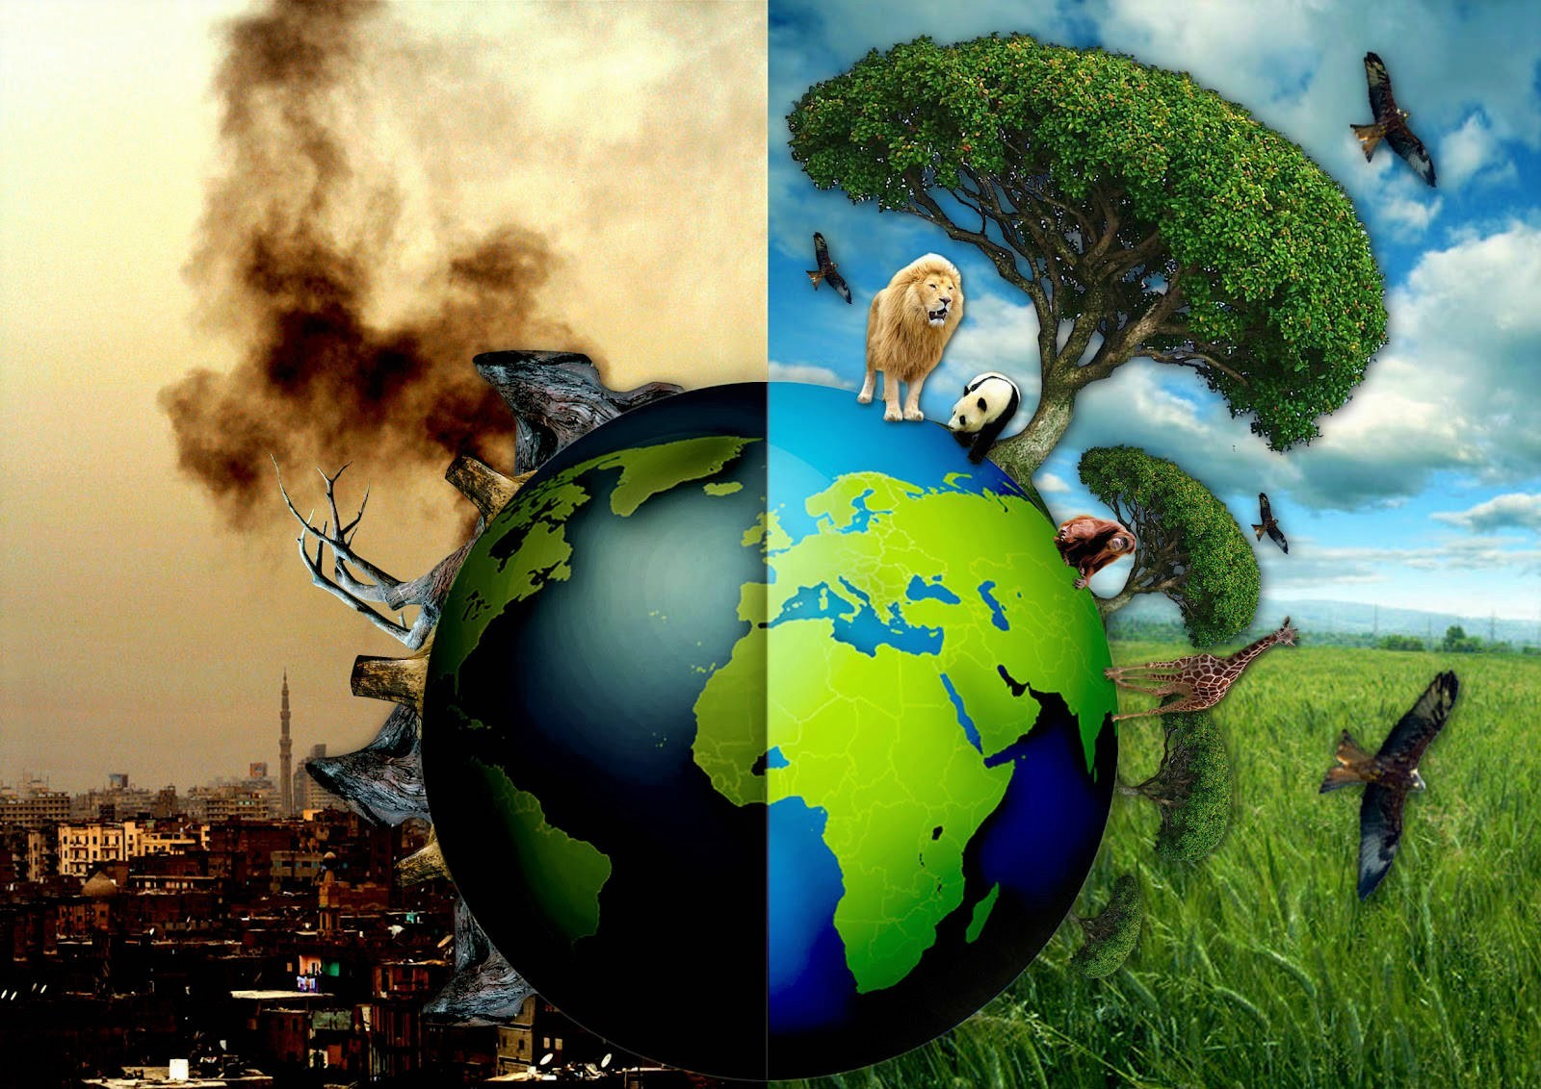
6

Slide 8

Conclusion
-Feminism is about all genders having equal rights and opprotunities .
-Patriarchy is about inequality between men and women, and it supports men and gives them the power and control over women .
- Environmentalism is about protecting our universe and environment we live in from any negatively-effect activity that humans could possibly do.
7

Slide 9
Reference
A feminist glossary because we didn't all major in Gender Studies. USA Today. Retrieved November 8, 2021 .
Patriarchy meaning. Patriarchy Meaning | Definitions of Patriarchy. (n.d.). Retrieved November 8, 2021
Encyclopædia Britannica, inc. (n.d.). Environmentalism. Encyclopædia Britannica. Retrieved November 8, 2021
8

Slide 10

9

