Slide 1


Improving Verbal Communication
Libyan International Medical University Faculty of Business Administration
NAME:ZAKARIYA RASHWAN
ID:2991
DATE:2021-11-09
E-mail:zakariya_2991@limu.edu.ly

Slide 2
Table of contents
01
03
02
04
05
Introduction
How to Improve Verbal Messages
Conclusion
Principles of Verbal Messages
References
2

Slide 3
Objectives
To Understand Verbal Messages
To Understand Principles of Verbal Messages
To understand how Improving Verbal Messages
3

Slide 4
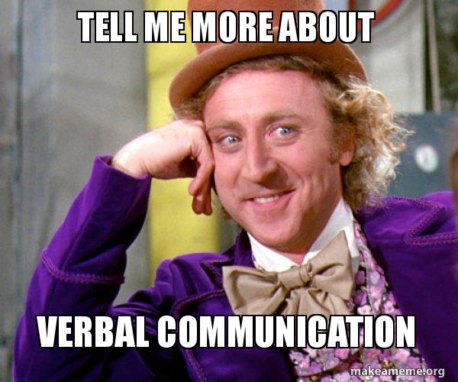
Introduction
Verbal communication is a type of oral communication wherein the message is transmitted through spoken words.
4

Slide 5
Principles of Verbal Messages
Syntactic Rules
Semantic Rules
Contextual Rules
5

Slide 6
How to Improve Verbal Messages
Think before speaking
Use concise language
Understand your audience
Show your authentic self
Practice your skills
Be mindful of your tone
Employ active listening
Speak with confidence
6

Slide 7
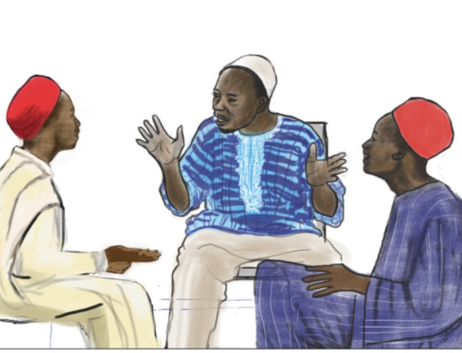
Conclusion
Verbal messages consist of using words and sounds to communicate with another person.
7

Slide 8

References
10 ways to improve verbal communication skills. Indeed Career Guide. (n.d.). Retrieved November 8, 2021, from https://www.indeed.com/career-advice/career-development/how-to-improve-verbal-communication-skills.
Simon, D., Grimes, M., Roch, S., & eCampusOntario. (2018, April 3). Principles of verbal communication. Communication for Business Professionals. Retrieved November 8, 2021, from https://ecampusontario.pressbooks.pub/commbusprofcdn/chapter/principles-of-verbal-communication/.
8

Slide 9

Thanks!
9

