Slide 1


Computer Software for Business
Libyan International Medical University
Faculty of Business Adminstration
Names: Alaa Buazza & Roua El.frgani
ID:2526,3169
1

Slide 2
Table Of Contents
01
02
03
Introduction
Enterprise management
Database Management System
04
05
Customer Relationship Management
Supply Chain Management
06
07
Conclusion
Reference
2

Slide 3
Objectives!
Understand how information technology affects business.
3

Slide 4
Introduction
Business software is an important asset that helps you to maintain, control and improve the running of your business. From human resource solutions to invoicing and payroll tasks, different software applications can automate and streamline many aspects of your business operations. Choose them carefully and you can gain the means of running your business more efficiently, effectively and with greater productivity.
4

Slide 5

Business benefits of new software
Businesses change over time and so do their software needs.
If your current software is out-of-date or holding your business back, upgrading can help you gain productivity and drive value from your initial investment.
5

Slide 6
ENTERPRISE SYSTEMS SOFTWARE
Enterprise systems (ES) are large-scale enterprise software packages that support business processes, information flows, reporting, and data analytics in complex organizations.
The software is intended to solve an enterprise-wide problem, rather than a departmental problem.
6

Slide 7
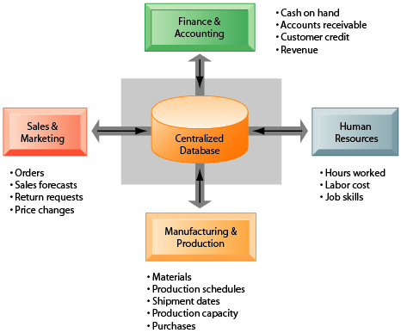
HOW ENTERPRISE SYSTEMS WORK
7

Slide 8
Enterprise software can be categorized by business function
Database Management System (DBMS)
Supply Chain Management (SCM)
Customer Relationship Management (CRM)
8

Slide 9
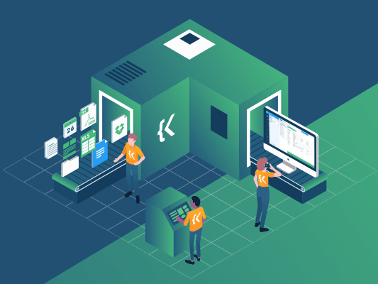
Database Management System
A software package that is designed to manipulate, manage, retrieve, store, and define data in a database is called Database Manage System (DBMS).
Examples of DBMS software
Microsoft Access
Microsoft SQL Server
Uses of DBMS software
Data Retrieval
Data Definition
User Administration
Data Updation
9

Slide 10
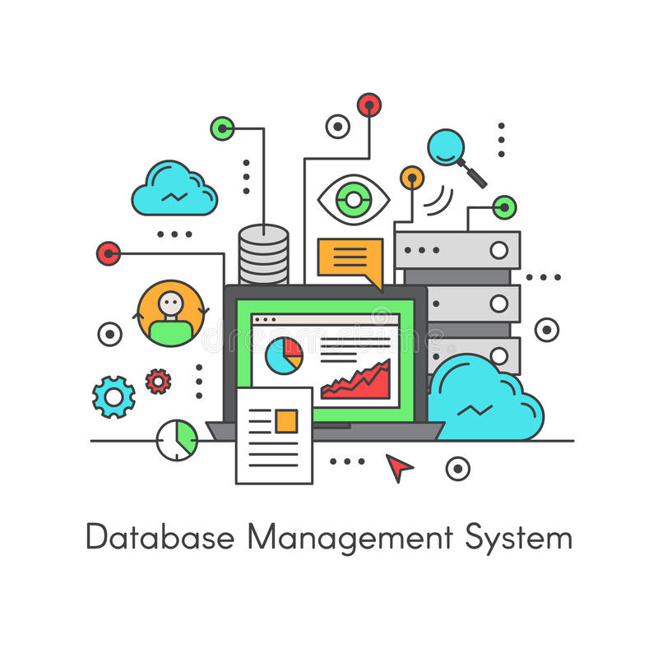
Significance of DMBS in other industries
Sales
Finance
HR management
Banking
Telecommunication
Manufacturing
10

Slide 11
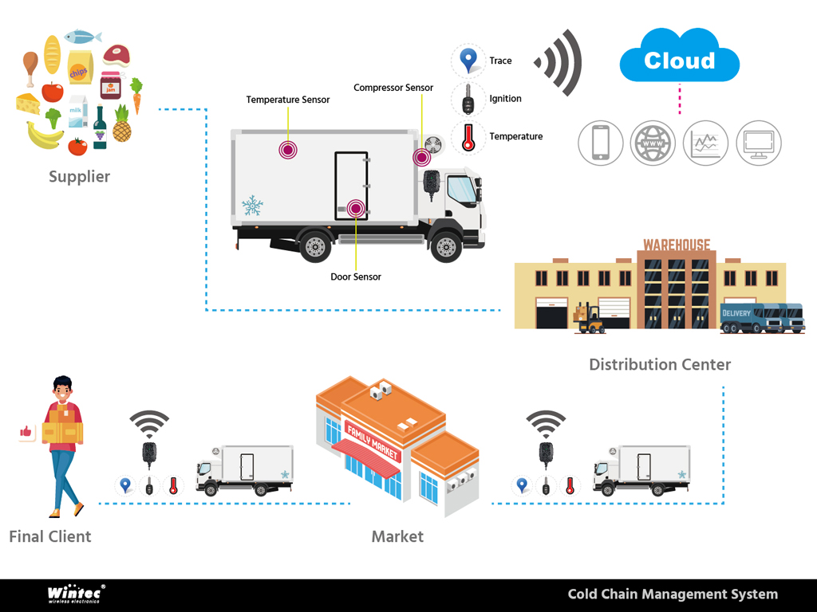
Supply chain management software
(SCM) is used in the management of producing a product from raw materials through the various manufacturing and distribution processes until the product ends up in the hands of the consumer.
11

Slide 12

Supply chain management can classified as
Supply chain planning systems
Systems which enable the firm to generate demand forecasts for a product, develop sourcing and manufacturing plans for that product, make adjustments to production and distribution plans, and share that information with relevant supply chain members
12

Slide 13

Supply chain execution systems:
Systems that manage the physical flow of products through distribution centres and warehouses to ensure that products are
delivered to the right locations in the most efficient manner.
13

Slide 14

Demand planning:
which determines how much product a business needs to make to satisfy all of its customers' demands.
14

Slide 15
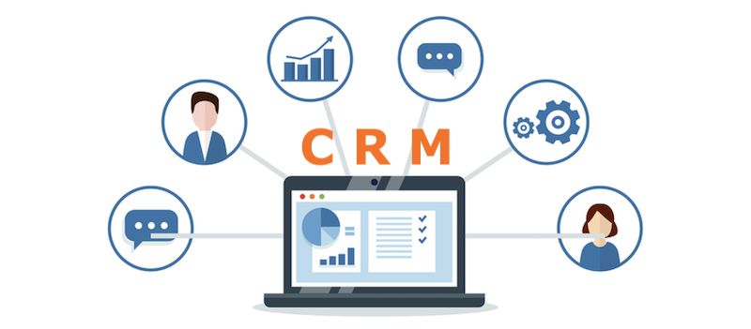
CUSTOMER RELATIONSHIP MANAGEMENT
CRM systems capture and integrate customer data from all over the organization, and consolidating, analysing data, then distributing the results to various systems and customer touch points across the enterprise.
15

Slide 16
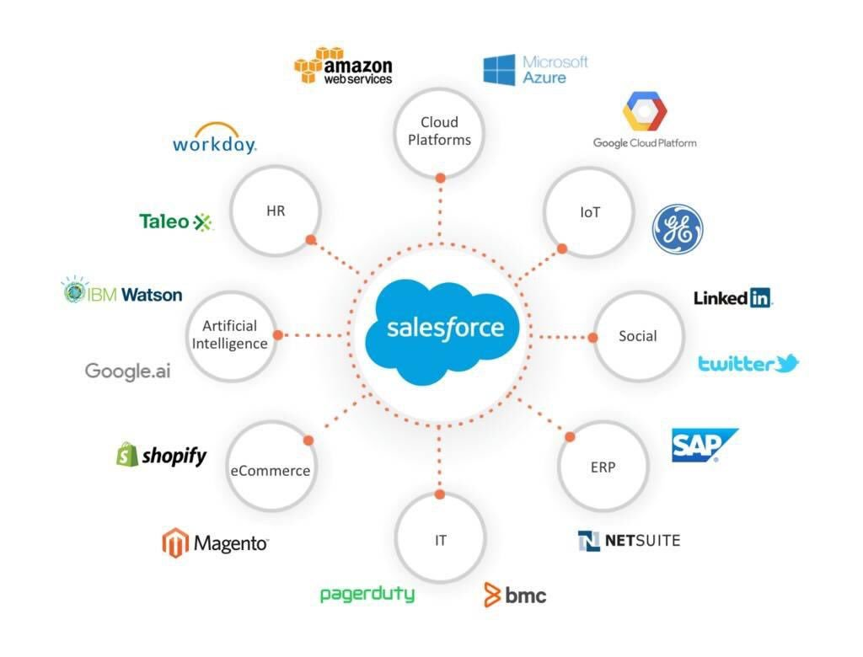
Customer relationship management software
Salesforce CRM
A CRM tool lets you store customer and prospect contact information, identify sales opportunities, record service issues, and manage marketing campaigns, all in one central location — and make information about every customer interaction available to anyone at your company who might need it.
16

Slide 17
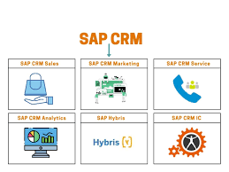
SAP CRM :
is a customer relationships solution from SAP designed to provide employees with customer insights and processes so they can deliver consistent and personalized customer experiences across all channels.
17

Slide 18
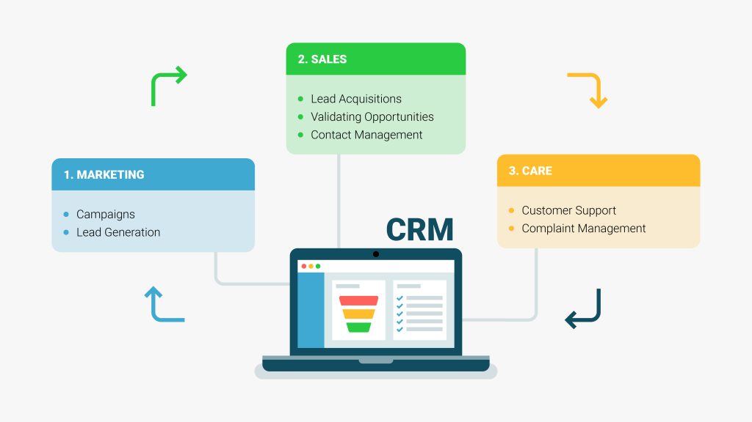
CRM systems provide
Sales force automation
Customer service
Marketing
18

Slide 19
Conclusion
• Flexibility
• Integration with other systems
• Links to customer and supplier systems
Advantages of new software for business
cut costs by automating routine tasks
improve the efficiency of staff
increase or measure office productivity
streamline business operations and accounts
replace paper processes
communicate more effectively with customers, suppliers or partners
19

Slide 20
Reference
Kenneth, C., LAUDON, L., & JANE, P. (2019). Management Information Systems: Managing the Digital Firm. PEARSON..
https://elearning.scranton.edu/resources/article/10-ways-enterprise-systems-affect-your-business/
https://www.nibusinessinfo.co.uk/content/types-business-software

Slide 21
Thank you
Does anyone have any question?

