Slide 1


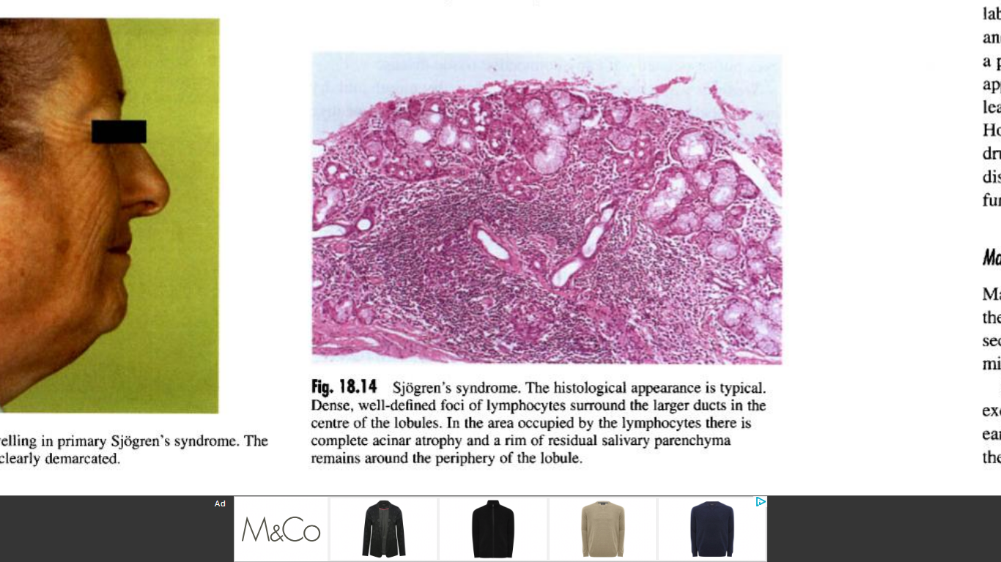
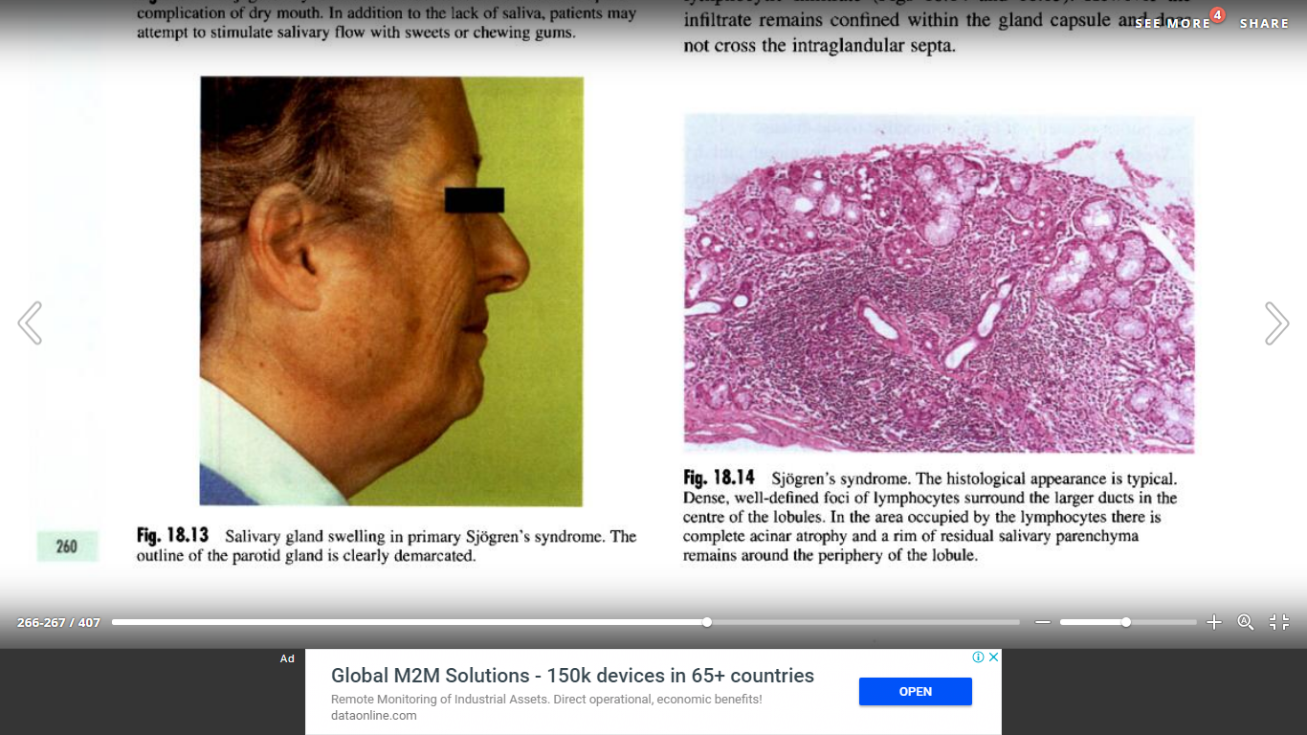
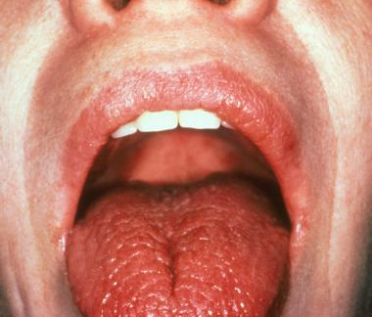
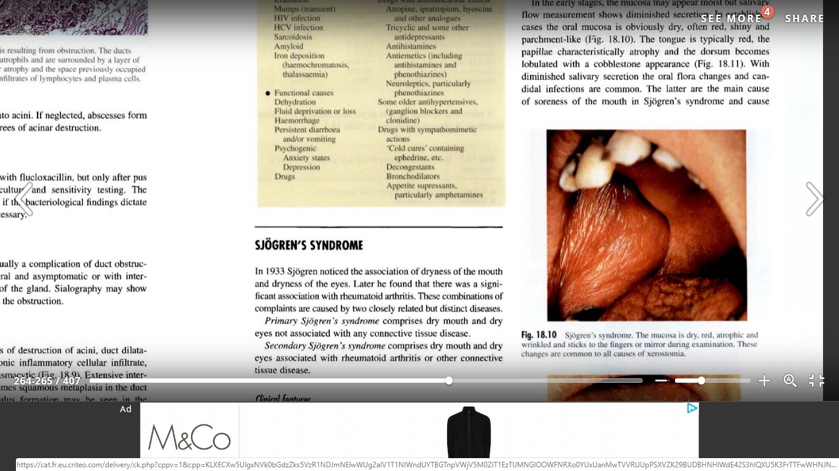
Oral Manifestations Of Systemic Disease
Sjögren's syndrome
AHMED AWAD EL BEIGO 2nd Year Dentistry
Faculty Of Basic Medical Science
Libyan International Medical University
Supervisor: DR.KHADIGA M. MANSUR
Introduction :
Other causes of xerostomia including drug induced must be excluded, Definite diagnosis by anti-body screening especially rheumatoid factor, SS-A (Ro) and SS-B (La), labial salivary gland biopsy showing periductal lymphocytic infiltrate^{[1]}.
Principal of management:
reassurance of the patient with symptomatic treatment of the dryness via artificial saliva as well as choline esterase inhibitor drugs, control any associated infection and dental caries. Regular follow up to observe for possible development of lymphoma^{[1]}.
Sjögren’s syndrome is a chronic inflammatory autoimmune disease, attacking the salivary and lacrimal glands, it’s characterized by dry mouth ( xerostomia ) and dry eyes ( xerophthalmia ), other organ manifestations may be seen ^{[1] [3]}.
It can be either primary, or secondary associated with rheumatoid arthritis or other connective tissue disease^{[1]}.
It should be differentiated from other causes of xerostomia, and it can only be treated by managing the symptoms ^{[1] [2][3]}.
Discussion :
Sjögren’s syndrome affects females nearly 10 times as frequently as males.
Primary sjögren's syndrome cause more severe oral and ocular changes ,and it has a higher risk of lymphomatous change than the secondary^{[1]}.
Sjögren’s syndrome the histological appearance^{[1]}.
Secondary sjögren’s syndrome affects
30% of systemic lupus erythematosus patients.
15% of rheumatoid arthritis patients.
The autoimmune disease results in destruction of salivary glands thus causing xerostomia which in turn, disturb quality of speech, predispose to infections, disturb taste sensation, cause difficulties in eating and swallowing, and increase susceptibility of dental caries^{[1]} .
Sjögren’s syndrome can have serious ocular effects including Failure of tear secretion, failure of clearance of foreign particles from cornea and conjunctiva, gritty sensation, inflammation, risk of impairment or loss of sight^{[1]}.
Extraglandular manifestations including synovitis, pulmonary fibrosis and peripheral neuropathy may be seen^{[3]}.
Salivary glands are often enlarged as a result of lymphocytic infiltrate ,
a parotid swelling appearing after years of the onset strongly suggests lymphomatous change^{[1]}.
Conclusion :
Dentists must be aware that oral diseases may be caused by a systemic disease.
Sjögren’s syndromes mainly result in dry mouth and dry eyes.
Secondary Sjögren’s syndrome is associated with connective tissue disorders.
Differential diagnosis is important excluding other causes of xerostomia, and using anti-body screening and labial salivary gland biopsy.
There is no current cure for the oral manifestations of sjögren’s syndrome, but supportive measures can alleviate the symptoms .
Salivary gland swelling in Sjögren’s syndrome^{[1]} .
References :
CAWSONS’S ESSENTIALS OF ORAL PATHOLOGY AND ORAL MEDICINE 7th Ed. chapter 18 p. 259 – 262.
Emedicine.medscape.com. (2018). Sjogren Syndrome Clinical Presentation: History, Physical Examination. [online] Available at: https://emedicine.medscape.com/article/332125-clinical [Accessed 22 Nov. 2018].
3. ROBBINS Basic Pathology 8th Ed. Chapter 5 p. 148.
Tongue in sjögren’s syndrome ^{[2]}.
Oral mucosa in sjögren’s syndrome^{[1]}.

