Slide 1


Libyan International Medical University
Faculty of Business Administration
Driving Globalization
BY: Monir Rifat Elmessory
ID : 2484
munir_2484@limu.edu.ly

Slide 2

Table of content
Introduction
Drivers of Globalization
Summary
References

Slide 3
Introduction
“Globalization is not something we can hold off or turn off … it is the economic equivalent of a force of nature – like wind or water.”
Bill Clinton (American 42nd US president (1993 – 2001))

Slide 4
Globalization is a powerful result of the new world system. It represents one of the most influential forces in determining the future course of business.
The first part of this research paper will define the major drivers of globalization.

Slide 5
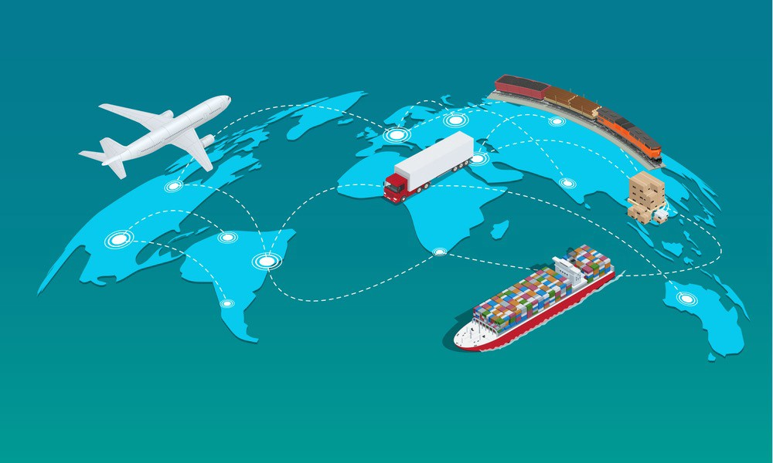
Drivers of Globalization:
The media and almost every book on globalization and international business speak about different drivers of globalization and they can basically be separated into five different groups:

Slide 6

1- Technological:
Technological shaped and set the foundation for modern globalization. Innovation in the transportation technology revolutionized the industry. The most important developments among these are the commercial jet aircraft and the concept of containerization in the late 1970s and 1980s.

Slide 7

2- Political Drivers:
Liberalized trading rules and deregulated markets lead to lowered tariffs and allowed foreign direct investments in almost all over the world.

Slide 8

3- Market drivers:
As domestic markets become more and more saturated, the opportunities for growth are limited and global expanding is a way most organizations choose to overcome this situation. Common customer needs and the opportunity to use global marketing channels and transfer marketing to some extent are also incentives to choose internationalization.

Slide 9

4- Cost Drivers:
Sourcing efficiency and costs vary from country to country and global firms can take advantage of this fact. Other cost drivers to globalization are the opportunity to build global scale economies and the high product development costs nowadays.

Slide 10

5- Competitive drivers
With the global market, global inter-firm competition increases and organizations are forced to “play” international. Strong interdependences among countries and high two-way trades and FDI actions also support this driver.

Slide 11
Summary
In the event of the recent global recession, globalization has come under much criticism as economic shocks can be felt across the globe and affect many people due to the growing interconnection between countries. However, although closing an economy may insulate it from shocks, it can also mean stagnation in growth and even more severe internal crises.

Slide 12
References
Bauernfeind, M. (n.d.). GRIN - Drivers of Globalization: Integration of Theories and Models. Retrieved December 3, 2019, from https://www.grin.com/document/57026.
Price, R. W. (2016, August 8). What is driving globalization? Retrieved December 3, 2019, from https://news.gcase.org/2011/06/29/what-is-driving-globalization/.

Slide 13


