Slide 1



Libyan International Medical University
The Importance of Literature Review in Research.
BY : SALEM IBRAHIM OSMAN
ID : 3799
Email:salem_3799@limu.edu.ly

Slide 2
Table of content
Definition for Literature Review.
Importance of Literature Review in Research.
Purpose of Literature Review.
2

Slide 3
literature review
definition
A literature review is an overview of the previously published works on a specific topic. The term can refer to a full scholarly paper or a section of a scholarly work such as a book, or an article.
3

Slide 4
Importance of literature review in research
1 It brings out the dialects of contradictions between different thoughts within the field to establish facts.
2 It helps in calculating the impact of the latest information in the field by mapping their progress of knowledge.
3 The research gaps scrutinized initially are further explored to establish the latest facts of theories to add value to the field.
4 Indicates the current research place in the schema of a particular field.
5 Provides information for relevancy and coherency to check the research.
6 Justifies the research and sets up the research question.
7 Helps to adopt a more suitable methodology for the research by examining the strengths and weaknesses of existing research in the same field.
4

Slide 5

8 Increases the value of the results by comparing it with the existing literature.
9 Provides a point of reference by writing the findings.
10 The more the reference of relevant sources of it could increase more of its trustworthiness with the readers.
11 By preventing plagiarism, it saves the scientific manuscript from rejection and thus also saves a lot of time and money.
12 Helps to compare and contrast to show the originality and uniqueness of the research than that of the existing other researches.
13 Rationalizes the need for conducting the particular research in a given field.
14 Helps to collect data carefully for allowing any new methodology of research than the existing ones.
5

Slide 6

6

Slide 7
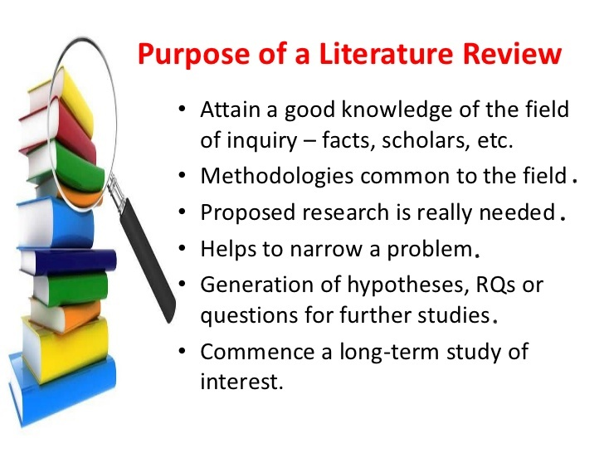


Slide 8
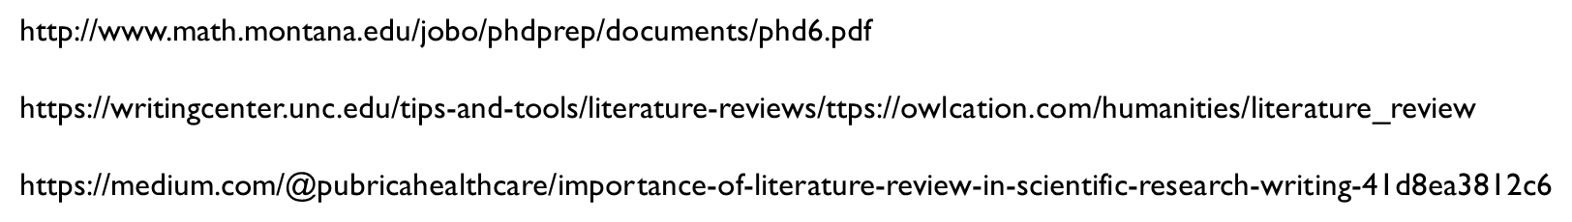
References
8

Slide 9

Thank you .
Any questions!

