Slide 1
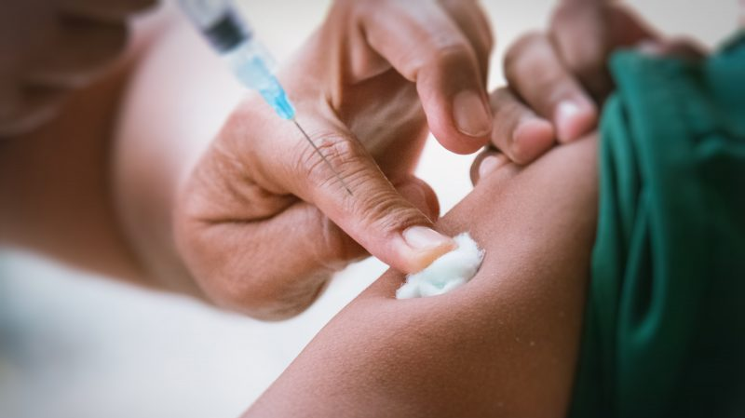


To be Immune
Year 1 (2021-2022)
Ayatallah Abed Elallegy 3311
June 1, 2022

Slide 2
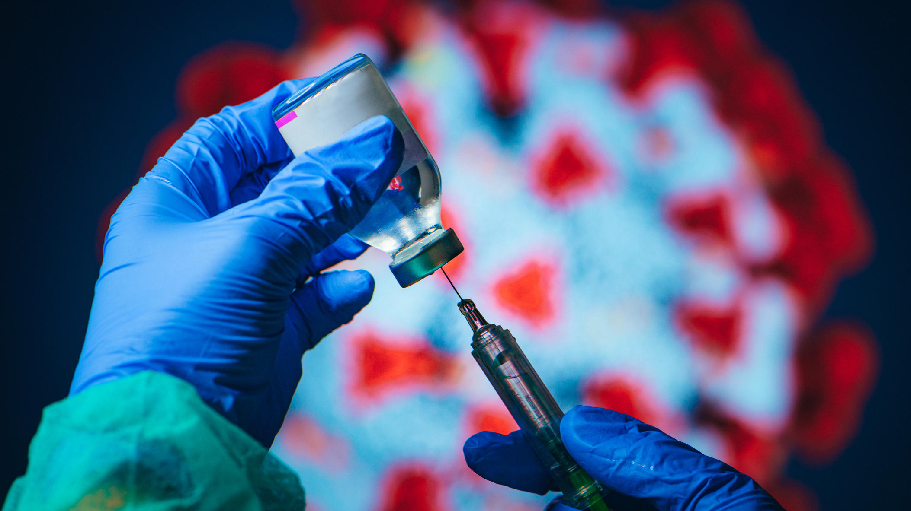
Introduction
Why is it important to be immunized?

Slide 3
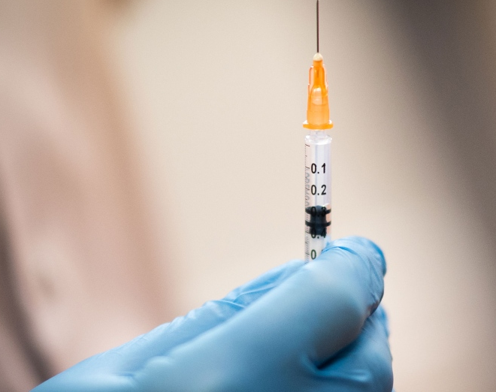
Objectives
Differentiate between vaccination & immunization
Outline how vaccines work
Discuss the types of vaccines
Outline the importance of vaccine tracking
Discuss the development process of vaccines
List the protocol of vaccines

Slide 4
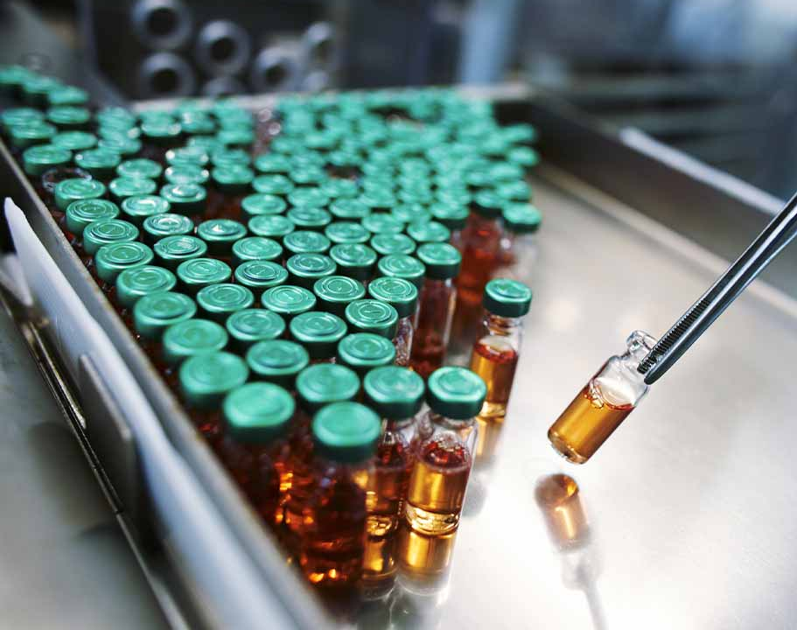
Immunization Vs Vaccine
Immunization is a process that makes a person protected or immune against a disease or infection through vaccination
A vaccine reduces risks of getting a disease by working with your body’s natural defense system and stimulates the body’s immune response against diseases by administering antigenic material.
“The 2 public health interventions that have had the greatest impact on the world’s health are clean water and vaccines” - The World Health Organization
1

Slide 5
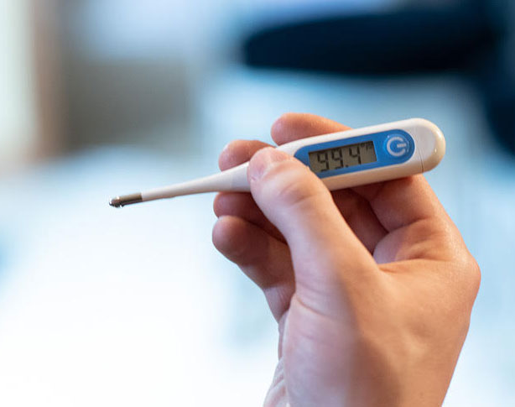
How a Vaccine Works
An infection is when germs and bacteria invade, multiply, attack and cause illness
Vaccines are artificial infections that causes illness while felicitating T-cell stimulation and antibody production
Develop normal and expected symptoms such as fever, sore arms and headaches that are due to the vaccine not having enough time to provide protection.
After the artificial infection goes away and a week has passed, you're left with developed B-cells and memory T-Cells that protect you from getting that same infection in the future
2

Slide 6
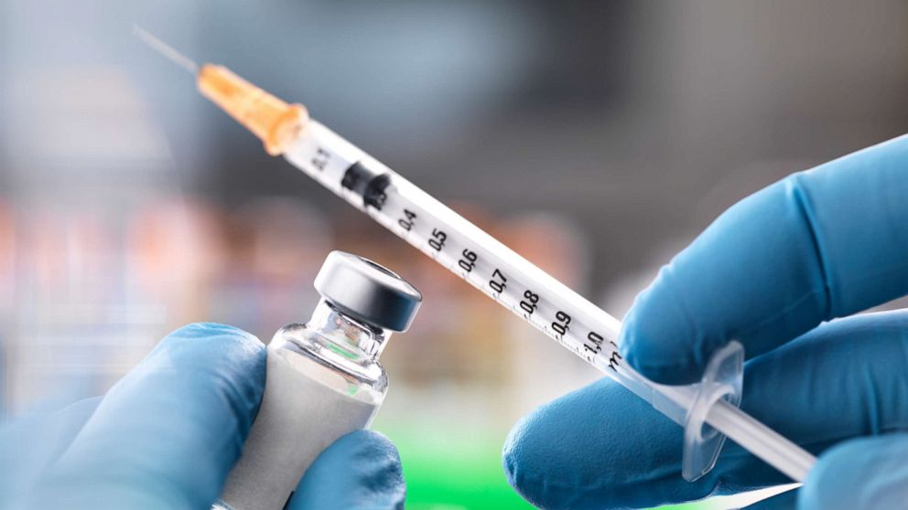
Subunit
Live
Toxoid
Inactive
Types of Vaccines
3
This Photo by Unknown Author is licensed under CC BY-SA

Slide 7

Vaccine Tracking
Ensures that the recommended vaccine is received
Precludes forgetting the date and type of vaccine you were given.
Keeps you informed of new and upcoming vaccines
If you move or travel it makes it a lot easier for your next GP
Ensures vaccinated patients do not receive the same vaccine twice .
  A- Helps control the cost of the drug
  B- Decrease the number of adverse reactions to vaccines
4

Slide 8
1. Exploratory stage
2. Pre-clinical stage
3. Clinical development
4. Regulatory review and approval
5. Manufacturing
6. Quality control
Development
5

Slide 9
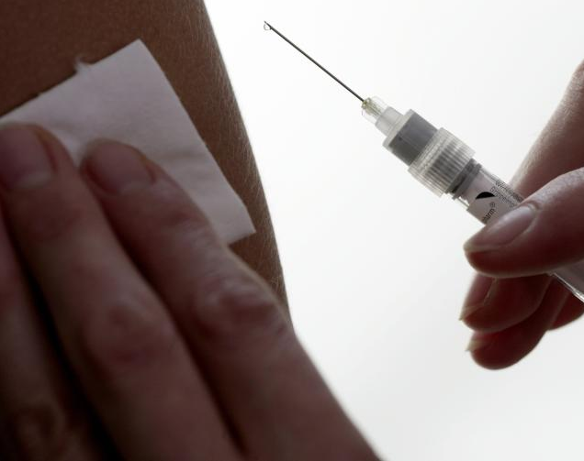
Vaccines Administration Protocol
Review immunization history
Assess for needle immunization
Screen for contraindications and precautions
Educate the patient
Prepare the vaccine
Administer the vaccine
Document the vaccine
6
This Photo by Unknown Author is licensed under CC BY-ND

Slide 10
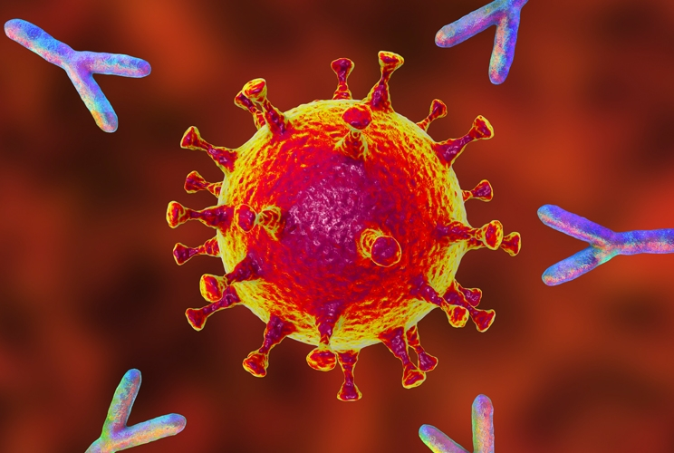
Conclusion
Why is it important to be immunized?
- Saved 2 to 3 million children each year from deadly diseases.
- Doesn’t discriminate against age, ethnicity or sex.
- Decrease the chance for diseases to spread and return.
- Keeps people who can’t be vaccinated safe
- We should all be grateful for the healthcare providers who put themselves in danger to keep us and our loved ones safe.
7

Slide 11


Slide 12
References
1. [Internet]. 2022 [cited 31 May 2022]. Available from: https://www.fraserhealth.ca/health-topics-a-to-
2. What Is Immunization? | immunizecanada [Internet]. Immunize.ca. 2022 [cited 31 May 2022]. Available from: https://immunize.ca/what-immunization
3. [Internet]. 2022 [cited 31 May 2022]. Available from: https://www.cdc.gov/vaccines/vac-gen/imz-basics.htm
4. [Internet]. Cpha.ca. 2022 [cited 31 May 2022]. Available from: https://www.cpha.ca/sites/default/files/assets/policy/immun_e.pdf
5. Adults [Internet]. Immunize BC. 2022 [cited 31 May 2022]. Available from: https://immunizebc.ca/adults
6. Five important reasons to vaccinate [Internet]. Immunize BC. 2022 [cited 31 May 2022]. Available from: https://immunizebc.ca/reasons-to-vaccinate
7. [Internet]. 2022 [cited 31 May 2022]. Available from: https://www.canada.ca/en/public-health/services/publications/healthy-living/parent-guide-vaccination.html
8. [Internet]. 2022 [cited 31 May 2022]. Available from: https://www.cdc.gov/vaccines/vac-gen/imz-basics.htm
9. How do vaccines work? [Internet]. Who.int. 2022 [cited 31 May 2022]. Available from: https://www.who.int/news-room/feature-stories/detail/how-do-vaccines-work

Slide 13
10. [Internet]. 2022 [cited 31 May 2022]. Available from: https://www.hhs.gov/immunization/basics/types/index.html
11. Types of vaccine | Vaccine Knowledge [Internet]. Vk.ovg.ox.ac.uk. 2022 [cited 31 May 2022]. Available from: https://vk.ovg.ox.ac.uk/vk/types-of-vaccine
12. [Internet]. 2022 [cited 31 May 2022]. Available from: https://www.cdc.gov/vaccines/hcp/acip-recs/general-recs/index.html
13. [Internet]. 2022 [cited 31 May 2022]. Available from: https://www.cdc.gov/vaccines/programs/vtrcks/index.html
14. [Internet]. 2022 [cited 31 May 2022]. Available from: https://www.cdc.gov/vaccines/basics/test-approve.html

