Slide 1


Logistics in Central Bank
Libyan International Medical University
Faculty of Business Administration
STUDENTS NAMES: Anwer Najem , Sohaib Elwerfali
STUDENT ID: 2233, 2671
Instructor: Mr. Mohamed Zuwawi
Date: 31.12.2021

Slide 2
Table of contents
01
INTRODUCTION
02
Digitalization of cash cycle
03
04
Standards along cash supply chain
CONLUSION
Cash-in-Transit logistics
REFERENCES
05
06
2

Slide 3
Central Banks must ensure the cash availability of banknotes and coins for professional cash handlers in a good quality and in adequate quantity at the right time
…
INTRODUCTION
3

Slide 4
01
Digitalization of cash cycle
4

Slide 5
Digitalization of cash cycle
Integrated order management systems with route network planning including tracking & tracing, with cash center management software, reporting and audit functionalities
Interoperability and open interface standards along the supply chain by auto-identification and electronic data interchange compliant to GS1 Standards for cash logistics
Sourcing and procurement strategies for cost-effective and reliable technologies and systems ensuring supply chain performance
5

Slide 6
02
Standards along cash supply chain
6

Slide 7
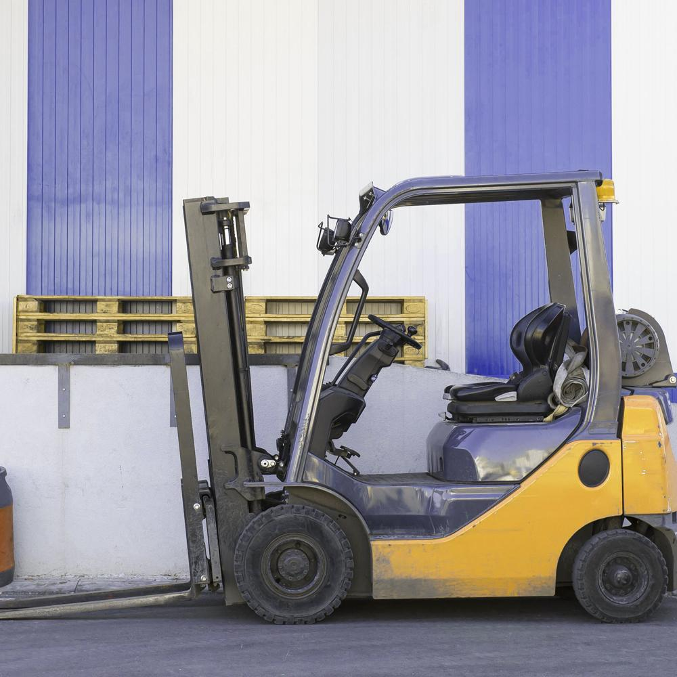
Standards along cash supply chain
Standardization of service portfolio, cash products and processes aiming a reduced variant diversity, zero-defect quality, security standards
Implementation of tamper-proofed, returnable boxes/ containers for the entire cash supply chain
7

Slide 8
03
Cash-in-Transit logistics
8

Slide 9
Cash-in-Transit logistics
Establishing/ market entry of a new CiT company
Transformation from “security company” to intelligent “cash carrier”
Cost optimization of transport operations aiming harmonized services and pricing, soft vehicles with ink dye protection, route network optimization, track & trace, insurance fees, Green Logistics programs
Risk assessments and auditing of CiT processes and policies
9

Slide 10
4
Cash Center Automation
10

Slide 11
Cash Center Automation
Design, engineering and implementation of automated cash centers on greenfield and brownfield site
Cost optimization of cash center operators by targeting services, processes and technology
Transformation of manual into automated processes in banknote and coin processing, shredding, pick & pack, automated storage and retrieval (AS/RS), inter-logistics (AGV, milk runs), security technique
Risk assessments and auditing of cash center processes and policies
11

Slide 12
CONLUSION
A central bank is an independent national authority that conducts monetary policy, regulates banks, and provides financial services including economic research
12

Slide 13
REFERENCES
Wholesale cycle. Cash InfraPro. (2021, December 18). Retrieved January 2, 2022, from
Logistics for banks, insurances, leasing, local authorities. (2016, August 11). Inter-Logistic
www.inter-logistic.eu/en/high-tech-logistics.html
www.cashinfrapro.com/services/wholesale-cycle
13

Slide 14
Thanks!
Do you have any questions?

