Slide 1

Operating System
Mohamed Abdullah Ali - 2975

Slide 2
1. Identify the component of thread with (figures)?
The general components of a thread include:
A thread ID uniquely identifying the thread.
A register set representing the status of the processor.
A user stack, employed when the thread is running in user mode, and a kernel stack, employed when the thread is running in kernel mode.
A private storage area used by various run-time libraries and dynamic link libraries (DLLs).
The register set, stacks, and private storage area are known as the context of the thread.

Slide 3
2. Explain the difference between thread and process ?
We can think of a thread as a part of a process that actually performs an execution of the program - a sequence of instructions read from the program. There is only one thread in a "traditional process" but there can be multiple threads - multiple execution sequences - within a single process. The threads can share many parts of the context of the process, like the program code (aka the text), variables and other data, open files, signals and other messages.
On the other hand, each thread is a separate execution sequence, and so it needs NOT to share certain parts of its context. Each thread needs to have its own separate program counter, CPU register values, thread id number, and run-time stack for supporting its own function calls.

Slide 4
3.Explain the benefits and challenges of designing multi-threaded processes ?
benefits
Responsiveness:
work is divided among threads and some threads can continue working while others are blocked (for example, waiting for I/O to complete) [ Note this is a type of concurrent processing that applies to a unit-processor ]
Resource sharing:
Unlike separate processes, threads can share memory and other resources by default, which makes it easier for them to communicate and cooperate. Also, there is efficient utilization of primary memory when threads share code and data .

Slide 5
Economy:
Not much needs to be done to add a new thread to an existing process, or to perform a context switch between two threads of the same process. Therefore these operations usually require less time and new memory allocation than creation of a new process or a context switch between different processes.
Scalability:
On a multiprocessor, multiple threads can work on a problem in parallel - truly simultaneously. A single-threaded process can only run on one CPU at a time, no matter how many CPU's are available in the computer.

Slide 6
4.Illustrate different approaches to implicit threading (pools, fork-join, and Grand Central Dispatch) ?
thread pools
The main thread of a busy Internet server does not have time to 'personally' perform the service for each client, because it needs to return immediately to the job of accepting the incoming request from the next client.
One way to deal with that problem is for the main thread to spawn a child, a service thread, for each client. The service thread then handles the client request and terminates.
However it can take excessive time for the creation and termination of the service threads, and if too many client requests come in too fast, there may be too many service threads taxing system resources.

Slide 7
The idea of a thread pool is for the server to create a fixed number of service threads at the time of process start up, and to allow them to 'stay alive' as long as the server operates. The service threads that don't have anything to do are kept suspended. When a client needs service, and if a service thread is available, the main thread assigns one to the client. Otherwise the main thread puts the client in a queue where it waits for a service thread to become available.
When a service thread finishes with a client, it does not terminate. It just 'goes back to the pool' and waits to be assigned to another client.
Generally it takes less time for a server process to use an existing thread to service a request than to create a brand new service thread. Also, no matter how much the server is flooded with client requests, the number of service threads never exceeds the fixed size of the pool.

Slide 8
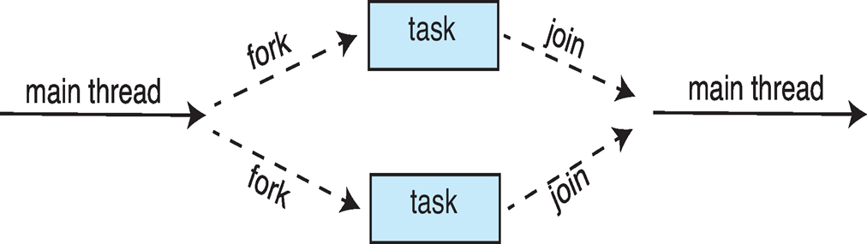
Fork-join
Multiple threads (tasks) are forked, and then joined:

Slide 9
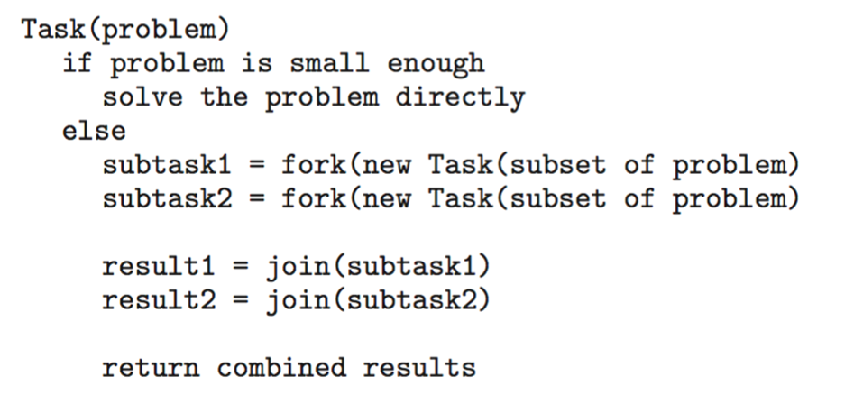
Fork-join
General algorithm for fork-join strategy:

Slide 10
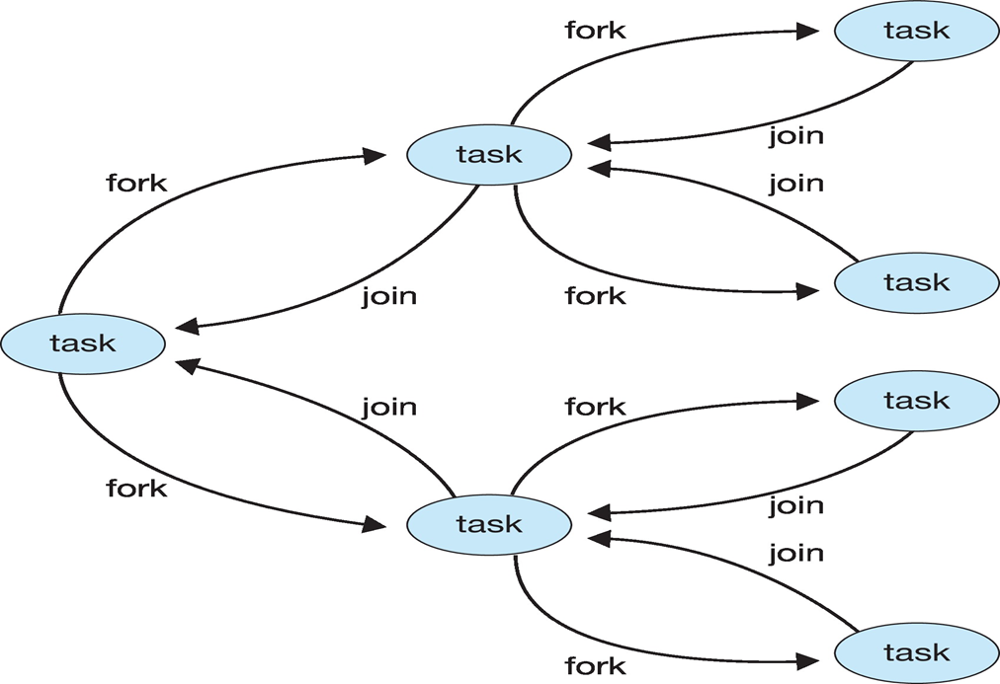
Fork-join

Slide 11
Grand Central Dispatch
Apple technology for macOS and iOS operating systems
Extensions to C, C++ and Objective-C languages, API, and run-time library
Allows identification of parallel sections
Manages most of the details of threading
Block is in “^{ }” :
ˆ{ printf("I am a block"); }
Blocks placed in dispatch queue
Assigned to available thread in thread pool when removed from queue

Slide 12
5. Explain how the Windows and Linux operating systems represent threads ?
In Windows, applications run as separate processes, which may have multiple threads. Per-thread resources include, ID number, register set, user stack and kernel stack (for the use of the OS when executing in behalf of the process, for example when executing a system call for the process), and private storage used by library code. There are three primary data structures for holding the context of threads: ETHREAD (executive thread block), KTHREAD (kernel thread block), and TEB (thread environment block). The first two reside in kernel memory, and the TEB is in user-space.

Slide 13
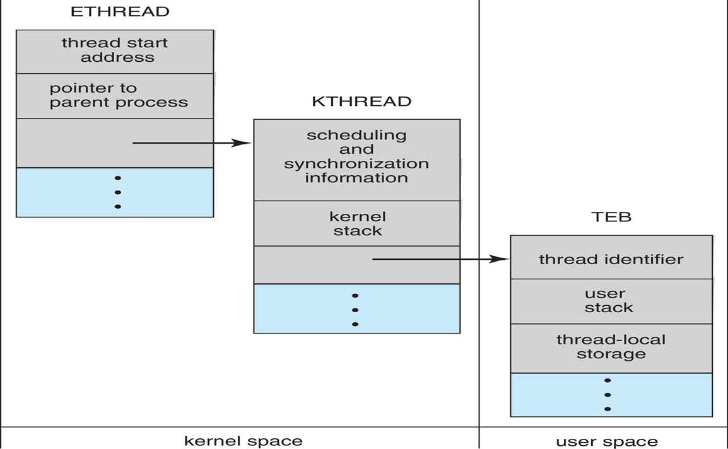

Slide 14
Linux has a traditional fork() system call that creates an exact duplicate of the parent.
Linux also has a clone() system call with flag parameters that determine what resources will be shared between parent and child (clone). If a large amount of context is shared between parent and clone, then the clone is about the same thing as what we have before called a new thread inside the parent process. On the other hand, if nothing is shared, then the clone is about the same as the child of a traditional fork() operation.

Slide 15
